Slide 1
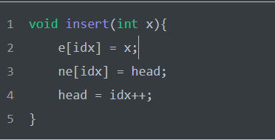
完成
1
3
6
2
6
7
e
1
3
6
2
Head = -1
Head = 1
Head = 3
Head = 0
Head = 2
ne
-1
0
1
2

