Slide 1
树的重心动画演示
蚊子的个人博客
制作：蚊子 时间：2019-11-3 仅供学习交流
提示：请结合代码观看动画演示，代码在文末。
下载：GitHub

Slide 2
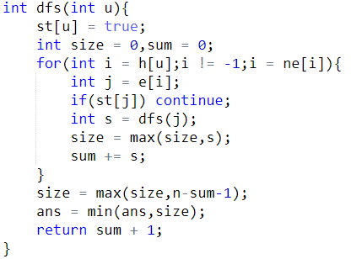
1
2
4
7
8
5
3
6
9
Size = 0
Dfs(8)
Size = 8
Sum = 0
J = 5
Size = 0
J = 8
1
2
8
Size = 1
S = 1
Dfs(2)
Sum = 0
Sum = 1
Ans = 8
Size = 0
J = 2
Dfs(1)
Sum = 0

Slide 3
1
2
4
7
8
5
3
6
9
Size = 8
Size = 0
Dfs(5)
Sum = 0
J = 5
Size = 6
J = 8
Size = 1
S = 1
1
2
5
8
Dfs(2)
Sum = 2
Sum = 1
J = 4
Size = 3
J = 2
Ans = 8
Size = 0
Ans = 6
Dfs(1)
S = 3
Sum = 0
Sum = 3

Slide 4
1
2
4
7
8
5
3
6
9
Size = 0
Dfs(9)
Size = 8
Sum = 0
Size = 0
J = 9
Size = 7
Dfs(3)
Size = 1
S = 1
Sum = 1
Sum = 0
J = 3
Size = 0
J = 6
1
2
3
4
5
8
9
Size = 2
S = 2
Dfs(4)
Sum = 2
Sum = 0
Ans = 6
Size = 3
J = 4
S = 3
Dfs(1)
Sum = 3

Slide 5
1
2
4
7
8
5
3
6
9
Size = 8
Size = 0
Dfs(6)
Sum = 0
Size = 2
J = 6
1
2
3
4
5
6
8
9
Dfs(4)
Size = 5
S = 1
Sum = 2
Sum = 3
J = 4
Size = 4
J = 7
Ans = 6
Size = 3
Ans = 5
Dfs(1)
S = 4
Sum = 7
Sum = 3

Slide 6
1
2
4
7
8
5
3
6
9
完成
Size = 8
1
2
3
4
5
6
7
8
9
Size = 0
Dfs(7)
Sum = 0
J = 4
Ans = 4
Size = 4
J = 7
Ans = 5
Dfs(1)
S = 1
Sum = 8
Sum = 7

Slide 7
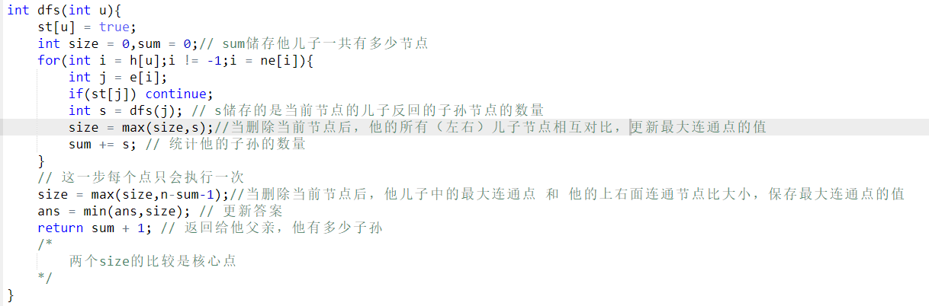
题目：ACwing846
注：代码思路来源与ACwing

