Slide 1
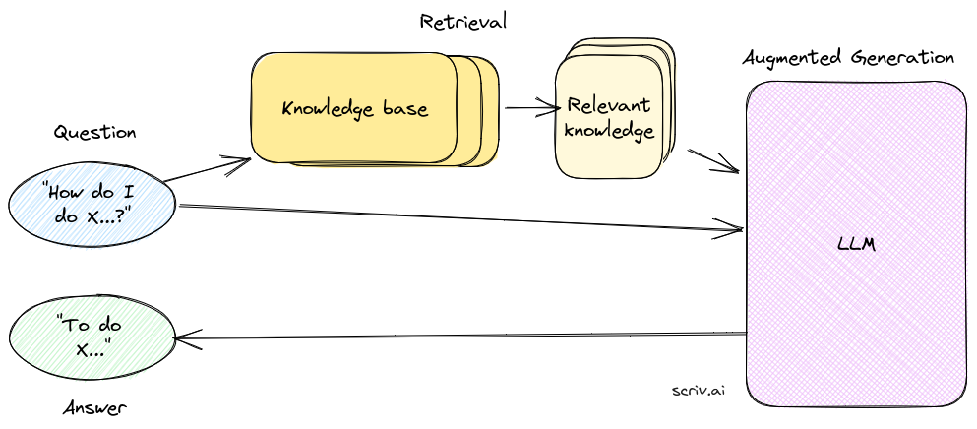
An Overview of Retrieval Augmented Generation (RAG)
https://scriv.ai/guides/retrieval-augmented-generation-overview/
Notes:
之所以叫做检索增强生成，用检索来增强生成，而不是直接检索获得答案，是因为为了充分挖掘大语言模型的生成能力。也就是我们为什么在获取到了knowledge base的知识后不直接检索这个knowledge base 去获得答案而是用检索出与问题进一步相关的知识一起作为prompt交给大语言模型进行生成文本。

Slide 2

Pre-trained language model problem
No source
Out of date
Notes:
您可能想知道为什么我们费心检索而不是只将整个知识库发送给 LLM。原因之一是模型对一次可以消耗的文本量有内置的限制（尽管这些限制正在迅速增加）。第二个原因是成本 —— 发送大量文本会变得相当昂贵。最后，有证据表明发送少量相关信息会得到更好的答案。

Slide 3
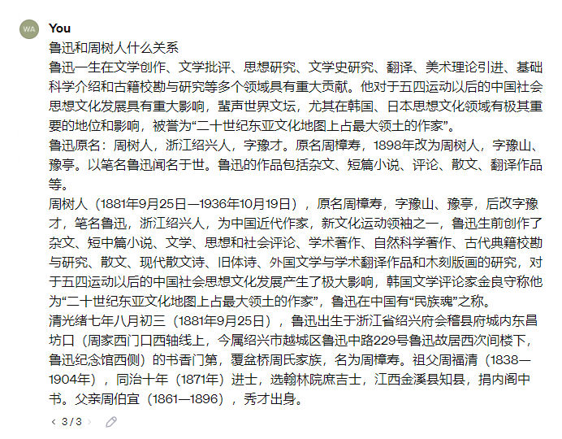
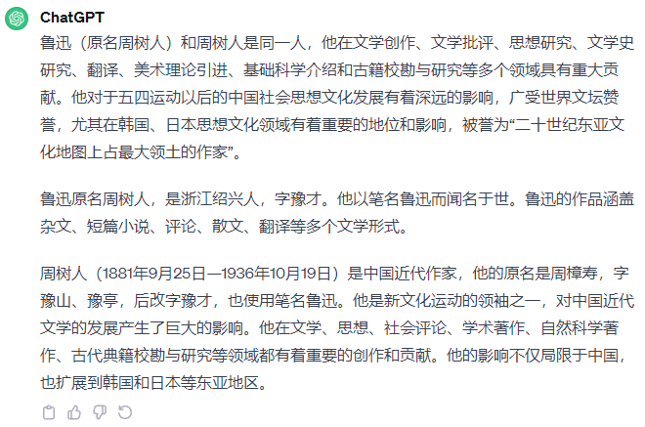
Pre-trained language model problem
Notes:
您可能想知道为什么我们费心检索而不是只将整个知识库发送给 LLM。原因之一是模型对一次可以消耗的文本量有内置的限制（尽管这些限制正在迅速增加）。第二个原因是成本 —— 发送大量文本会变得相当昂贵。最后，有证据表明发送少量相关信息会得到更好的答案。

Slide 4
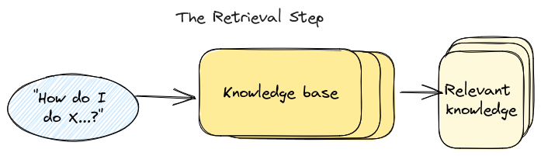
Retrieval Augmented Generation (RAG)

Slide 5
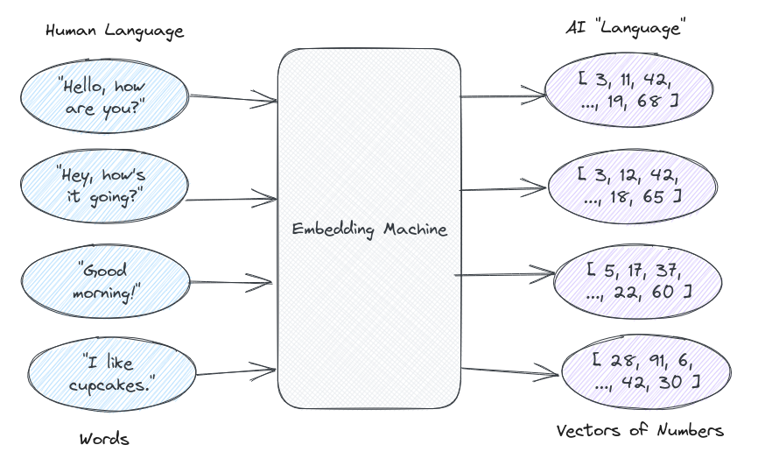
Retrieval Augmented Generation (RAG)

Slide 6
Retrieval Augmented Generation (RAG)

Slide 7
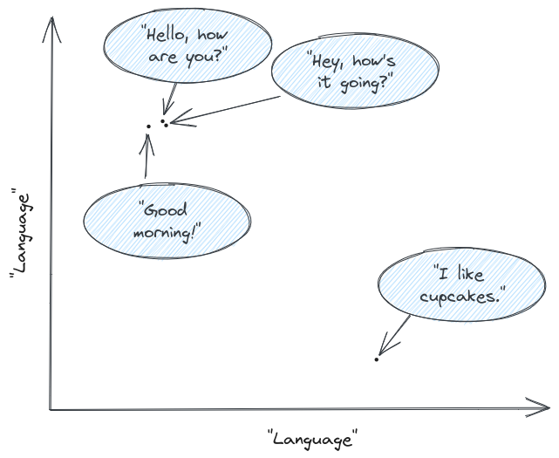
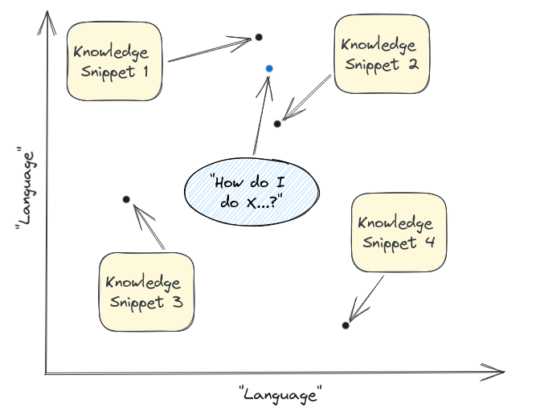
Retrieval Augmented Generation (RAG)

Slide 8
Retrieval Augmented Generation (RAG)

Slide 9

ZS-BERT: Towards Zero-Shot Relation Extraction with Attribute Representation Learning
Proceedings of the 2021 Conference of the North American Chapter of the Association for Computational Linguistics(NAACL): Human Language Technologies

Slide 10
Introduction(Zero-shot Learning .ZSL)
First, when putting the relation extraction task in the wild, existing supervised models cannot well recognize the relations of instances that are extremely rare or even never covered by the training data. That said, in the real-world setting, we should not presume the relations/classes of newcoming sentences are always included in the training data. Thus it is crucial to invent new models to predict new classes that are not defined or observed beforehand.
Second, the idea of ZSL is to connect seen and the unseen classes by finding an intermediate semantic representation. Unlike the common way to train a supervised model, seen and unseen classes are disjoint at training and testing stages. Hence, ZSL models need to generate transferable knowledge between them. With a model for ZSL relation extraction, we will be allowed to extract unobserved relations, and to deal with new relations resulting from the birth of new entities.
Notes:
当将关系提取任务放在野外时，现有的监督模型不能很好地识别训练数据极其罕见甚至从未覆盖的实例的关系。也就是说，在真实世界的设置中，我们不应该假设新出现的句子的关系/类别总是包括在训练数据中。因此，发明新的模型来预测事先没有定义或观察到的新类别是至关重要的。
ZSL的想法是通过找到一个中间语义表示来连接可见和不可见的类。与训练监督模型的常见方式不同，可见类和不可见类在训练和测试阶段是不相交的。因此，ZSL模型需要在它们之间产生可转移的知识。利用用于ZSL关系提取的模型，我们将被允许提取未观察到的关系，并且处理由新实体的诞生而产生的新关系。

Slide 11
Motivation
(1)First, previous study cannot perform zeroshot relation extraction without putting more human effort on it, as they solve this problem via pre-defining question templates. However, it is infeasible and impractical to manually create templates of new-coming unseen relations under the zero-shot setting. We would expect a model that can produce accurate zero-shot prediction without the effort of hand-crafted labeling. In this work, we take advantage of the description of relations, which are usually publicly available, to achieve the goal.
(2) Second, although there exists studies that also utilize the accessibility of the relation descriptions (Obamuyide and Vlachos, 2018), they simply treat zero-shot relation extraction as the text entailment task and only output a binary label that indicates whether the entities in the input sentence can be depicted by a given relation description.
Notes:
先前的工作无法在不投入更多人力的情况下执行零炮关系分类，因为他们通过预定义的问题模板解决了这个问题。然而，在零镜头设置下手动创建新出现的不可见关系的模板是不可行和不切实际的。我们期待一个不需要手工标注就能产生准确零命中率预测的模型。在这项工作中，我们利用关系的描述，这通常是公开可用的，以实现目标。
第二，尽管存在也利用关系描述的可访问性的研究，但它们只是将零镜头预测视为文本蕴涵任务，并且仅输出指示输入句子中的实体是否可以由给定的关系描述来描述的二进制标签。(这种问题公式化需要在所有关系描述上不切实际地执行多重分类，并且不能使关系彼此可比)

Slide 12
Model Contribution
Zero-shot BERT (ZS-BERT), to perform zero-shot learning for relation extraction to cope with the challenges mentioned above. ZS-BERT takes two model inputs. One is the input sentence containing the pair of target entities, and the other is the relation description, i.e., text describing the relation of two target entities. The model output is the attribute vector depicting the relation. The attribute vector can be considered as a semantic representation of the relation, and will be used to generate the final prediction of unseen relations.
We think a better utilization of relation descriptions by representation learning is more cost-effective than collecting tons of instances with labeled relations. Therefore, an essential benefit of ZS-BERT is free from heavycost crowdsourcing or annotation, i.e., annotating what kind of attribute does a class have, which is commonly used in zero-shot learning problem.
Notes:
本文提出了一种新的模型——zero-shot BERT (ZS-BERT)，用于进行零样本学习，以应对上述挑战。ZS-伯特采用两个模型输入。一个是包含目标实体对的输入句子，另一个是关系描述，即描述两个目标实体的关系的文本。模型输出是描述关系的属性向量1。属性向量可以被认为是关系的语义表示，并且将被用于生成对不可见关系的最终预测。我们认为，通过表征学习更好地利用关系描述比收集大量带有标记关系的实例更具成本效益。因此，ZS-bert的一个本质好处是免于heavycost众包或标注，即标注一个类具有什么样的属性，这是零炮学习问题中常用的(Lu et al，2018；Lampert等人，2009年)。

Slide 13
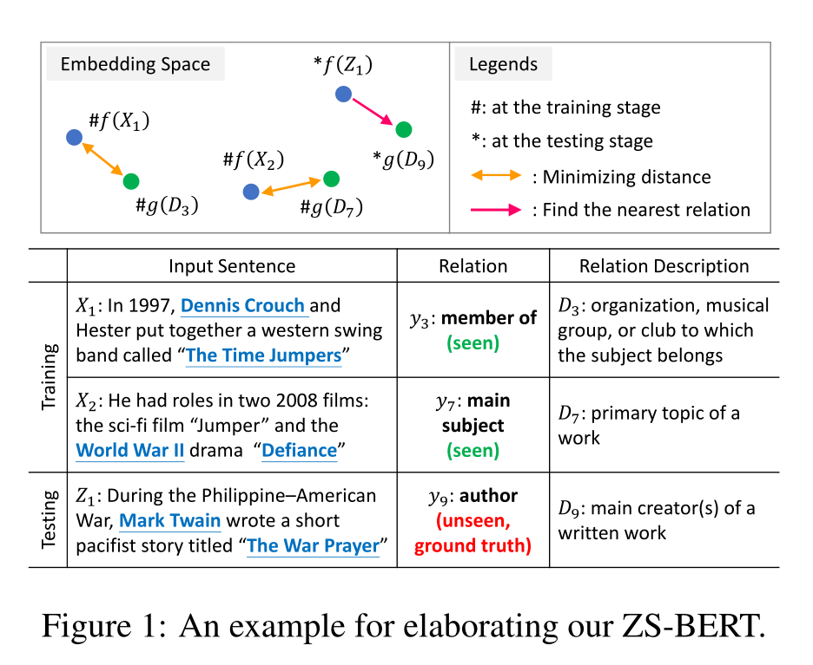
Model Example Elaboration

Slide 14
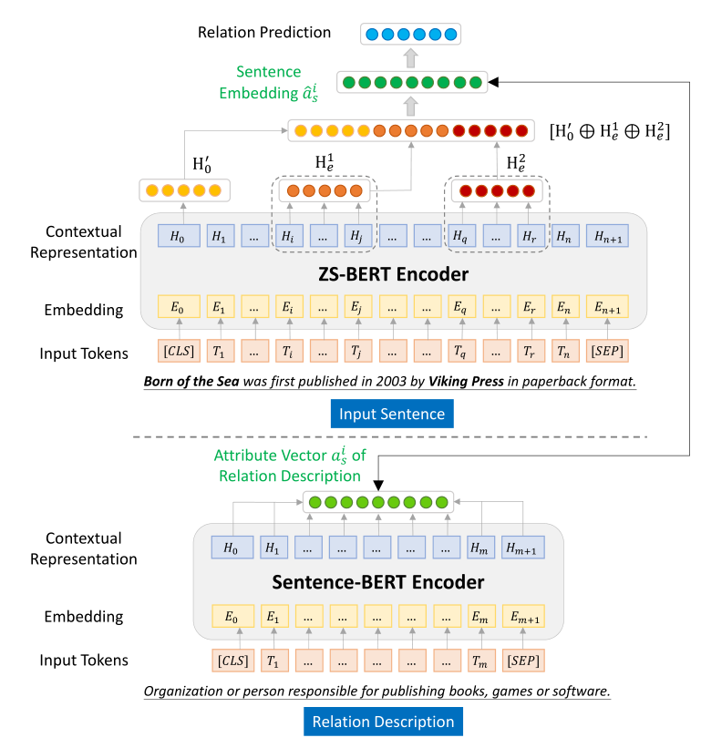


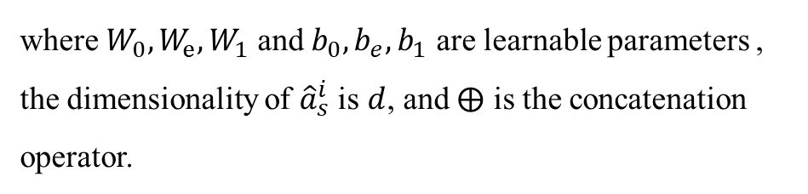
Model
Let $H_{0}$ be the hidden state of the first special token [CLS].
where $W_{0},W_{e},W_{1}$ and $b_{0},b_{e},b_{1}$ are learnable parameters , the dimensionality of ${\hat{a}}_{s}^{i}$ is $d$, and $⨁$ is the concatenation operator.
Notes:
\

Slide 15
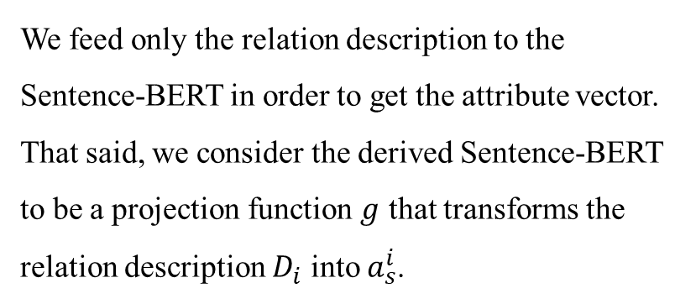
Model
$$a_{s}^{i}=SentenceBert Encoder(D_{i})$$
We feed only the relation description to the Sentence-BERT in order to get the attribute vector. That said, we consider the derived Sentence-BERT to be a projection function $g$ that transforms the relation description $D_{i}$ into $a_{s}^{i}$.
Notes:
\

Slide 16



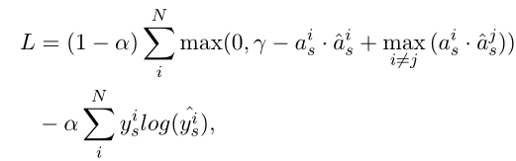
Model Loss
Classification probability distribution over seen relations:
Loss:
Notes:
\损失函数的这种设计可以被视为将正确的关系属性排在比最接近的不正确的属性更高的位置。

Slide 17

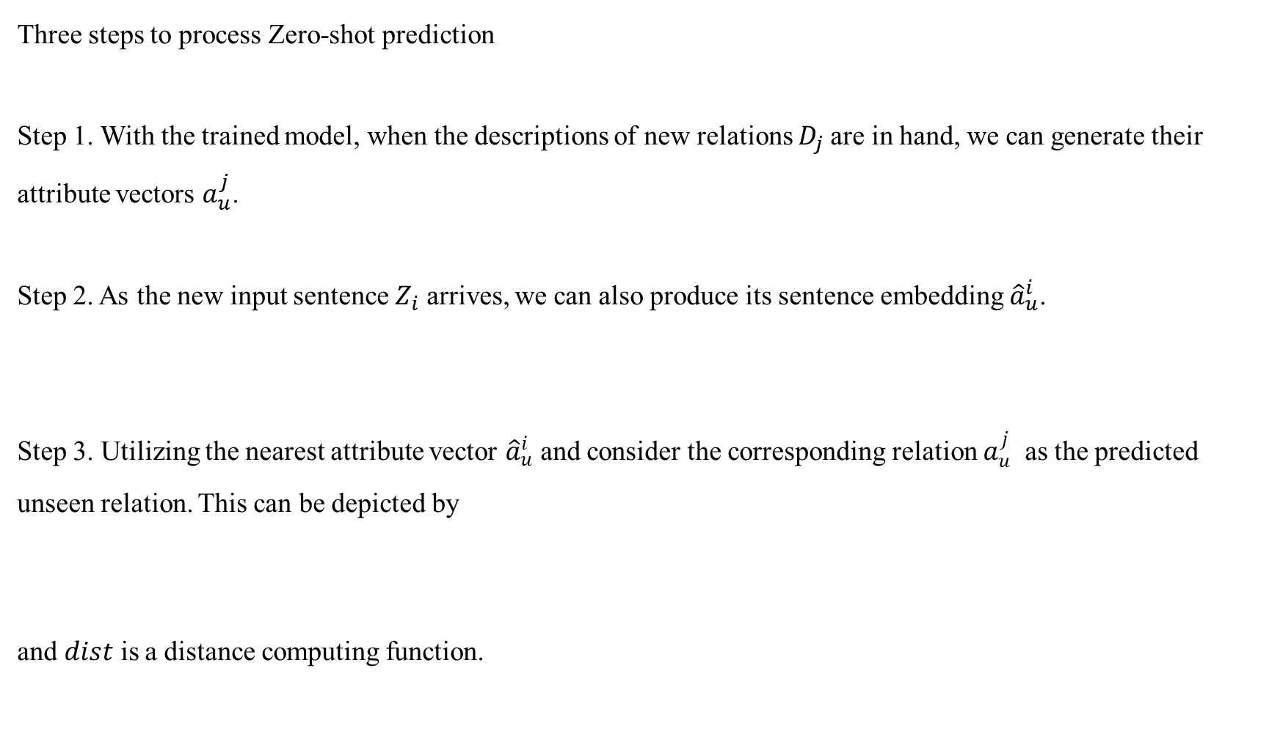

Generating Zero-shot Prediction
Three steps to process Zero-shot prediction
Step 1. With the trained model, when the descriptions of new relations $D_{j}$are in hand, we can generate their attribute vectors $a_{u}^{j}$.
Step 2. As the new input sentence $Z_{i}$ arrives, we can also produce its sentence embedding ${\hat{a}}_{u}^{i}$.
Step 3. Utilizing the nearest attribute vector ${\hat{a}}_{u}^{i}$ and consider the corresponding relation $a_{u}^{j}$ as the predicted unseen relation. This can be depicted by
and $dist$ is a distance computing function.
$$a_{u}^{j}=SentenceBert Encoder(D_{j})$$

Slide 18
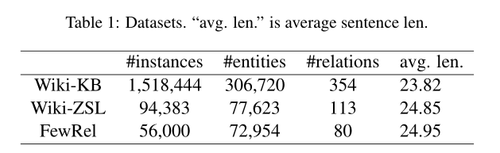
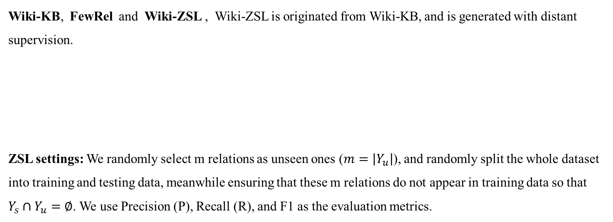
Datasets
Wiki-KB, FewRel and Wiki-ZSL , Wiki-ZSL is originated from Wiki-KB, and is generated with distant supervision.
ZSL settings: We randomly select m relations as unseen ones ($m=\left|Y_{u}\right|$), and randomly split the whole dataset into training and testing data, meanwhile ensuring that these m relations do not appear in training data so that
$Y_{s}∩Y_{u}=∅$. We use Precision (P), Recall (R), and F1 as the evaluation metrics.

Slide 19
Baselines
Baselines consist of two categories, supervised relation extraction (SRE) models and text entailment models.
SRE baselines: CNN-based SRE , Bi-LSTM SRE, Attentional Bi-LSTM SRE , and RBERT. These SRE models use different ways to extract features from the input sentences and perform prediction. They have achieved great performance with fully supervision but fail to carry out zero-shot prediction.
Text entailment baselines, ESIM and CIM . These two models follow a well-known implementation that formulates zero-shot relation extraction as a text entailment task, which accepts sentence and relation description as input, and output a binary label indicating whether they are semantically matched.
Notes:
这些SRE模型使用不同的方式从输入句子中提取特征并执行预测。他们在完全监督下取得了很好的成绩，但未能实现零炮预测。为了使它们能够进行零炮预测，也为了进行公平的比较，我们将每个SRE竞争方法的最后一个隐藏层改为具有双曲正切激活函数的全连接层，嵌入维数d与ZS-伯特相同，而不是最初使用softmax层来输出其维数等于可见关系的概率向量。最近邻搜索应用于输入句子嵌入和关系属性向量，以生成零镜头预测。
这两个模型遵循一个众所周知的实现，该实现将零镜头关系提取公式化为文本蕴涵任务，该任务接受句子和关系描述作为输入，并输出指示它们是否语义匹配的二进制标签。

Slide 20
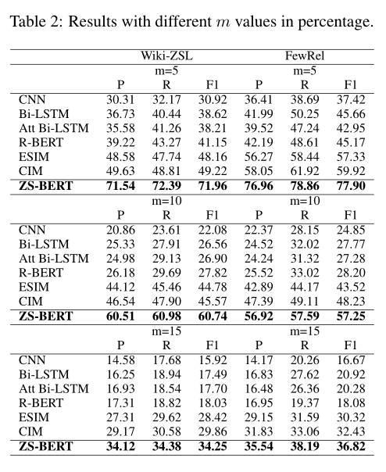
Main Result
First, it can be apparently found that the proposed ZSBERT steadily outperforms the competing methods over two datasets when targeting at different numbers of unseen relations. The superiority of ZSBERT gets more significant on m = 5.
Second, although the text entailment models ESIM and CIM perform well among competing methods, their performance is still obviously lower than ZS-BERT. The reason is that their approaches cannot precisely distinguish the semantics of input sentences and relation descriptions in the embedding space.
Notes:
不仅验证了利用关系描述的有效性，还证明了所提出的损失函数结构的有效性，该结构更好地编码了输入句子的语义，并且使关系属性向量相互区分。
原因是他们的方法不能精确区分嵌入空间中输入句子和关系描述的语义。

Slide 21
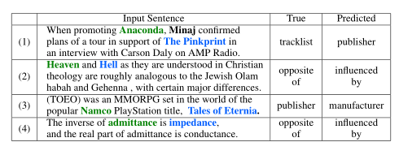
Main Result
Third, we also find that the improvement of ZS-BERT gets larger when m is smaller. We also speculate another underlying reason is that although ZS-BERT can effectively capture the latent attributes for each relation, relations themselves could be to some extent semantically similar to one another, and more unseen relations will increase the possibility that obtains a predicted relation that is semantically close but actually wrong.
Notes:
我们还推测另一个潜在的原因是，尽管ZS-bert可以有效地捕捉每个关系的潜在属性，但关系本身在某种程度上可能在语义上彼此相似，并且更多看不见的关系将增加获得语义上接近但实际上错误的预测关系的可能性。

Slide 22
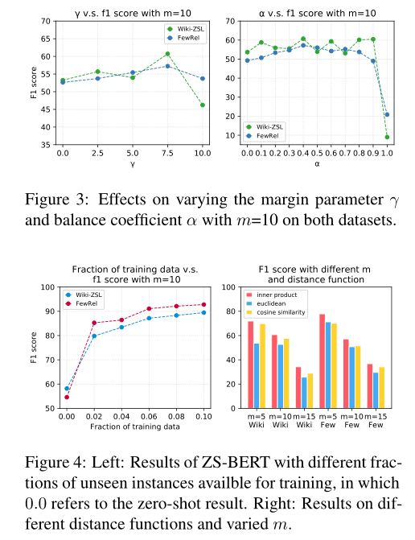
Hyperparameter Sensitivity
When γ is too low, the distance between the positive pair and negative pair would not be far enough. Thus, when performing nearest neighbor search, it is more likely to reach the wrong relations. In contrast, when γ gets too high, it is hard for the training process to converge at the point that the distance between relations is expected to be that high. We would suggest setting γ = 7.5 to derive satisfying results across datasets.
We find that α = 0.4 can achieve the best performance, indicating that the margin loss plays a more significant role in training ZS-BERT. Also notice that when α = 1.0, the performance drops dramatically, showing that the margin loss is essential to our model.
Notes:
当γ太低时，正对和负对之间的距离不够远。因此，当执行最近邻搜索时，更有可能到达错误的关系。相反，当γ太高时，训练过程很难收敛到关系之间的距离预期那么高的点。我们建议将γ设置为7.5，以便在数据集之间获得令人满意的结果。
因为我们的模型依赖于嵌入的质量，因此完全依赖交叉熵损失导致零炮预测的失败。不同关系的嵌入之间的分离越好，我们的模型就越有可能生成准确的零镜头预测

Slide 23
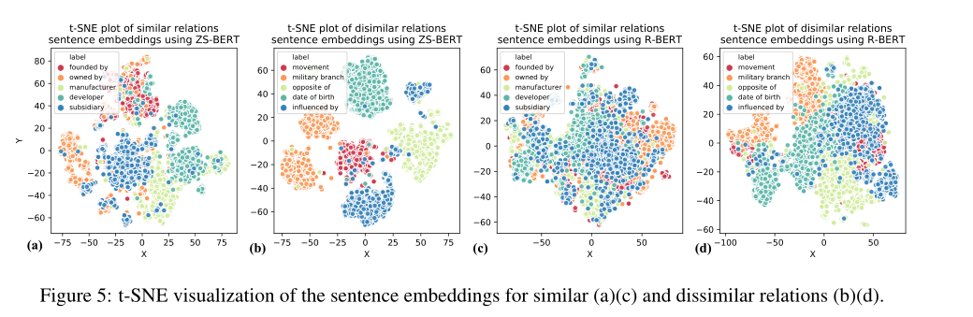
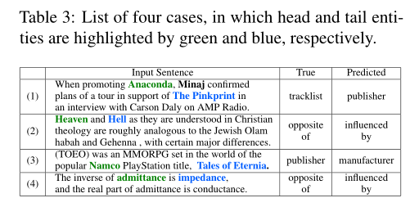
Case Study
(1) The predicted relation is not precise for the targeted entity pair
but may be suitable for other entities that also appear in the sentence. (2) The true relation is not appropriate because it comes from distant supervision. (3) The predicted relation is ambiguous or is a synonym of other relations.(4) The relation is wrongly predicted but should be able to be correctly classified.

