Slide 1
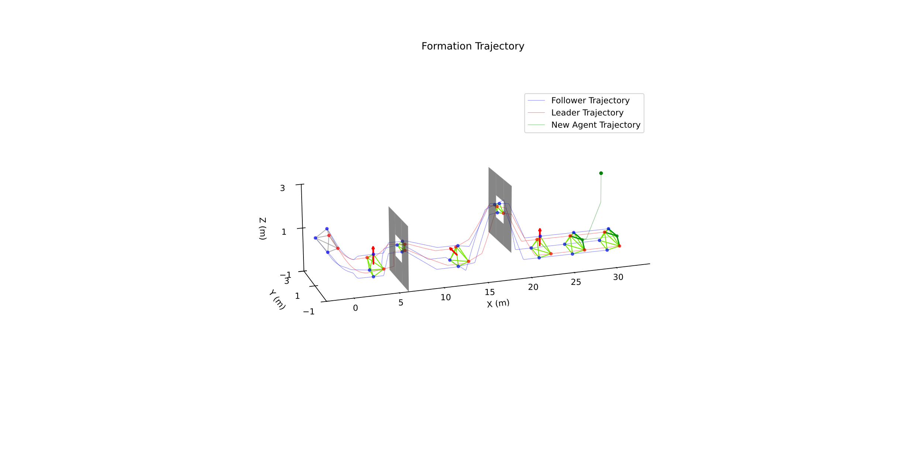
New Agent Join
Rotation Axis Change
Form Target Formation

Slide 2
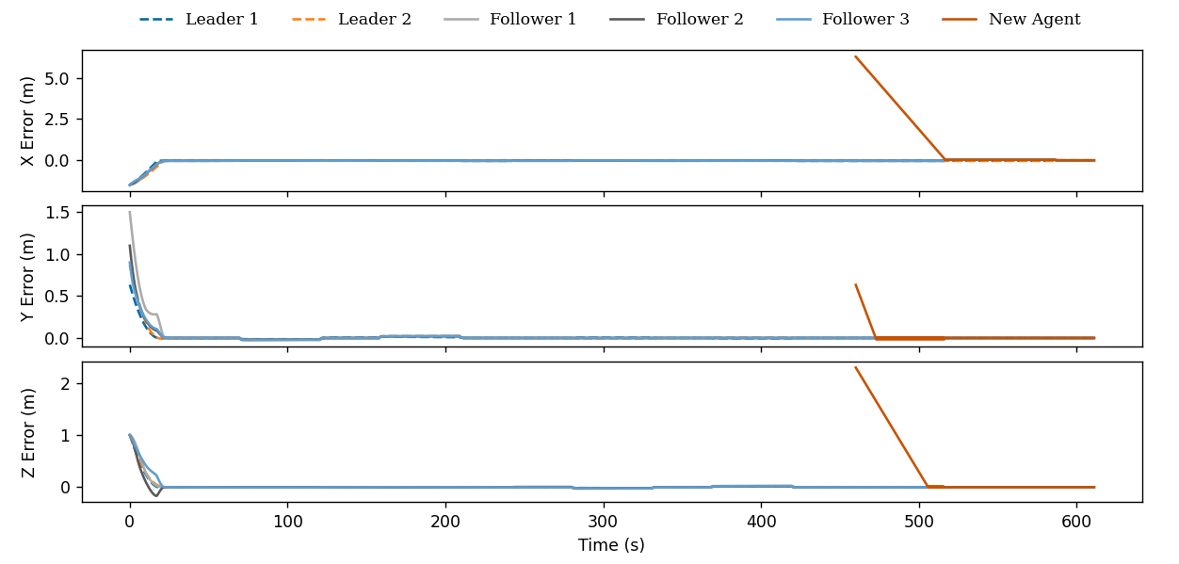
Form Target Formation
Rotation Axis Change
New Agent Join

