Slide 1
AI Tradeoff
Team A
Chenxi Li, Kartik Moudgil, Yuchen Wang, Zhouyi Yang

Slide 2
Which model is better in Primary Scenario
？
Popularity Prediction

Slide 3
1
Accuracy
2
Training time & Inference Time
3
Model Size
4
Interpretability
5
Linear / Non-linear

Slide 4
Accuracy

Slide 5
Split the data into train-test split of 70% : 30%
Linear Regression Lasso MSE: 0.496426
Random Forest MSE: 0.283986

Slide 6
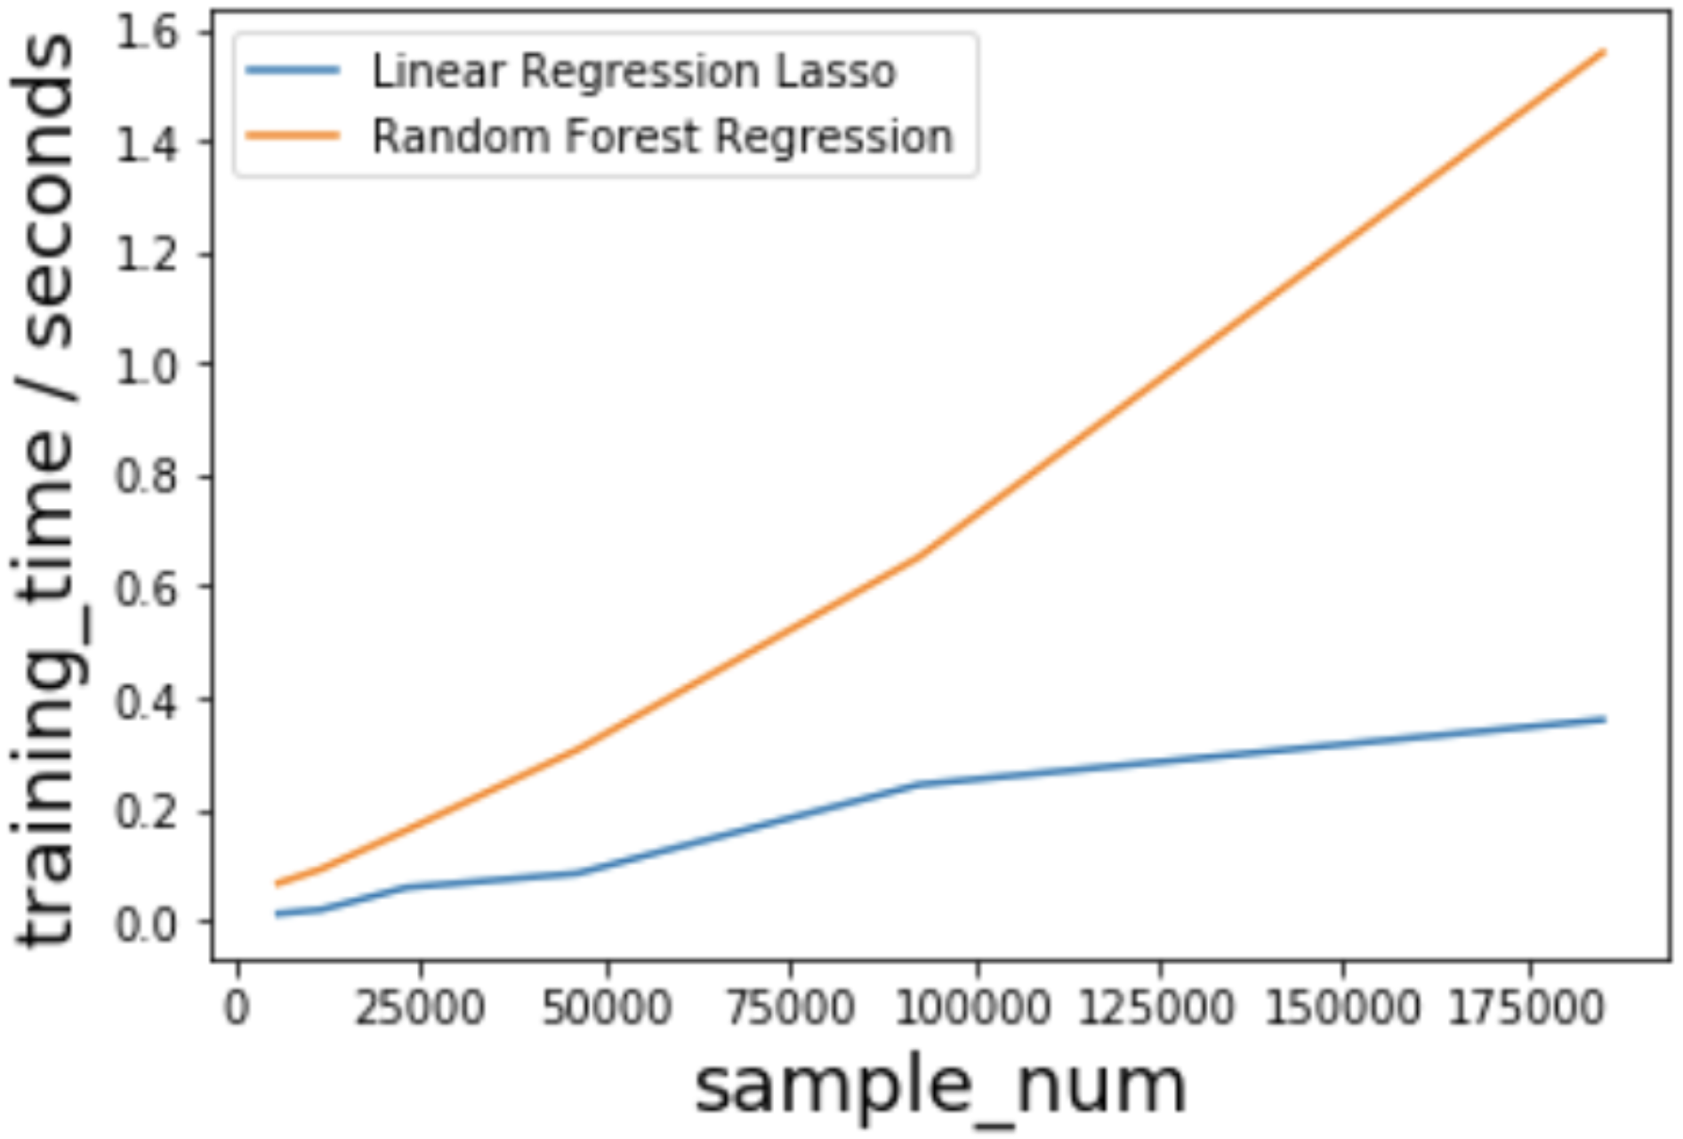
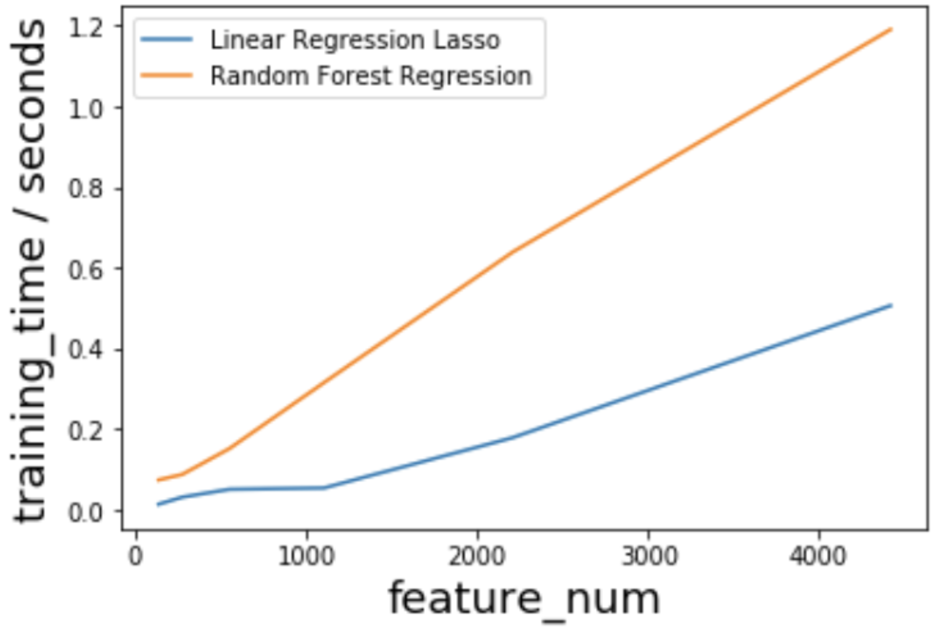
Training Time
72时
#sample
#feature

Slide 7
Lower: Linear Regression

Slide 8
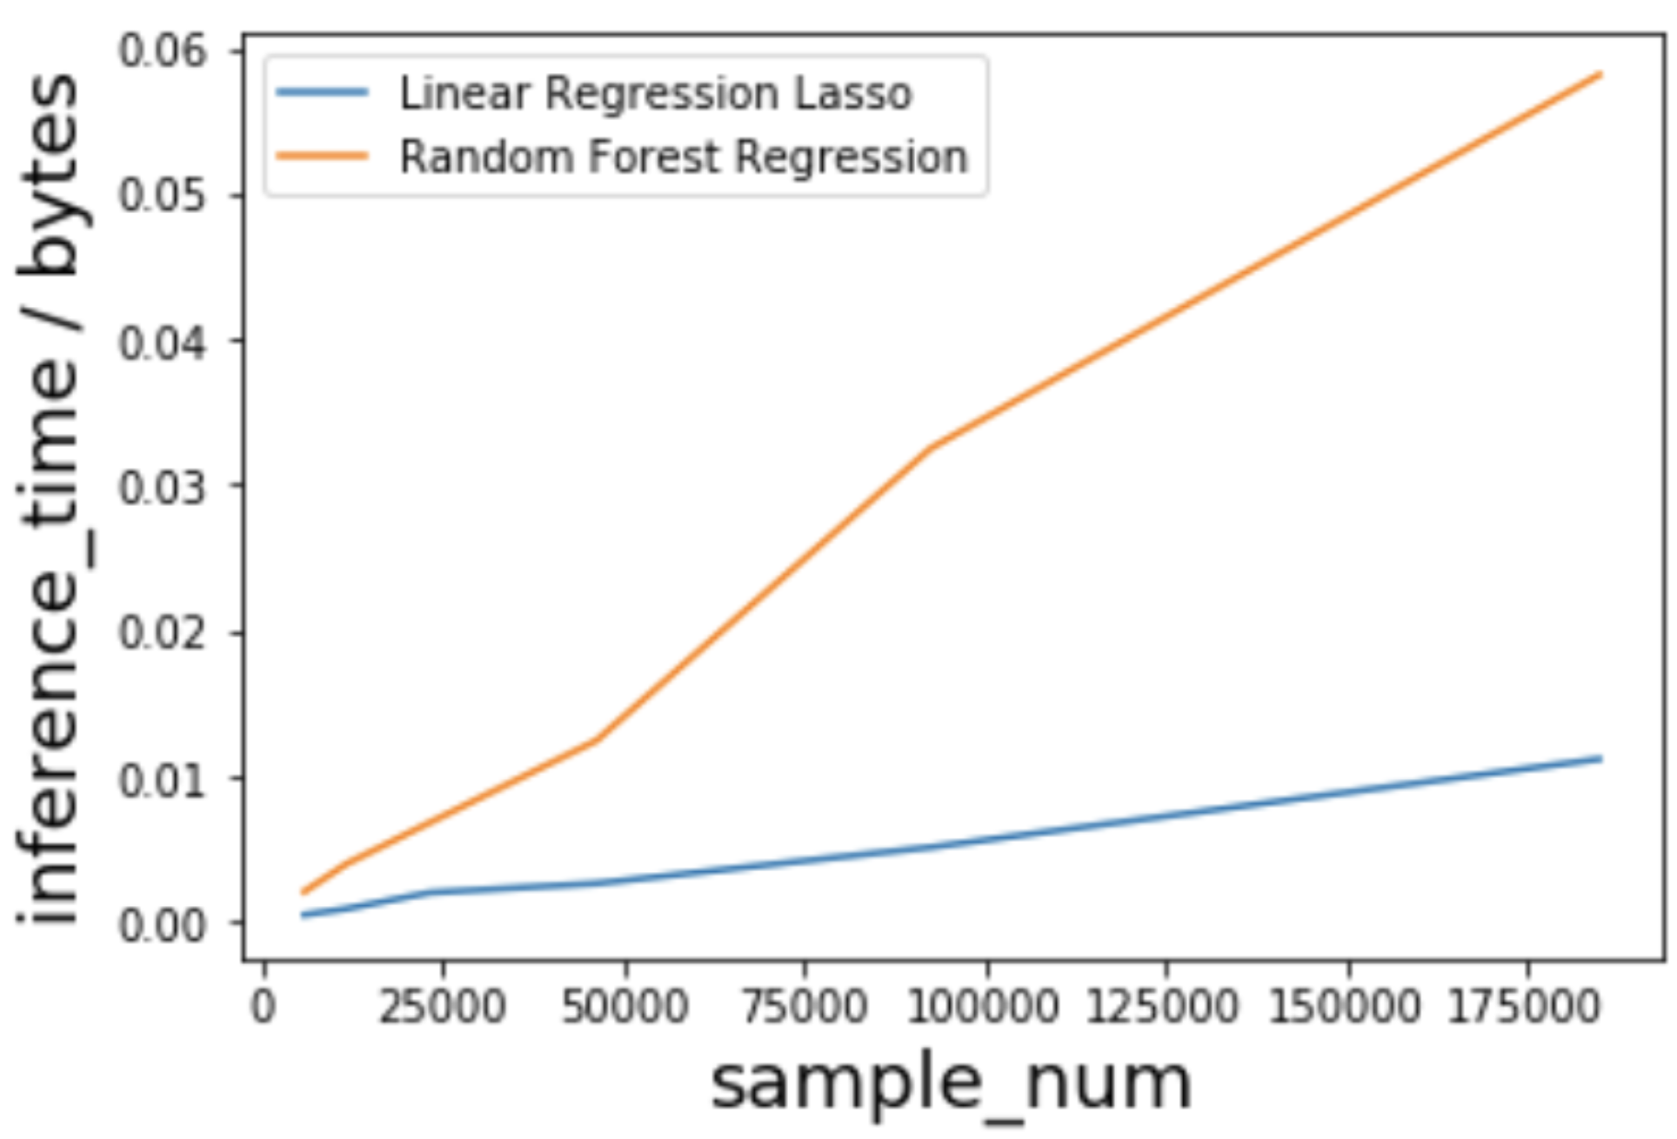
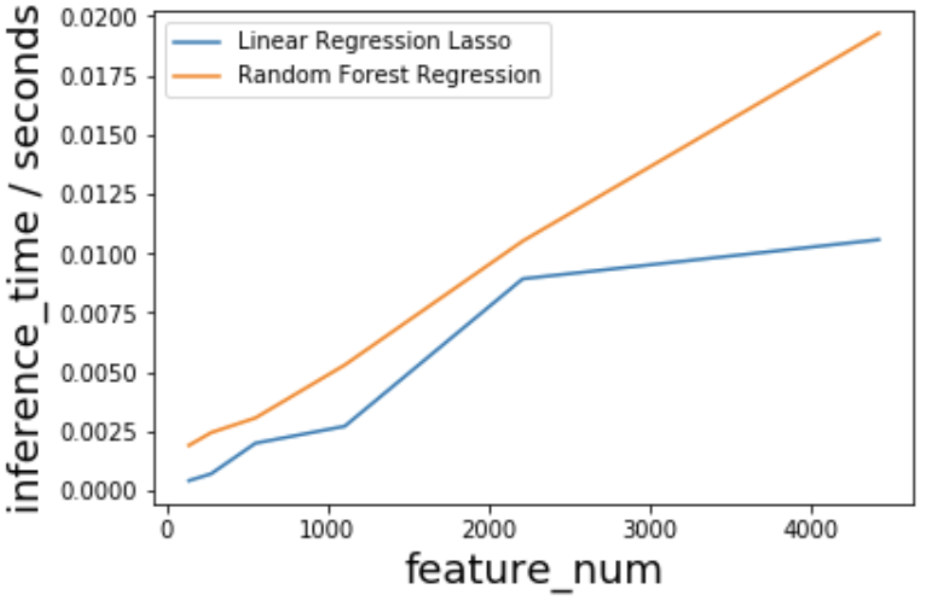
Inference Time
72时
#sample
#feature

Slide 9
Lower: Linear Regression

Slide 10
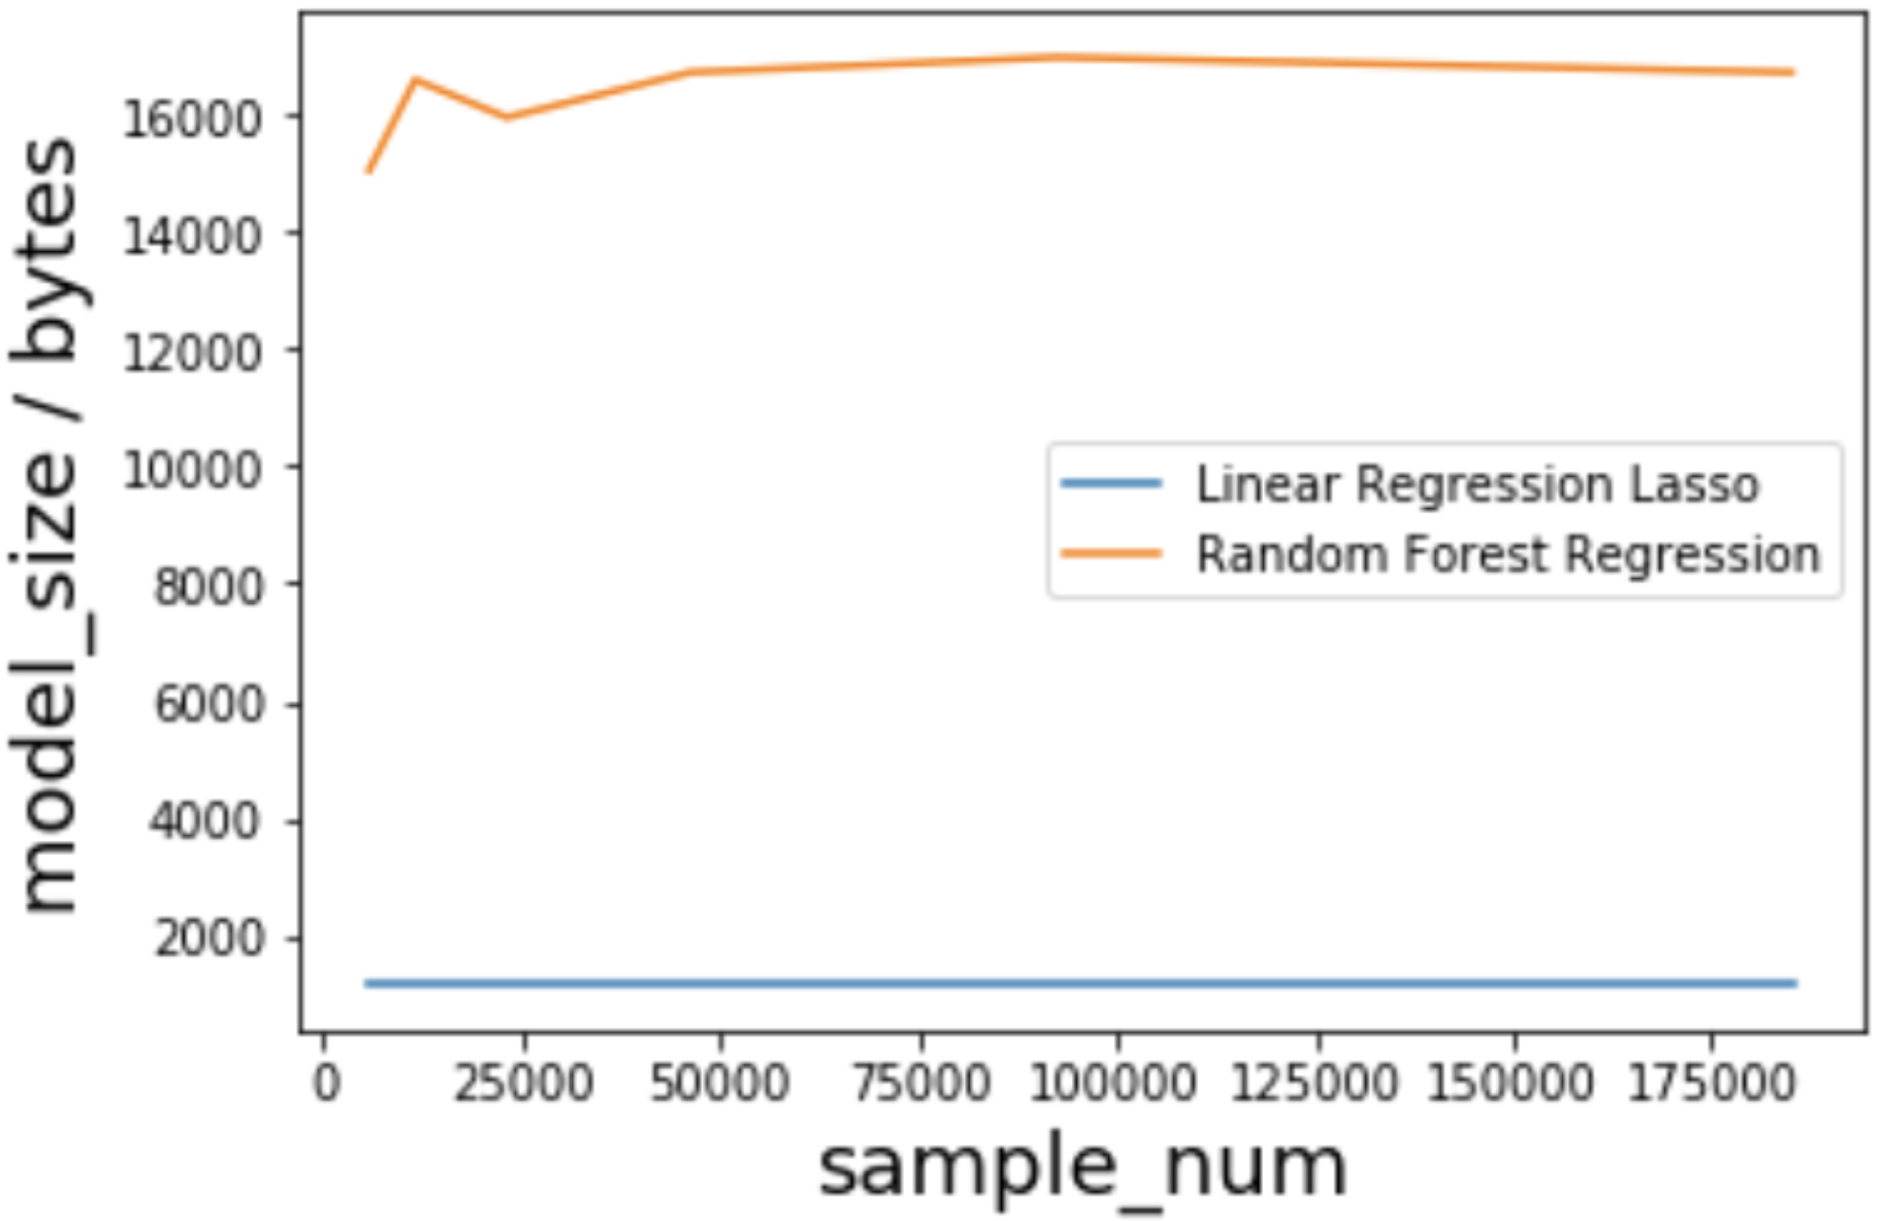
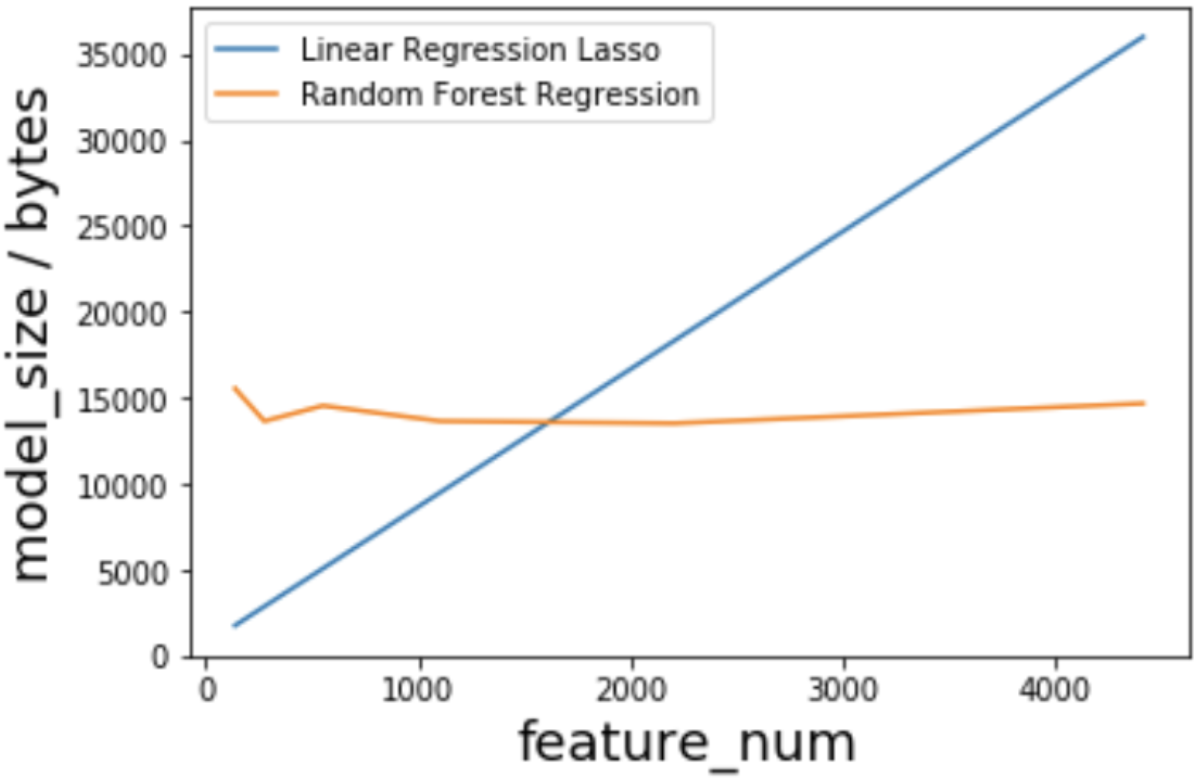
Model Size
72时
#sample
#feature

Slide 11
Lower: Linear Regression

Slide 12
Interpretability:
Better: Linear Regression
1. For for low-dimension data, linear regression can be used to produce intuitive visualizations by scattering the data points and drawing a line. This really helps stakeholders who do not have much machine learning background to easily grasp the meaning.
2. Second, each parameter in linear regression has a very clear relationship with one of the features. You can even tell how much popularity increase or decrease you can expect if you tune one of the movie features.
3. if you have a large random forest with deep trees, the interpretibility of this model may decrease a lot compared to a single decision tree

Slide 13
Linear / Non-Linear:
Better: Random Forest
The linear regression can only capture linear relationship in the data if you do not use tricks like polynomial terms. However, for a random forest, it has the ability to detect the non-linear relationship in the data.

Slide 14
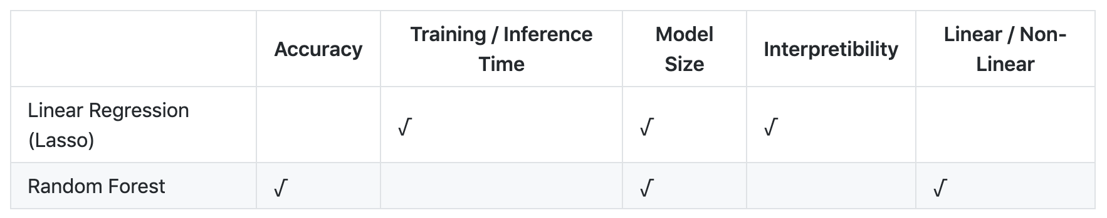
Recommendation - Random Forest
Accuracy has a high priority
The training and inference time may not necessarily require on-the-fly speed of response. It can be done in the back-end once in a while
The model size of the models depend on different things: one is number of features in data, another is hyper-parameters.
The interpretibility and linear / non-linear are the properties of the models themselves

Slide 15
？
Alternative Scenario
Linear Regression is Better

Slide 16
Movie Rate
By
Users’ Age / Gender / Movie Genres

Slide 17
Natural Linear Relationship?
Output is Numerical value?
Light-Scale, Quick-to-Run, Frequently-Trained Model?
Consider Attributes + Constraints

Slide 18
This Scenario Inspired By…
User continuously watching new movies -> Model required to be frequently trained
User see the recommendation result right after they visit the website (or APP) -> Inference time should be as low as unnoticeable
Privacy Issue -> User not want to upload their age or gender information to server -> Model may not be able to deployed on server or cloud side -> deploy on users’ local device -> light-scale, small-size model
Output is numerical -> Movie Rate is numerical

Slide 19
Why Linear Regression Better?
1.Low Training Cost
2.Short Inference Time
3.Small Model Size

Slide 20
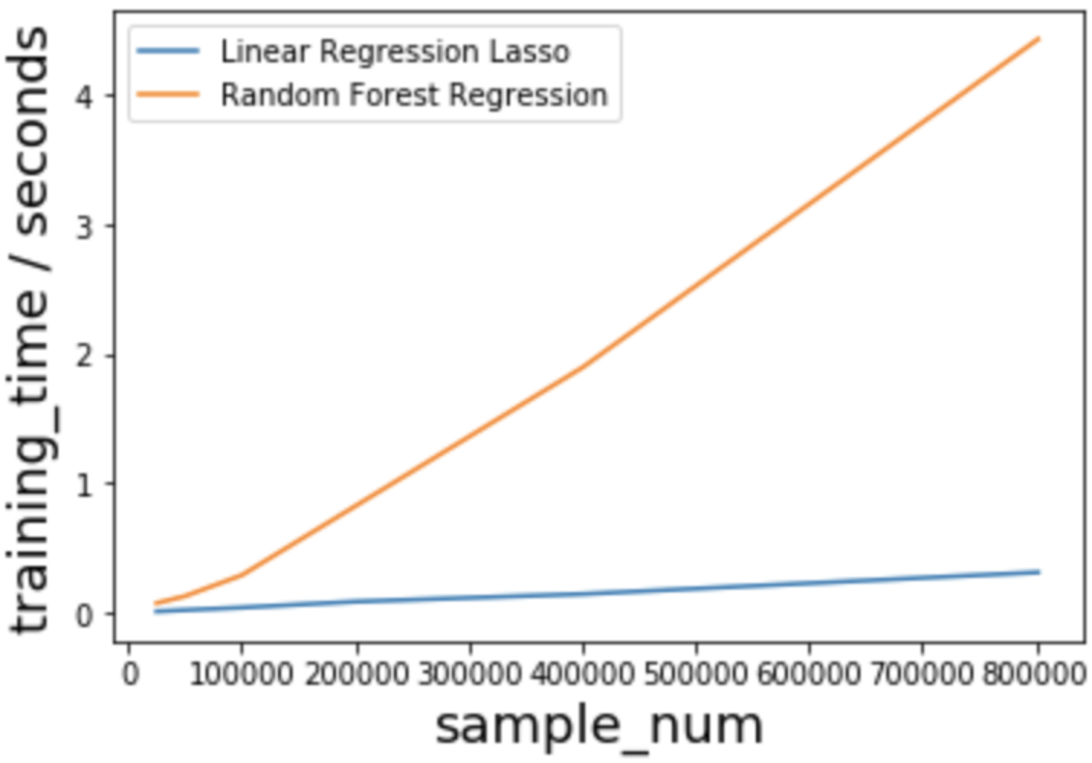
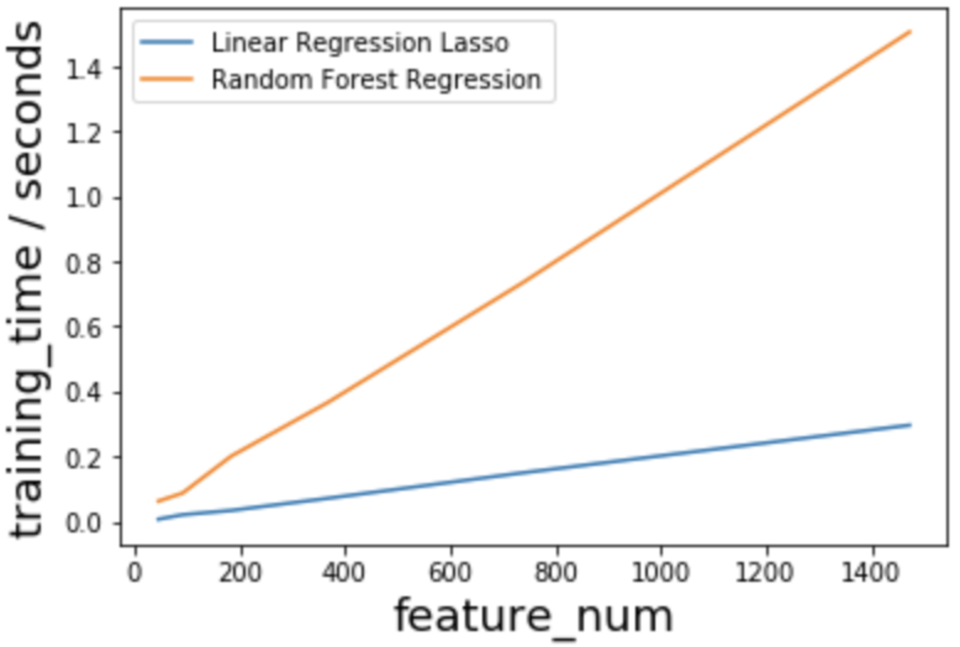
Linear Regression
1.Low Training Cost
2.Low Inference Time
3.Small Model Size

Slide 21
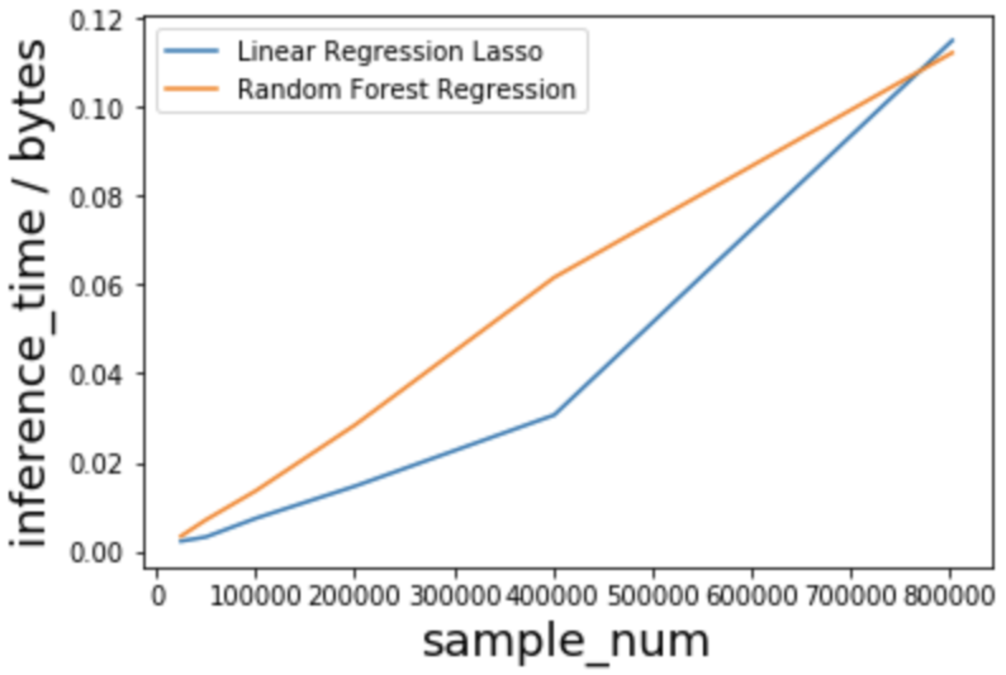
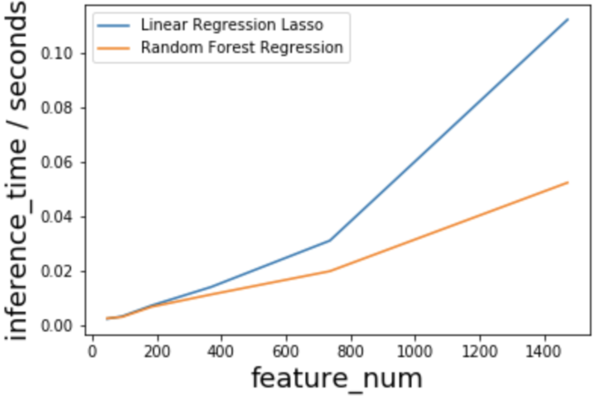
Linear Regression
1.Low Training Cost
2.Low Inference Time
3.Small Model Size

Slide 22
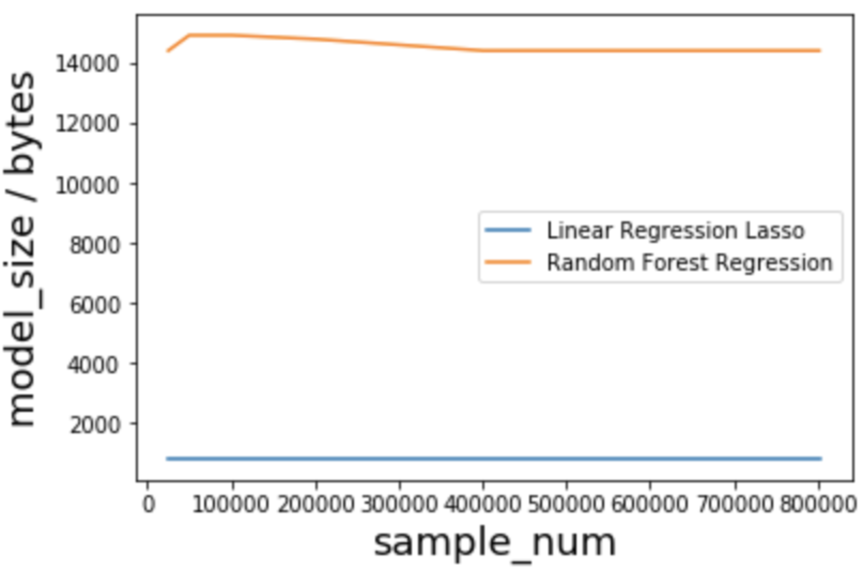
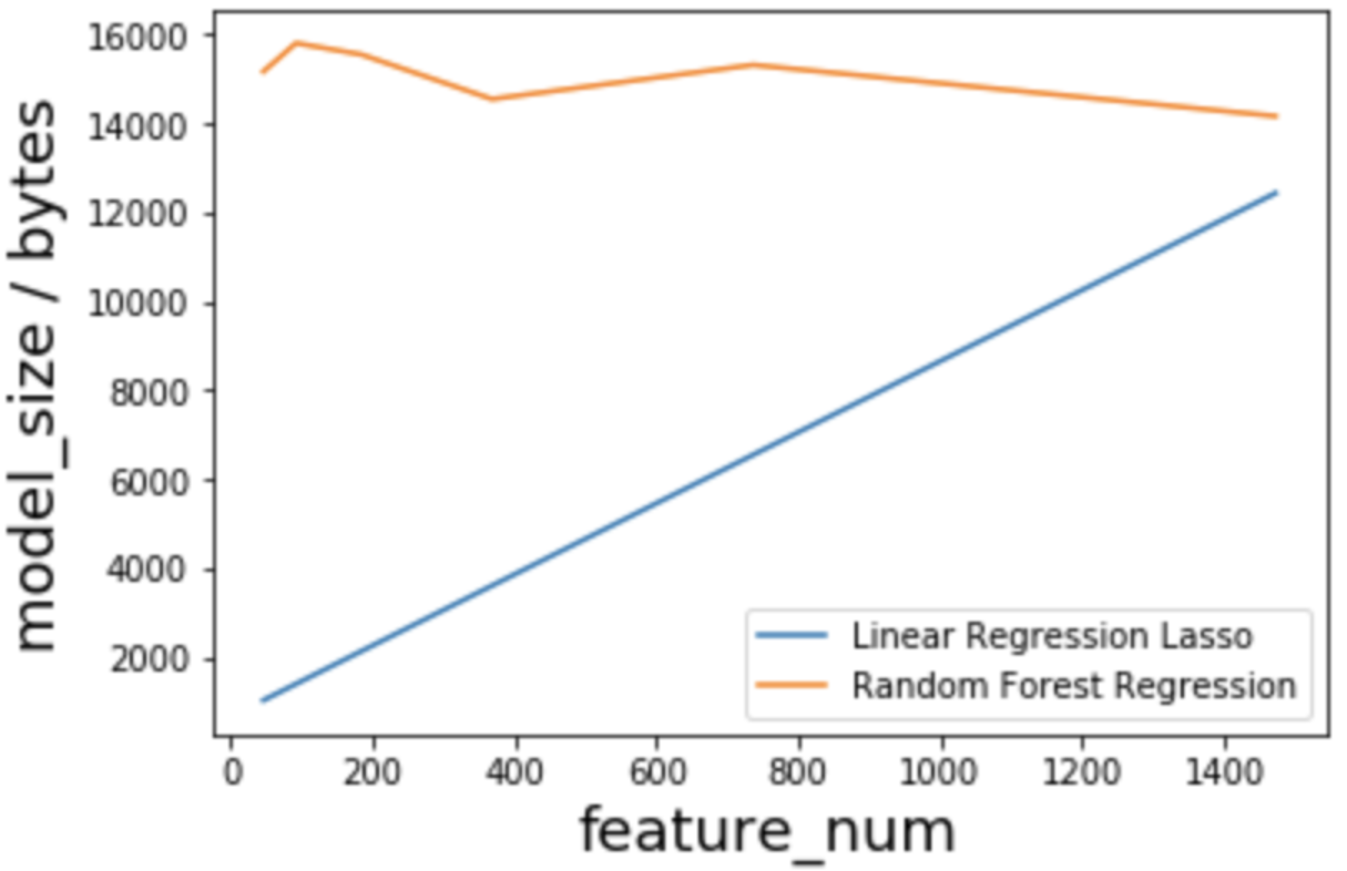
Linear Regression
1.Low Training Cost
2.Low Inference Time
3.Small Model Size

Slide 23
Split the data into train-test split of 75% : 25%
Linear Regression Lasso MSE: 0.533825
Random Forest MSE: 0.533390

Slide 24
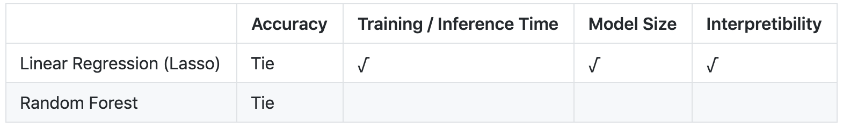
Recommendation - Linear Regression
Short Training Time / Short Inference Time / Small Model Size has a high priority
Accuracy are almost the same

Slide 25

Summary
When doing AI tradeoff, we should alway consider from attributes and constraints.
Quality Attributes
Project Attributes
Design Attributes
ML Task
Accuracy
Training Time
Inference Time
Memory Usage
Linear Regression
◦ Advantages:
▪ The model size is very concise
▪ Faster to run
▪ Easy to understand
◦ Disadvantages:
▪ Accuracy is relatively low
▪ cannot capture non-linear relationship
Random Forest
◦ Randomly construct lots of decision trees
◦ Final output is the mode or mean of individual trees
◦ High accuracy and reduced overfitting, incremental
◦ Reduced interpretability, large number of trees can take up space

Slide 26
THANK YOU
Q & A

