Slide 1
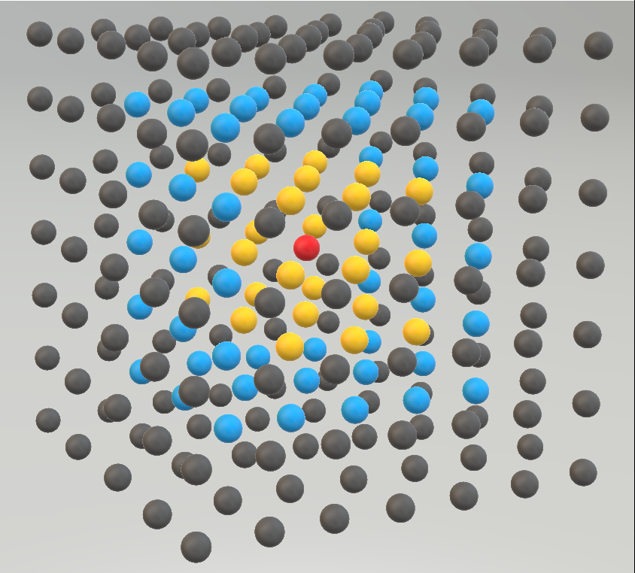
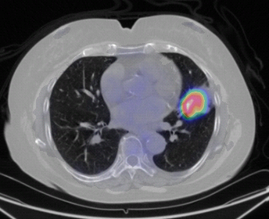
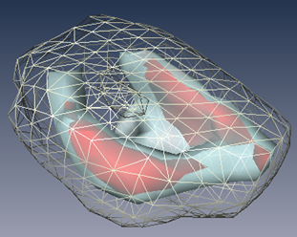

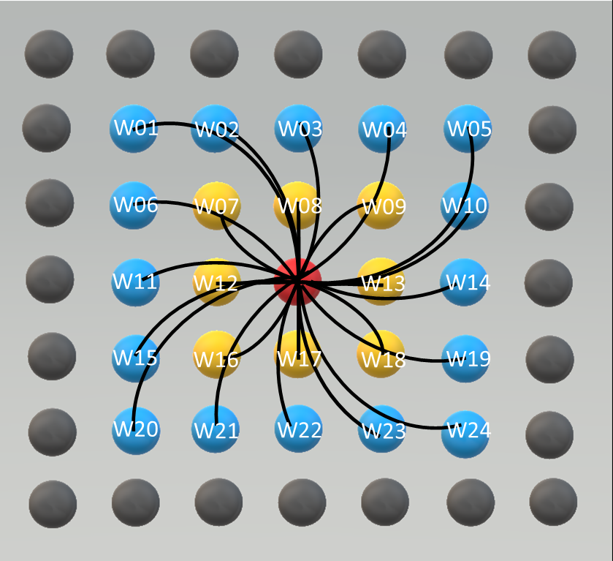
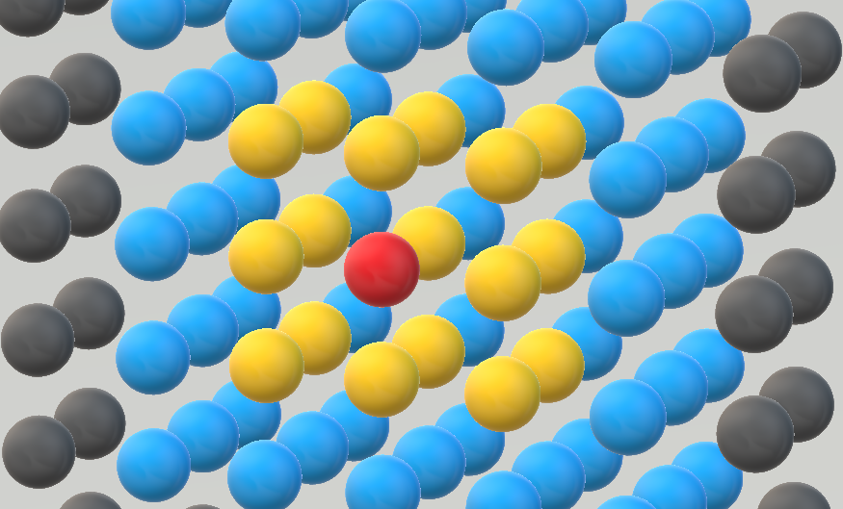
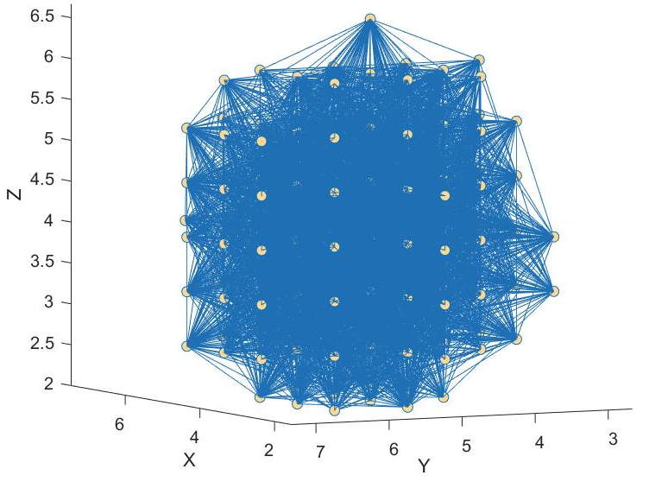
PET Image with ROI
Network Construction
Central Voxel
Neighbor with Weight=1
Neighbor with Weight=1/2
Not Neighbor
PET Images
ROI
3D PET Matrix
Weighted Edges
Nodes
3D tumor network
2D view of connectivity
Weight Calculation
Network Visualization

