Slide 1
BBOX data observation
Zihao Zhou
zihao.zhou@eng.ox.ac.uk

Slide 2
Main Logic
Data Observation
Feature Engineering
Baselines
Evaluation
T-SNE

Slide 3
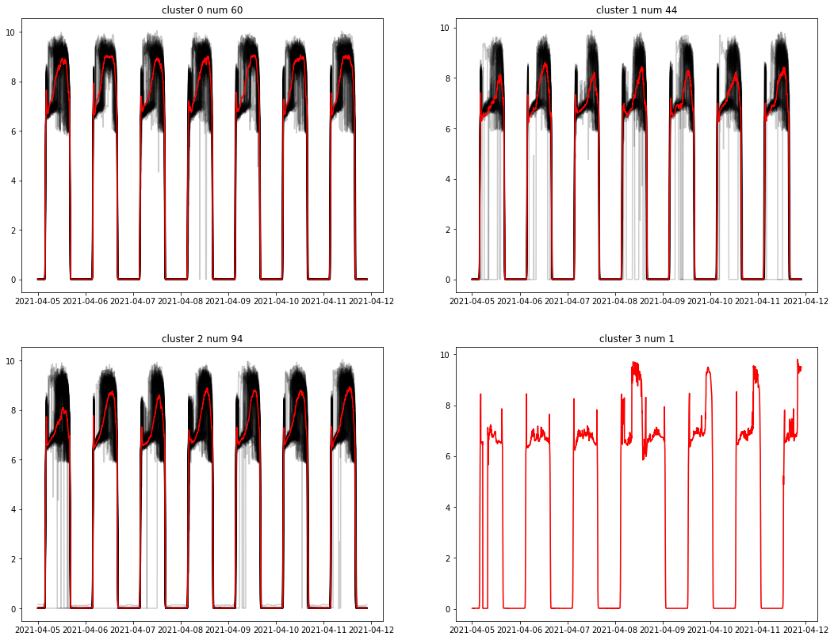
1 Try divide cells based on area (by ‘panel_voltage’)
All cells seems share same time for sunny weather which indicate their locations are relatively same
Abnormal cell index: 153 (range from 0)

Slide 4
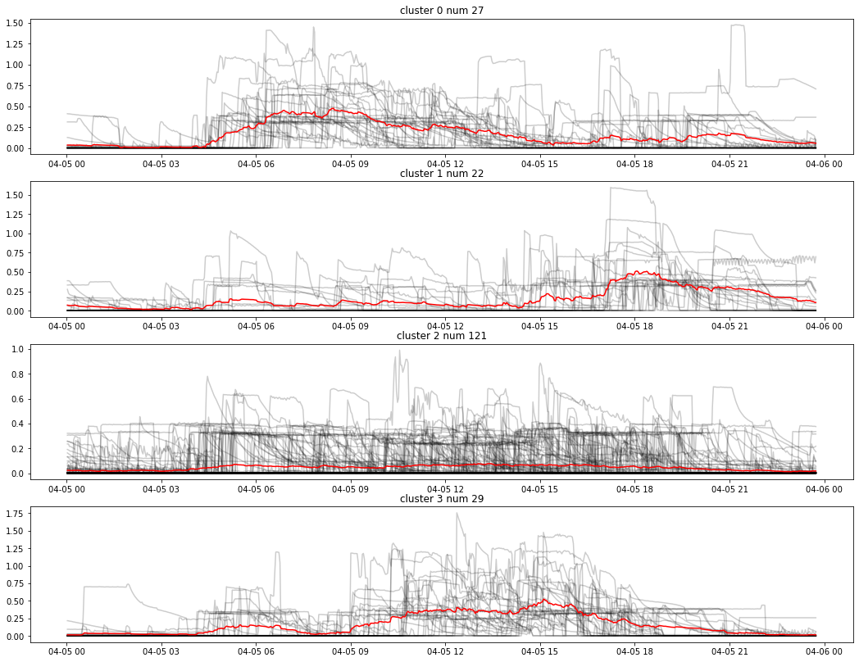

2.1.1 Try divide cells based on outer usage 1 (by ‘usb_current’)
For this specific day, usage pattern differences locate on time domain
Cluster 0: heavily used in morning (5 am – 2 pm)
Cluster 1: heavily used in night (5 pm – 11 pm)
Cluster 2: Not Clear, many cells are used uniformly intense during the whole day
Cluster 3: heavily used in daytime (9 am – 6 pm)

Slide 5
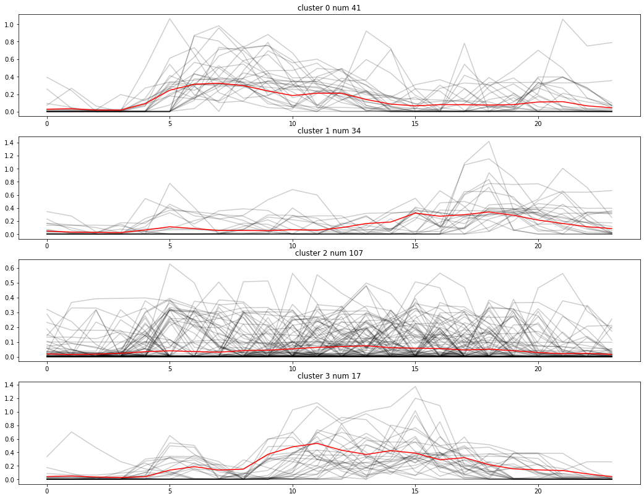
2.1.2 Try divide cells based on outer usage 1 (by ‘usb_current’) averaging in 1 hour level
Also the mentioned usage differences in time are more clear

Slide 6
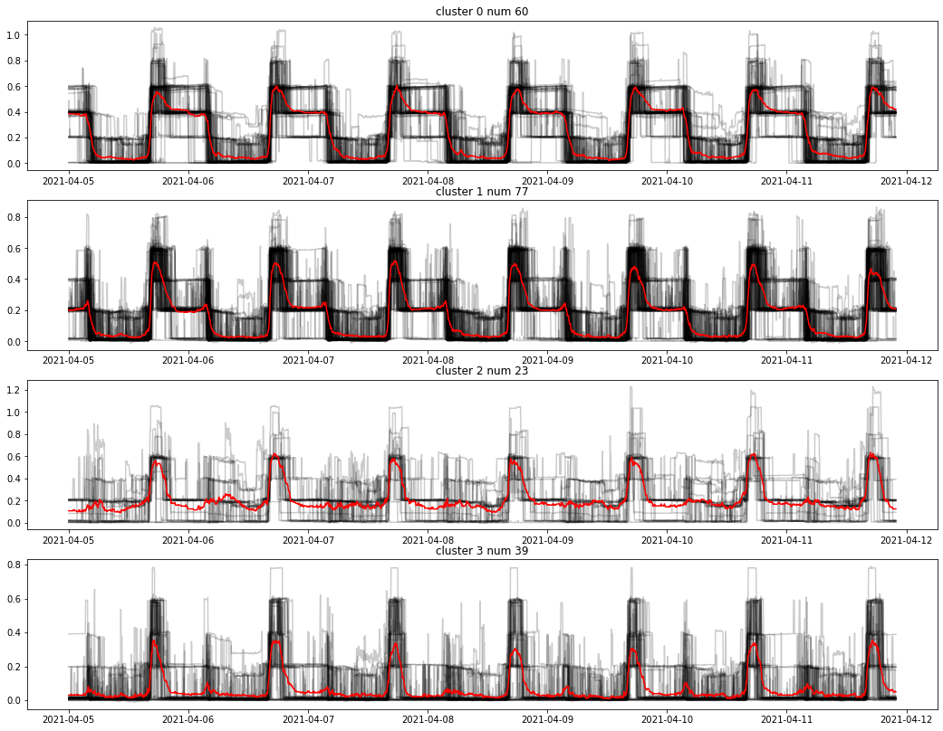

2.2.1 Try divide cells based on outer usage 2 (by ‘current_out’ – ‘usb_current’)
Clearly 4 different usage patterns but not in time level, maybe in equipment level
For cluster 0 & 1
The platforms differences at
0.4A (cluster 0 )
0.2A(cluster 1)
cluster 2 seems have constant usage at 0.2A
Does the differences related to different energy-consumption equipments ?

Slide 7
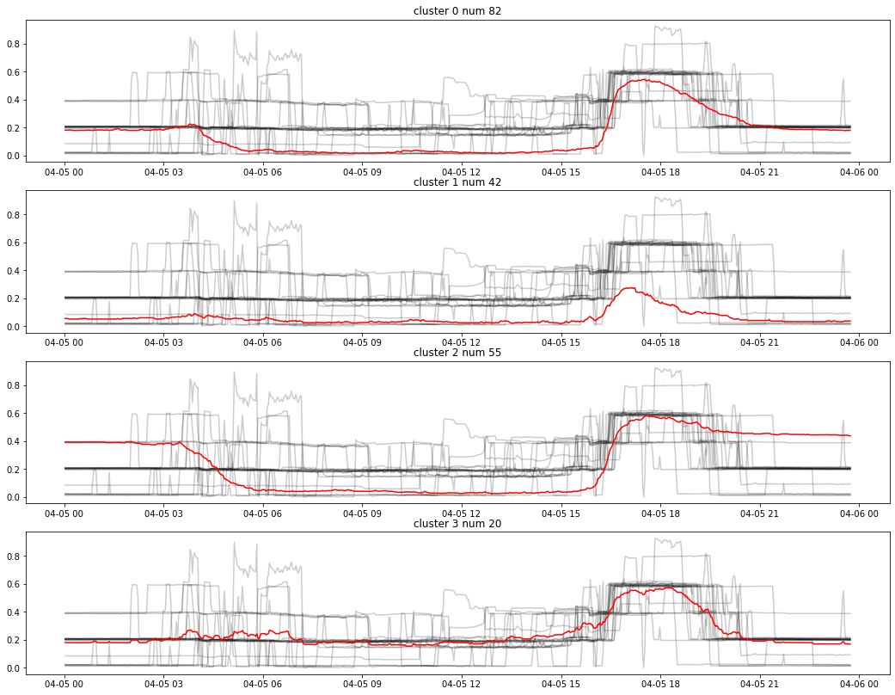
2.2.1 Try divide cells based on outer usage 2 (by ‘current_out’ – ‘usb_current’)
Also the mentioned usage differences within one day

Slide 8
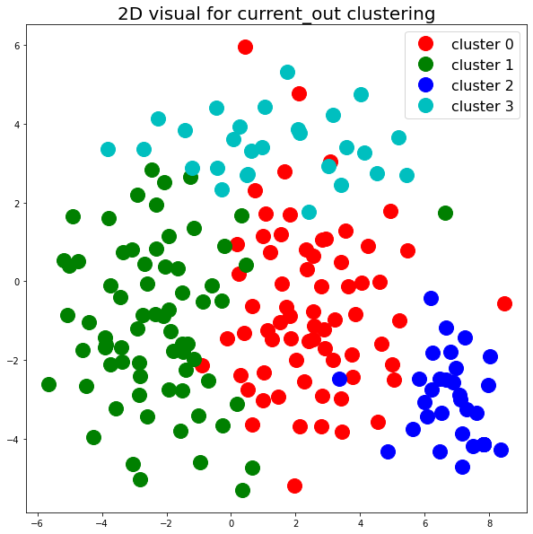
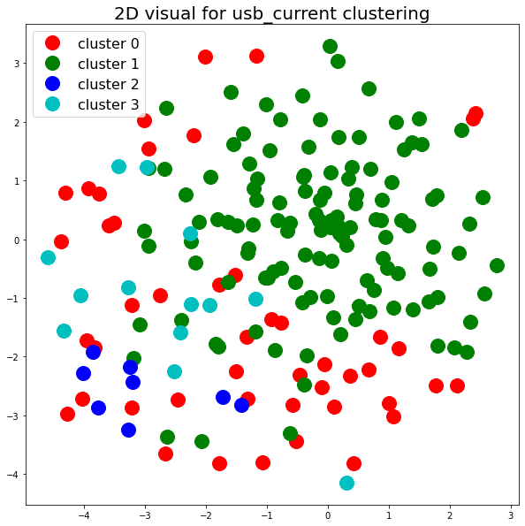
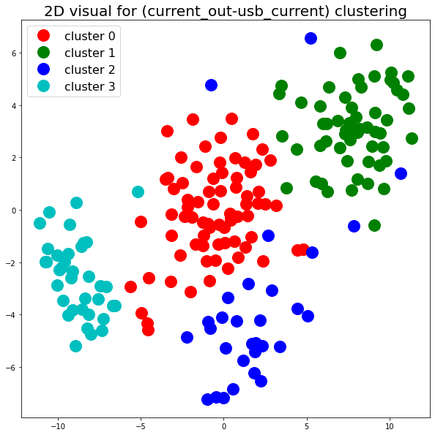
3.1 Visualization by t-SNE (one week’s data 4-15 2021 to 4-22 2021)

Slide 9
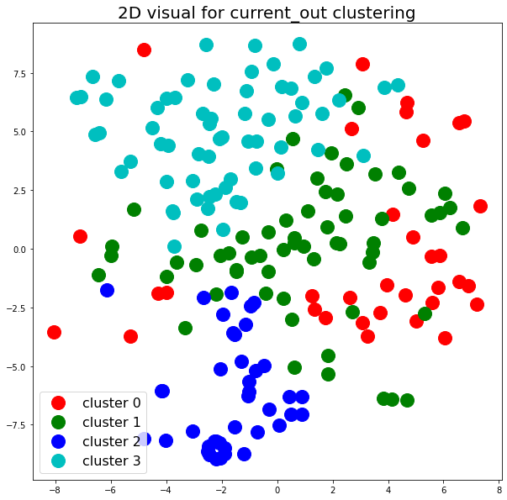
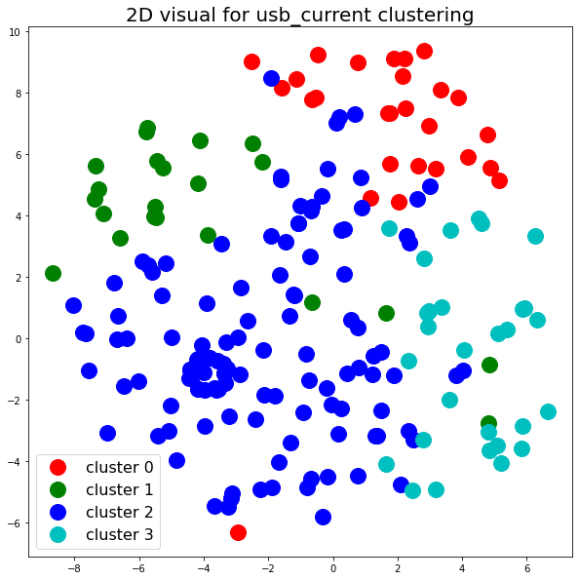
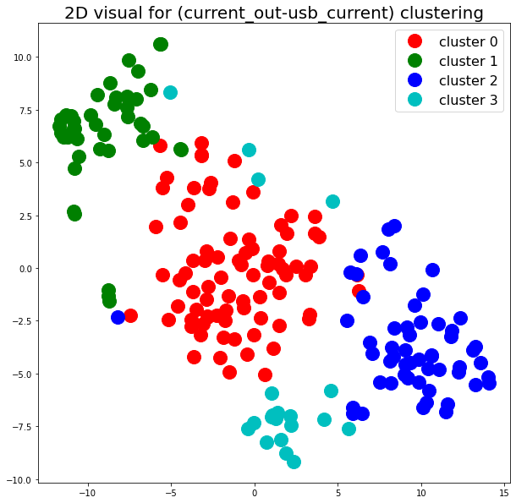
3.2 Visualization by t-SNE (one day’s data 4-15 2021 to 4-22 2021)

