Slide 1
Contact Map Prediction using SVM
Introduction
protein structure
prediction protein structure
Background Material
Contact Map Prediction using SVM
Notes:
ICS320-Foundations of Adaptive and Learning Systems
Part3 Decision Tree Learning

Slide 2
Introduction
Machine learning methods are widely used in bioinformatics and computational and system biology.
Here, we review the development of machine learning methods for protein structure prediction, one of the most fundamental problems in structural biology and bioinformatics.

Slide 3
Protein Structure
A protein is a polymeric macromolecule made of amino acid building blocks arranged in a linear chain and joined together by peptide bonds. The linear polypeptide chain is called the primary structure of the protein.
In its native environment, the chain of amino acids (or residues) of a protein folds into local secondary structures including alpha helices, beta strands, and nonregular coils

Slide 4
Protein Structure
the secondary is specified by a sequence classifying each amino acid into the corresponding secondary structure element. The secondary structure elements are further packed to form a tertiary structure depending on hydrophobic forces and side chain interactions, such as hydrogen bonding between amino acids.

Slide 5
Protein Structure
The tertiary structure is described by the x, y, and z coordinates of all the atoms of a protein or in a more coarse description, by the coordinates of the backbone atoms.
Several related protein chains can interact or assemble together to form protein complexes. These protein complexes correspond to the protein quaternary structure.

Slide 6
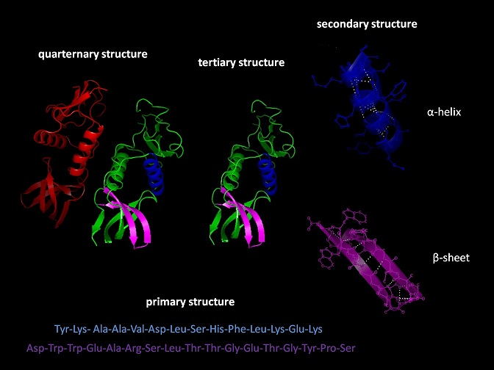
Protein Structure

Slide 7
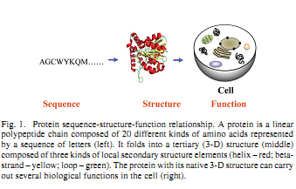
Protein Structure

Slide 8
Protein Structure Prediction 1D, 2D, 3D, 4D
Protein structure prediction is such a complex problem that it is often decomposed and attacked at four different levels :
    1-D prediction of structural features along the primary sequence of amino acids
    2-D prediction of spatial relationships between amino acids
    3-D prediction of the tertiary structure of protein
    4-D prediction of the quaternary structure of a multi protein complex

Slide 9
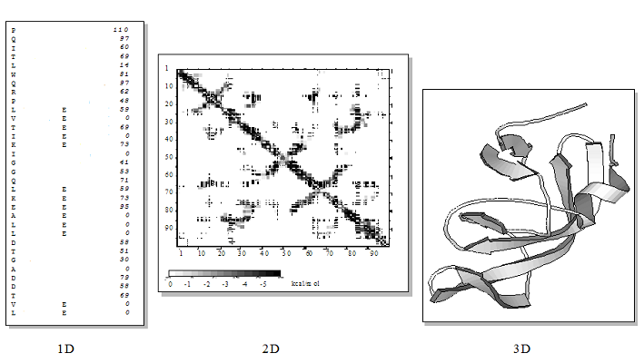
Notation : protein structure 1D, 2D, 3D

Slide 10
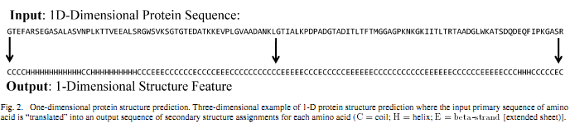
1-D Structure Prediction

Slide 11
2-D Structure Prediction
The classic 2-D structure prediction problem is the prediction of Protein Contact Maps.

Slide 12
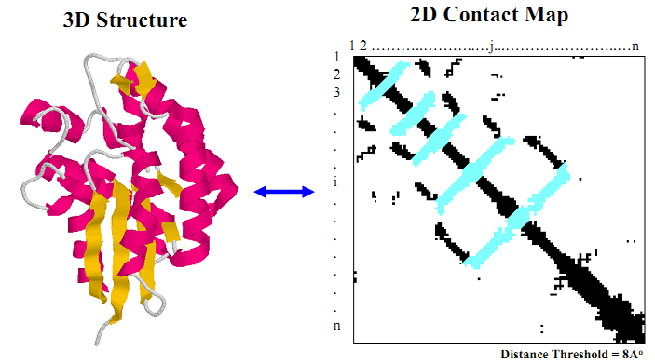
3-D Structure Prediction

Slide 13
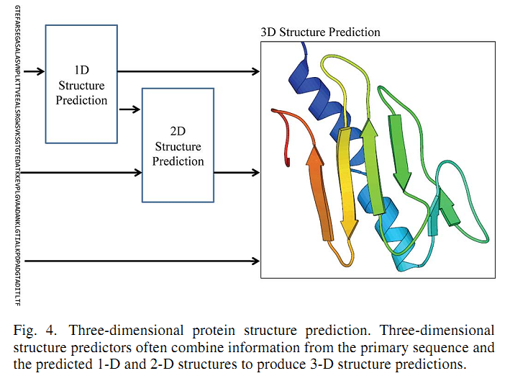
prediction protein structure 1D, 2D, 3D

Slide 14
Background Material
Contact Map
Non-local Contacts
CATH

Slide 15
Contact Map
A Protein Contact Map is a matrix C, where C[i,j] is either one or zero, depending on whether the Euclidean distance between the two amino acids at linear positions i and j is above a specified distance threshold (e.g., 8 Angstrom) or not.
Distances can be measured, for instance, between corresponding backbone carbon atoms.

Slide 16
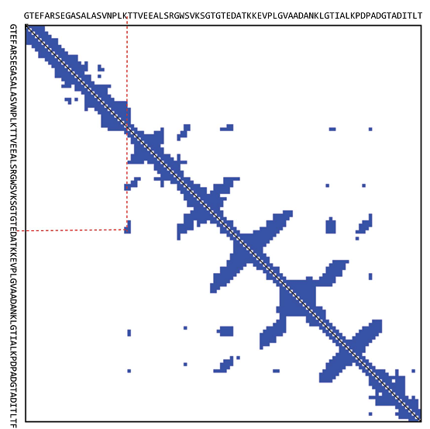
Contact Map

Slide 17
Non-local Contact
Consider a protein sequence [a1, a2,..., aN] where N is the number of amino acid residues.
non-local any pairwise interactions between amino acids ai and aj with the sequence separation |i-j| > 6.

Slide 18
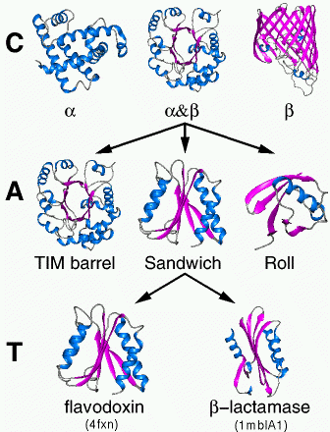
CATH
Three major classes
are recognized;
mainly-alpha,
mainly-beta and
alpha-beta.

Slide 19
Contact Map Prediction
The problem of contact map prediction can be stated as a classification problem.
Given a set of proteins with known structures, contact residues and non-contact residues are separated as positive instances and negative instances.

Slide 20
Contact Map Prediction
various features are collected to capture useful information of the pair of residues, including amino acid content, physicochemical environment, secondary structures, evolutionary correlation, and other information that can discriminate contacts from non-contact

Slide 21
Contact Map Predictor
These feature vectors of both positive and negative instances are used as the input to a classification tool to learn a classifier(i.e. predictor).

Slide 22
Contact Map Prediction
Given a sequence with unknown structures, the resulting predictor classifies the pairs of residues of the sequence to be contacts and non-contacts based on their feature vectors.
In our approach, we employed SVM as the classification tool and collected various features based on primary sequence, multiple sequence alignments, predicted secondary structures and correlated mutation analysis.

Slide 23
Contact Map Prediction
Correlated Mutation Analysis (CMA)
Sequence Conservation (Con)
Feature
Sequence Separation (Sep)
Predicted Secondary Structures (PSS)
Sequences Profile (SP)
Model

Slide 24
Correlated Mutation
CMA tools have been proposed to predict non-local contact.
The frequencies of particular amino acid appearances in one position are dependent on the amino acid residue in the other position.
We used the ten first principal components that resulted from a principal components analysis on 142 physicochemical vectors in AAindex

Slide 25
Correlated Mutation
We also employ similar correlation coefficient measure, but use pairwise amino acid scoring matrix. The positions that are completely conserved or contain more than 10% gaps in MSA are not included for CMA calculation.

Slide 26
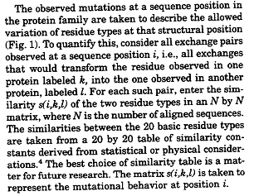
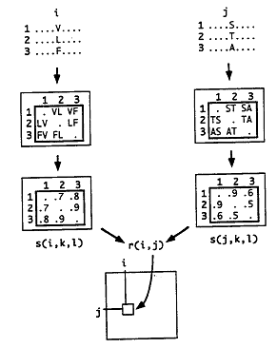
Correlated Mutation

Slide 27

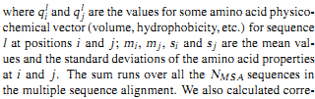
Correlated Mutation
Given a multiple sequence alignment (MSA) of a protein, for each pair of amino acids of the protein, the extent of covariation in mutations was calculated using a simple correlation coefficient

Slide 28
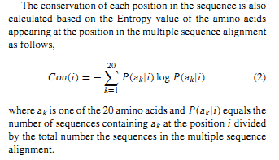
Sequence Conservation

Slide 29
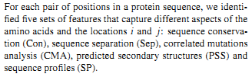
Feature

Slide 30



Sequence Separation & Predicted Secondary Structures

Slide 31
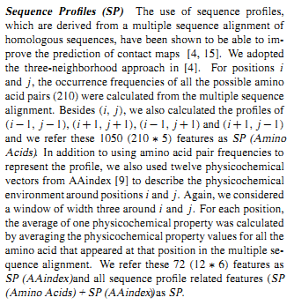
Sequence Profiles

Slide 32
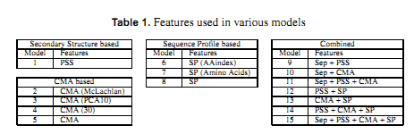
Model
We trained 15 SVM models by using different sets of features.
All the 15 models contain the sequence conservation(Con) features for position i , j.

Slide 33
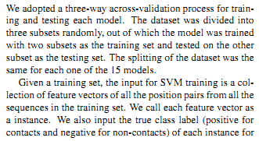
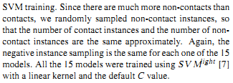
Support Vector Machine (SVM) Training

Slide 34
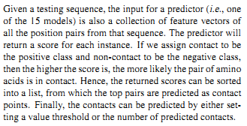
Prediction of Contacts

Slide 35
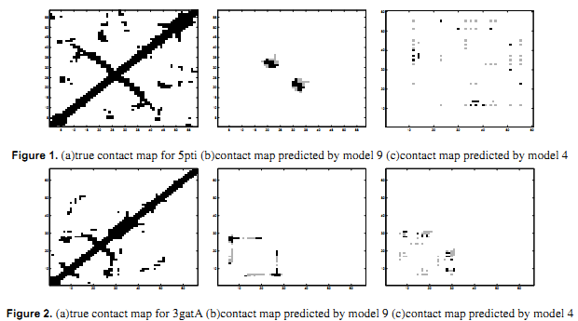

Slide 36
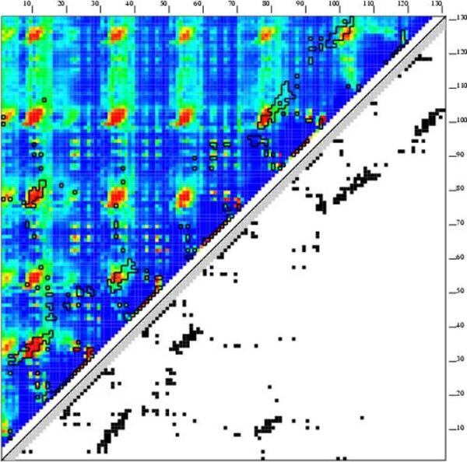

Slide 37
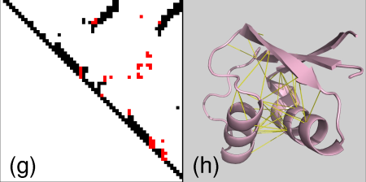

Slide 38
THANK YOU FOR ATTENTION

