Slide 1
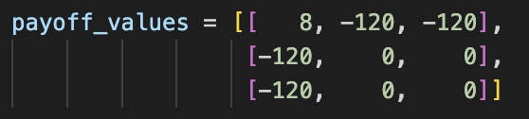
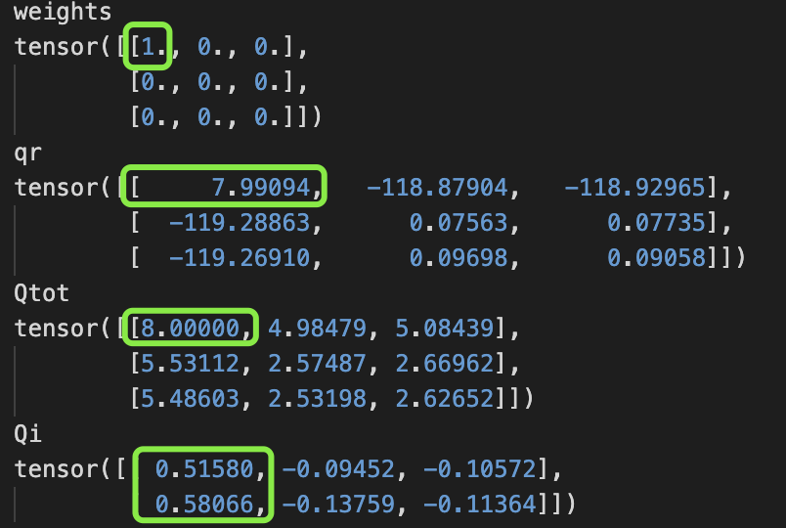
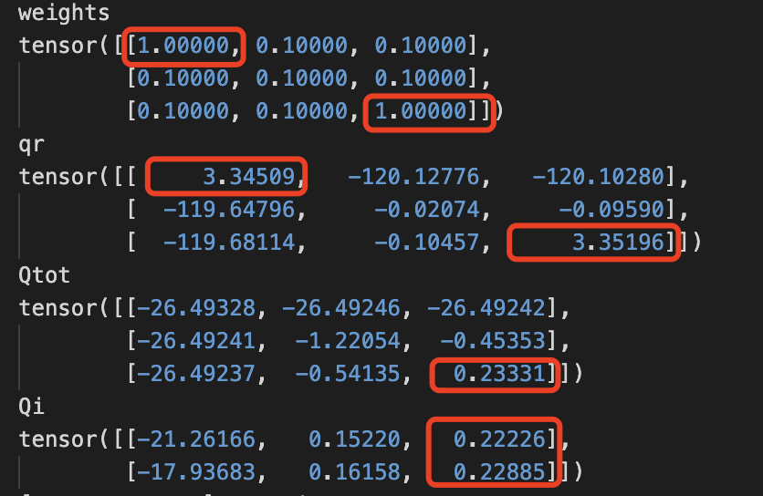
Performance of POW-QMIX with Different Alpha Parameters in Matrix Experiments
(a) Payoff Matrix
(b) Reconstructed Joint and Individual Values
Alpha = 0
(c) Reconstructed Joint and Individual Values
Alpha = 0.1

Slide 2
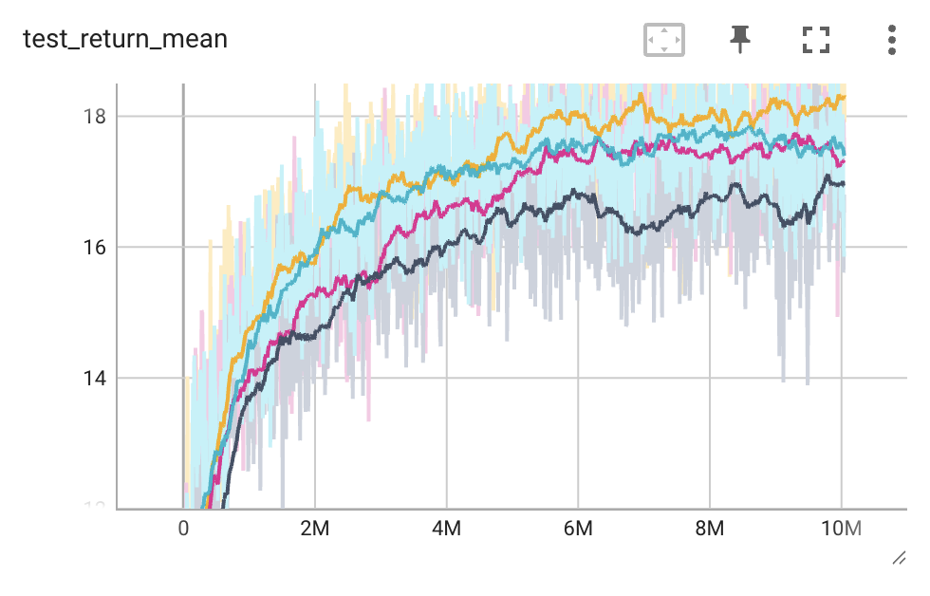
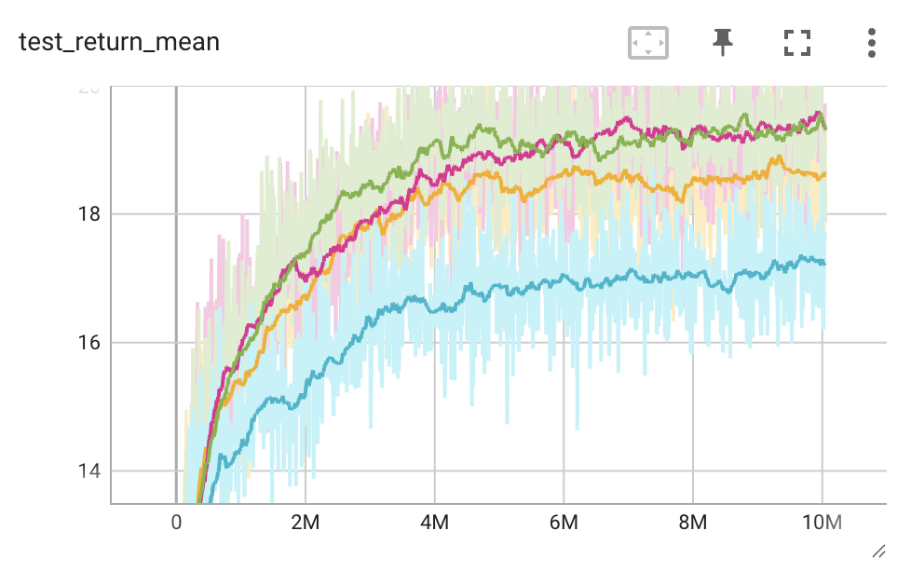
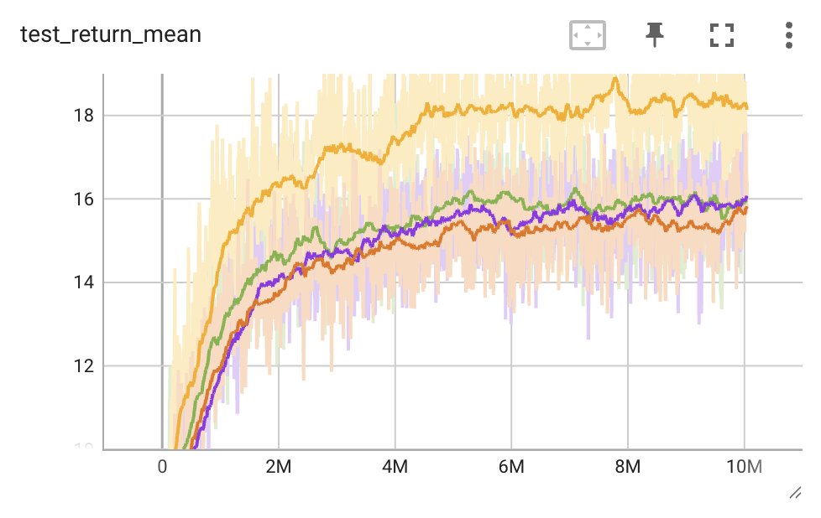
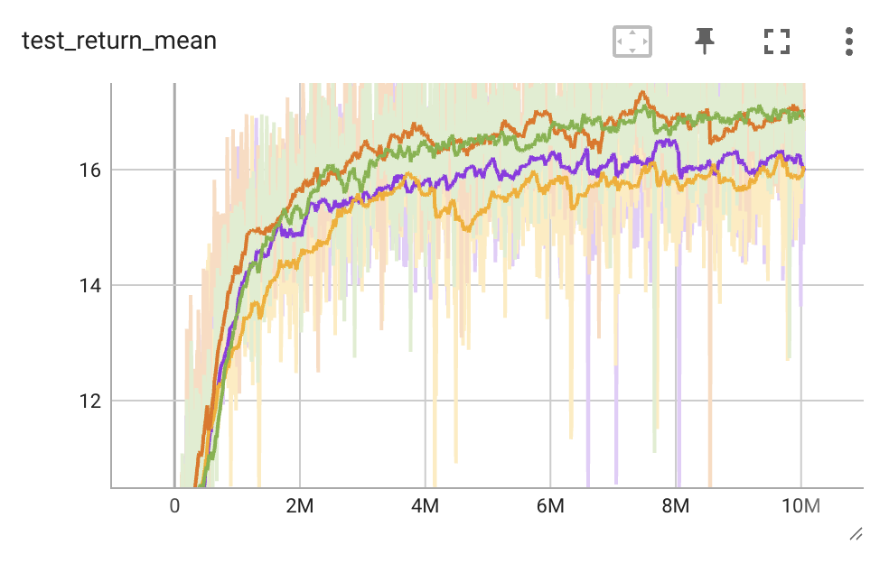
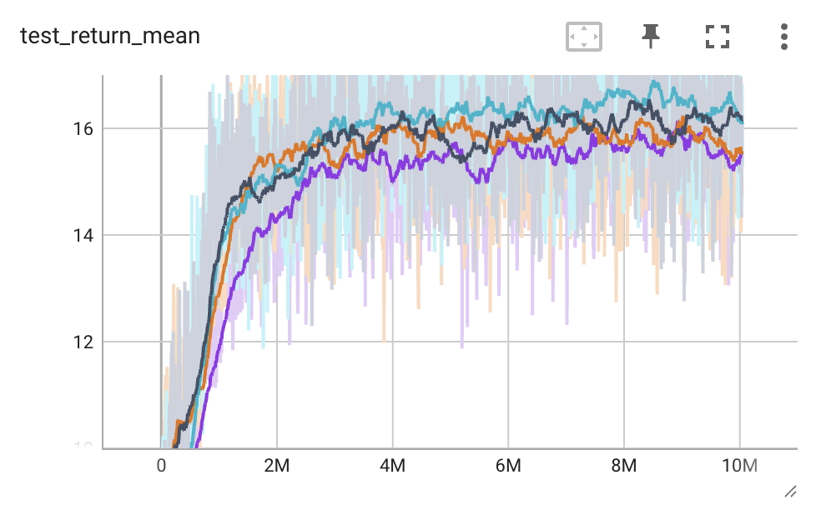
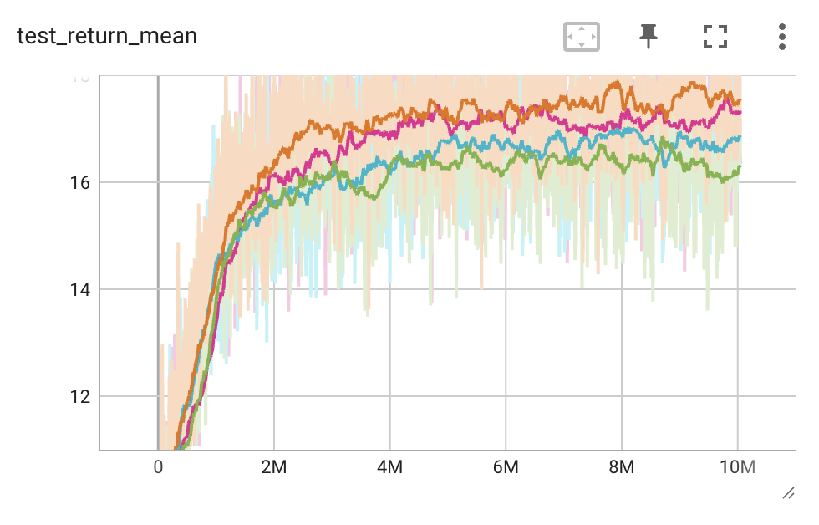
Performance of CW-QMIX and OW-QMIX on SMACv2 Benchmark (4 random seeds)
(a) CW-QMIX
(b) OW-QMIX
Protoss
Protoss
Terran
Terran
Zerg
Zerg

Slide 3
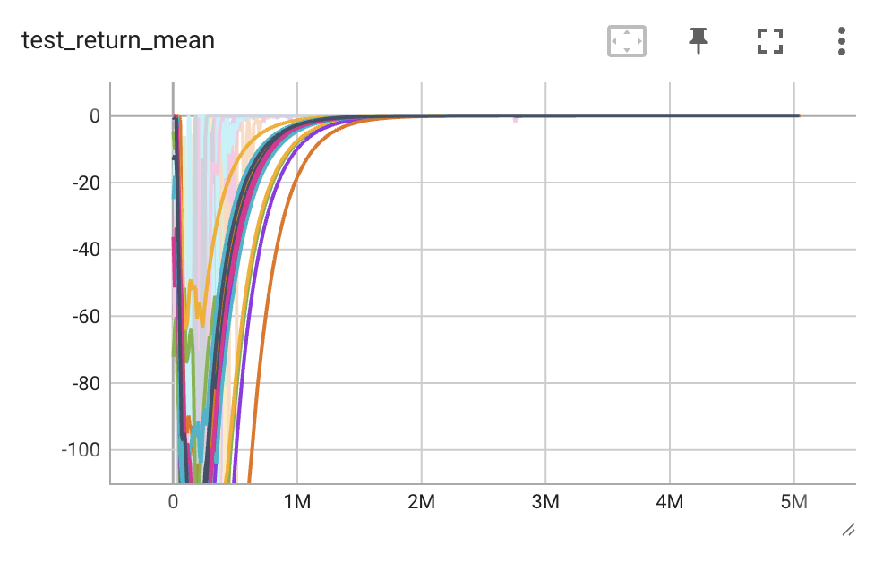
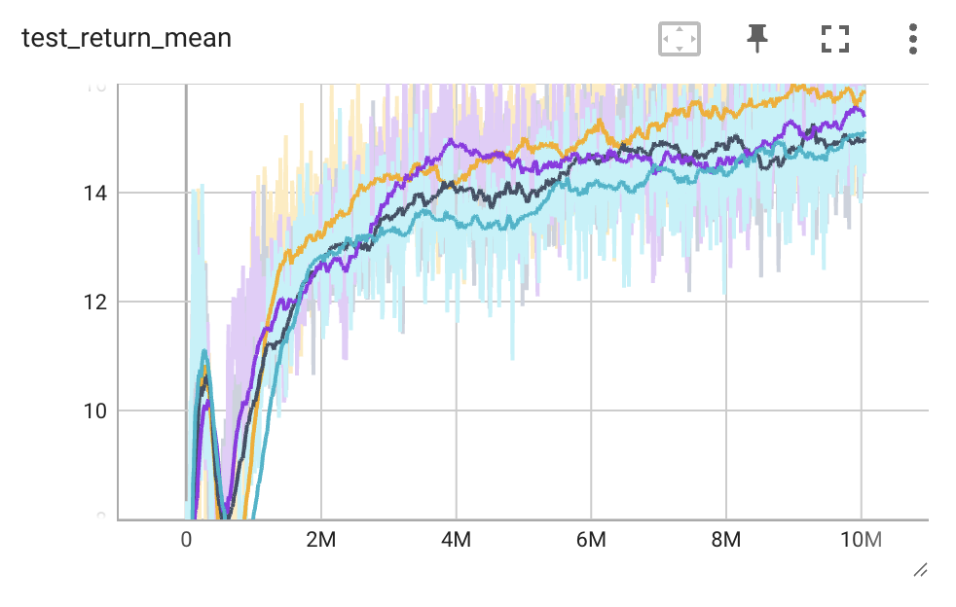
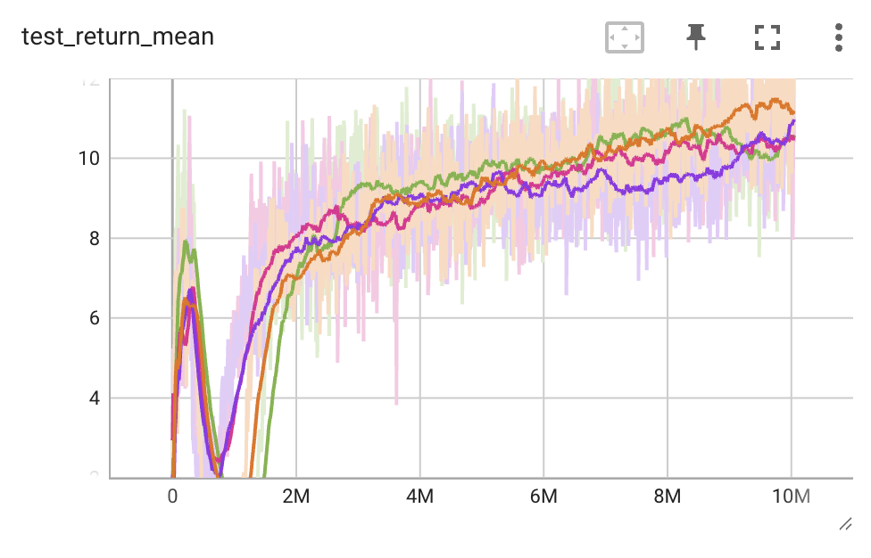
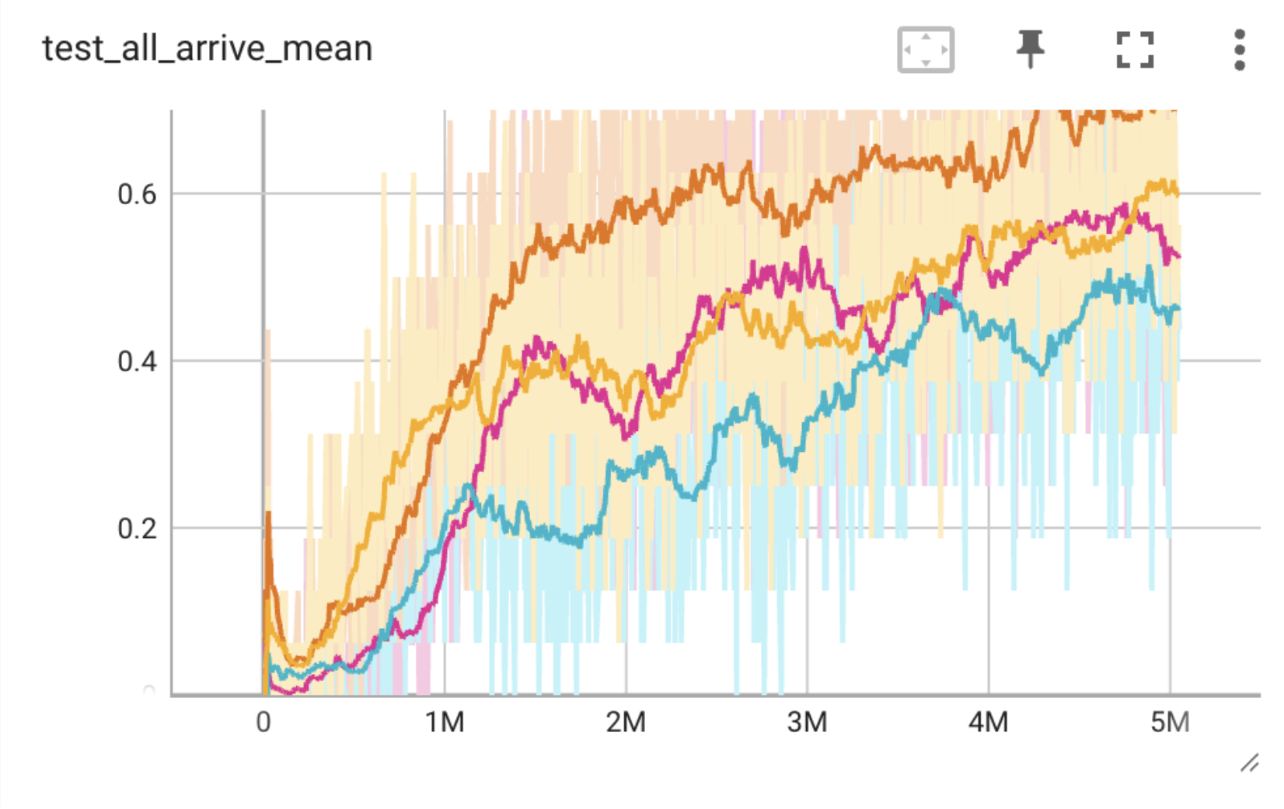
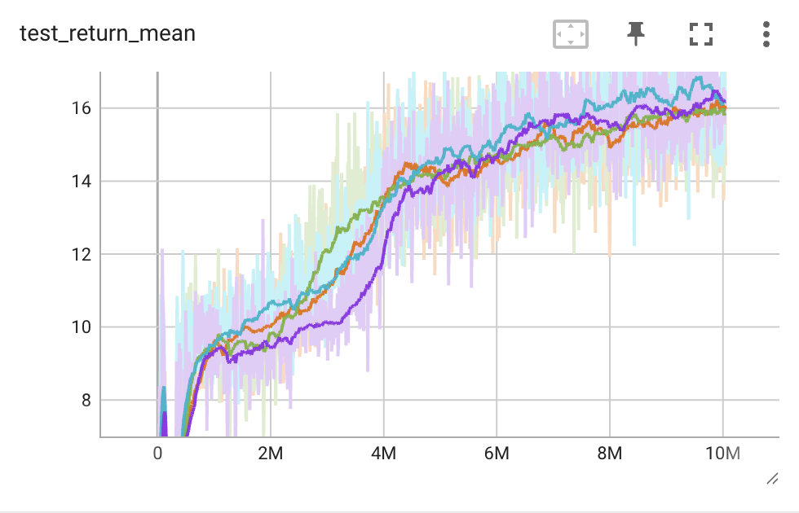
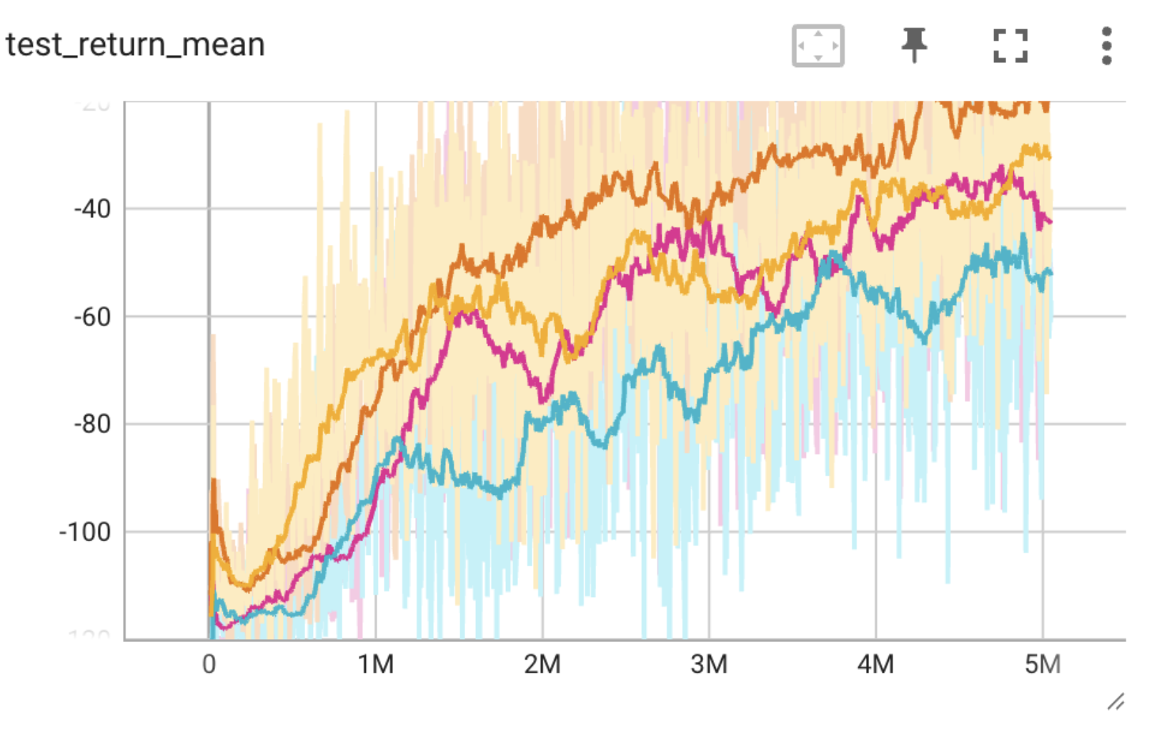
Performance of QTRAN on Benchmarks (4 random seeds)
(a) Predator-Prey
(b) SMACv2
Protoss
* The final performance for penalties of -3/-4/-5 is all 0.
(a) Intersection in Highway-env
Terran
Test Success Rate
Test Return Mean
Zerg

