Slide 1

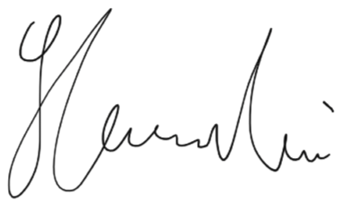

We are excited to present this Certificate of Completion to 洪一城(Frank) for completing the course Unlocking the Secrets of the Universe Congratulations for your excellent performance in the course! Keep up the good work ☺
Course director
Lawrence 朱繁诚
Date:
2021-03-14
JinJin STEM Academy

