Slide 1
CSE 534 Final Project Internet Outage Analysis
Name: Guanyu Zhu, Wei-Ting Lin, Zhaowei Sun
Professor: Phillipa Gill

Slide 2
Motivation/ Goal
Motivation:
(1) Network outages can lead societal and economic impact.
(2) Knowing the reasons of network outages are always desirable
Goal: (1) Find out what type of outages occur commonly
(2) Predict the on-going outage type

Slide 3
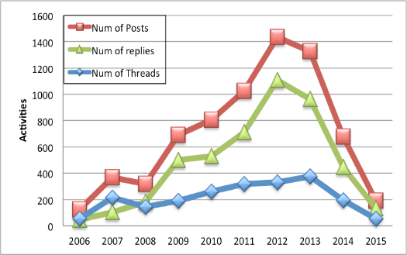
Data Set
What - Outage Mailing list
Why - Public (Free) / rich information
First Email | Sep 29, 2006
Last Email | Mar 24, 2015
Num of Posts | 6963
Num of Threads | 2102
Num of Replies | 4725
Num of Posters | 1256
Summary of Outage mailing list dataset

Slide 4
Preliminary Data Analysis:
Content Providers (Yahoo, google, facebook…etc)
ISPs (AT&T, Verizon, Sprint…etc)
Protocols (BGP, DNS, IPv6…etc)
Security (DDoS, Hijack, Virus…etc)

Slide 5
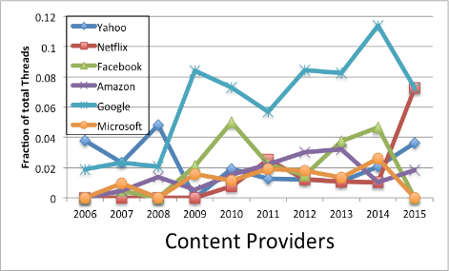
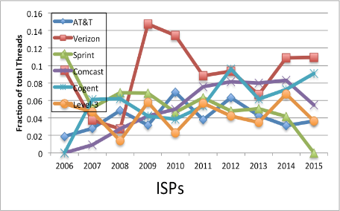
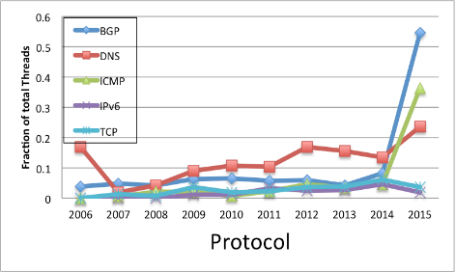
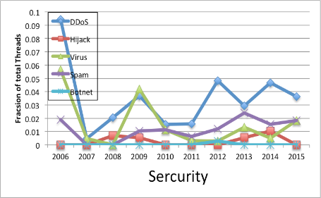
Preliminary Data Analysis

Slide 6
Data Preprocessing
Steps:
Integrate threads
Remove words unrelated to network outage
Stemming and Lemmatization
Remove words with less TF-IDF value
Generate Term Frequency in the dataset

Slide 7
Classification
Labeling
Labeling Standard

Slide 8
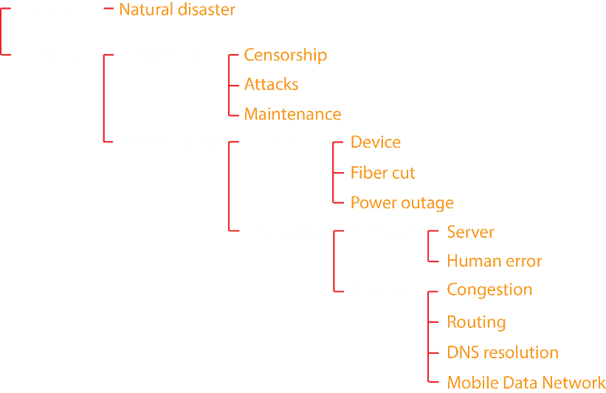
Labeling Standard

Slide 9
Classification
Labeling
Labeling Standard
Why labeling
How to label(Fleiss’ kappa)

Slide 10
Classification
Train the classifier
Multiple Classification -> Multiple Binary Classification ---- one vs all
Why using this method?
Test the classifier’s effect
Halve labeled data--training data and test data separately
Evaluation the Classifier – Accuracy of the classification, Confusion Matrix

Slide 11
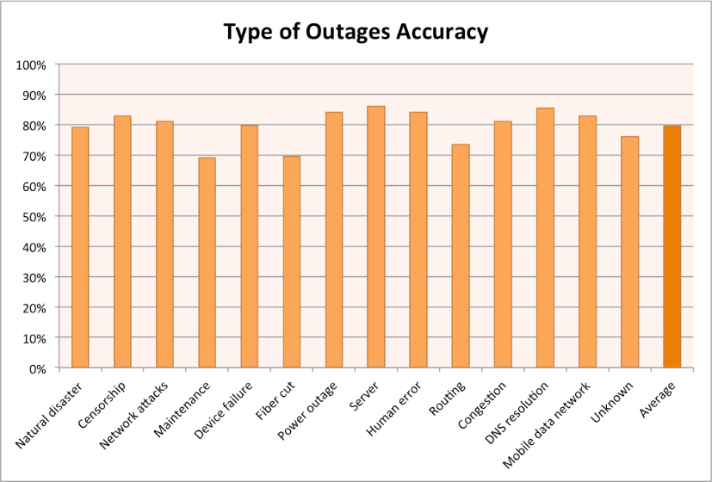
Classifier accuracy

Slide 12
Classification
Train the classifier
Multiple Classification -> Multiple Binary Classification ---- one vs all
Why using this method?
Test the classifier’s effect
Halve labeled data--training data and test data separately
Evaluation the Classifier – Accuracy of the classification, Confusion Matrix
Classify the unlabeled data
Based on the substantial well accuracy of the classification, classify the remaining unlabeled data.

Slide 13
Result
Outage Types Distribution of each year

Slide 14
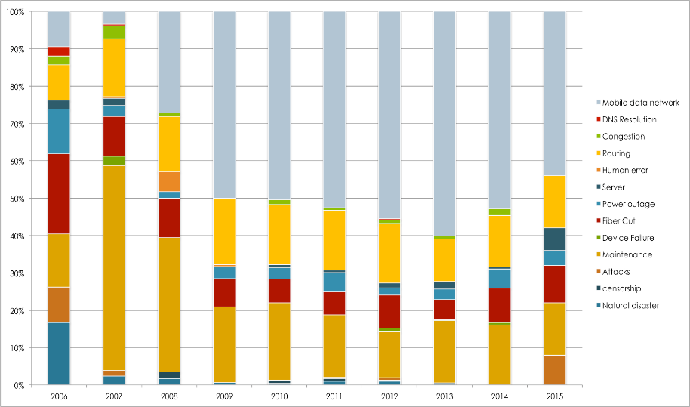
Outage Types Distribution of Each Year

Slide 15
Result
Each year outage types distribution
2006-2015 every outage type percentage

Slide 16
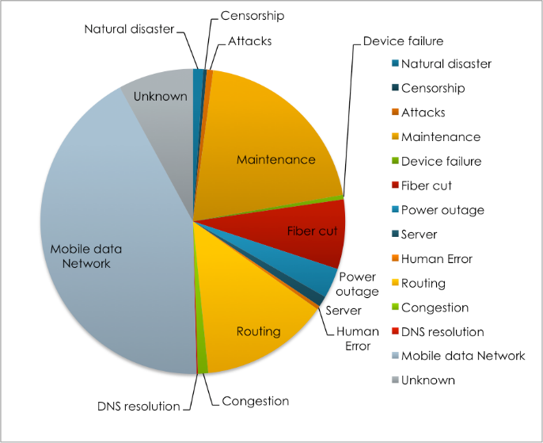
Outage Types Percentage 06 - 15

Slide 17
Result
Each year outage types distribution
2006-2015 every outage type percentage
Extension:
Real-time outage type prediction

Slide 18
Real-time outage type prediction
How to do
Integrate data preprocessing, classification method, real-time predict new mail’s outage type and show on website immediately.
What to show
If the mail text include traceroute information, then extract it and show on the website.
Combine the 2015’s all mail text and analyze the tendency of the outage type.

Slide 19
Real-time outage type prediction

Slide 20
Conclusion
Feature of Outage Causes
Mobile network issues are increasing
Common outage types are easily observed by users
Real-time Predict the on-going Outage Type
Future Work
Analyzing keywords with associated outage type in advance
Integrate data based on subjects VS threads

