Slide 1
Malware detection: hands on experience
Francesco Piccinno <stack.box@gmail.com>

Slide 2
What is Malware?
A software program whose objective is malevolent
Any code added, changed or removed from a software system in order to intentionally subvert the intended functionality of the system itself
For us a generic term that encompasses viruses, trojans, spywares and other intrusive code

Slide 3
Malware Detection Techniques
Signature based
Anomaly based
Specification based
Signature based
Anomaly based
Specification based
Static
Dynamic
Hybrid

Slide 4
Anomaly based techniques
Hofmeyr et al. proposed a study base on syscalls.
A normal profile is derived by observing the program in normal conditions (n-gram).
An anomaly is then detected whether the current profile differs from the normal profile (Hamming distance).
Sekar et al. proposed a similar approach based on FSA. We implemted it.
Sato et al. instead used frequency analysis and DP matching algorithm

Slide 5
Specification based techniques
Bergeron et al. proposed a static analysis of the executable.
First the code is disassembled and then converted to an intermediate level language. Then a CFG is derived.
From the CFG an API-graph where only API calls are considered is extracted. The API-graph is matched against a set of security policies in order to detect anomalies
The idea of Sekar et al. is similar and exploits a domain specific language (ASL) derived at compile time from the executable. The ASL is used at runtime to check whether the program is acting following the specifications or not.

Slide 6
Signature based techniques
Static analyzer of vicious executables (SAVE)
The signature is essentially a sequence of Windows API calls (n-grams).
Each API call is a 32-bit number (higher 16-bits = module, lower 16-bits = function)
Static inspection to extract sequence of API calls from the executable
A similarity measurement is evaluated on a knowledge base of malicious sequences.

Slide 7
Our approach: Syscall tracing through DBI
Dynamic signature based detection based on syscall tracing
Extensive logging, including:
Full parameters dump
Stack unwinding to get the address of the caller
Collector module insert all the gathered information in a SQL database for easying the querying
Analyzer use the database to carry out the analysis

Slide 8
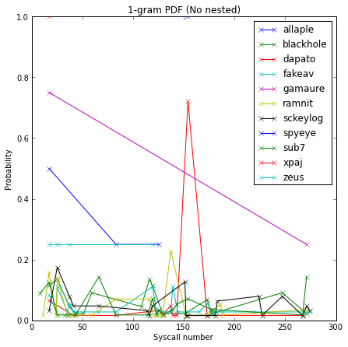
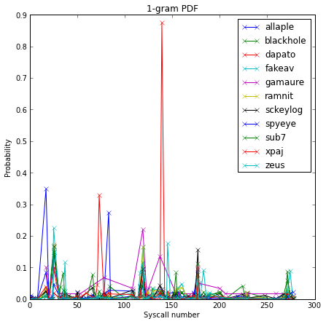
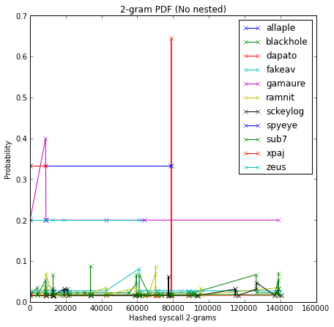
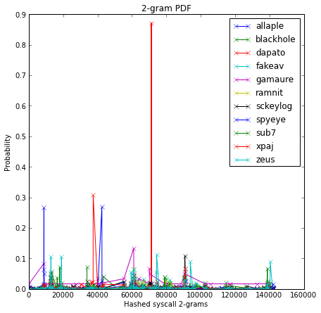
Results
We analyzed 10 different malwares, trying to extract a malicious commonality
Plotted PDF graph of syscalls invocations

Slide 9
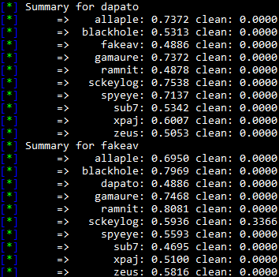
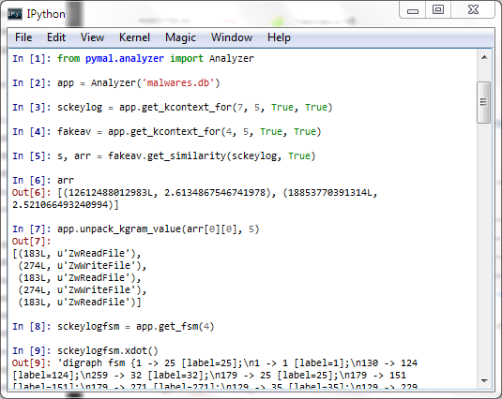
Similarity measurements and interactive analysis

Slide 10
Why we failed?
We were looking for malicious sequences that are common to all malwares. But does this commonality really exists?
Just looking at the sequence of syscalls do not provide use enough information. Syscalls are too way generic and do not have enough detailed information.
Are we looking at the problem from the wrong perspective?

Slide 11
Possible solutions
API calls are instead more informative and context specific. At least in Windows environments
Use API call sequences instead of syscall sequences seems to produce better results
That’s what IMDS (Intelligent Malware Detection System) and SAVE did.
Their results are promising but why ours are not?

Slide 12
Learn from your errors
Syscalls are too generic. API calls have a precise semantic and meaning
Probably 10 malwares samples are way too few for deriving a proper malicious knowledge base.
IMDS uses about 17k malwares (four order of magnitudes more than our test bed)
Hooking API calls from PIN is straightforward. But is this possible from a VMM (dom0)?
This work was Windows specific. Results in UNIX based systems may vary.

Slide 13
Is it all wasted?
We implemented a simple interpreter to provide a playground for malware analysis
For example we easily implemented an FSA checker similar to the proposal of Sekar et al. and a simple static analyzer thanks to pedump
There’s space for improvements and new ideas

Slide 14
Future works
Exploits all the information collected
Grouping calls and discover resource usage patterns
Use this knowledge for sandboxing the application
Taint analysis to discover unsafe paths

