Slide 1
RDMA: Intro and Some Applications
朱家祺
2021.07.29

Slide 2
Contents
Introduction to RDMA
RDMA Abstraction
Remote Regions [ATC 2018]
Distributed Compute System
FaRM [NSDI 2014]
Distributed Memory System
CoRM [SIGMOD 2021]
JVM
Naos [ATC 2021]

Slide 3
Contents
Introduction to RDMA
RDMA Abstraction
Remote Regions [ATC 2018]
Distributed Compute System
FaRM [NSDI 2014]
Distributed Memory System
CoRM [SIGMOD 2021]
JVM
Naos [ATC 2021]

Slide 4
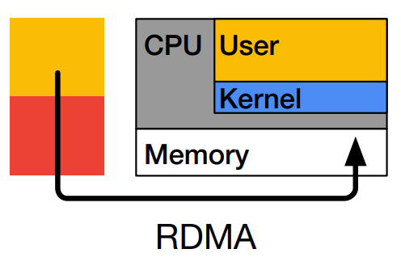
Introduction to RDMA
Background:
Low-latency network communication: datacenter
Network becomes bottleneck
RDMA (Remote direct memory access)
Directly read/write remote memory
Bypassing kernel
Memory zero copy

Slide 5
RDMA Technologies
InfiniBand
An interconnect technology
High-speed, low latency, low CPU overhead
Incompatible with Ethernet
RoCE (RDMA over Converged Ethernet)
A standard for RDMA over Ethernet
RoCEv1
RoCEv2: Based on UDP/IP
iWARP
Based on TCP/IP
RoCE has clear performance advantages over iWARP
Notes:
InfiniBand refers to two distinct things. The first is a physical link-layer protocol for InfiniBand networks. The second is a higher level programming API called the InfiniBand Verbs API. The InfiniBand Verbs API is an implementation of a remote direct memory access (RDMA) technology.

Slide 6
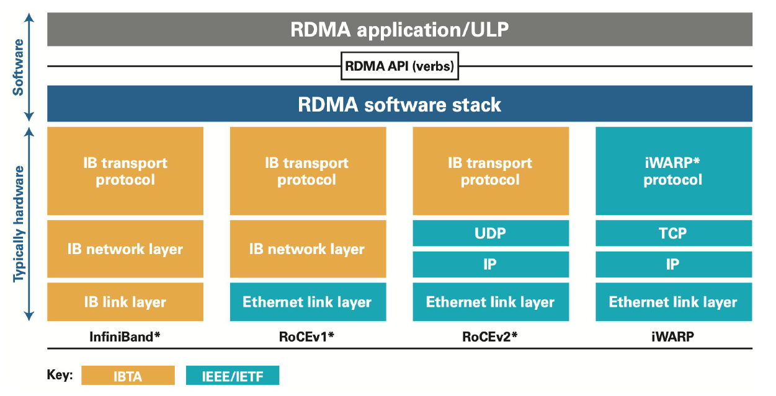
RDMA Technologies
Notes:
InfiniBand refers to two distinct things. The first is a physical link-layer protocol for InfiniBand networks. The second is a higher level programming API called the InfiniBand Verbs API. The InfiniBand Verbs API is an implementation of a remote direct memory access (RDMA) technology.

Slide 7
RDMA Glossary
Work Queue (WQ)
Send Queue / Receive Queue
Send Queue (SQ)
A work queue which holds Send Requests (SR) posted by the user
Receive Queue (RQ)
A work queue which holds Receive Requests (RR) posted by the user

Slide 8
RDMA Glossary
Completion Queue (CQ)
A queue which contains Completion Queue Entries (CQE)
Completion Queue Context (CQC)
Is stored in the hardware
Queue Pair (QP)
A pair of SQ and RQ; Is roughly equivalent to a socket
Queue Pair Context (QPC)
Is stored in the hardware

Slide 9
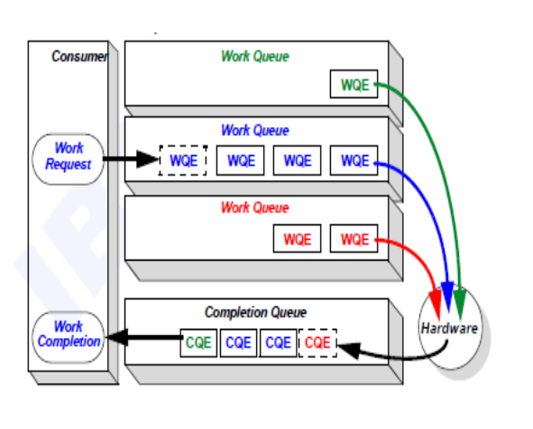
Work Flow
Host posts WRs to WQ
Hardware fetch WQE and posts CQE to CQ
Host fetch CQE

Slide 10
RDMA Glossary
Memory Registration
Keep physical <-> virtual mapping
Every MR has a remote key (r_key) and a local key (l_key)
Notes:
A mechanism that allows an application to describe a set of virtually contiguous memory locations or a set of physically contiguous memory locations to the network adapter as a virtually contiguous buffer using virtual addresses

Slide 11
RDMA Glossary
Memory Translation Table (MTT)
Just like a page table
Translate physical address to virtual address
Is stored in hardware
Memory Protection Table (MPT)
An entrance of address translation
Store the physical address of MTT
Is stored in hardware

Slide 12
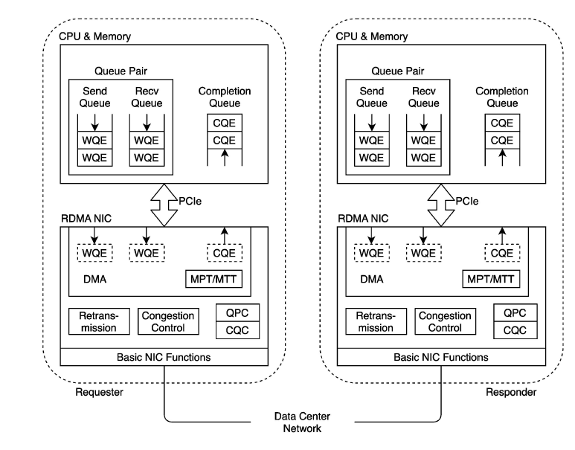
RDMA Architecture

Slide 13
RDMA Programming: Two-sided
Send / Send With Immediate
Send data to a remote host
The receiver must have previously posted a receive buffer
An immediate 4 byte (Send With Immediate)
As part of a receive notification
Not contained in the data buffer
Receive
The corresponding operation to a send operation
The receiving host is notified that a data buffer has been received
Notes:
在完成基本的建立连接和注册MR 后，数据的接收方需要事先调用RECV 操作指定数据将要存入
的缓冲区。随后数据的发送方调用SEND 操作进行数据发送。如果接收方未实
现调用RECV 操作，发送方的SEND 操作将会返回接收方未就绪错误

Slide 14
RDMA Programming: Send/Recv
System A and B create SQ, RQ, CQ
Register memory
SQ
SQ
System A
System B
Host Memory
HCA
HCA
Host Memory
Registered Memory
RQ
RQ
Registered Memory
CQ
CQ
Data to Transfer
Buffer to Place Data
Notes:
HCA: host channel Adapter: the equivalent of the NIC card but they do much more

Slide 15
RDMA Programming: Send/Recv
System B create a RR, and place it on the RQ
SQ
SQ
System A
System B
Host Memory
HCA
HCA
Host Memory
Registered Memory
RQ
RQ
Registered Memory
CQ
CQ
Data to Transfer
Buffer to Place Data
Notes:
应用层从已注册的MR 中选取接收缓冲区，并将操作类型、本地缓冲区描述信息等提交给驱动，随后挂起该线程等待完成事件
驱动准备RECV WQE 并插入RQ，通知硬件

Slide 16
RDMA Programming: Send/Recv
System A create a SR, and place it on the SQ
SQ
SQ
System A
System B
Host Memory
HCA
HCA
Host Memory
Registered Memory
RQ
RQ
Registered Memory
CQ
CQ
Data to Transfer
Buffer to Place Data
Notes:
应用层准备MR 中的缓冲区，装入要发送的数据，并将必要的信息提交给驱动，随后挂起该线程等待完成事件
驱动准备SEND WQE 并插入SQ，通知硬件

Slide 17
RDMA Programming: Send/Recv
HCA consume WQE from System A
System A send data to system B
SQ
SQ
System A
System B
Host Memory
HCA
HCA
Host Memory
Registered Memory
RQ
RQ
Registered Memory
CQ
CQ
Data to Transfer
Buffer to Place Data

Slide 18
RDMA Programming: Send/Recv
When data begins arriving at System B, the HCA will consume the WQE in the RQ
SQ
SQ
System A
System B
Host Memory
HCA
HCA
Host Memory
Registered Memory
RQ
RQ
Registered Memory
CQ
CQ
Data to Transfer
Buffer to Place Data

Slide 19
RDMA Programming: Send/Recv
The HCA of system B posts CQE to the CQ since system B receive the data
SQ
SQ
System A
System B
Host Memory
HCA
HCA
Host Memory
Registered Memory
RQ
RQ
Registered Memory
CQ
CQ
Data to Transfer
Buffer to Place Data

Slide 20
RDMA Programming: Send/Recv
The HCA of system B will send ACK to system A (Reliable Connection)
The HCA of system A posts CQE to the CQ after receiving ACK
SQ
SQ
System A
System B
Host Memory
HCA
HCA
Host Memory
Registered Memory
RQ
RQ
Registered Memory
CQ
CQ
Data to Transfer
Buffer to Place Data

Slide 21
RDMA Programming: One-sided
Write / Write With Immediate
Write the data to the remote host
No notification to the remote host
An immediate 4 byte (Write With Immediate)
Notify the remote host of the immediate value
Notes:
允许请求方在远端CPU 无感知的情况下，仅通过远端网卡的硬件
响应写/读远端MR 中指定地址和长度的数据。

Slide 22
RDMA Programming: One-sided
Read
Read data from the remote host
No notification to the remote host
Notes:
允许请求方在远端CPU 无感知的情况下，仅通过远端网卡的硬件
响应写/读远端MR 中指定地址和长度的数据。

Slide 23
RDMA Programming: Write
System A and B create SQ, RQ, CQ
Register memory
SQ
SQ
System A
System B
Host Memory
HCA
HCA
Host Memory
Registered Memory
RQ
RQ
Registered Memory
CQ
CQ
Data to Transfer
Buffer to Place Data

Slide 24
RDMA Programming: Write
System A create a SR , and place it on the SQ
SQ
SQ
System A
System B
Host Memory
HCA
HCA
Host Memory
Registered Memory
RQ
RQ
Registered Memory
CQ
CQ
Data to Transfer
Buffer to Place Data

Slide 25
RDMA Programming: Write
HCA consume WQE from System A
System A send data to system B
SQ
SQ
System A
System B
Host Memory
HCA
HCA
Host Memory
Registered Memory
RQ
RQ
Registered Memory
CQ
CQ
Data to Transfer
Buffer to Place Data

Slide 26
RDMA Programming: Write
The HCA of system B sends ACK to system A (Reliable Connection)
The HCA of system A posts CQE to the CQ after receiving ACK
SQ
SQ
System A
System B
Host Memory
HCA
HCA
Host Memory
Registered Memory
RQ
RQ
Registered Memory
CQ
CQ
Data to Transfer
Buffer to Place Data

Slide 27
RDMA Programming: Atomic extensions
Atomic fetch and add
Increase the value at a specified virtual address by a specified count
The value prior to being incremented is returned to the caller
Atomic compare and swap
Notes:
everything is handled asynchronously

Slide 28
Contents
Introduction to RDMA
RDMA Abstraction
Remote Regions [ATC 2018]
Distributed Compute System
FaRM [NSDI 2014]
Distributed Memory System
CoRM [SIGMOD 2021]
JVM
Naos [ATC 2021]

Slide 29

Remote Regions
Remote regions: a simple abstraction for remote memory
ATC 2018
Background:
RDMA programming is complex
Initialize contexts
Register memory
Establish connections
Create QP and associate QP with connections
Exchange RDMA keys
Post commands on queues
Poll queues for completions

Slide 30
Remote Regions
Abstraction: use files as the interface to remote memory
Provide functionality lacking in RDMA
name space, timestamps, access control
Balance between expressiveness and efficiency

Slide 31

Remote Regions: Abstraction
Linux: Everything is a File
Regions provide a file system : /rigions
Support usual file operations:
Create, open, close, read, write, mmap, chmod
Memory allocation within a region

Slide 32
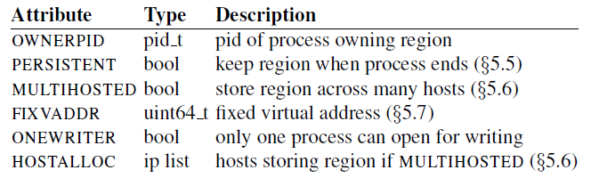
Remote Regions : Abstraction
Region attributes
Prefetch and make-dirty
Reduce page faults
Because memory mapping of a remote region is implemented using page faults

Slide 33
Remote Regions : Abstraction
Synchronization
Barriers; mutexes; door bells
Caching
Write-back cache
Doesn’t provide cache coherence
Sharing data
Owner-remote sharing
Remote-remote sharing
Notes:
Owner-remote sharing involves the remote cache
Remote-remote sharing involves two caches, one for each remote process

Slide 34
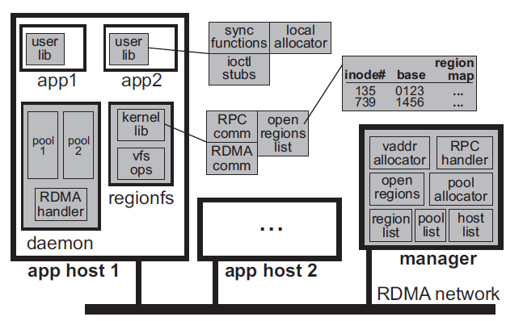
Realizing Regions using RDMA
RegionFS file system
User library
Synchronization
Performance enhancing functions
Manager
Handle file system operation
Daemon
Allocates and maintains large pools of memory
Notes:
Owner-remote sharing involves the remote cache
Remote-remote sharing involves two caches, one for each remote process

Slide 35
Realizing Regions using RDMA: Manager
Handle operations
Open, create, read, write
Memory-mapping
Allocation of memory
Keep track of the hosts in the system
Single manager, replicated for high availability
Notes:
Owner-remote sharing involves the remote cache
Remote-remote sharing involves two caches, one for each remote process

Slide 36
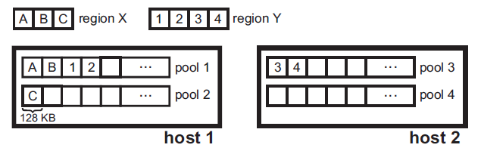
Realizing Regions using RDMA: Daemon
A pool is a chunk of physical memory
The daemon allocates big pools of physical memory
Because the RDMA’s cache is small and can not keep many connection
RDMA registers each poll
Notes:
Owner-remote sharing involves the remote cache
Remote-remote sharing involves two caches, one for each remote process

Slide 37
Contents
Introduction to RDMA
RDMA Abstraction
Remote Regions [ATC 2018]
Distributed Compute System
FaRM [NSDI 2014]
Distributed Memory System
CoRM [SIGMOD 2021]
JVM
Naos [ATC 2021]

Slide 38
FaRM
FaRM: Fast Remote Memory
NSDI 2014
Background:
Main memory is cheap
100GB – 1TB per server
New data center networks
1-3 μs latency
RDMA primitives

Slide 39
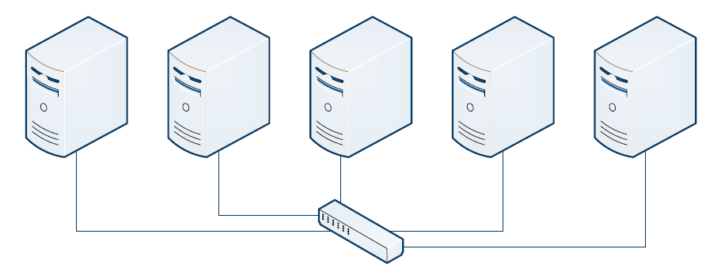
FaRM: Introduction
Platform for distributed computing
Data is in memory
RDMA
Shared memory abstraction
Transactions
Lock-free reads
A hash table for key-value store

Slide 40
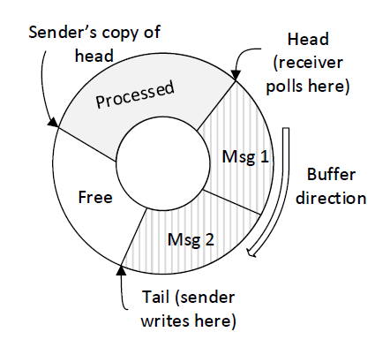
FaRM: RDMA Design
One-sided RDMA read/write
Buffer is stored on the receiver
Receiver periodically polls the “Head” position
Non-zero value indicates a new message
Sender maintains a local copy of “Head” position
Never writes messages beyond that position
Lazily updated by the receiver (Use RDMA write)

Slide 41
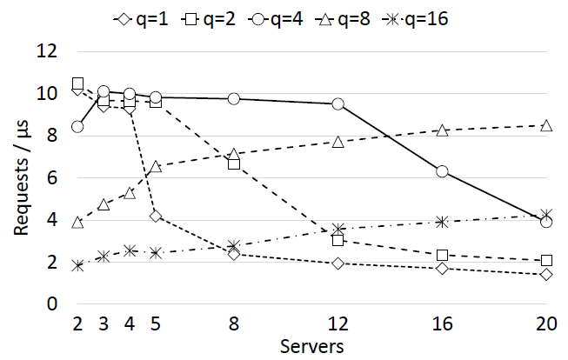
FaRM: RDMA Design
Queue pair sharing
NIC has no space to cache QP data, lead to a decrease in request rate
Thread <-> thread
Thread <-> q threads

Slide 42
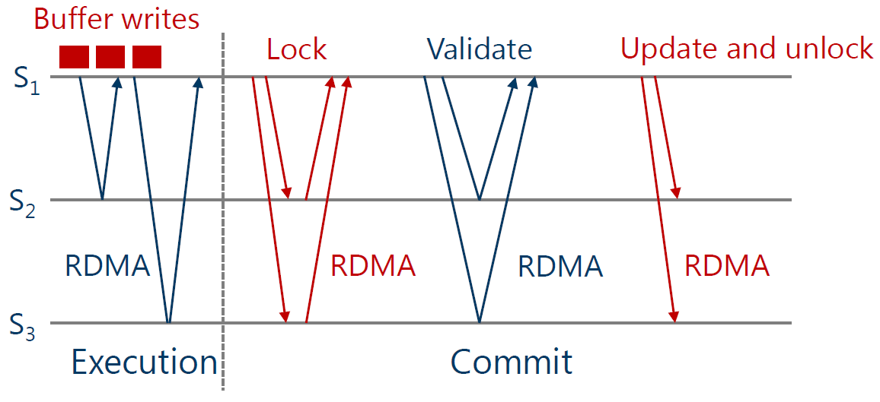
FaRM: Transaction
Two-phase commit
S1 wants to write objects to S2 and S3
Notes:
Record the version numbers of objects read/written by the transacation.
Send prepare messages to all participants

Slide 43
FaRM: Lock-free read
Traditional lock-free read
Read:
V
1. Read version
2. Read data
3. Read version again and compare

Slide 44
FaRM: Lock-free read
Traditional lock-free read
Update:
V’
V
1. Lock
2. Update data
3. Unlock and update

Slide 45
FaRM: Lock-free read
One-sided RDMA read
Store an object’s version in the object header and each cache line
V
$
V
$
V
$
Cache line

Slide 46
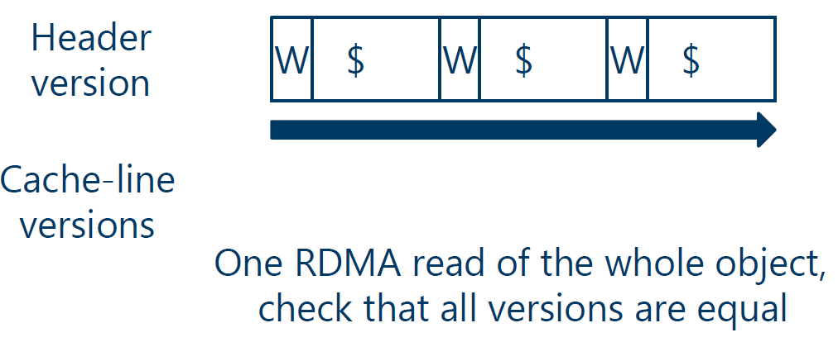
FaRM: Lock-free read
One-sided RDMA read
Store an object’s version in the object header and each cache line

Slide 47
Contents
Introduction to RDMA
RDMA Abstraction
Remote Regions [ATC 2018]
Distributed Compute System
FaRM [NSDI 2014]
Distributed Memory System
CoRM [SIGMOD 2021]
JVM
Naos [ATC 2021]

Slide 48
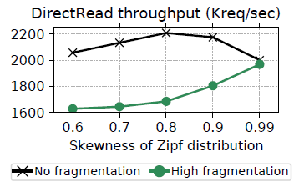
CoRM
CoRM: Compactable Remote Memory over RDMA
SIGMOD 2021
Background:
RDMA is used in distributed memory systems
Remote objects are accessed by virtual address
Fragmentation affects throughput of RDMA read

Slide 49
CoRM: Background
RDMA can prevent memory optimization strategies
E.g. memory compaction
memory compaction
Allocate five
Notes:
If the remote host relocates an object, the virtual address might change. Therefore, some RDMA systems avoid exposing the virtual address of the stored object.

Slide 50
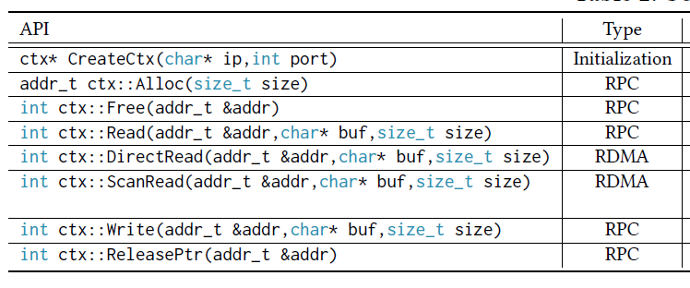
CoRM: Introduction
A shared memory system
Use RDMA for fast remote access
One-sided RDMA read
Support memory compaction
Compaction is RDMA-safe: objects are still accessible via one-sided RDMA

Slide 51
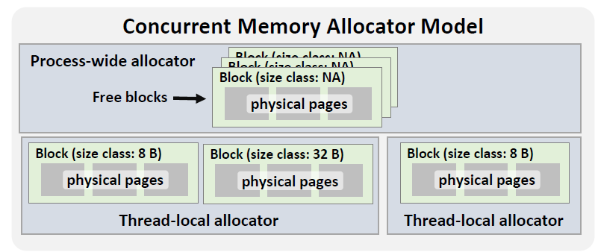
CoRM: Concurrent Memory Allocator
Thread-local allocator requests memory from process-wide allocator
Block
Consists of some pages
Fetched from process-wide allocator in a single access
Block are used to store objects belonging to predefined size classes

Slide 52
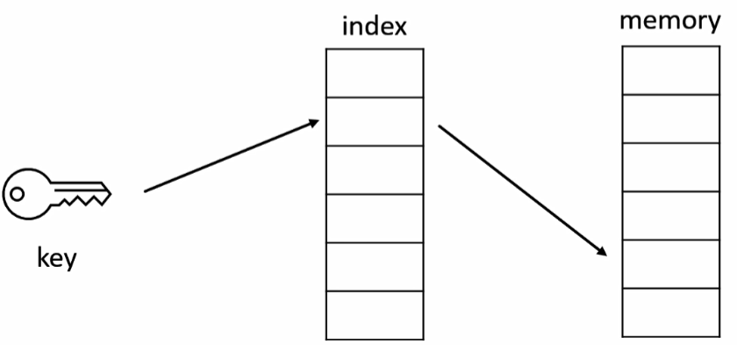
CoRM: Memory Compaction
Traditional memory compaction
Indirection table
2x reduction in RDMA read throughput
Mesh
Merge scarcely utilized blocks into one block and update virtual-to-physical mapping
Require the relocated objects to reside at the same offset as in their original blocks

Slide 53
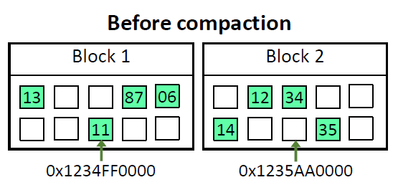
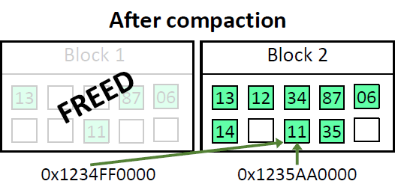
CoRM: Memory Compaction
128 bit pointers to access objects
Each object has an ID: ID is unique within a single block
Compaction is just like Mesh

Slide 54
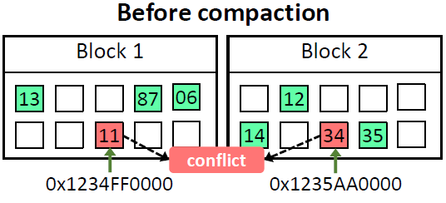
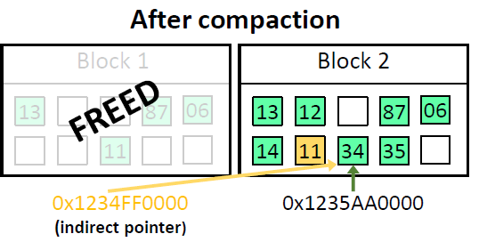
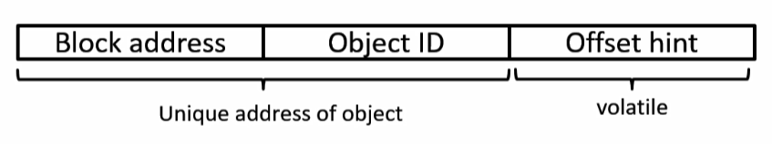
CoRM: Memory Compaction
Deal with offset conflicts:
An object is unique by “Block address + ID”

Slide 55
CoRM: Memory Compaction
Pointer correction
If a pointer is indirect, we need pointer correction
Use offset hint to avoid searching objects in the block

Slide 56
Contents
Introduction to RDMA
RDMA Abstraction
Remote Regions [ATC 2018]
Distributed Compute System
FaRM [NSDI 2014]
Distributed Memory System
CoRM [SIGMOD 2021]
JVM
Naos [ATC 2021]

Slide 57
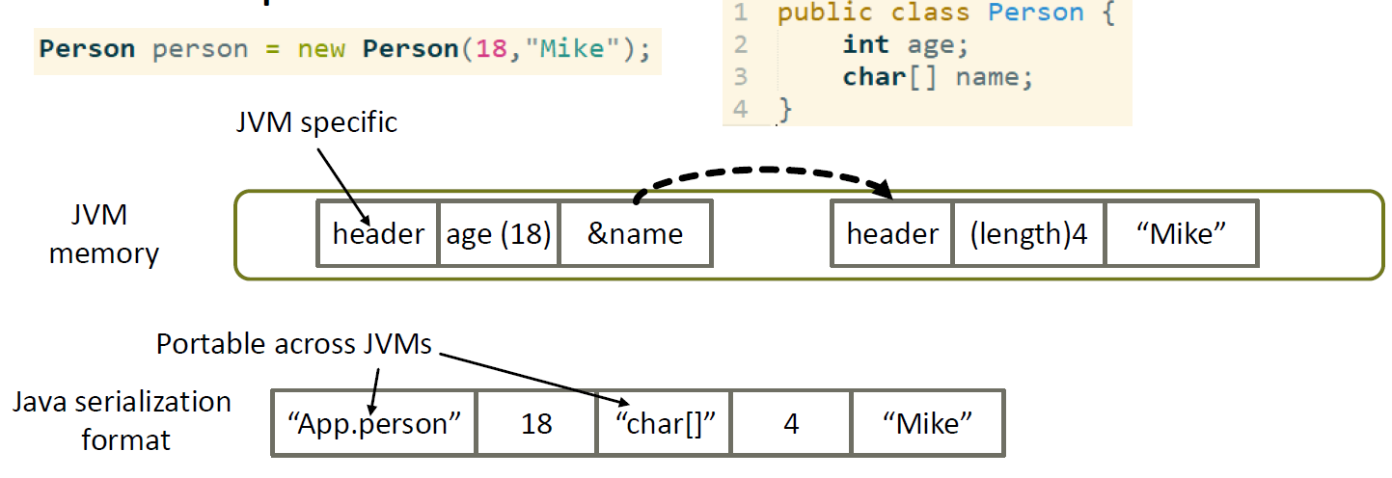
Naos
Naos: Serialization-free RDMA networking in Java
ATC 2021
Background:
To transport data through network, Java force to serialize/de-serialize the object (OSD)

Slide 58
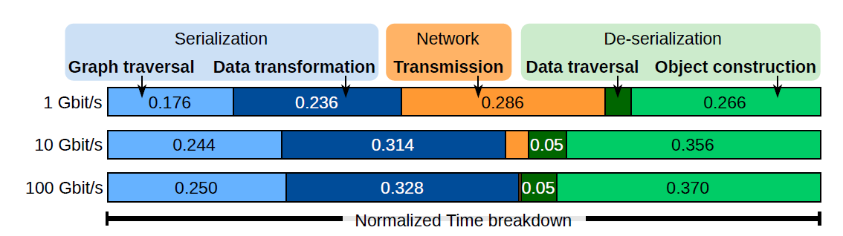
Naos: Background
Send an array of 1.28M objects:
The network is not a bottleneck anymore!

Slide 59
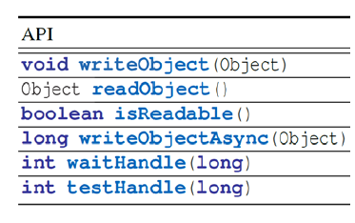
Naos: Introduction
A serialization-free networking library
Send objects directly from local JVM memory to remote JVM memory
Support TCP and RDMA

Slide 60
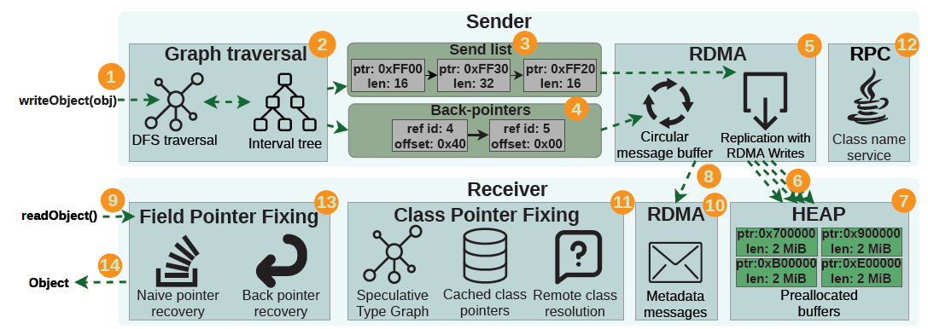
Naos: Work-flow

Slide 61

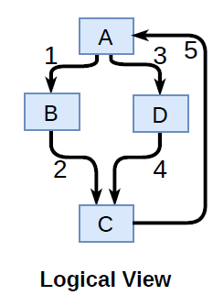
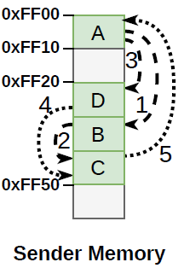
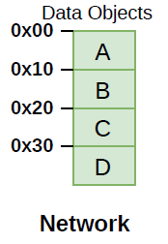
Naos: Send An Object
Metadata
DFS traversal
Object

Slide 62
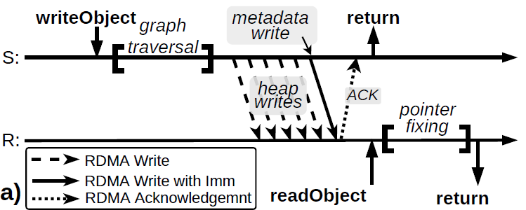
Naos: RDMA Design
One-side RDMA communication
Receiver pre-registers buffers of fixed size in its heap
Sender Writes the objects
The metadata is sent separately using a circular buffer
Write with Immediate data

Slide 63
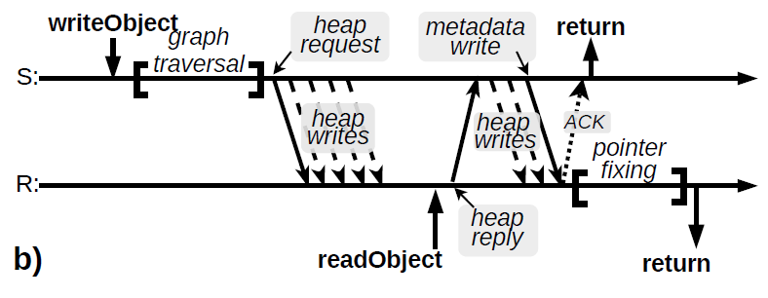
Naos: RDMA Design
Sender needs to requests extra heap memory

Slide 64
Naos: Other issues
Memory registration is an expensive process
Register large fixed-size memory regions
Garbage collector can concurrently touch/move objects
Use object pinning to prevent GC from moving objects
Small objects
Buffer some objects before sending

Slide 65
Summary
RDMA
One-sided: Read/Write
Two-sided: Send/Recv
Applications
Distributed compute system
Distributed memory system
JVM

