Slide 1
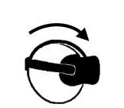
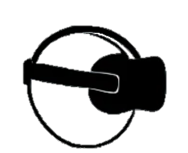
t
…
Fixation
Saccade
Fixation
Saccade
…
Data source:
Head data
Eye data
Head
t | Yaw | Pitch | Row | X | Y | Z
0 | 71 | 112 | 12 | 0 | 0 | 0
1 | 76 | 128 | 14 | 1 | 3 | 12
Eye
t | Yaw | Pitch | Row
0 | 71 | 112 | 12
1 | 76 | 128 | 14
…
…
Post process:
Raw
t | Yaw | Pitch | …
0 | 0 | 0 | …
Spectrum
t | Yaw | Pitch | …
0 | 0 | 0 | …
Deviation
t | Yaw | Pitch | …
0 | 0 | 0 | …
…
…
…

