Slide 1
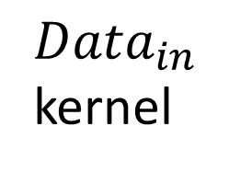
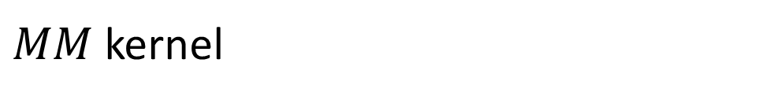
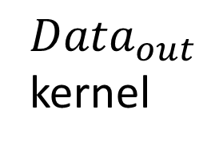
$MM$ kernel
$Data_{in}$
kernel
$Data_{out}$
kernel
Accumulating structure
…
X
+
X
+
FIFO
FIFO
Buffer1
X
+
X
…
Dot product unit
Accumulating Tile
Buffer2
DDR3 on Catapult FPGA

