Slide 1
Symbolic Compiler：编译深度学习模型到FPGA
朱思晓
4/6/2016

Slide 2
深度学习：体系结构的视角
计算密集：
IO密集：

Slide 3
FPGA：Pros & Cons
现场可编程门阵列。
Pros：
高度定制：精确的缓存、数据流控制；强大的低精度定点计算能力
大量并行：1590 DSP (Multiplier) for Stratix V
节约能源：25W for Stratix V V.S. 250W for GeForce GTX TITAN X
价格：200$ Stratix V V.S. 1200$ for TITAN X
Cons：
主频低：300MHz for Stratix V VS. 2.4GHz for Xeon E5-2620.
编程复杂：Verilog V.S. C++/Java/Python

Slide 4

深度学习$×$FPGA：可行性
二值化网络：Training deep neural networks with binary weights during propagations. M. Courbariaux, et al.

Slide 5
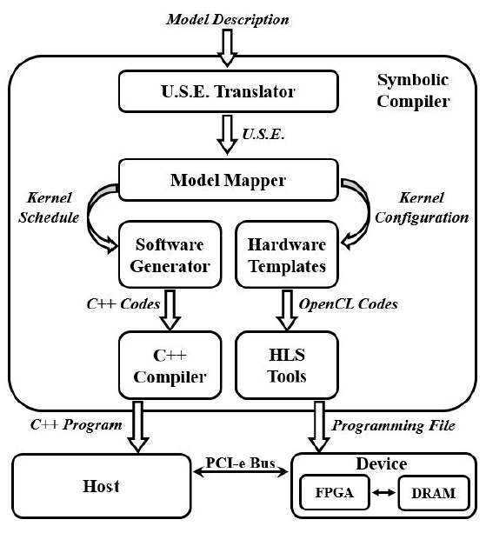
Symbolic Compiler:
Model Mapper:
Hardware Template:
Software Generator:

Slide 6
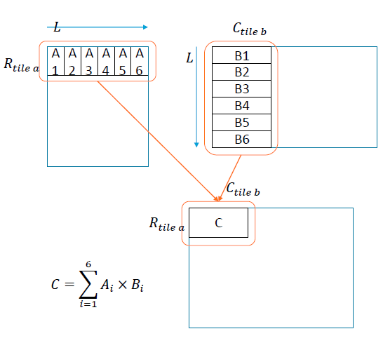
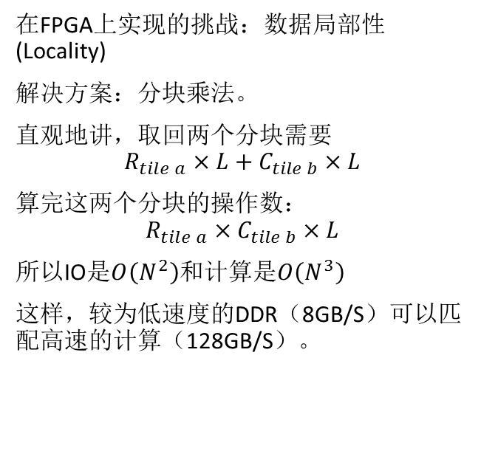
矩阵乘法：原理
在FPGA上实现的挑战：数据局部性(Locality)
解决方案：分块乘法。
直观地讲，取回两个分块需要
$$R_{tile a}×L+C_{tile b}×L$$
算完这两个分块的操作数：
$$R_{tile a}×C_{tile b}×L$$
所以IO是$O\left(N^{2}\right)$和计算是$O\left(N^{3}\right)$
这样，较为低速度的DDR（8GB/S）可以匹配高速的计算（128GB/S）。

Slide 7
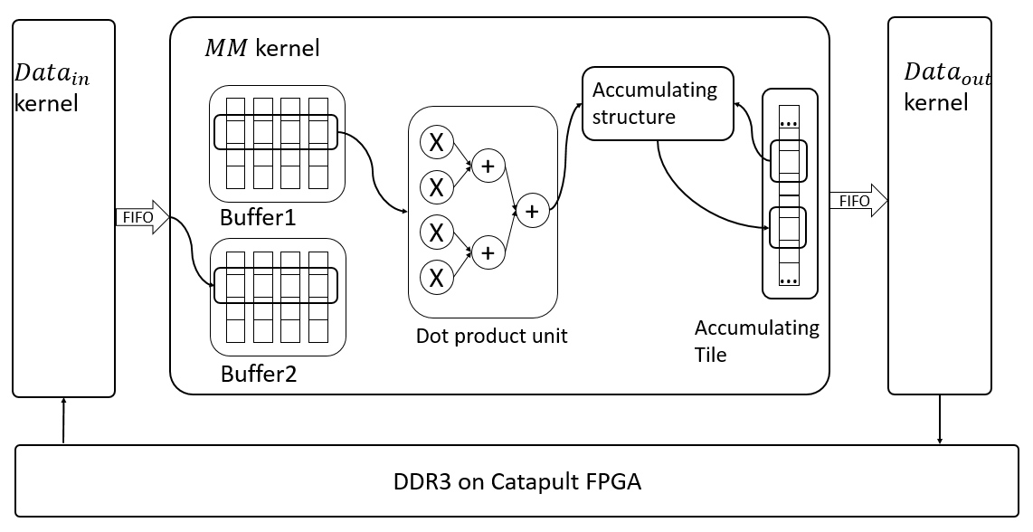
矩阵乘法：实现
“乒乓”技巧：
Buffer1在输出当前分块用作计算的时候，Buffer2在从DDR接收下一组分块
Buffer1和Buffer2都完成各自操作后，两个Buffer调换角色
保证计算和IO重叠
树状点乘器，降低流水线深度
特殊优化结构来优化下述操作：
accu [i] = accu[i] + dot_result

Slide 8
Content
A analysis of current difficulties to implement large CNN models on FPGA card.
A novel solution to maximize IO bandwidth and put the performance bottleneck to calculation resources.
Verified experiment result at VGG19 model that achieves 399.6 gops, 2.9 times faster than current known best related work.

Slide 9
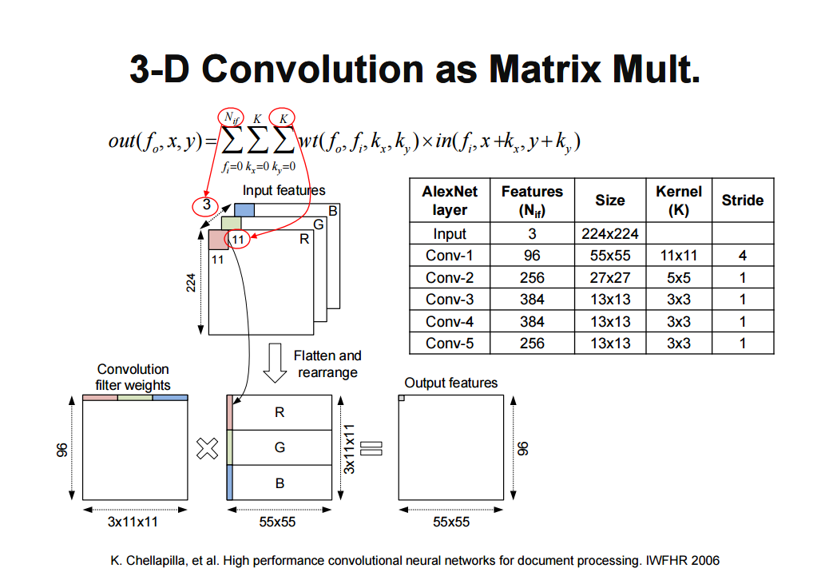
案例研究：卷积神经网络（CNN）
Used by main stream CNN implementations: cuCNN, caffe.

Slide 10
案例研究：长短期神经网络（LSTM）

Slide 11
Why not FFT?
Small filter size. With FFT, one convolution at time domain equals one product at frequency domain. Small filter kernel gains less acceleration than big kernel, unfortunately, 3 is the most common case (VGG, AlexNet).
Complex multiplication consume 4 times more. But the DSP resource are limited (now only 9/4 acceleration).
DFT and reverse DFT overhead. Non-trivial, hard to parallel.
IO bottom neck. Point wise multiplication at frequency domain relies heavily on DDR bandwidth (fetching : calculation = 1 : 1), 8GB/S DDR on FPGA (512bit / cycle) cannot keep up with calculation (up to 1024 multiplication / cycle).
In conclusion: gflops is even worse than GEMM based approach for 3 x 3 kernel convolution.

Slide 12
Convolution as GEMM: Difficulties
Model too big for block RAM. 5.25MB BRAM for Stratix-V. In VGG19, maximal feature map size up to 3.2 MB, note input feature map and output feature map must simultaneously be stored on BRAM.
DDR access must be sequential. 1024 DSP GEMM requires about 16 fetch per cycle. Through maximal DDR bandwidth achieves 8GB/S, that is about 512bit / cycle, but this bandwidth requires strict condition: Access must be 512bits at a time for a burst transfer, and access must hit sequential DDR address, otherwise DDR must recharge for random or large stride access, making IO a bottleneck.

Slide 13
Convolution as GEMM: Difficulties
Online address convert not feasible.
Filter slide window covers 2D rectangle, can not be sequentially fetched . If kernel size == 3, every 3 numbers’ fetch causes a DDR recharge.
Successive element on target matrix randomly distributed across source feature maps, need to calculate actual address on feature map online, in parallel. Large resource consumption, and impossible to do parallel random access to DDR

Slide 14
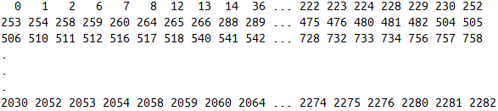
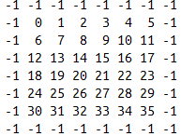
Not the same #feature map: 3 V.S. 64
64 X 3 X 3
Address on feature map storage in DDR
The first fmap, totally 64 of them.
64 feature map’s certain filter window location expand to one row of target matrix of length 64 X 3 X 3, successive 64 8bit fix number (burst length) strides across 7 ~ 8 feature maps and three rows of each feature map, thus the actual address of successive elements are nearly randomly distributed.

Slide 15
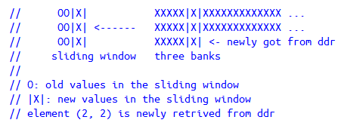
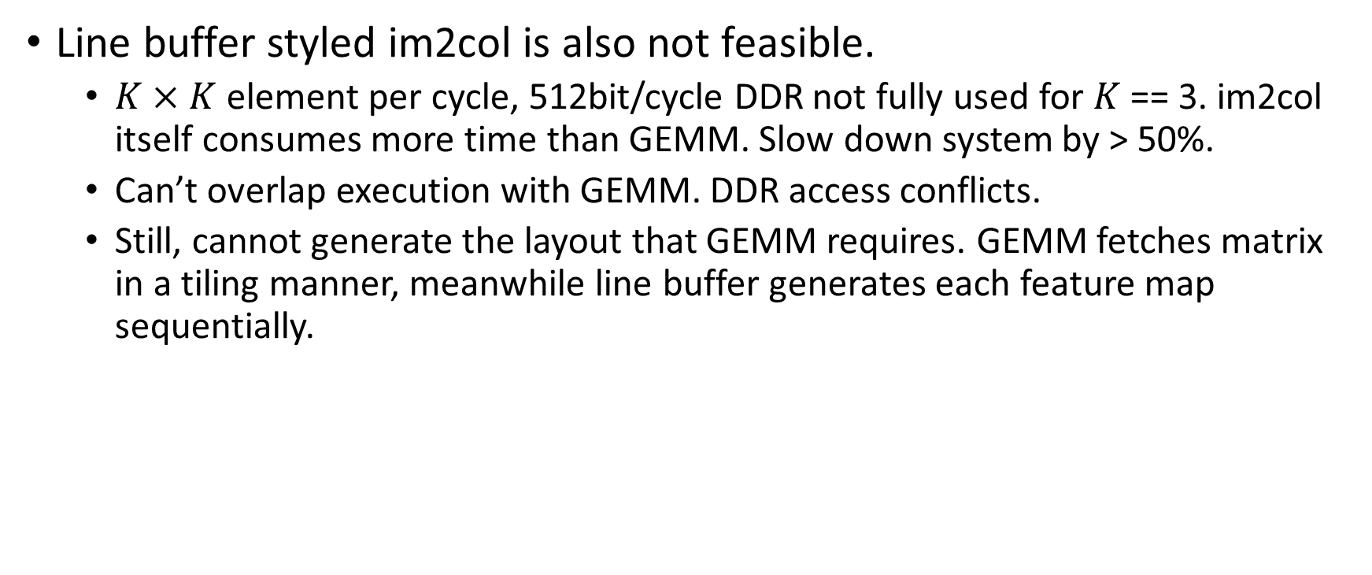
Convolution as GEMM: Difficulties
Line buffer styled im2col is also not feasible.
$K×K$element per cycle, 512bit/cycle DDR not fully used for $K$ == 3. im2col itself consumes more time than GEMM. Slow down system by > 50%.
Can’t overlap execution with GEMM. DDR access conflicts.
Still, cannot generate the layout that GEMM requires. GEMM fetches matrix in a tiling manner, meanwhile line buffer generates each feature map sequentially.

Slide 16
Solution: Change the feature map and filter memory format
L = size of one burst DDR read (512bit), also size of one tile (64 8bit fix point number).
Old: fmap[Nfmap][Nposition]
// format protocal for both GEMM’s input and output (next layer’s input)
New: fmap[Nfmap/L][Nposition][L]
Old: filter[Nfilter][Nposition]
// rearranged off line
New: filter[Nfilter/L][Nposition][L]

Slide 17
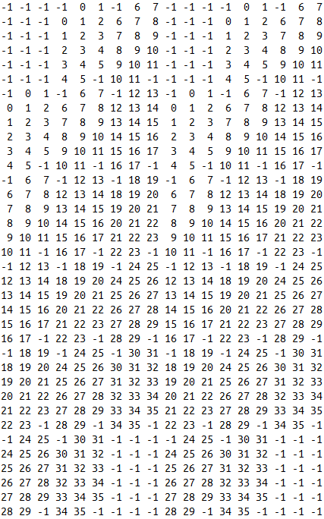
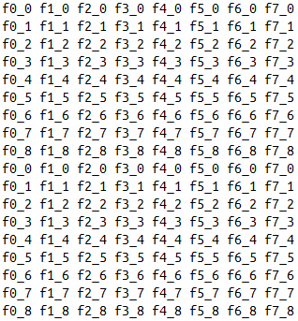
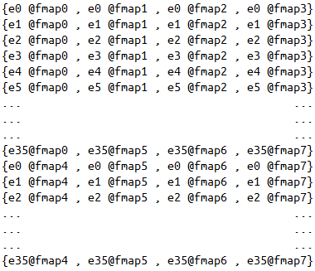

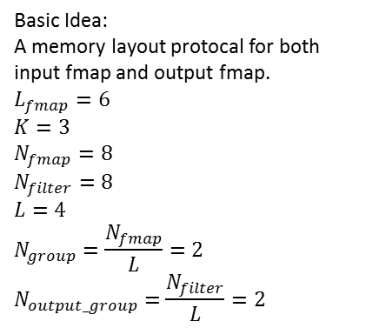






Tile B $L×L$
Basic Idea:
A memory layout protocal for both input fmap and output fmap.
$$L_{fmap}=6$$
$$K=3$$
$$N_{fmap}=8$$
$$N_{filter}=8$$
$$L=4$$
$$N_{group}=\frac{N_{fmap}}{L}=2$$
$$N_{output_group}=\frac{N_{filter}}{L}=2$$
Tile A $Rt×L$
Output tile$Rt×L$
Output Fmap $0\sim (L−1)$
Output Fmap $L\sim (2L−1)$
Input Fmap $0\sim (L−1)$
Input Fmap $L\sim (2L−1)$

Slide 18





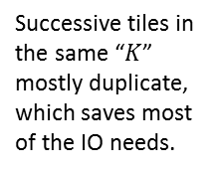
Target Matrix A
Successive tiles in the same “$K$” mostly duplicate, which saves most of the IO needs.
GEMM tile slide direction
$$L_{fmap}=6$$
$$K=3$$
$$N_{fmap}=8$$
$$L=4$$
$$N_{group}=\frac{N_{fmap}}{L}=2$$
Filter slide direction
Element id for one feature map, -1 for padding. (Totally $N_{fmap}$ such feature maps)
Fmap $0\sim (L−1)$
Fmap $L\sim (2L−1)$

Slide 19

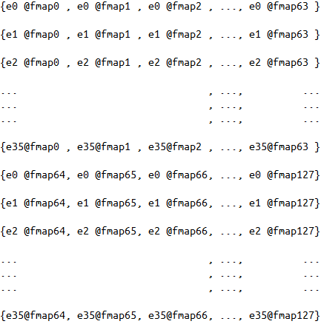
Sequential Access
Fmap $0\sim (L−1)$
Fmap $L\sim (2L−1)$

Slide 20
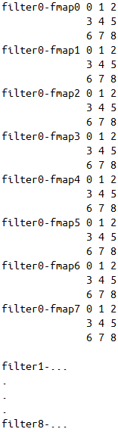
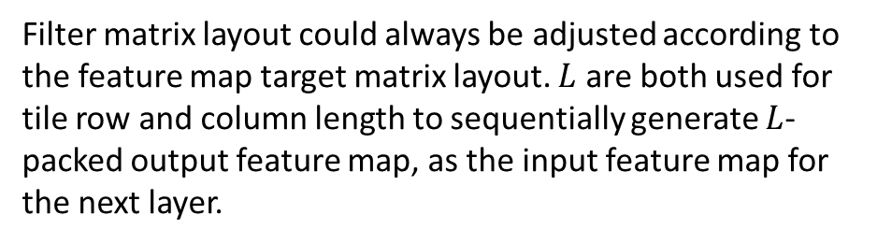

$L×L tile$, $4×4$ in this example
Tile slide direction
Filter matrix layout could always be adjusted according to the feature map target matrix layout. $L$ are both used for tile row and column length to sequentially generate $L$-packed output feature map, as the input feature map for the next layer.

Slide 21
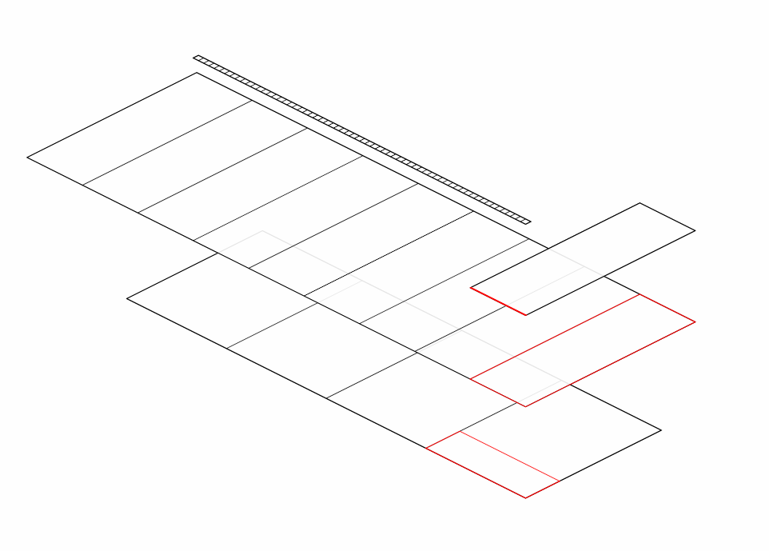

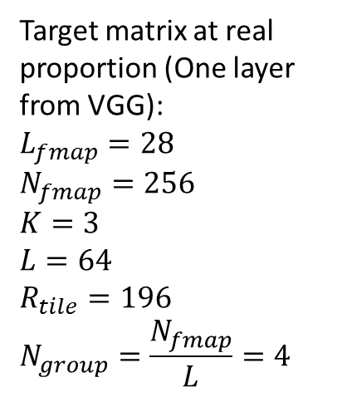




Target matrix at real proportion (One layer from VGG):
$$L_{fmap}=28$$
$$N_{fmap}=256$$
$$K=3$$
$$L=64$$
$$R_{tile}=196$$
$$N_{group}=\frac{N_{fmap}}{L}=4$$
$$K×K×L$$
$$L$$
$$196$$
One DDR burst read
$$N_{group}×K×K×L$$
One GEMM tile
$$28×28$$
Target matrix

Slide 22
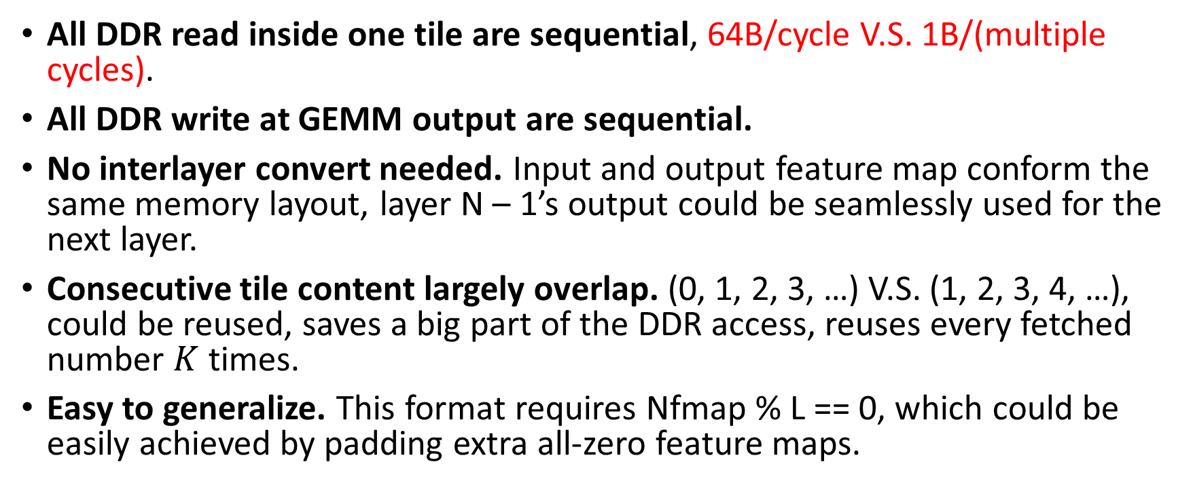
Benefit for the optimized CNN memory layout
All DDR read inside one tile are sequential, 64B/cycle V.S. 1B/(multiple cycles).
All DDR write at GEMM output are sequential.
No interlayer convert needed. Input and output feature map conform the same memory layout, layer N – 1’s output could be seamlessly used for the next layer.
Consecutive tile content largely overlap. (0, 1, 2, 3, …) V.S. (1, 2, 3, 4, …), could be reused, saves a big part of the DDR access, reuses every fetched number $K$ times.
Easy to generalize. This format requires Nfmap % L == 0, which could be easily achieved by padding extra all-zero feature maps.

Slide 23
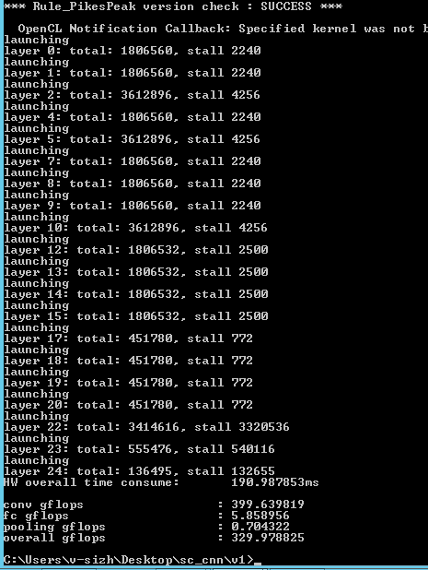
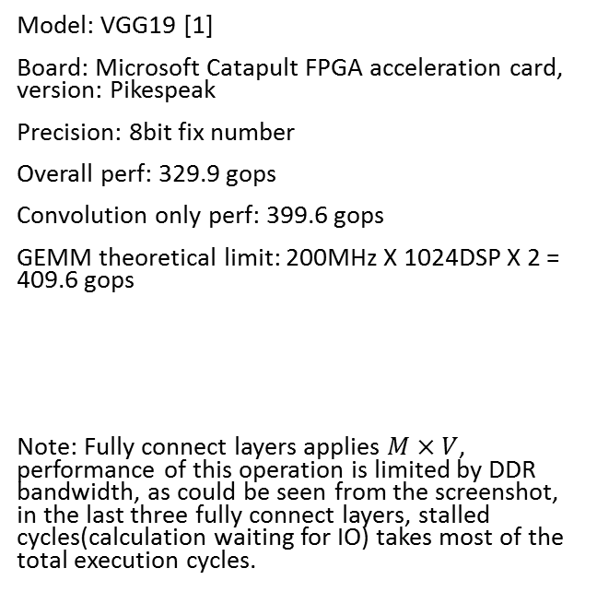
Experiment result
Model: VGG19 [1]
Board: Microsoft Catapult FPGA acceleration card, version: Pikespeak
Precision: 8bit fix number
Overall perf: 329.9 gops
Convolution only perf: 399.6 gops
GEMM theoretical limit: 200MHz X 1024DSP X 2 = 409.6 gops
Note: Fully connect layers applies $M×V$, performance of this operation is limited by DDR bandwidth, as could be seen from the screenshot, in the last three fully connect layers, stalled cycles(calculation waiting for IO) takes most of the total execution cycles.
[1] Russakovsky, Olga, et al. "Imagenet large scale visual recognition challenge."International Journal of Computer Vision 115.3 (2015): 211-252.

Slide 24
Comparison to related works
 | [1] ICCD’13 | [2] FPGA’15 | [3] FPGA’16 | [3] FPGA’16 | this work
FPGA | Virtex-6 VLX240T | Virtex-7 VX485T | Stratix-V GSD8 | Stratix-V GSD8 | Stratix-V GSMD5
Frequency | 150 MHz | 100 MHz | 140 MHz | 120 MHz | 200 MHz
CNN model | 2.74 GMAC | AlexNet 1.33 GOP | AlexNet 1.46 GOP | VGG-16 30.9 GOP | VGG-19
Precision | fixed | float (32b) | fixed (8-16b) | fixed (8-16b) | Fixed (8b)
Performance | 17 GOPS^{b} | 61.6 GOPSª | 126.6 GOPSª 72.4 GOPS^{b} | 136.5 GOPSª 117.8 GOPS^{b} | 399.6 GOPSa 329.9 GOPSb
ª convolution operations only ^{b} all operations for image classification
1 GMAC = 2 GOP
[1] M. Peemen, et al. Memory-centric accelerator design for convolutional neural networks. In ICCD 2013.
[2] C. Zhang, et al. Optimizing FPGA-based accelerator design for deep convolutional neural networks. In ACM ISFPGA 2015.
[3] Suda, Naveen, et al. "Throughput-Optimized OpenCL-based FPGA Accelerator for Large-Scale Convolutional Neural Networks." Proceedings of the 2016 ACM/SIGDA International Symposium on Field-Programmable Gate Arrays. ACM, 2016.

Slide 25
Thanks

