Slide 1
Symbolic Compiler: State-of-Art CNN implementation on FPGA
Sixiao Zhu, Ningyi Xu, MSRA
4/6/2016

Slide 2
Content
A analysis of current difficulties to implement large CNN models on FPGA card.
A novel solution to maximize IO bandwidth and put the performance bottleneck to calculation resources.
Verified experiment result at VGG19 model that achieves 399.6 gops, 2.9 times faster than current known best related work.

Slide 3
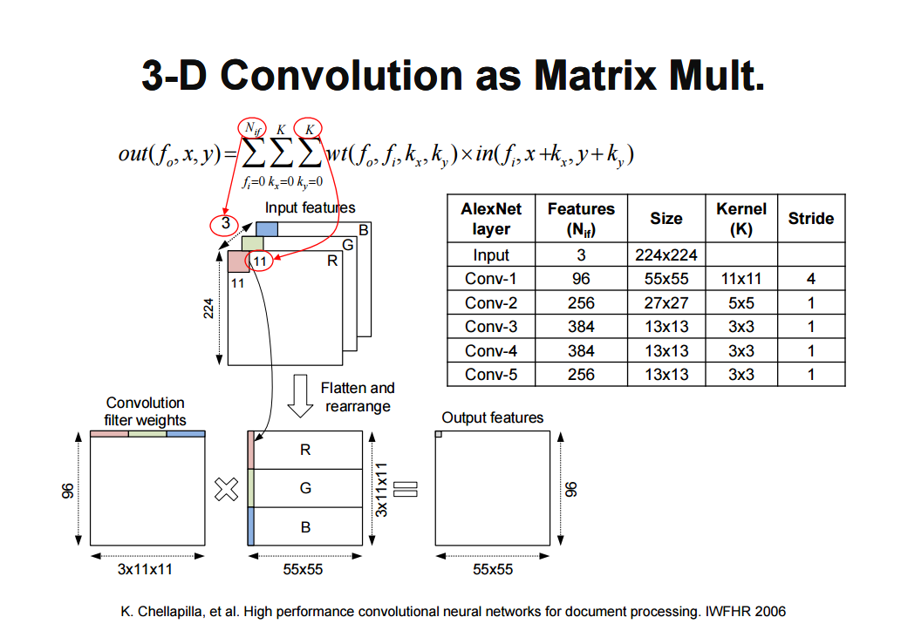
Convolution as GEMM: Common idea
Used by main stream CNN implementations: cuCNN, caffe.

Slide 4
Why not FFT?
Small filter size. With FFT, one convolution at time domain equals one product at frequency domain. Small filter kernel gains less acceleration than big kernel, unfortunately, 3 is the most common case (VGG, AlexNet).
Complex multiplication consume 4 times more. But the DSP resource are limited (now only 9/4 acceleration).
DFT and reverse DFT overhead. Non-trivial, hard to parallel.
IO bottom neck. Point wise multiplication at frequency domain relies heavily on DDR bandwidth (fetching : calculation = 1 : 1), 8GB/S DDR on FPGA (512bit / cycle) cannot keep up with calculation (up to 1024 multiplication / cycle).
In conclusion: gflops is even worse than GEMM based approach for 3 x 3 kernel convolution.

Slide 5
Convolution as GEMM: Difficulties
Model too big for block RAM. 5.25MB BRAM for Stratix-V. In VGG19, maximal feature map size up to 3.2 MB, note input feature map and output feature map must simultaneously be stored on BRAM.
DDR access must be sequential. 1024 DSP GEMM requires about 16 fetch per cycle. Through maximal DDR bandwidth achieves 8GB/S, that is about 512bit / cycle, but this bandwidth requires strict condition: Access must be 512bits at a time for a burst transfer, and access must hit sequential DDR address, otherwise DDR must recharge for random or large stride access, making IO a bottleneck.

Slide 6
Convolution as GEMM: Difficulties
Online address convert not feasible.
Filter slide window covers 2D rectangle, can not be sequentially fetched . If kernel size == 3, every 3 numbers’ fetch causes a DDR recharge.
Successive element on target matrix randomly distributed across source feature maps, need to calculate actual address on feature map online, in parallel. Large resource consumption, and impossible to do parallel random access to DDR

Slide 7
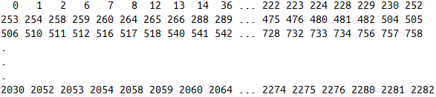
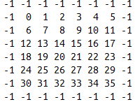
Not the same #feature map: 3 V.S. 64
64 X 3 X 3
Address on feature map storage in DDR
The first fmap, totally 64 of them.
64 feature map’s certain filter window location expand to one row of target matrix of length 64 X 3 X 3, successive 64 8bit fix number (burst length) strides across 7 ~ 8 feature maps and three rows of each feature map, thus the actual address of successive elements are nearly randomly distributed.

Slide 8
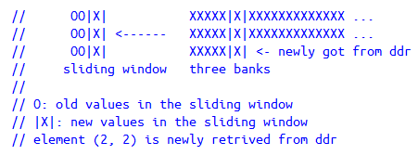
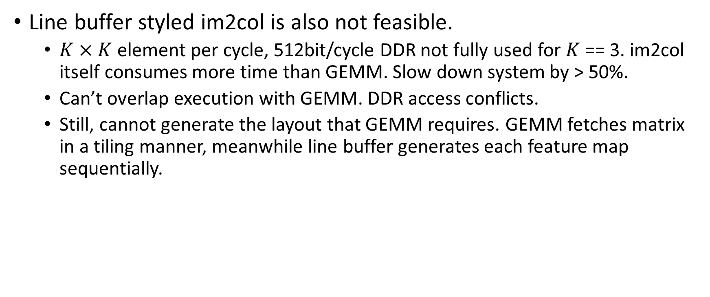
Convolution as GEMM: Difficulties
Line buffer styled im2col is also not feasible.
$K×K$element per cycle, 512bit/cycle DDR not fully used for $K$ == 3. im2col itself consumes more time than GEMM. Slow down system by > 50%.
Can’t overlap execution with GEMM. DDR access conflicts.
Still, cannot generate the layout that GEMM requires. GEMM fetches matrix in a tiling manner, meanwhile line buffer generates each feature map sequentially.

Slide 9
Solution: Change the feature map and filter memory format
L = size of one burst DDR read (512bit), also size of one tile (64 8bit fix point number).
Old: fmap[Nfmap][Nposition]
// format protocal for both GEMM’s input and output (next layer’s input)
New: fmap[Nfmap/L][Nposition][L]
Old: filter[Nfilter][Nposition]
// rearranged off line
New: filter[Nfilter/L][Nposition][L]

Slide 10
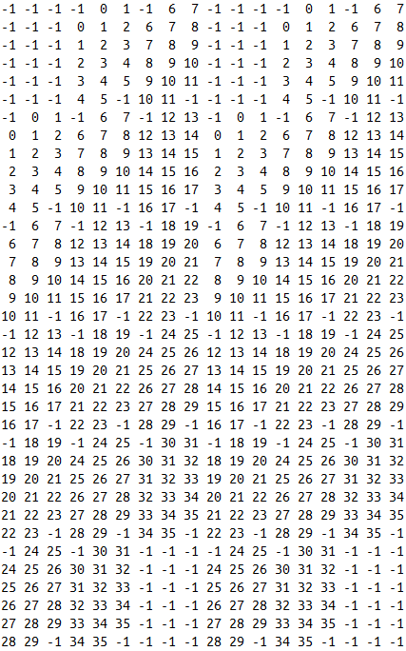
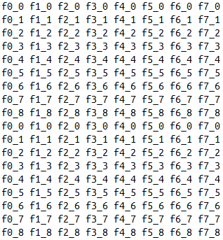
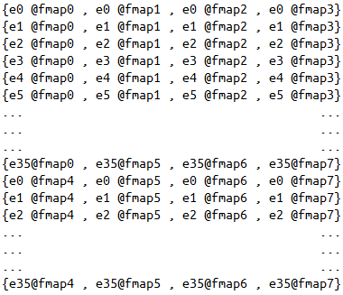

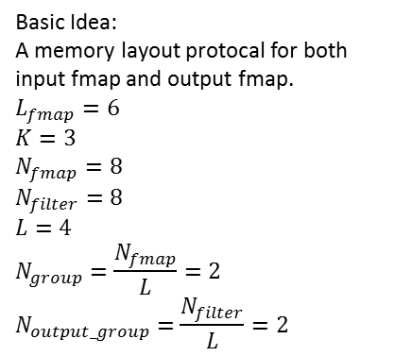






Tile B $L×L$
Basic Idea:
A memory layout protocal for both input fmap and output fmap.
$$L_{fmap}=6$$
$$K=3$$
$$N_{fmap}=8$$
$$N_{filter}=8$$
$$L=4$$
$$N_{group}=\frac{N_{fmap}}{L}=2$$
$$N_{output_group}=\frac{N_{filter}}{L}=2$$
Tile A $Rt×L$
Output tile$Rt×L$
Output Fmap $0\sim (L−1)$
Output Fmap $L\sim (2L−1)$
Input Fmap $0\sim (L−1)$
Input Fmap $L\sim (2L−1)$

Slide 11





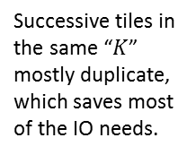
Target Matrix A
Successive tiles in the same “$K$” mostly duplicate, which saves most of the IO needs.
GEMM tile slide direction
$$L_{fmap}=6$$
$$K=3$$
$$N_{fmap}=8$$
$$L=4$$
$$N_{group}=\frac{N_{fmap}}{L}=2$$
Filter slide direction
Element id for one feature map, -1 for padding. (Totally $N_{fmap}$ such feature maps)
Fmap $0\sim (L−1)$
Fmap $L\sim (2L−1)$

Slide 12

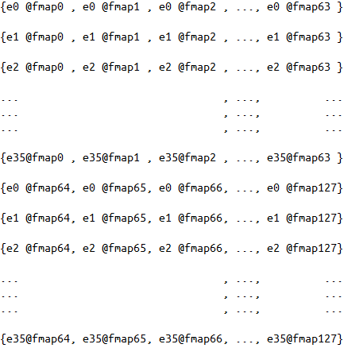
Sequential Access
Fmap $0\sim (L−1)$
Fmap $L\sim (2L−1)$

Slide 13
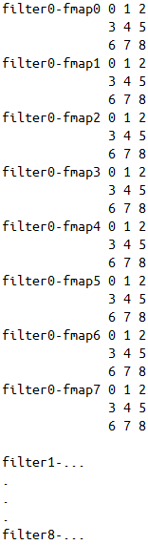
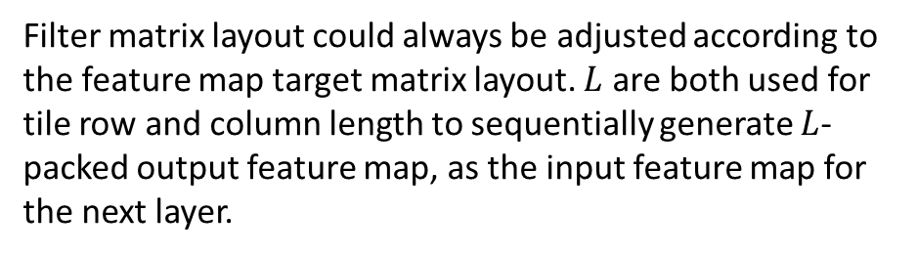

$L×L tile$, $4×4$ in this example
Tile slide direction
Filter matrix layout could always be adjusted according to the feature map target matrix layout. $L$ are both used for tile row and column length to sequentially generate $L$-packed output feature map, as the input feature map for the next layer.

Slide 14
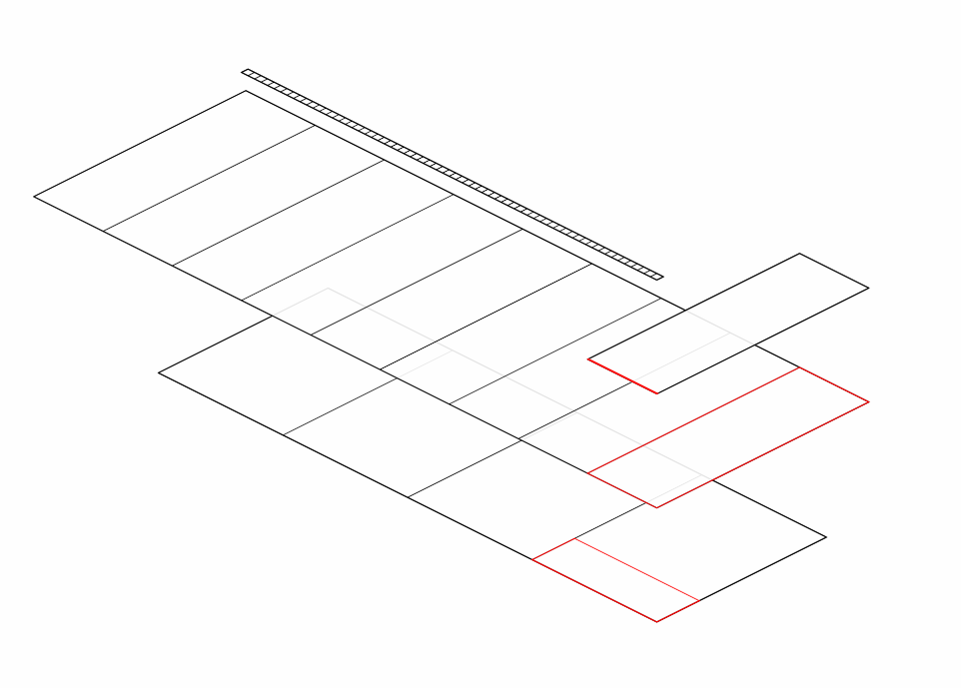

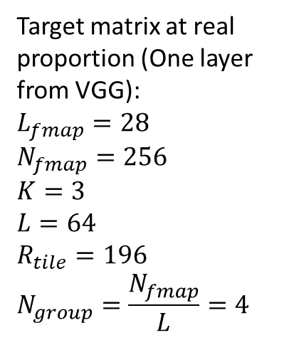




Target matrix at real proportion (One layer from VGG):
$$L_{fmap}=28$$
$$N_{fmap}=256$$
$$K=3$$
$$L=64$$
$$R_{tile}=196$$
$$N_{group}=\frac{N_{fmap}}{L}=4$$
$$K×K×L$$
$$L$$
$$196$$
One DDR burst read
$$N_{group}×K×K×L$$
One GEMM tile
$$28×28$$
Target matrix

Slide 15
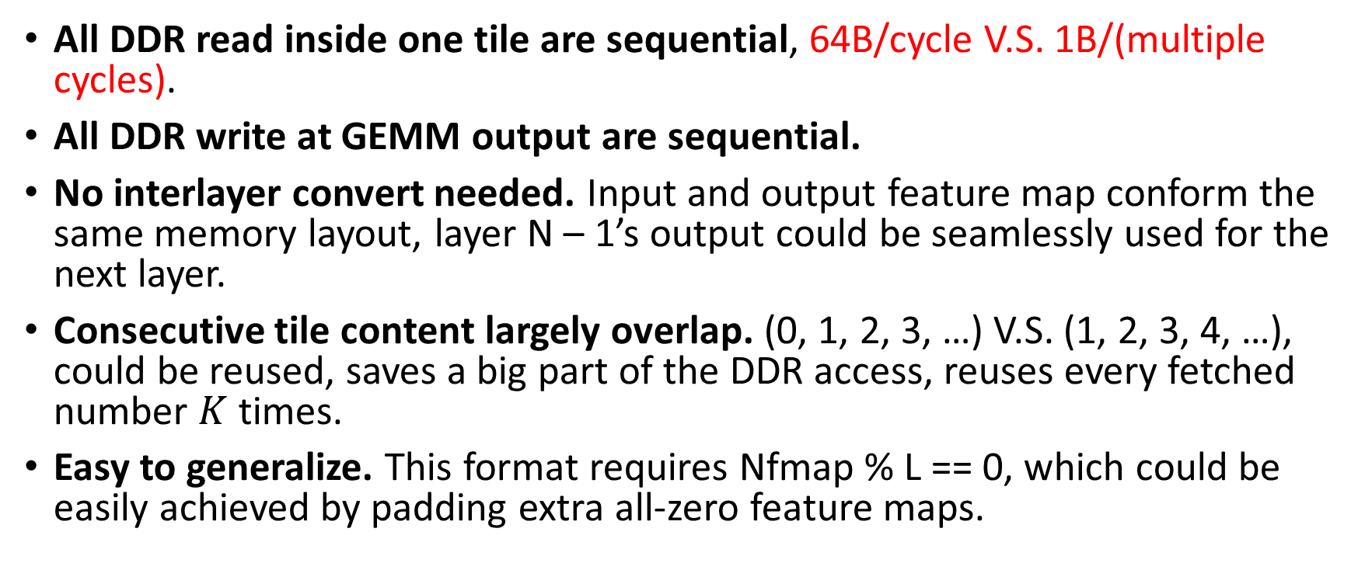
Benefit for the optimized CNN memory layout
All DDR read inside one tile are sequential, 64B/cycle V.S. 1B/(multiple cycles).
All DDR write at GEMM output are sequential.
No interlayer convert needed. Input and output feature map conform the same memory layout, layer N – 1’s output could be seamlessly used for the next layer.
Consecutive tile content largely overlap. (0, 1, 2, 3, …) V.S. (1, 2, 3, 4, …), could be reused, saves a big part of the DDR access, reuses every fetched number $K$ times.
Easy to generalize. This format requires Nfmap % L == 0, which could be easily achieved by padding extra all-zero feature maps.

Slide 16
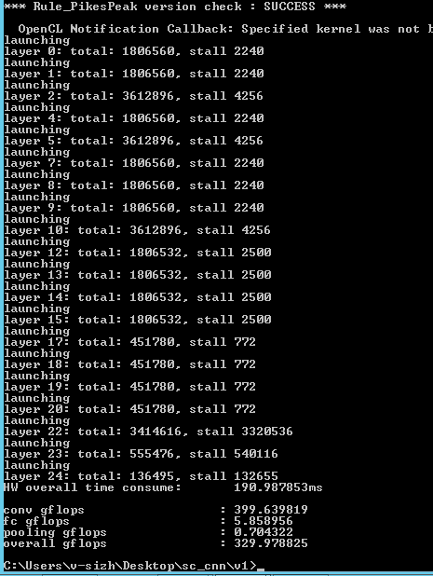
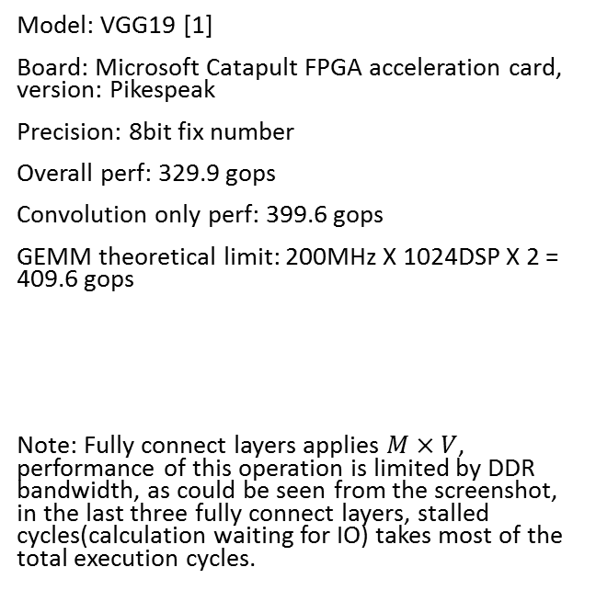
Experiment result
Model: VGG19 [1]
Board: Microsoft Catapult FPGA acceleration card, version: Pikespeak
Precision: 8bit fix number
Overall perf: 329.9 gops
Convolution only perf: 399.6 gops
GEMM theoretical limit: 200MHz X 1024DSP X 2 = 409.6 gops
Note: Fully connect layers applies $M×V$, performance of this operation is limited by DDR bandwidth, as could be seen from the screenshot, in the last three fully connect layers, stalled cycles(calculation waiting for IO) takes most of the total execution cycles.
[1] Russakovsky, Olga, et al. "Imagenet large scale visual recognition challenge."International Journal of Computer Vision 115.3 (2015): 211-252.

Slide 17
Comparison to related works
 | [1] ICCD’13 | [2] FPGA’15 | [3] FPGA’16 | [3] FPGA’16 | this work
FPGA | Virtex-6 VLX240T | Virtex-7 VX485T | Stratix-V GSD8 | Stratix-V GSD8 | Stratix-V GSMD5
Frequency | 150 MHz | 100 MHz | 140 MHz | 120 MHz | 200 MHz
CNN model | 2.74 GMAC | AlexNet 1.33 GOP | AlexNet 1.46 GOP | VGG-16 30.9 GOP | VGG-19
Precision | fixed | float (32b) | fixed (8-16b) | fixed (8-16b) | Fixed (8b)
Performance | 17 GOPS^{b} | 61.6 GOPSª | 126.6 GOPSª 72.4 GOPS^{b} | 136.5 GOPSª 117.8 GOPS^{b} | 399.6 GOPSa 329.9 GOPSb
ª convolution operations only ^{b} all operations for image classification
1 GMAC = 2 GOP
[1] M. Peemen, et al. Memory-centric accelerator design for convolutional neural networks. In ICCD 2013.
[2] C. Zhang, et al. Optimizing FPGA-based accelerator design for deep convolutional neural networks. In ACM ISFPGA 2015.
[3] Suda, Naveen, et al. "Throughput-Optimized OpenCL-based FPGA Accelerator for Large-Scale Convolutional Neural Networks." Proceedings of the 2016 ACM/SIGDA International Symposium on Field-Programmable Gate Arrays. ACM, 2016.

Slide 18
Thanks

