Slide 1
Low latency DSSM hardware accelerater
Sixiao Zhu, Ningyi Xu, MSRA
5/20/2016

Slide 2
DSSM: introduction
DSSM stands for Deep Structured Semantic Model, or more general, Deep Semantic Similarity Model. DSSM, developed by the MSR Deep Learning Technology Center, is a deep neural network (DNN) modeling technique for representing text strings (sentences, queries, predicates, entity mentions, etc.) in a continuous semantic space and modeling semantic similarity between two text strings (e.g., Sent2Vec).
DSSM has wide applications including information retrieval and web search ranking, ad selection/relevance, contextual entity search and interestingness tasks, question answering, knowledge inference, image captioning, and machine translation, etc.

Slide 3
Necessarity for FPGA acceleration
Bing performs DSSM model inference on real time.
When a query enters, Bing uses DSSM to encode the query into a 300 dimension vector, and then calculate cosine similarity with offline calculated encoding of saved web docs. This similarity is used as a ranking fector for search results.
Latency is crucial in this process.

Slide 4
DSSM: inference mechanism
Consider “apple”, in this model, it is spilted into a series of trigrams, “#ap”, “app”, “ppl”, “ple”, “le#”.
The list of trigrams of a certain sentence could be regarded as a 49292 dimension sparse vector.
The sentence “aaaa fa” is represented as [(“#aa”, 1), (“aaa”, 2), (“aa#”, 1), (“#fa”, 1), (“fa#”, 1)]

Slide 5
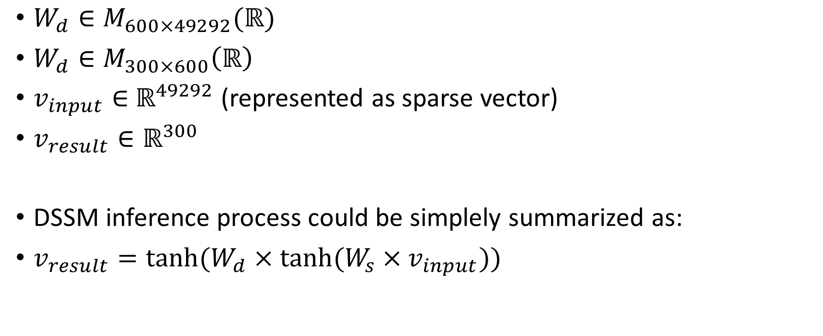
DSSM: inference mechanism
$W_{d}∈M_{600×49292}(ℝ)$
$W_{d}∈M_{300×600}\left(ℝ\right)$
$v_{input}∈$ $ℝ^{49292}$ (represented as sparse vector)
$v_{result}∈ℝ^{300}$
DSSM inference process could be simplely summarized as:
$v_{result}=tanh⁡(W_{d}×tanh⁡(W_{s}×v_{input}))$

Slide 6
Host
FPGA
PCIe: trigram stream
dispatcher
Cached trigram
Uncached trigram
Cached kernel
Uncached kernel
Data from DDR
Cached 600 vector
Uncached 600 vector
accumulation
600 vetor
tanh
Trigram stream
PCIe: 300 vetor
Dense MV, tanh

Slide 7
Cache: analysis
On the sparse MV stage, FPGA could easily perform a high parallel vector element-wise addition.
10GB/s DDR delivers about 16 float point per cycle under 200MHz , ideally.
Noticed that by the nature of language, some trigram appears frequently, like “con”, “er#”, and “#th”. (“#”means beginning or ending)
We could cache frequently hit v600 on BRAM, and use FIFO to decompose the cached fetch and uncached fetch process.

Slide 8
Trigram frequency anslysis: caching the most frequent trigrams’ vector while significantly reduce fetch latency

Slide 9
Query analysis: Query contains mostly 10-30 trigrams

Slide 10
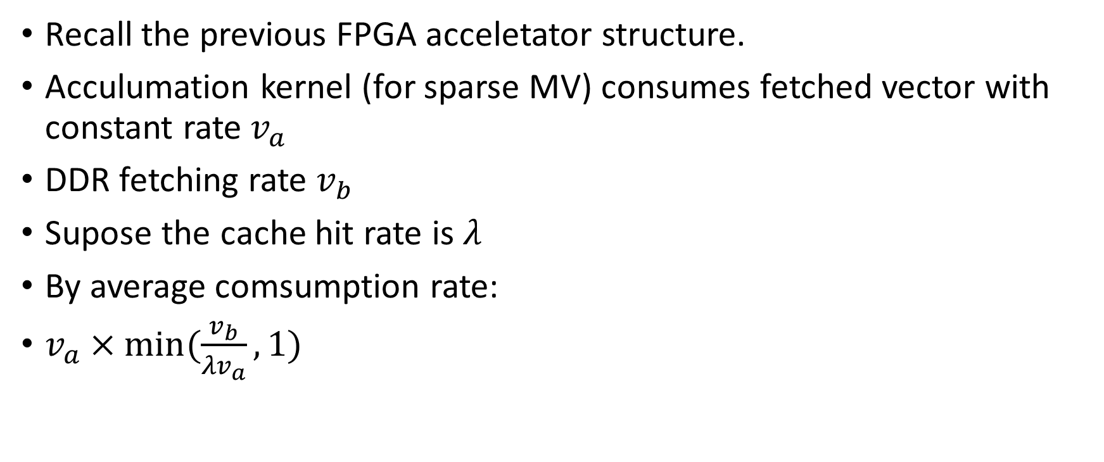
Cache performance analysis
Recall the previous FPGA acceletator structure.
Acculumation kernel (for sparse MV) consumes fetched vector with constant rate$v_{a}$
DDR fetching rate $v_{b}$
Supose the cache hit rate is $λ$
By average comsumption rate:
$v_{a}×min⁡(\frac{v_{b}}{{λv}_{a}},1)$

Slide 11
Cache evaluation: calculate performance sparse performance from slope on different number of trigrams.
All miss case, actually 14 parallel / potentially 32 parallel
All hit case, actually 24 parallel / potentially 32 parallel

Slide 12
Performance
Accroding to production team’s result, the software version latency of a single query is by average 4ms.
Our current implementation performs on average 0.04ms, about 100 times acceleration. Correctness verified.

Slide 13
End-to-end profiling for prototype implementation

Slide 14
Thanks

