Slide 1
Efficient Matrix Multiplication on FPGAs
Sixiao Zhu, Jiali Jiang, Wenqiang Wang, and Ningyi Xu, MSRA
February 3, 2016

Slide 2
Introduction
BLAS (Basic Linear Algebra Subprograms) is fundamental to most computations in scientiﬁc applications
BLAS Level1: Dot-product, O(N)
BLAS Level2: Gaxpy, Matrix*Vector, O(N²)
BLAS Level3: GEMM, Matrix*Matrix, O(N³)
GEMM is important
Heavily used in image/speech recognition, and many other machine learning applications
Using MM to calculate CNNs has been adopted by many DL libraries (cuDNN, Caffe)
Goal: a scalable, highly efficient FPGA BLAS library (fBLAS) for various users
End User | Programming Language | fBLAS library format
SW programmers who want to use Catapult FPGA | C++/CUDA/OpenCL | cuBLAS-like API and .lib
FPGA programmers | OpenCL | OpenCL source code
RTL designer | Verilog/VHDL/A++ | A++ source code/generated RTL
Notes:
GAXPY: General matrix A multiplied by a vector X plus a vector Y.

Slide 3
OpenCL-based implementation
Approach: single work-item style
Benefits
Easy to use by software programmers (OpenCL APIs)
Easy to be integrated to OpenCL-based FPGA projects
Scalable (e.g. DSP numbers, matrix size, tile size) and flexible (e.g. floating point -> fixed point)
Challenge: fine-grained control of generated circuits with OpenCL
Hardware structure
Fully pipelined, tile-based structure
Efficient adder tree
Ping-pong buffer
Notes:
1.9x over Intel’s MKL (Math Kernel Library), better than Altera lib in area/perf, etc

Slide 4
OpenCL fBLAS GEMM performance results
fBLAS/Altera MM
Catapult Pikes Peak
Altera SDK for OpenCL, 64-Bit Offline Complier, Version 15.1.0 Build 185
42.9 GFLOPS
MKL
Intel Xeon E5620(@2.40GHz) 4 Core 4/8 Threads, Intel compiler version 16.0, MKL version 11.3
22.5 GFLOPS/31.4 GFLOPS

Slide 5
OpenCL fBLAS GEMM performance results
Notes:
Microsoft Catapult FPGA accelerating card with Altera Stratix V D5 FPGA
A single memory channel to the on-board 4GB of DDR3 memory (512M x 72b + ECC, 800MHz bus), exposing an Avalon bus interface operating at 200 MHz
ALM: 121990 / 172600 (71 %)
RAM bits: 11810950 / 41246720 (29 %)
DSP: 136 / 1590 (9 %)
Altera SDK for OpenCL, 64-Bit Offline Complier, Version 15.1.0 Build 185

Slide 6
OpenCL implementation bottleneck
 | Coding Style | RAM bits (41,246K) | ALMs (172K) | DSPs (1590) | DDR3 BW | Performance (4096x4096)
fBLAS (OpenCL) | Single workitem | 11,810K (29 %) | 122K (71%) | 136 (8.5%) | 2GBps (25%) | 42.9 GFLOPS
Altera M*M OpenCL | Multiple workitem | 10,952K (27%) | 166K (96%) | 264 (17%) | 1.54GBps (18.4%) | 33.0 GFLOPS
M*V (by Srinidhi Kestur, John Davis, Eric S. Chung) | Verilog, Xilinx V6-LX240T, 32PE | 63% | 71% | 56% | 80% | 1.14 GFLOPS
Bottleneck
ALMs: ‘reduction operation’ in dot-product (sum up 128 float)
Compiler generates human unreadable Verilog code
Current version makes use of 128 DSP (total: 1590) because of the ALM limitation, 8.5% DSP uses up 71% logic resource
Solution(s)
OpenCL: more resources (256 DSP version coming soon), optimized reduction operation
A++: generates the same Verilog code with AOC
Verilog HDL:
Utilize all DSPs: 10x in peak GFLOPS, bottleneck will be DDR3 BW
Customized floating point unit

Slide 7
Limitations by now: Resource
Resource consumes heavily on reducing operation in dot product (128 float points sum up in one cycle).
Compiler generates human unreadable Verilog code.
Current version makes use of 128 DSP (totally 1590 on board) because of the ALM limitation, 9% DSP uses up 71% logic resource.
 | Coding Style | RAM bits | ALMs | DSPs | Performance (4096x4096)
fBLAS (OpenCL) | Single workitem | 11,810K (29 %) | 122K (71%) | 136 (8.5%) | 1.3x
Altera MM OpenCL example | Multiple workitem | 10,952K (27%) | 166K (96%) | 264 (17%) | 1

Slide 8
Structure and major techniques
Kernel for fp operation and accumulate
accumulate
Kernel for DDR read
+
FIFO
X
+
Tile A (four banks)
X
X
+
+
X
FIFO
Dot product unit
Register array
Tile B (four banks)
DDR Read
DDR Write
DDR3 on Catapult

Slide 9
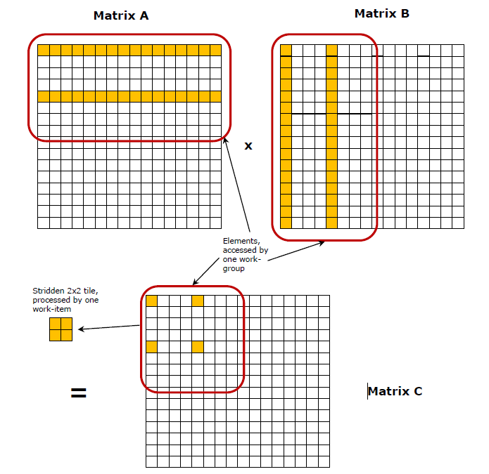
Basic strategy: Do the calculation by tile

Slide 10
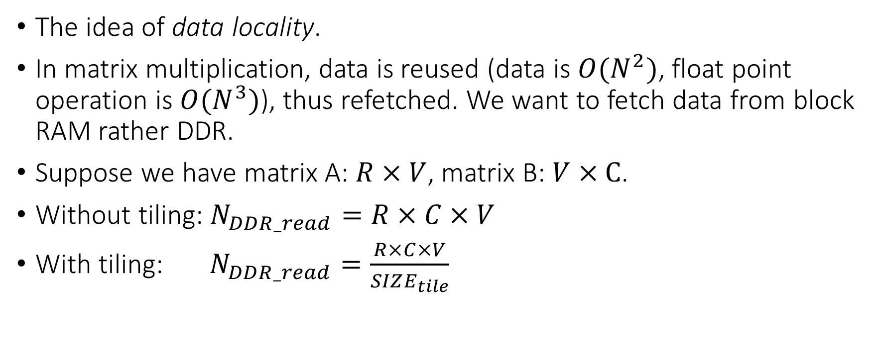
Basic strategy: Why tiling?
The idea of data locality.
In matrix multiplication, data is reused (data is $O(N^{2})$, float point operation is $O(N^{3})$), thus refetched. We want to fetch data from block RAM rather DDR.
Suppose we have matrix A: $R×V$, matrix B: $V×C$.
Without tiling: $N_{DDR_read}=R×C×V$
With tiling: $N_{DDR_read}=\frac{R×C×V}{SIZE_{tile}}$

Slide 11
Further improve DDR Read with Asynchronous IO
Decompose IO and computing: kernel 1 for DDR reading and kernel 2 for computing.
K1 and K2 are connected with a deep FIFO, with push and pop ports width ratio 1:4.
K1 reads a tile from DDR, pushes it into the deep FIFO with low bandwidth.
K2 pops the tile from the FIFO, with high bandwidth, and compute.
Resulting: K2 is computing current tile, while K1 is pushing into the next tile. In fact a implicitly Ping-Pong.
Reduces 75% IO time consume.

Slide 12
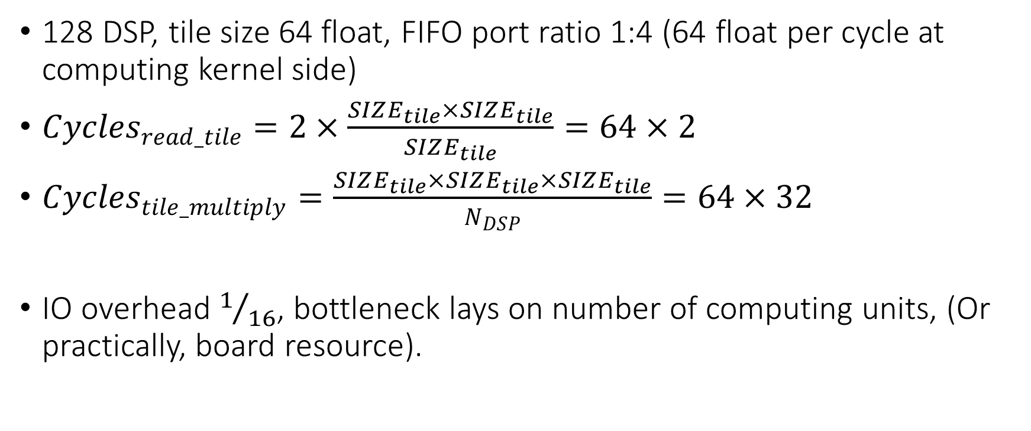
A simple performance analysis
128 DSP, tile size 64 float, FIFO port ratio 1:4 (64 float per cycle at computing kernel side)
$Cycles_{read_tile}=2×\frac{SIZE_{tile}×SIZE_{tile}}{SIZE_{tile}}=64×2$
$Cycles_{tile_multiply}=\frac{SIZE_{tile}×SIZE_{tile}×SIZE_{tile}}{N_{DSP}}=64×32$
IO overhead $1/{16}$, bottleneck lays on number of computing units, (Or practically, board resource).

Slide 13
A simple performance analysis
The computing intensive part is fully pipelined, performance is highly predictable.

Slide 14
Optimization detail: Improve local bandwidth
128 DSP means on chip storage system must feed 128 + 128 floats to the multipliers.
How to provide the high local bandwidth? Banking + Dual port reading.
Banking: One bank for one column, for reading one row per cycle from FIFO to local RAM.
#pragma unroll
for (int c = 0; c < TILE_SIZE; ++c)
tile_b[r][c] = tmp[c];
Dual port reading: Make compiler infer dual port RAM.
float2 tmp = (float2)(tile_b[r][c], tile_b[r + 1][c]);

Slide 15
Optimization detail: Asynchronously transpose
Matrix A and B are stored row major, but in matrix multiplication, rows of A dot product columns of B.
Tile B need to be transposed, we want O(1) transpose.
Difficulty: tile B is banked stored, one bank per column, for storing one row per cycle. So we can not fetch an entire column in one cycle.

Slide 16
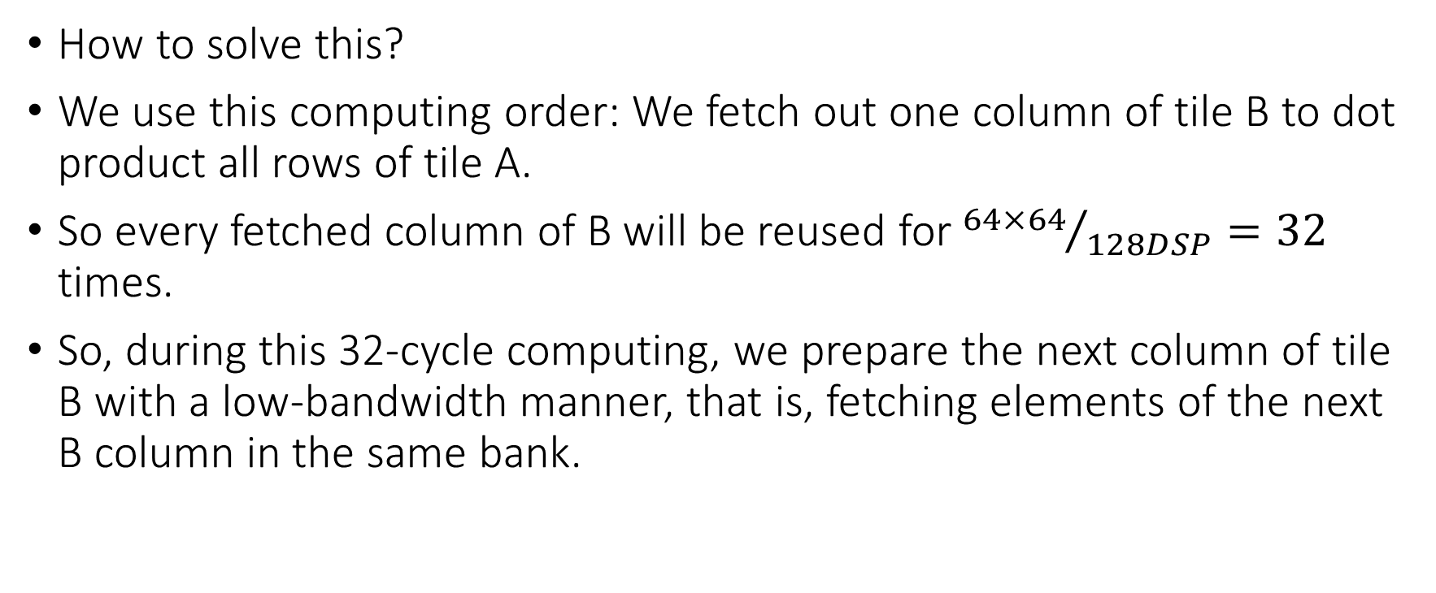
Optimization detail: Asynchronously transpose
How to solve this?
We use this computing order: We fetch out one column of tile B to dot product all rows of tile A.
So every fetched column of B will be reused for ${64×64}/{128DSP}=32$ times.
So, during this 32-cycle computing, we prepare the next column of tile B with a low-bandwidth manner, that is, fetching elements of the next B column in the same bank.

Slide 17
Optimization detail: Asynchronously transpose
Channel B
Four banks
Dual port read
Substitute
Current column
Next column

Slide 18
Optimization detail: Stall free pipeline at critical region
Advantage of HLS: Auto pipelining.
Consider the following code, this is the compute intensive portion of the MXM.
for (int i = 0; i < TILE_SIZE; ++i) {
for (int j = 0; j < TILE_SIZE; ++j) { // one B_column for all A_row
result_i_j = dot (tile_A_row_j, tile_B_column_i);
accu[i][j] += result_i_j; // [1] may exists write after read problem
}
}
At the compiler’s perspective, Resign [1] may exists data dependency risk, so it generates hardware that executes serially (stall the pipeline) at this region.
Yet at the programmer’s perspective, there is no such dependency cause we know the logic.

Slide 19
Optimization detail: Stall free pipeline at critical region
Shift trick:
#pragma unroll
for (int i = 0; i < L - 1; ++i) {
sh[i] = sh[i + 1];
}
accu[ndx - (N_SH - 1)] = sh[0];
sh[N_SH - 1] = accu[ndx] + sum;
We explicitly tell the compiler to shift load and store operation on the same BRAM index by an amount of cycles.
Making place for the compiler to generate the pipelined hardware, as while meeting our semantics.

Slide 20
Tile multiplication and accumulation pipeline
Channel A
Channel B
Batch IO
Batch IO
Accumulating tile
Dot product
+
Four banks
Dual port read
substitute
Shifting queue to solve load/store dependency
Current tile B column
Next tile B column

Slide 21
Altera OpenCL experience
Altera’s OpenCL compiler provides little primitives, design purpose is inferred by coding style. Subtle tricks are needed for generate the design we want.
We summarized these experiences into a write paper.

Slide 22
Altera OpenCL experience: Example
Inferring a register array
Inferring a bank interleaved block RAM array
reg[SIZE];
#pragma unroll
for (int i = 0; i < SIZE; ++i) {
reg[i] = 0;
}
banked_bram[SIZE][SIZE]
for(int i = 0; i < SIZE; ++i) {
#pragma unroll
for (int j = 0; j < SIZE; ++j) {
banked_bram[i][j] = 0;
}
}

Slide 23
Future work
fBLAS
BLAS library written in OpenCL/A++
Usage
APIs to SW
Invoked by higher level compilers ()
Evaluated on Dragontail Peak

Slide 24

Thanks

Slide 25
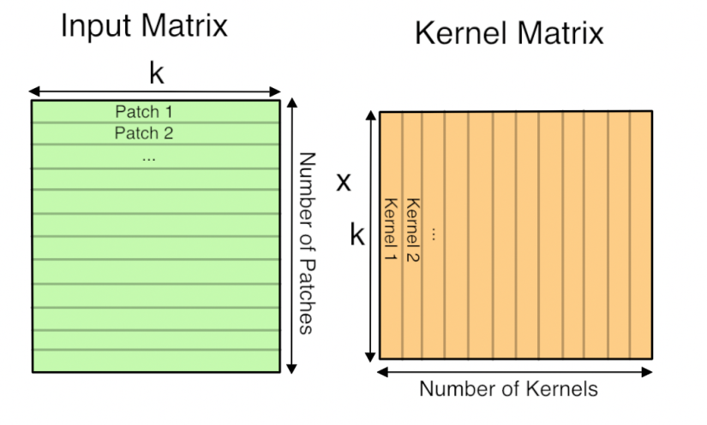
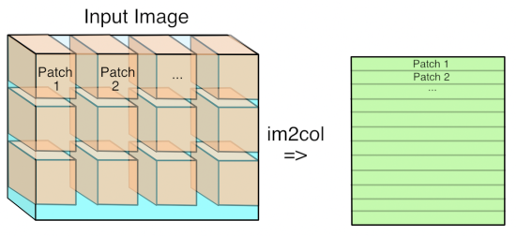

3rd-level BLAS (Basic Linear Algebra Subprograms)
3rd–level BLAS stands for matrix multiplication:
$$C=α×A×B+β×C$$
Useful in accelerating convolution operation in CNNs
Many deep learning library like cuDNN and Caffe have adopted this approach.

Slide 26
A FPGA MM library: fBLAS
Achieves up to 90% performance advantage over Intel’s Math Kernel Library.
Better than Altera provided example on:
Saving resources: 30% performance promote with half DSP usage and about 20% logic resource usage.
Single workitem, easier to be integrated into other applications.
Performance predictable
Fully pipelined, maxing the hardware’s computing capacity

Slide 27
Related work
John David
FPGA BLAS
cuBLAS
MKL

