Slide 1







GEMM on FPGA
Tiling for data locality
Important for computing intensive applications like CNN
$$L$$
$$C_{tile b}$$
$$R_{tile a}$$
A1
A2
A3
A4
A5
A6
$$L$$
B1
B2
B3
B4
B5
B6
$$C_{tile b}$$
$$R_{tile a}$$
C
$$C=\sum_{i=1}^{6}{A_{i}×B_{i}}$$

Slide 2
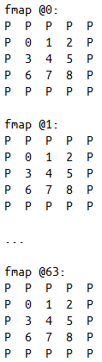
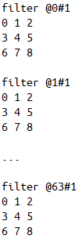
Convolution layer: Data locality can be a problem
fmap @0
filter [@0..@63]#0
next layer fmap @0
fmap @1
filter [@0..@63]#1
next layer fmap @1
...
...
...
fmap @63
filter [@0..@63]#31
next layer fmap @31
conv
next layer fmap #1:
P P P P P
P 0 1 2 P
P 3 4 5 P
P 6 7 8 P
P P P P P
conv
sum up
conv

Slide 3
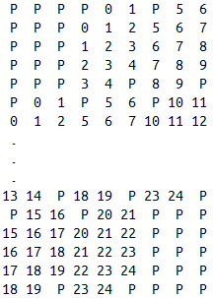

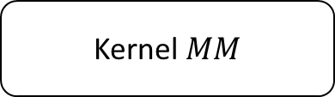
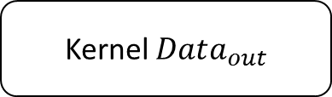

Rearrange the fmap layout that best fit the GEMM’s fetch order.
One DDR burst (64X8 bits)
DDR for input feature maps:
0@[0-63] 1@[0-63] 2@[0-63] ... 24@[0-63]
DDR sequential read
DDR for input filters:
0@[0-63]#0 0@[0-63]#1 ... 63@[0-63]#63
Fetch direction
Virtual matrix B
Kernel $Data_{in}$
Virtual matrix A
Kernel$MM$
Kernel $Data_{out}$
DDR for output feature maps:
0#[0-63] 1#[0-63] ... 5#[0-63] ... 63#[0-63]

Slide 4
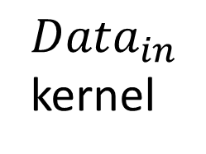
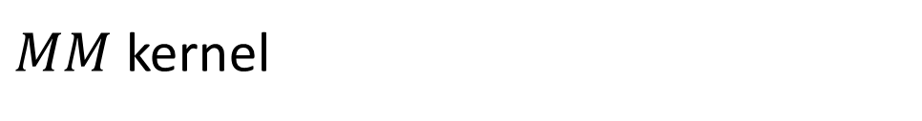
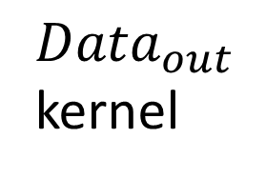
Hardware structure for previous graph
$MM$ kernel
$Data_{in}$
kernel
Accumulating structure
$Data_{out}$
kernel
X
…
+
X
FIFO
FIFO
Buffer1
+
X
+
X
…
Dot product unit
Accumulating Tile
Buffer2
DDR3 on Catapult FPGA

