Slide 1
Low latency DSSM hardware accelerater
Sixiao Zhu, Ningyi Xu, MSRA
5/20/2016

Slide 2
DSSM: introduction
DSSM stands for Deep Structured Semantic Model, or more general, Deep Semantic Similarity Model. DSSM, developed by the MSR Deep Learning Technology Center, is a deep neural network (DNN) modeling technique for representing text strings (sentences, queries, predicates, entity mentions, etc.) in a continuous semantic space and modeling semantic similarity between two text strings (e.g., Sent2Vec).
DSSM has wide applications including information retrieval and web search ranking, ad selection/relevance, contextual entity search and interestingness tasks, question answering, knowledge inference, image captioning, and machine translation, etc.

Slide 3
Necessarity for FPGA acceleration
Bing performs DSSM model inference on real time.
When a query enters, Bing uses DSSM to encode the query into a 300 dimension vector, and then calculate cosine similarity with offline calculated encoding of saved web docs. This similarity is used as a ranking fector for search results.
Latency is crucial in this process.

Slide 4
DSSM: inference mechanism
Consider “apple”, in this model, it is spilted into a series of trigrams, “#ap”, “app”, “ppl”, “ple”, “le#”.
The list of trigrams of a certain sentence could be regarded as a 49292 dimension sparse vector.
The sentence “aaaa fa” is represented as [(“#aa”, 1), (“aaa”, 2), (“aa#”, 1), (“#fa”, 1), (“fa#”, 1)]

Slide 5
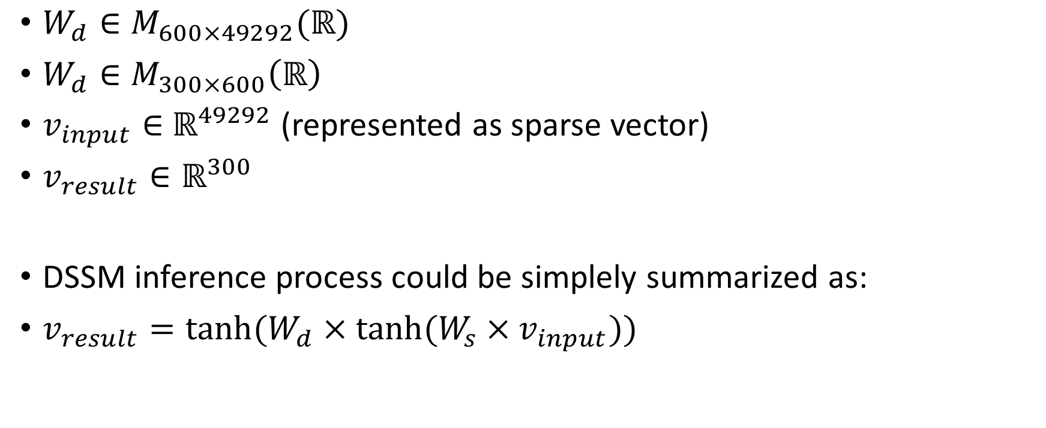
DSSM: inference mechanism
$W_{d}∈M_{600×49292}(ℝ)$
$W_{d}∈M_{300×600}\left(ℝ\right)$
$v_{input}∈$ $ℝ^{49292}$ (represented as sparse vector)
$v_{result}∈ℝ^{300}$
DSSM inference process could be simplely summarized as:
$v_{result}=tanh⁡(W_{d}×tanh⁡(W_{s}×v_{input}))$

Slide 6
Host
FPGA
PCIe: trigram stream
dispatcher
Cached trigram
Uncached trigram
Cached kernel
Uncached kernel
Data from DDR
Cached 600 vector
Uncached 600 vector
accumulation
600 vetor
tanh
Trigram stream
PCIe: 300 vetor
Dense MV, tanh

Slide 7
Cache: analysis
On the sparse MV stage, FPGA could easily perform a high parallel vector element-wise addition.
10GB/s DDR delivers about 16 float point per cycle under 200MHz , ideally.
Noticed that by the nature of language, some trigram appears frequently, like “con”, “er#”, and “#th”. (“#”means beginning or ending)
We could cache frequently hit v600 on BRAM, and use FIFO to decompose the cached fetch and uncached fetch process.

Slide 8
Trigram frequency anslysis: caching the most frequent trigrams’ vector while significantly reduce fetch latency

Slide 9
Query analysis: Query contains mostly 10-30 trigrams

Slide 10
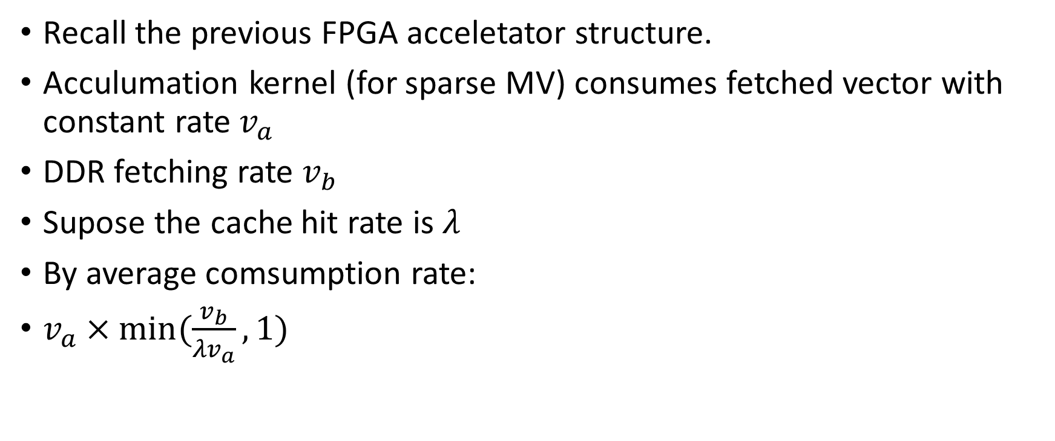
Cache performance analysis
Recall the previous FPGA acceletator structure.
Acculumation kernel (for sparse MV) consumes fetched vector with constant rate$v_{a}$
DDR fetching rate $v_{b}$
Supose the cache hit rate is $λ$
By average comsumption rate:
$v_{a}×min⁡(\frac{v_{b}}{{λv}_{a}},1)$

Slide 11
Cache evaluation: calculate performance sparse performance from slope on different number of trigrams.
All miss case, actually 14 parallel / potentially 32 parallel
All hit case, actually 24 parallel / potentially 32 parallel

Slide 12
Performance
Accroding to production team’s result, the software version latency of a single query is by average 4ms.
Our current implementation performs on average 0.04ms, about 100 times acceleration. Correctness verified.

Slide 13
End-to-end profiling for prototype implementation

Slide 14
README
build a dssm.exe in ./build and copy it to ./runtime
cd runtime
setenv.bat
dssm.exe golden.sof dssm.aocx

Slide 15
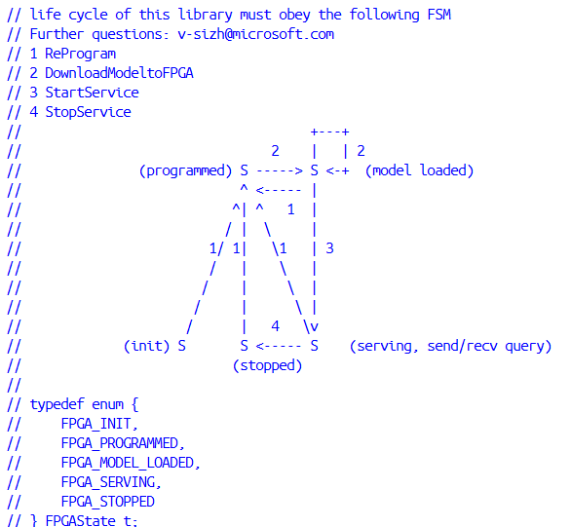
Host code
1. Some OpenCL/MicrosoftCatapult specific routines are encapsulated into easy-to-use classes.
2. The life cycle is given as the FSM. Note not all transferred are tested, I just tested the most common use. You may experience memory leak problems if you move along this FSM at casual, please modify the code and fix them.

Slide 16
Only do FPGA programming
Way1: rsu -pgm <filename>.sof
Way2: rsu -write <filename>.rpd && rsu –reconfig
Way3: %QUARTUS_ROOTDIR%\\bin64\\quartus_pgm.exe -c Microsoft-HyperBlaster --mode=JTAG -o p;<filename>.sof

Slide 17
Do synthesis
Generate Verilog code: aoc -c -v -g --report <filename>.cl (takes about 5min)
Generate Verilog code & synthesis: aoc -v -g --report –fp-relaxed <filename>.cl (takes about 8h)

Slide 18
Thanks

