Slide 1
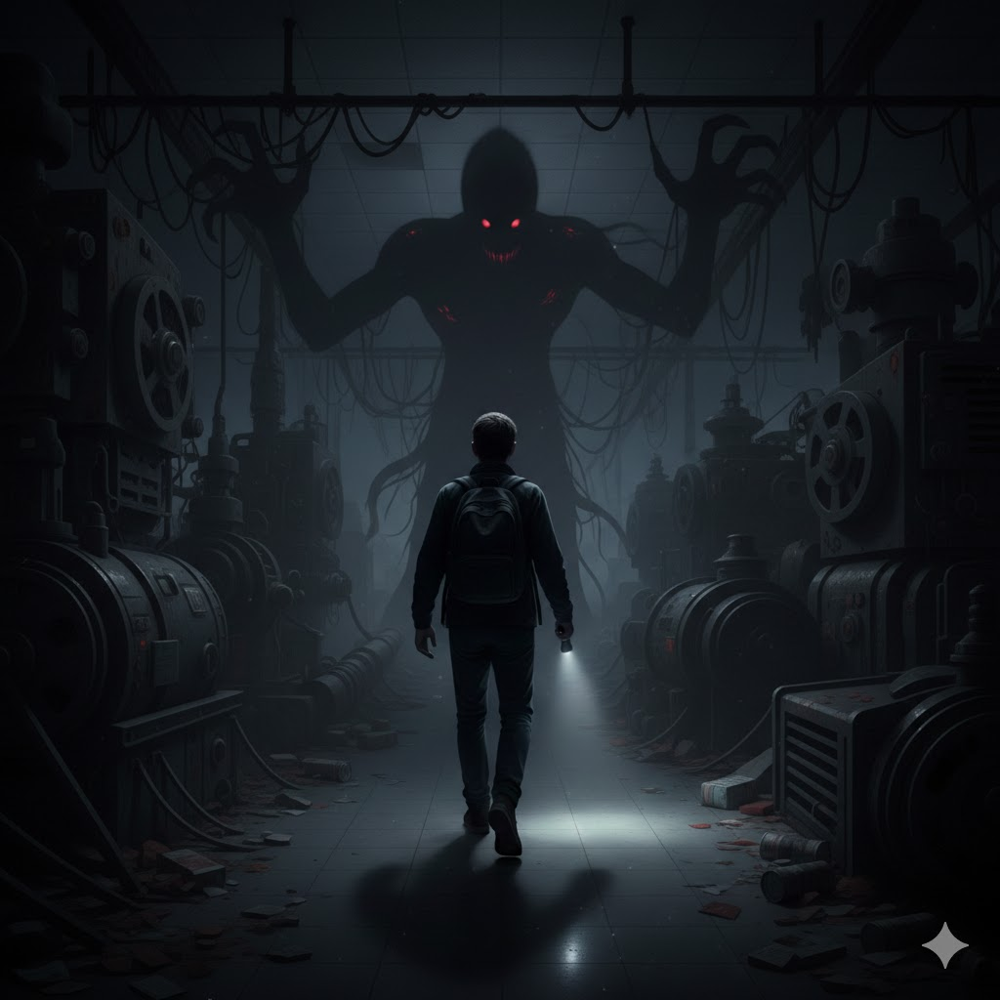
A3 PR-02: Level Design Documentation
Shadow Energy
Zach Hubbard
GAME 724-N01: Immersive Level Design
Winter 2026
By Zach Hubbard

Slide 2

Level Summary
Items and Weapons
Items -
Flashlight – Illuminates Area, when active prevents monster from attacking player.
Batteries – Replenishes Flashlight
Breaker Switches – Serves as checkpoint, permanently illuminates an area. Also is a key component of final boss fight
Keys – keys can be used to unlock some doors.
Notes – Placed to gives more narrative background to the level
Doors
Weapons -
Bat/Wooden Plank –Melee Item for the small enemies, limited durability, scattered around map. Can stun final boss in boss fight.
Flashlight – Serves as both item and weapon to prevent monster from attacking, although monster can get close to you but backs away when flashlight is pointed at the player.
The Three C’s
Character Abilities - The player can:
Pick up and toggle a Flashlight ON/OFF
Sprint
Crouch
Pick up Items
Read Notes
Camera - First-Person Camera Perspective
Controls -
WASD - Movement,
Left Ctrl – Sprint
C – Crouch
F – Toggle Flashlight
E – Pick Up Items
Zoom – Hold Right-Click
Movement Metrics - Walking – 450, Sprinting – 250, Crouching– 120

Slide 3
Level Summary
Bartle Player Type
Achievers – Completing the encounters, avoiding the monster and defeating the boss effectively
Explorers – Exploring the level and the factory space
Summary - You are an urban explorer, always looking for an adrenaline rush inside the next-best abandoned building, and today you find yourself inside an abandoned government power plant. Early in the night, you realize you are not alone like you originally thought. Armed with only a flashlight.
The goal of the level is to explore the linear space through using your flashlight
Making sure the flashlight does not go out by finding batteries, as that gives the monster the ability to strike.
Level Cinematics
Opening – The player awakens on factory floor, armed with only a flashlight.
Closing – The player has defeated the monstrous entity and escaped the factory.
Setting - Set in modern day, inside an old, dark, long abandoned power plant, tight corridors, vents and air ducts that require crouching, some flickering lights
Time of Day - Midnight
Estimated Player Completion Time – Approx. 10-15 Minutes

Slide 4
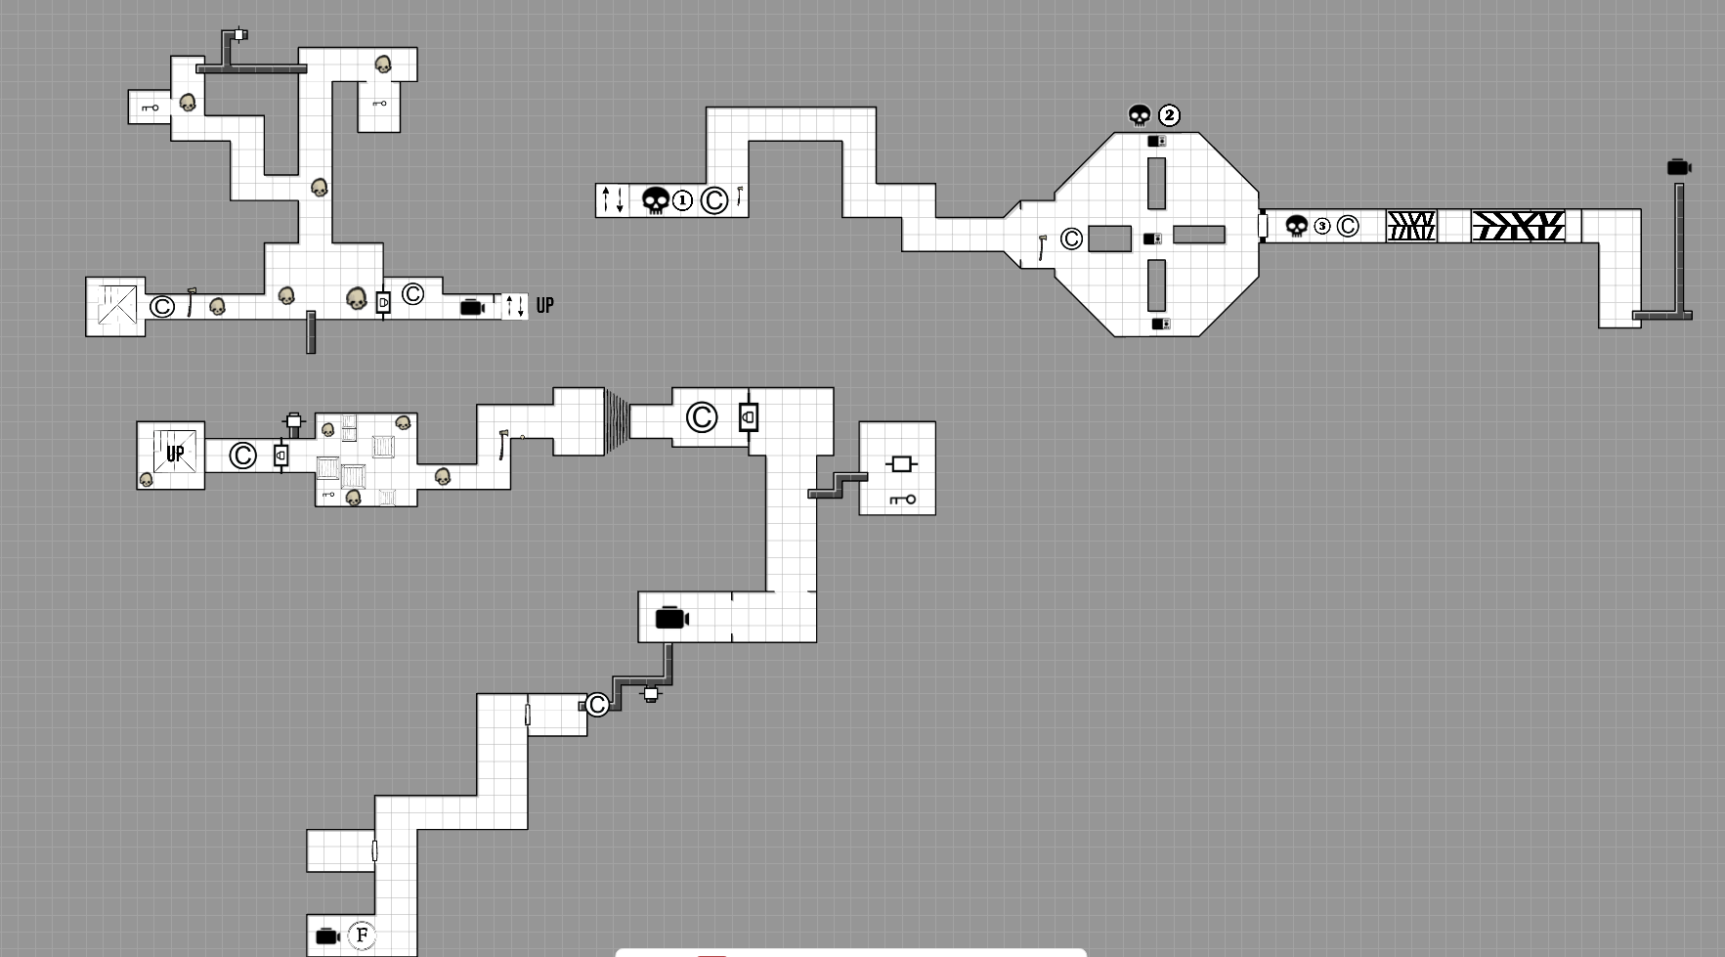












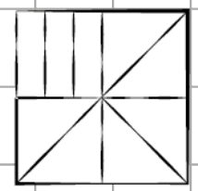

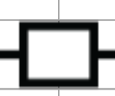


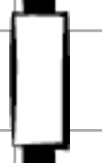






Encounter 2 – Part 2
Encounter 3
Legend
Boss
Flashlight
Small Enemy
Encounter 2 – Part 1
Cinematic
Boss Phase
Vent
Locked Door
Reactor Breaker
Checkpoint
Encounter 1
Key
Chasm
Door
Spiral Stairs
Stairs
Battery
Elevator
Reactor Door
Melee Weapon
Obstacle

Slide 5







Encounter Design Icon Key
Time For Player Completion
Achiever
Player Type
Boss Encounter
Explorer
Player Type
Easy Encounter
Low Intensity
Medium Encounter
Medium Intensity
Hard Encounter
High Intensity

Slide 6
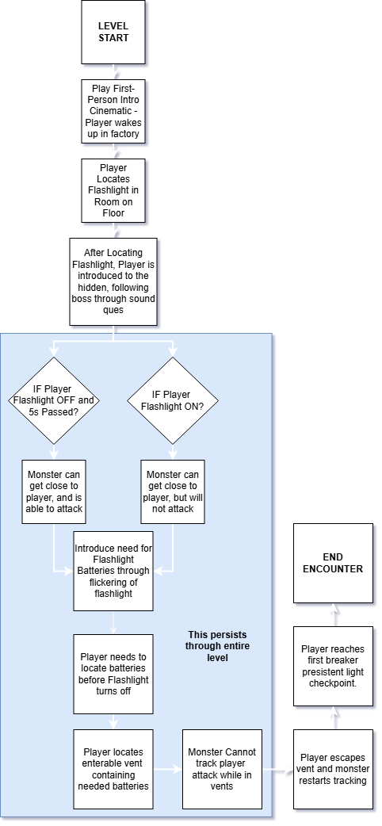
Encounter 1 – Introduction
3:00
Description– This first encounter occurs right at the start of gameplay, focusing on introducing the player to the various gameplay systems, such as using the flashlight and batteries, the first breaker switch checkpoint, all alongside the persistent threat of the large monster tracking the player.
Setting – Power Plant Maintenance Hallways and Offices
Mood – Foreboding
Player Abilities Required – Flashlight, Crouching, Batteries to replenish Flashlight, some sprinting.
Pacing – Starts off Slow but increases steadily as player gains their bearings and the monster slowly approaches them from behind.
Rewards -
Cinematics –
Contains opening cinematic of player waking up in factory
Ending encounter cinematic of player barely escaping boss monster in vent.

Slide 7
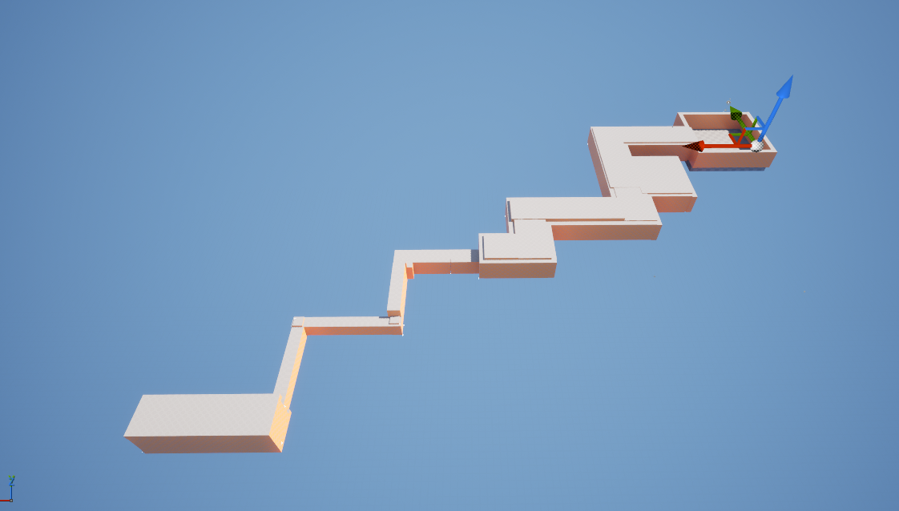
Encounter 1 – Introduction – Block Out

Slide 8
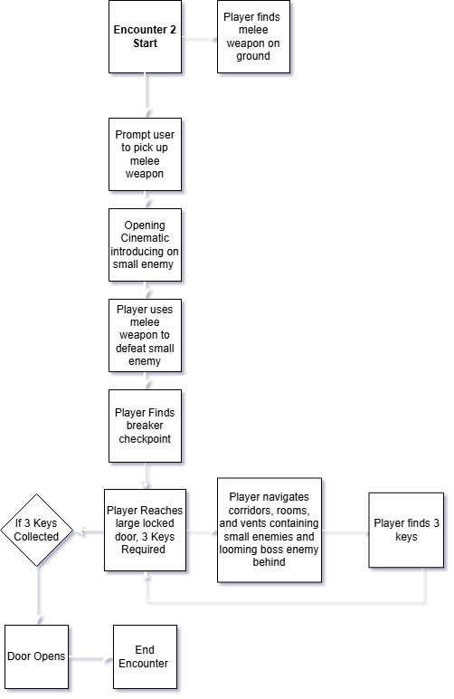
Encounter 2 – Small Enemies
5:00
Description– This encounter introduces a small, agile enemy, in addition to the boss monster chasing you, which adds more danger. The player gains access to melee weapon, while continuing to use the mechanics from the previous encounter to help in completion of this encounter.
Setting – Power Plant Maintenance Hallways and Offices
Mood – Urgency
Player Abilities Required – Flashlight, Crouching, Batteries to replenish Flashlight, some sprinting, key pickups, melee weapons.
Pacing – Medium pacing. Faster paced than previous encounter.
Cinematics –
Opening Cinematic - player waking up in factory.
Ending Encounter Cinematic - Player barely escapes boss monster through crawling in vent.

Slide 9
Encounter 3 – Final Boss Fight
7:00
Description– The final encounter
Setting – Abandoned Power Plant Reactor Core
Mood – Determination
Phase 1 – Chase
Boss Monster begins to evolve to where the flashlight becomes ineffective, leading the boss monster to begin to chase to the player at a much faster pace, leading to a sprinting, crouching and platforming sequence.
Phase 2 – Fight
Boss fight now takes place in a large circular reactor room.
The player now has to overload the reactor by finding three breakers within the reactor room,
Once the reactor is overloaded. The player must escape through a closing blast door out of the reactor room.
Player Abilities Required – All previous mechanics from the past two encounters are required to complete the boss fight.
Pacing – Very fast paced
Rewards - Defeating the boss and then escaping the factory is the level reward.
Cinematics -
Start Phase 1 Cinematic
Start Phase 2 cinematic
Start Phase 3 cinematic
Escape Cinematic
Phase 3 - Escape
Boss has been defeated in reactor
Player must escape the power plant before it destructs.

Slide 10
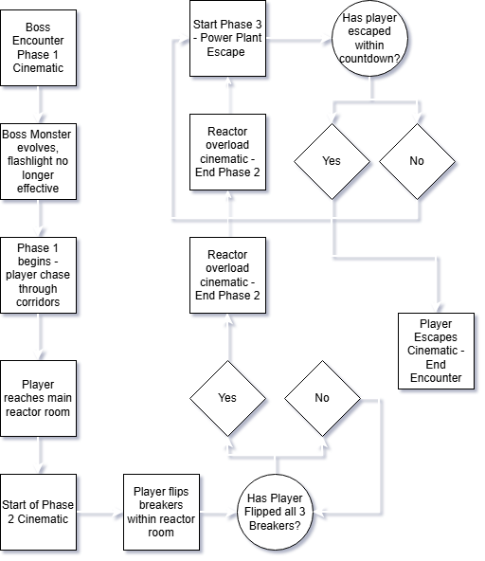
Encounter 3 – 3 Phase Final Boss Fight - UML Diagram

Slide 11
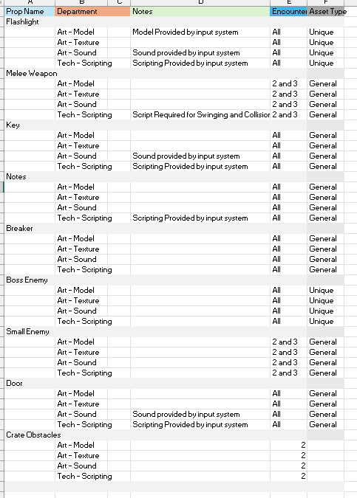
Level Asset List

Slide 12
First-Person Movement Template V1
Credits
Encounter Design Icons created using Google Gemini AI and Adobe Photoshop
Input System – First Person Movement Template V1 by Treety from Fab Store – https://fab.com/s/0842b1e00e26
Dungeon Scrawl Map Creator and Icons used for Level Layout.

