Slide 1


Happiness, alcohol, and suicide
Vadym Zhukhovytskyy

Slide 2
CORRELATION IS NOT CAUSATION

Slide 3
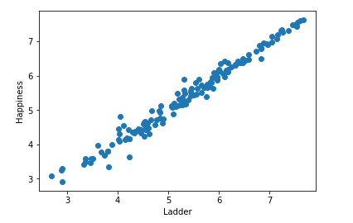
Happiness and life ladder (life satisfaction)
from sklearn.metrics import mean_squared_error, r²_score
Mean Squared Error (MSE): 0.0302
R-squared (R²): 0.981
Conclusion:
Life satisfaction and happiness vary widely both within and among countries. It only takes a glimpse at the data to see that people are distributed along a wide spectrum of happiness levels.

Slide 4
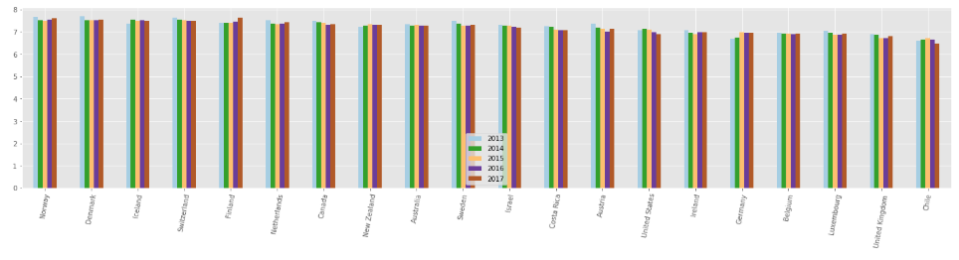
Dynamics of happiness change during 2012 – 2017 years
Conclusion:
Tiny difference in happiness index across twenty of the most
developed countries in the world during 5 years.

Slide 6
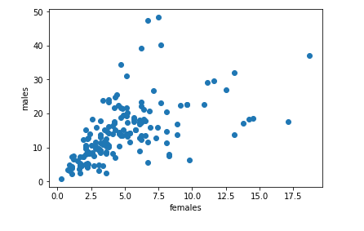
Happiness (male – female relationship)
MSE: 63.1
R²: 0.329
R² << 90%
Nevertheless there is some correlation:
the more females are happy, the more males feel happiness themselves.
I am pretty sure that it is extremely important conclusion!

Slide 8
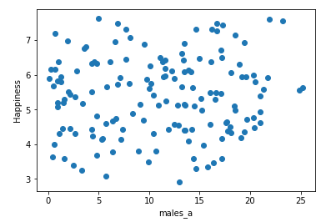
Happiness – alcohol: Complicated
MSE: 1.595
R²: -0.007
For many, alcohol is described as a fun, social substance. Drinking alcohol can make people feel happy in the moment…
https://www.alcohol.org/guides/alcohol-fueled-emotions/
Mean Squared Error (MSE): 1.5947892230894452 R-squared (R2 ): -0.007098066653168589
In [62]:

Slide 9
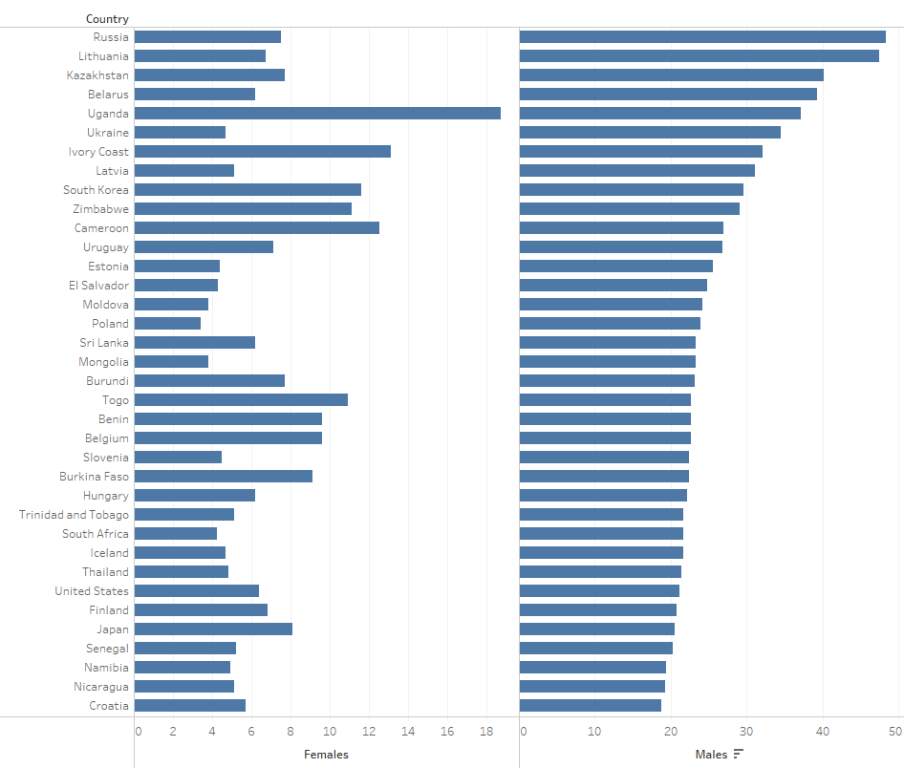
Suicide around the world
Females
Males

Slide 10
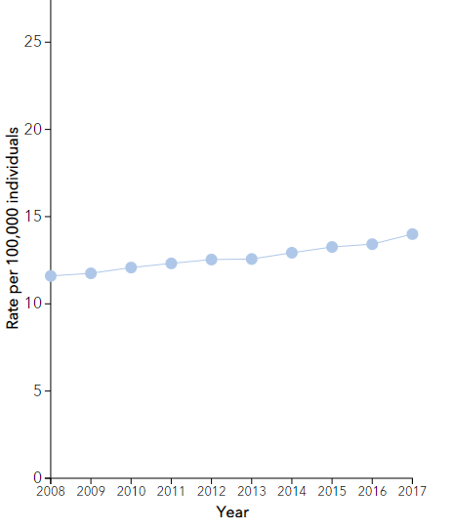
Suicide rates in the United States
R² = 0.922
In 2017, more than 151,000 Americans died of suicide or causes related to drugs or alcohol—the highest rate in U.S. history, according to a new study by Trust for America's Health and Well Being Trust.

Slide 11
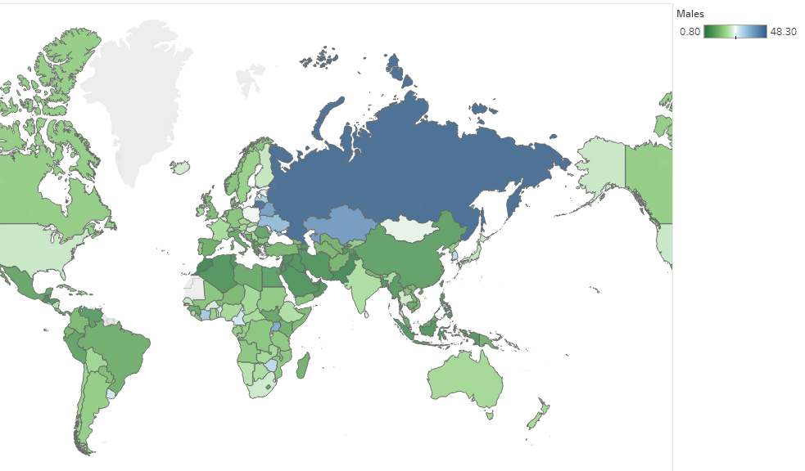
Suicide around the world (male)
48.3
15.1
40.1
21.1
7.1
17.4
Notes:
In this entry, we discuss the data and empirical evidence that might answer these questions. Our focus here will be on survey-based measures of self-reported happiness and life ladder (life satisfaction). Here is a preview of what the data reveals.

Slide 12
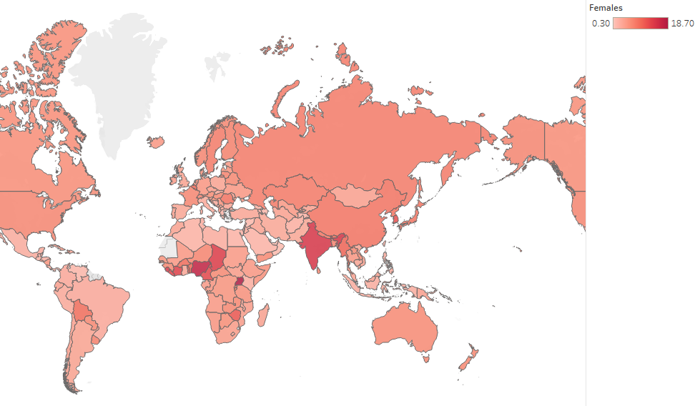
Suicide around the world (female)
7.50
5.80
7.70
6.40
8.30
6.10

Slide 13
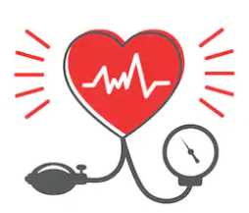
Suicide around the world
Most of the countries I showed report a higher male than female suicide rate:
about 3 male suicides for 1 female suicide
Conclusion: Take care of men!

Slide 14
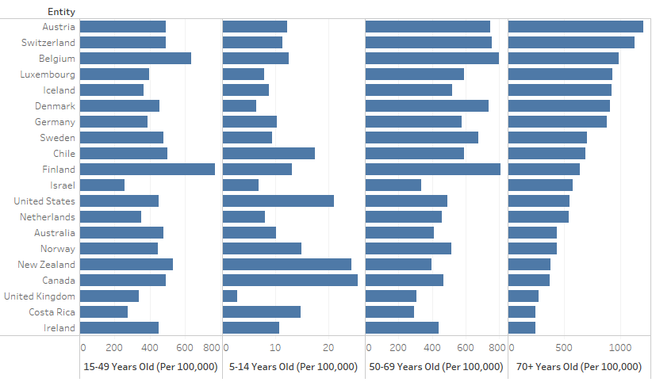
Suicide around the world and age
Kimberly Van (Orden, University of Rochester):
“Older adults tend to die on their first attempt. Their frailty often makes them less likely to survive; their isolation makes them less likely to be rescued and they tend to be more planful and determined in their suicidal behavior.”

Slide 15
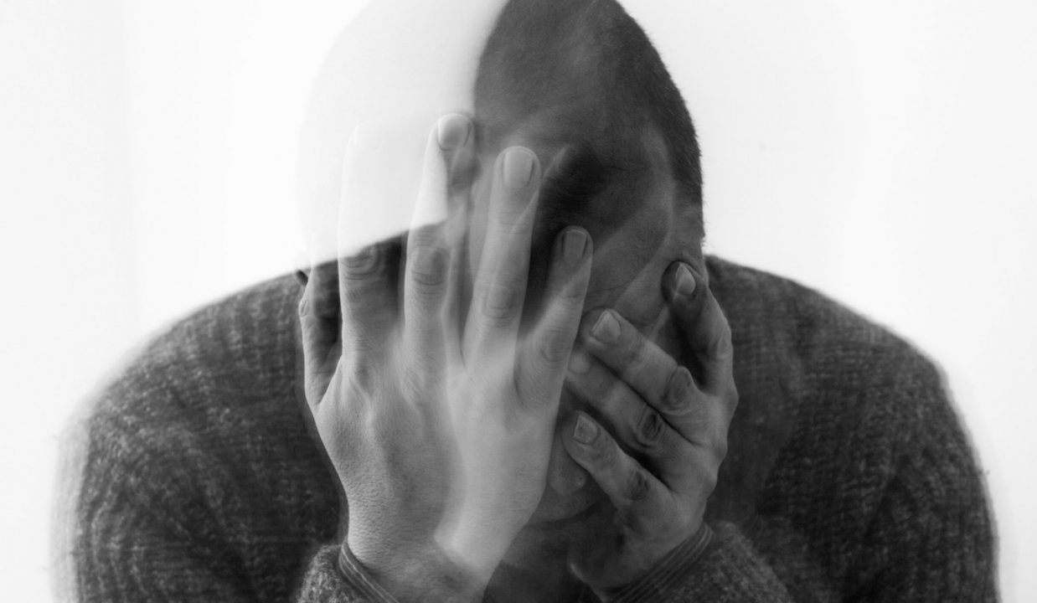
Older adults: Risk factors
Depression
Prior suicide attempts
Other medical conditions
Physical pain
Social dependency or isolation
Family discord or loss
Inflexible or rigid personality
Access to lethal means
https://www.newsweek.com/machine-learning-algorithms-can-predict-suicide-risk-more-readily-clinicians-561732

Slide 16
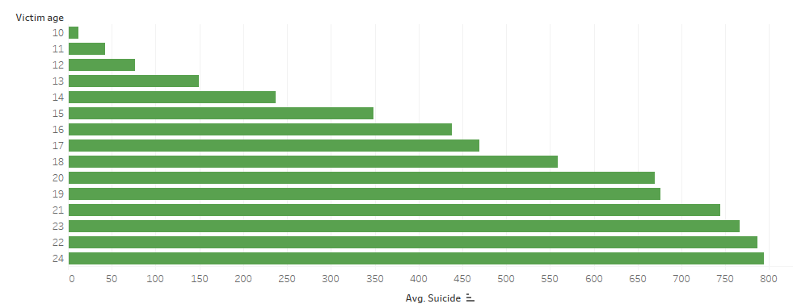
Average suicide at 10–24 years old
Conclusion:
Deaths by suicide because of drugs and alcohol reached an all-time high in the last years

Slide 17
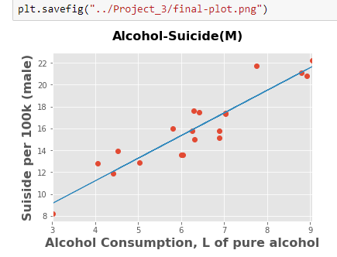

Alcohol—Suicide (male)
Conclusion:
Alcohol consumption is a cause of increasing number of suicides in men

Slide 18
Summary
Drinking alcohol is correlated with increased rates of suicide. Now there is evidence that suicide risk among alcoholics increases as they become older as well.
Suicide rates in general increase with age.
Life satisfaction and happiness vary widely both within and among countries
Alcohol is a tricky substance. It may cause our body to make us feel relaxed, but it's also classified as a depressant. https://www.alcohol.org/guides/alcohol-fueled-emotions/

Slide 19


Acknowledgements
Student success manager: Angelica
Instructors: Grant and Dave
TAs: Cate, Phillip, and Kevin
Classmates

Slide 20
Questions?

