Slide 1
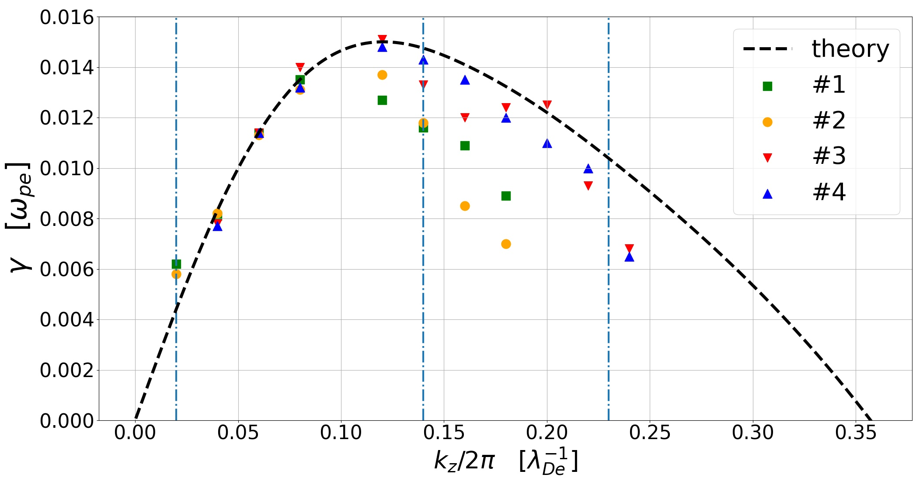
Resolved by #1 & #2
Resolved by #3 & #4

