Slide 1
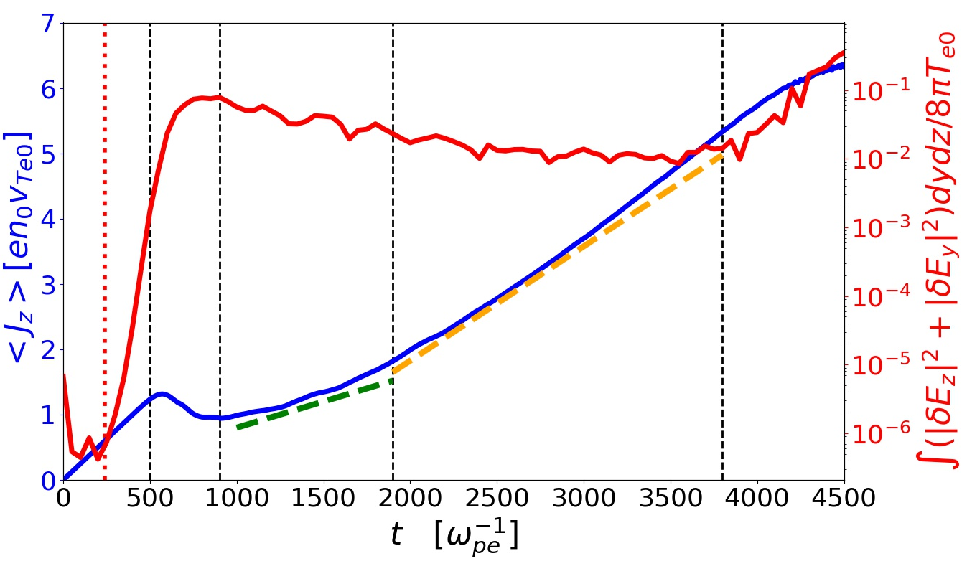
I
II
III
IV
V
EAW burst

