Slide 1
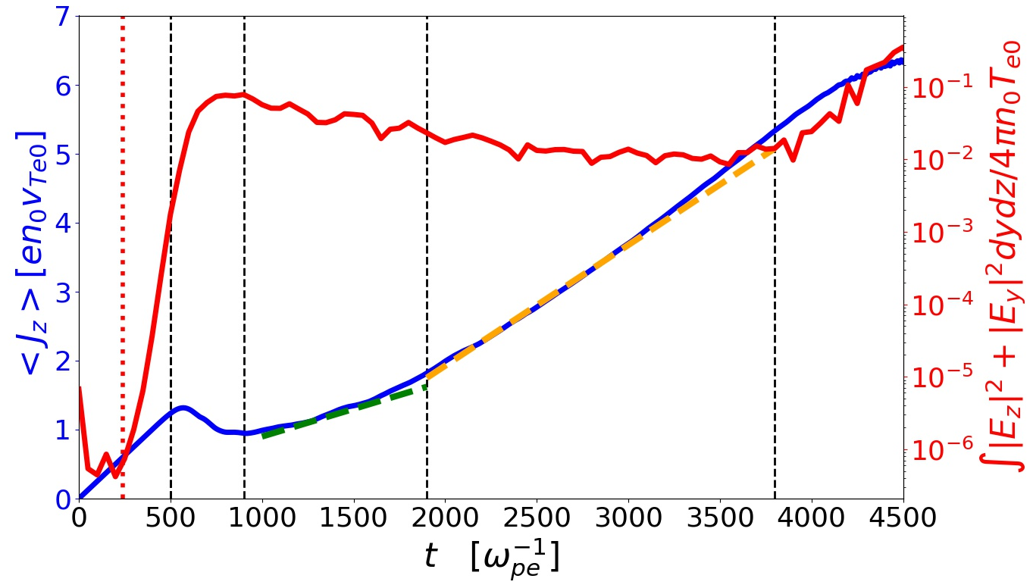
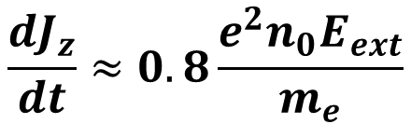
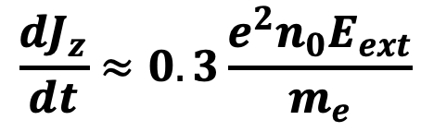
I
II
III
IV
V
EAW burst
$$\frac{dJ_{z}}{dt}≈0.8\frac{e^{2}n_{0}E_{ext}}{m_{e}}$$
$$\frac{dJ_{z}}{dt}≈0.3\frac{e^{2}n_{0}E_{ext}}{m_{e}}$$

