Slide 1
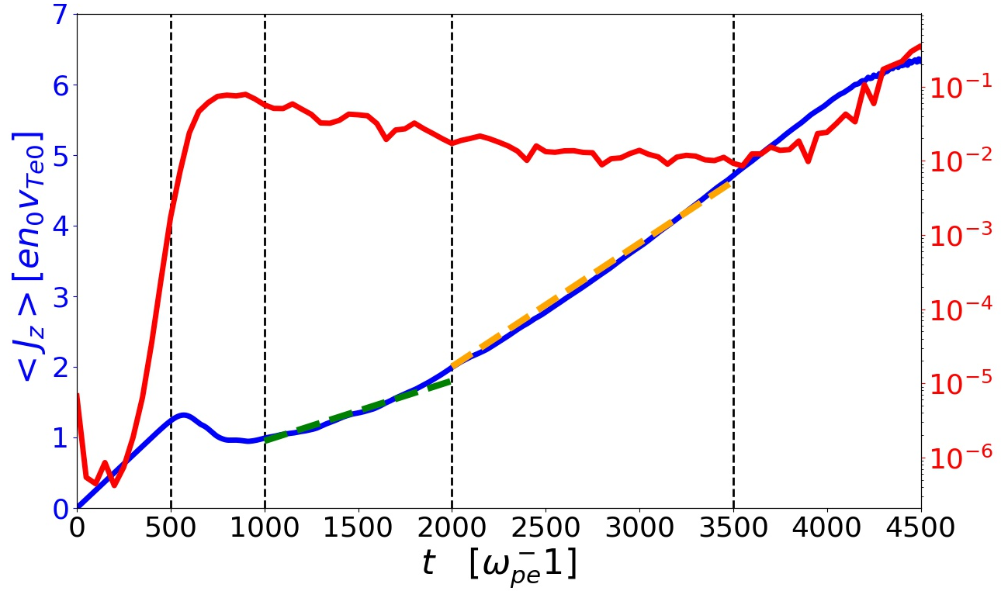
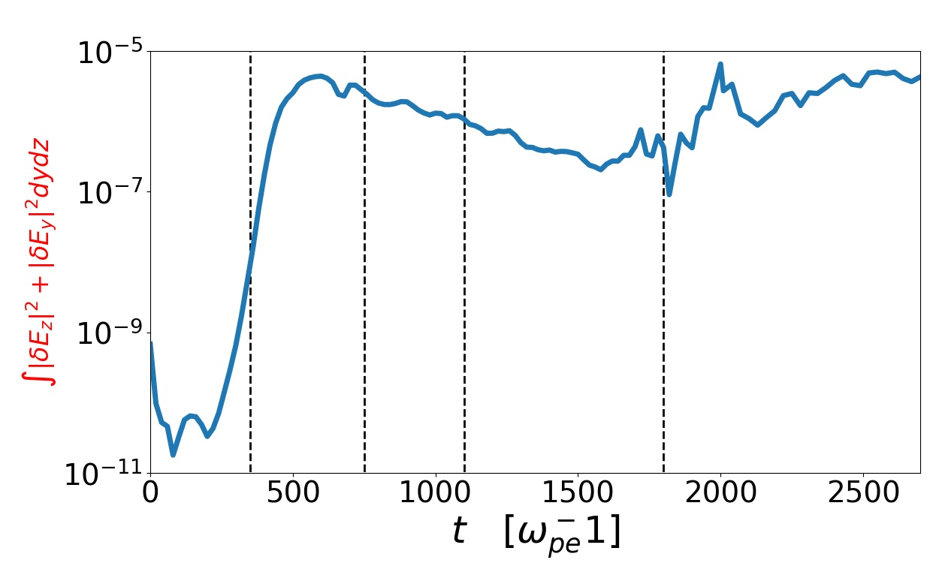
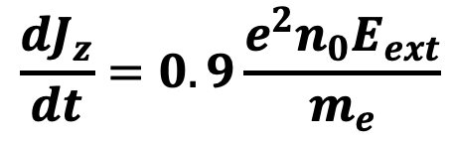
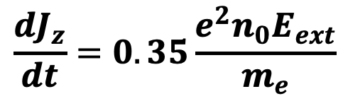
I
II
III
IV
V
EAW burst
$$\frac{dJ_{z}}{dt}=0.9\frac{e^{2}n_{0}E_{ext}}{m_{e}}$$
$$\frac{dJ_{z}}{dt}=0.35\frac{e^{2}n_{0}E_{ext}}{m_{e}}$$

Slide 2
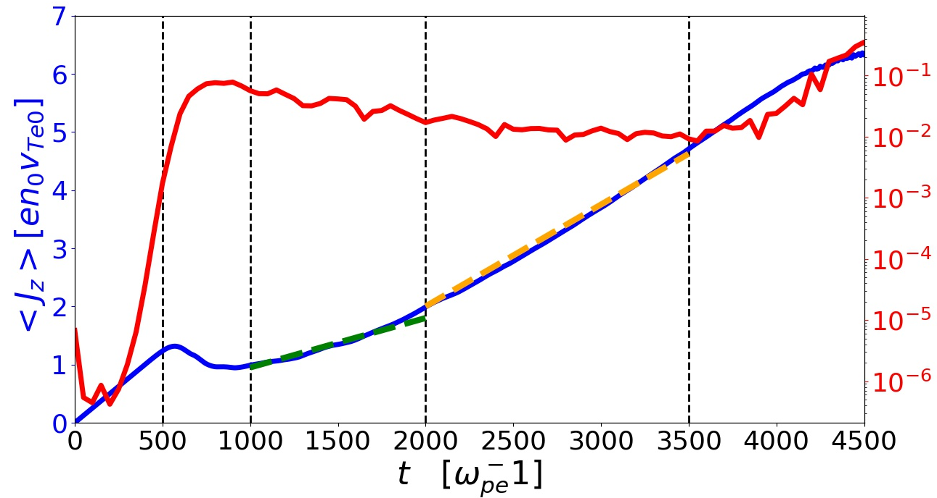

Slide 3
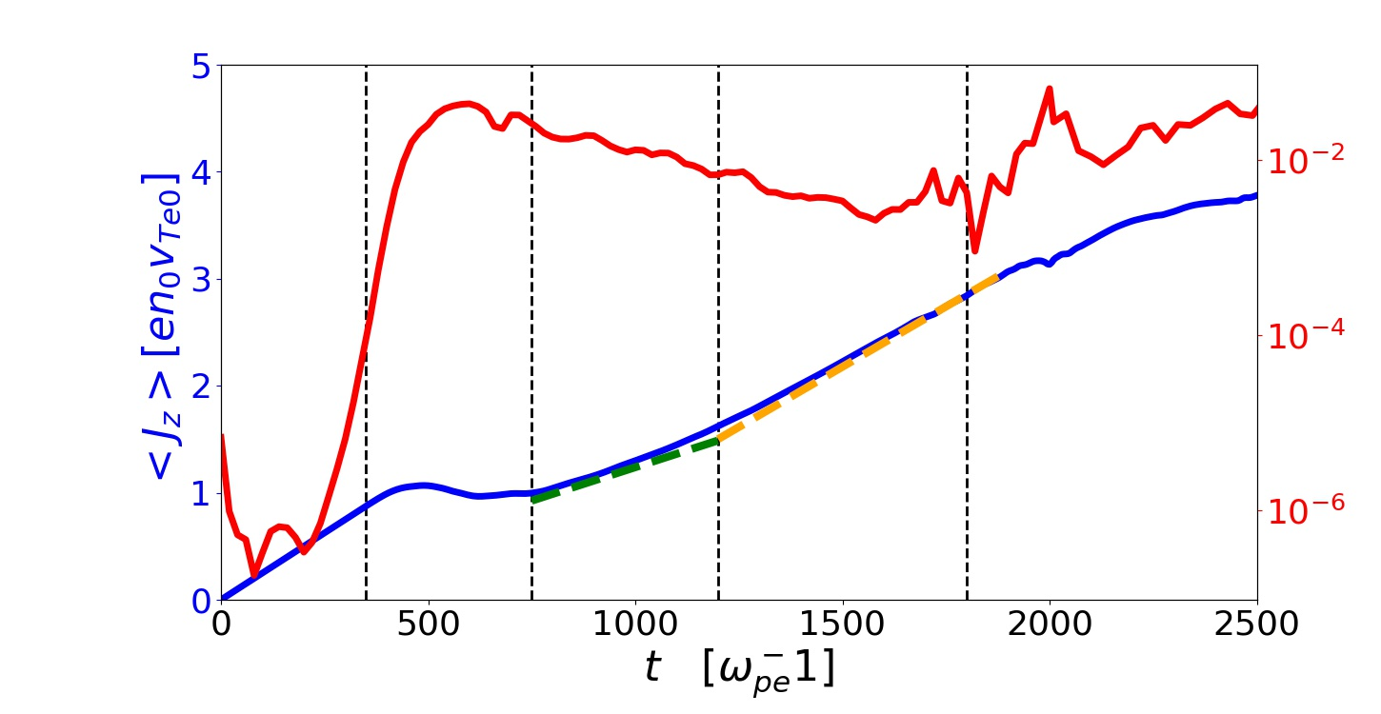
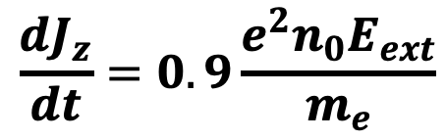
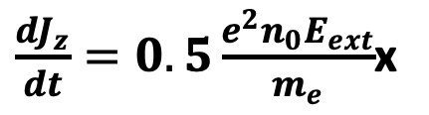
I
II
III
IV
V
EAW burst
$$\frac{dJ_{z}}{dt}=0.9\frac{e^{2}n_{0}E_{ext}}{m_{e}}$$
$\frac{dJ_{z}}{dt}=0.5\frac{e^{2}n_{0}E_{ext}}{m_{e}}$x

