Slide 1
Smart Plug
Date: March 7, 2022
Notes:
Zoom link: https://ucr.zoom.us/j/98007689673?pwd=YUo1WVowY2ZLcjB3cUVqTXhNcVhYQT09

Slide 2
Concept and Application of the Design
A socket remote control system
Two sockets, a remote controller and a phone application.
Lora
IoT - smart home
Purpose: Remotely turn on/off the socket and the remote controller and application are able to show the status of each socket.
Circuit designs, embedded systems, and software development
Notes:
Slide 2: Concept and application of the design: What did you design, technical principles, why this is a meaningful project, what are the intended applications, how is it related to subjects in electrical engineering.
We designed a socket remote control system, which include two sockets, a remote controller. The key feature of this system is to achieve long-distance control and Lora is the main technology that we used. Lora has a low frequency compared to wifi and Bluetooth in order to achieve the long-distance communication. About why this is a meaningful project, we believe that IoT(Internet of things) is the future and smart home is the indispensable part.

Slide 3
Technical Design Objectives
The remote controller is able to control the socket 0.5 mile away in the open air.
The response time of using application or remote controller to control the socket should be within 1 second.
The new state of the socket will update on the application with a delay of 250 ms to 2000ms.
Transformer will transfer 110V AC to 5V DC to power the STM32, and 3.3V to power the ESP8266.

Slide 4
Final High-level Design
Legend
System Module
Outer Module
Power
Sockets(Plugs)
Communication
Remote Controller
LoRa
915MHz
Socket 1
Downstream
Electrical Appliances
APP on Android
Router
Socket 2
Web
Server
WiFi 2.4GHz
~
110V AC

Slide 5
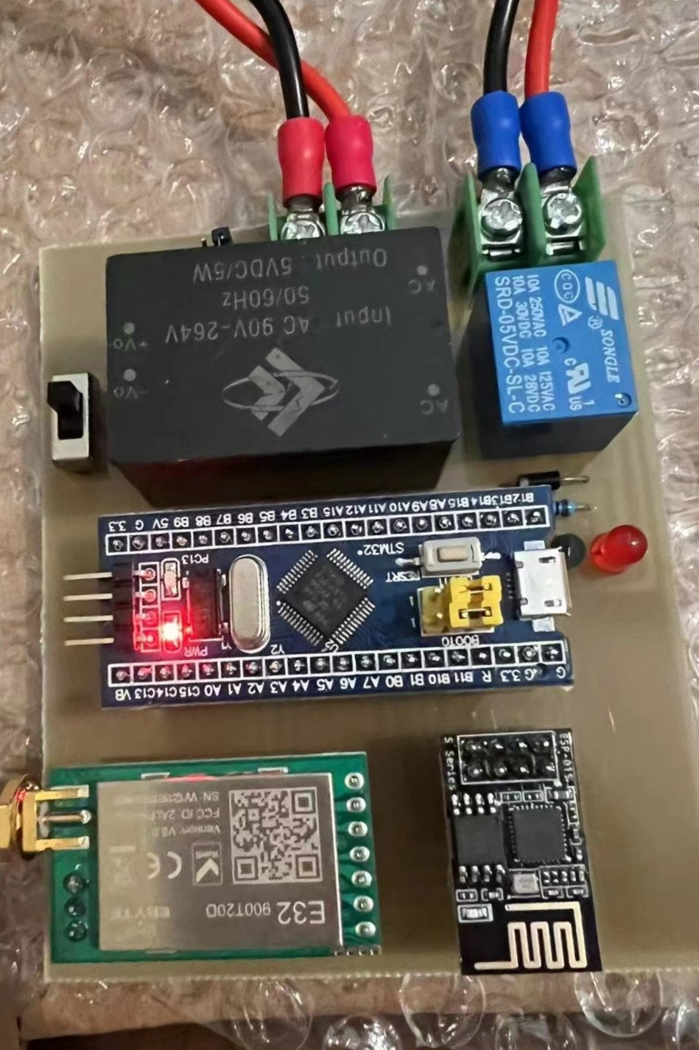
Final Low-level Design: Socket(Plug)
Transformer
(120V AC to
5V DC)
120V AC
Relay
AC Input
120V 50Hz
AC Input
120V 50Hz
5V DC
GPIO
STM32F103
(Blue Pill)
UART
5V DC
3.3V DC
UART
LoRa Module
(SX1276)
WiFi Module
(ESP8266)
LoRa 915MHz
WiFi 2.4GHz
LED
Socket ID Jumper

Slide 6
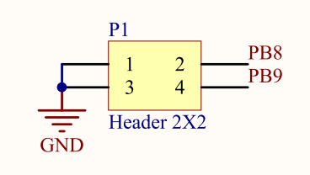
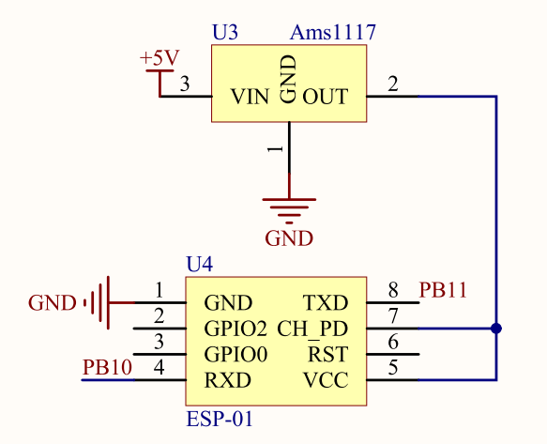
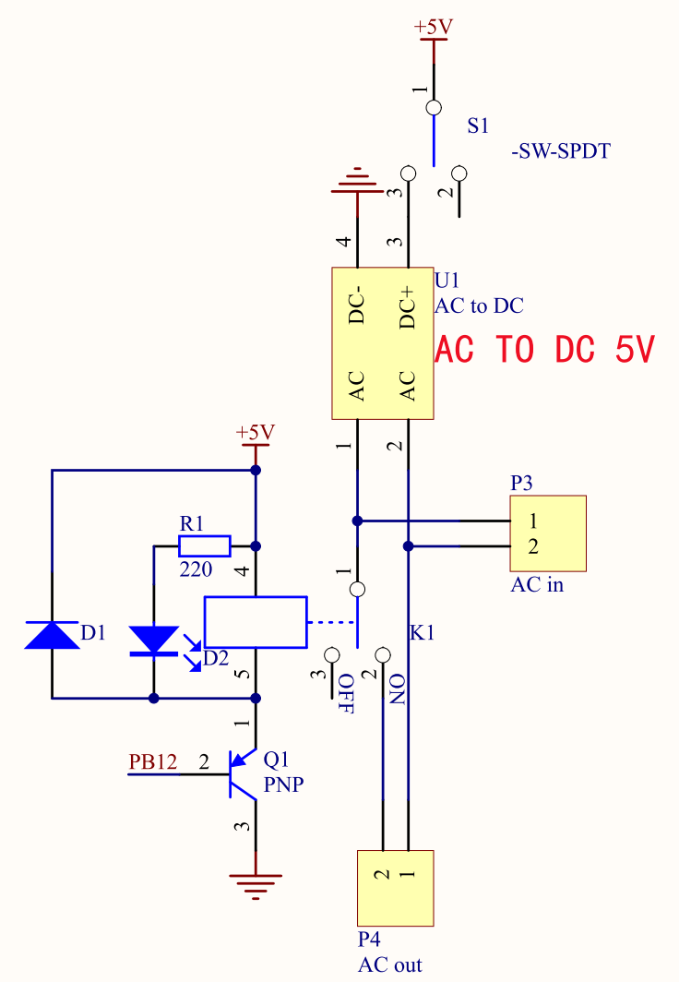
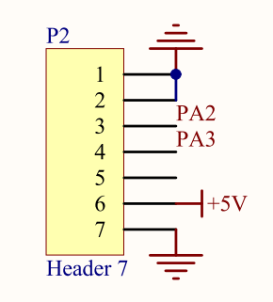
Socket(Plug) Circuit Diagram
Socket ID Jumper
WiFi Module
Transformer and Relay
LoRa Module

Slide 7
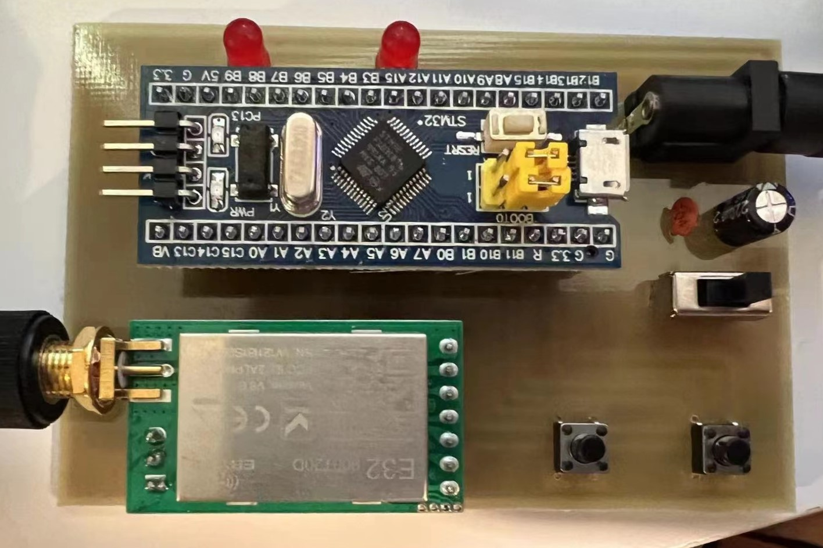
Final Low-level Design: Remote Controller
Button 1
Button 2
GPIO
GPIO
STM32F103
(Blue Pill)
LED1
5V DC Input
LED2
UART
LoRa Module
(SX1276)
LoRa 915MHz

Slide 8
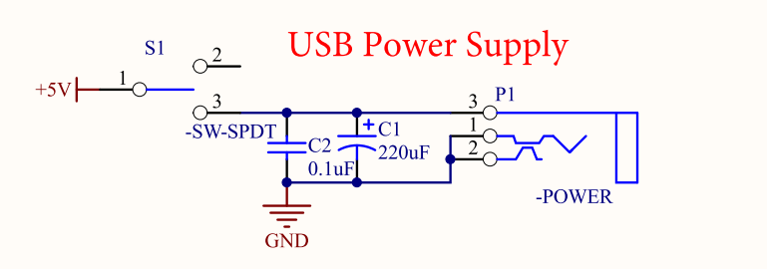
Remote Controller Circuit Diagram
LoRa Module
USB Power Supply

Slide 9
Final Low-level Design: Device Flow Charts
main()
main()
Init()
Init(): dalay, interrupt control, clock,GPIO,UART
Socket ID Pin Identify
while(1):
while(1):
Timer handler: Iterate millisecond counter variable
UART Receive?
UART handler: Blink LED
Timer
UART Receive?
UART handler: handle plug state change from remote controller
Button1 Clicked?
Send Socket1 Control Byte
Per 1s
Check if WiFi module receive change(AT)
Update Plugs, set connection counter variable
Button2 Clicked?
Send Socket2 Control Byte

Slide 10
Final Low-level Design: App Flow Charts
mainActivity()
initView: App interface
initData: server ip, port
initEvent: build TCP Connection
onCreate()
Override method handleMessage()
Message Types: Connection states
“success, timeout, error, read…”
read: update plugs states
Customized Handler
onDestroy()
“App Destroy”

Slide 11
Technical Challenges
Hardware Issues:
Devices: STM32, LoRa
PCB board design
Programming Issues:
Interface Protocols
C programming language
Connectivity Issues:
Network Communication Protocol
WiFi module(Parse AT Command)
Mobile Application Development
Extensibility
Communication Safety

Slide 12
Major Components & Work Distribution
Hardware
Zhuocheng
Sockets
STM32
Zhengxuan
LoRa
Zhengxuan
ESP8266
Zhengxuan
Hardware
Zhuocheng
Remote Controller
System Integration
STM32
Yaoteng
LoRa
Yaoteng
App/Server
App development
Yaoteng
Server solution
Zhuocheng

Slide 13
Design Consideration
Realistic Constraints
Internal Power Consumption
Designed to run continuously
Low power MCU, LoRa, and Wi-Fi Modules
Maximum internal power: <1 W for sockets, <0.7 W for remote controller
Weight & Size
Compact design
Highly integrated
Light weight
Safety
AC power source
Isolation & insulation
Minimize wires
Printed PCBs & conformal coating
Budget
Under $100

Slide 14
Industry Standards
LoRa
IEEE Standards Association. IEEE 802.11ah-2017: IEEE standard for 900 MHz license-exempt bands to provide extended-range networks.
ESP8266
IEEE Standards Association. IEEE 802.11n-2009: IEEE standard for wireless networking that uses multiple antennas to increase data rates.

Slide 15
Test Plans
Test 1: Test voltages over major components
Measure voltages over major components when system is under different states
Expected value:
STM32 - 5 V (Working range 4.7 V - 5.5 V)
LoRa - 5 V (Working range 2.3 V - 5.5 V)
ESP8266 - 3.3V (Working range 3 V - 3.6 V)

Slide 16
Components | Minimum voltage (V) | Maximum voltage (V) | Percentage error comparing to typical values | In working voltage range (Yes/No)
STM32 in socket A | 4.95 | 5.05 | -0.1% ~ 1.0% | Yes
STM32 in socket B | 4.89 | 5.01 | -2.2% ~ 0.2% | Yes
STM32 in remote controller | 4.93 | 4.99 | -1.4% ~ -0.2% | Yes
LoRa in socket A | 4.83 | 4.91 | -3.4% ~ -1.8% | Yes
LoRa in socket B | 4.91 | 5.03 | -1.8% ~ 0.6% | Yes
LoRa in remote controller | 5.01 | 5.06 | 0.2% ~ 1.2% | Yes
ESP8266 in socket A | 3.29 | 3.37 | -0.3% ~ 2.1% | Yes
ESP8266 in socket B | 3.25 | 3.33 | -1.5% ~ 0.9% | Yes
Results
All voltages within range
Largest percentage error comparing to typical value: -3.4 %

Slide 17
Test 2: Test LoRa communication range
Test control range of system based solely on the remote controller
Expected range:
> 3 km - in line of sight
> 0.8 km - residential areas

Slide 18
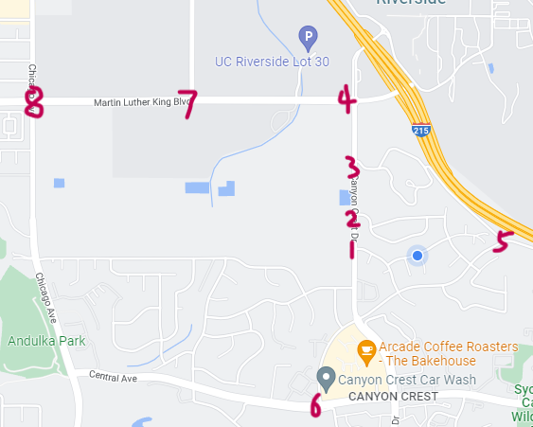
Results
Maximum range: 1.36 km (0.85 miles)
Control range significantly larger than bluetooth, Wi-Fi, etc
Location # | Distance (km) | Controllability (Yes/No)
1 | 0.31 | Yes
2 | 0.36 | Yes
3 | 0.56 | Yes
4 | 0.82 | Yes
5 | 0.44 | Yes
6 | 0.9 | Yes
7 | 1.36 | Yes
8 | 2.04 | No

Slide 19
Test 3: Test system algorithms and synchronization
Test if the system correctly reacts to commands & if the status synchronizes correctly among sockets, remote controller, and app
Use MATLAB to randomly generates 4 arrays of 100 commands and test with different initial states

Slide 20
System initial states (socket A, socket B) *For sockets: 1 = ON, 0 = OFF | Command *1 = press button A on the remote controller, 2 = press button B on the remote controller, 3 = press button A on the app, 4 = press button B on the app
0,0 | 2 4 4 2 2 3 3 1 1 1 1 2 3 4 3 4 1 3 4 2 4 4 1 3 1 1 2 2 2 2 2 3 4 1 2 3 4 4 3 1 3 4 1 2 2 2 2 4 1 1 4 3 2 2 3 3 3 4 1 2 1 3 4 3 1 1 4 1 4 2 2 1 4 2 2 2 2 2 3 3 1 1 2 4 4 3 2 4 2 1 3 4 4 4 4 3 4 4 3 4
0,1 | 4 4 2 4 4 4 4 2 4 4 2 1 4 3 4 2 2 3 4 3 2 2 2 1 3 4 3 2 4 4 4 3 3 2 3 4 2 3 2 3 1 1 1 3 4 4 3 1 3 4 4 2 2 1 3 3 1 2 2 4 4 3 1 3 3 2 1 2 4 2 4 3 4 4 3 3 3 1 4 4 3 2 2 1 3 3 3 1 1 2 2 4 4 4 1 1 3 3 3 2
1,0 | 2 2 1 1 3 2 4 3 3 3 4 2 4 4 4 1 2 2 3 1 2 4 2 1 4 3 1 2 3 3 2 3 1 4 4 2 4 2 3 1 3 3 1 1 2 2 4 1 4 1 2 2 4 1 4 3 2 4 3 2 4 2 4 3 4 3 1 4 4 1 3 2 3 2 4 3 3 1 2 2 4 4 3 4 4 3 4 2 2 1 4 2 4 4 2 2 1 4 3 2
1,1 | 4 3 3 3 4 1 2 2 1 1 4 1 4 3 1 1 4 2 4 1 4 1 4 4 3 4 3 4 3 1 4 3 4 2 1 3 2 1 4 3 4 2 4 4 2 4 2 1 2 1 1 3 3 3 3 4 1 3 3 3 4 2 1 2 4 2 2 1 2 3 4 3 3 4 2 2 2 3 2 2 3 4 4 4 3 2 1 1 3 4 3 4 1 3 2 1 4 2 1 4
Number of total commands tested | 400
Accuracy | 100%
Results
Accuracy: 100%
No major issues

Slide 21
Test 4: Test system behavior under intensive commands
Test system behavior when users press buttons on remote controller/app rapidly
Expected results:
System not designed for high speed communication
Desynchronization may happen

Slide 22
User behavior | Interval between commands (ms) | System behavior
Pressing buttons on the remote controller rapidly | 1000 | Normal
 | 500 | Normal
 | 333 | Normal
 | 200 | LEDs on the remote controller desynchronize at a probability of 50%
Pressing buttons on the app rapidly | 1000 | Normal
 | 500 | Normal
 | 333 | Normal
 | 333 | Normal
Pressing buttons both on the remote controller and the app rapidly | 1000 | Normal
 | 500 | Normal
 | 333 | Normal
 | 200 | LEDs on the remote controller desynchronize at a probability of 60%
Results
System may desynchronize when LoRa modules send and receive at the same time (commands interval < 300 ms)
No issue for app/ESP8266
System re-synchronize after users returning to normal behavior
Analysis & improvement
SX1276 LoRa Module: half-duplex
Possible solutions:
Add 1 extra LoRa module to socket and remote controller: dedicated for sending/receiving
Full-duplex LoRa module: hardly available for personal buyers

Slide 23
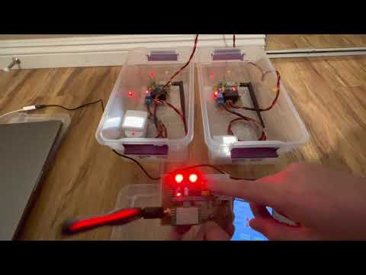
Video Demo

Slide 24
Summary
Thanks to the LoRa, we greatly extend the control range of the remote controller compared to those using traditional Bluetooth and IR techniques. And users are able to use this feature without Internet connections by using the remote controller within a suitable distance. It makes our project broadly applicable. Furthermore, by using the server and phone app, the users can control the sockets and monitor their status from everywhere from the world as long as they have Internet connections. All these features promote a convenient life.

Slide 25
Acknowledgement
Dr. Roman Chomko
Faculty advisor
Reviews and supervises project
Offers technical advice
Cody Simons
Section teaching assistant
Reviews and supervises project
Offers technical advice and helps
Manglai Zhou
Research & development engineer
Offers advice on PCBs and hardware designs
Gang Zhao
Provides a server of Alibaba cloud.

