Slide 1

Analysis of Used Vehicle
With A Prediction of Value
Hanzhong Gao
Zhuohan Yu
Aaron Yang
Team B

Slide 2
Background Introduction
Second-hand vehicle has a huge market base.
price of a vehicle will reduce because of its age, mileage, damage etc.
Look for potential influences on the values of used vehicle
Produce strategies based on the analysis.

Slide 3
Background Introduction
SMART Questions
Understand and analyze what factors have impact on the value of a used vehicle most.
The influence of a vehicle’s brand, body type, fuel type and gearbox type on the value of the vehicle.
The influence of a vehicle’s milage, engine power and whether the car has been damaged or not on the value of the vehicle.
Predict the value of each used vehicle in our dataset.
Give suggestions on how to buy a used vehicle with high-cost effectiveness.

Slide 4
Dataset Introduction
-31 variables, over 200,000 observations
-15 variables are anonymous we will drop them later.
-150,000 observations will be train set and 50,000 observation will be test.

Slide 5
Factors That Have Impact on The Value
Vehicle’s brand, Body type, Fuel type and Gearbox type
    EDA
    Model

Slide 6
Factors That Have Impact on The Value 2
    Vehicle’s milage, Engine power and whether the Car has been damaged or not
    EDA
    Model

Slide 7
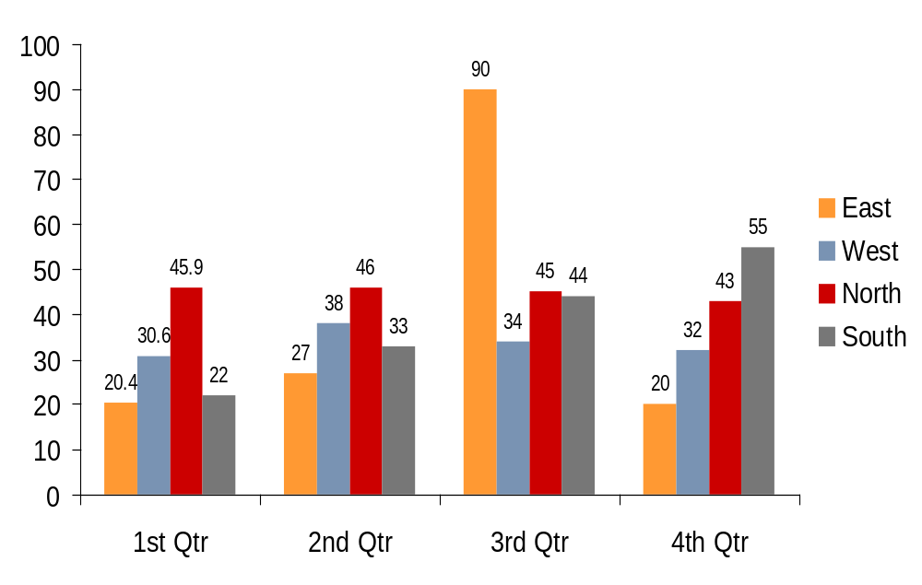
Model Instruction
Subheading (first level text)
  Bullet 1 (second level text)
    Bullet 2
      Bullet 3
        Bullet 4

Slide 8
Value Prediction
Subheading (first level text)
  Bullet 1 (second level text)
    Bullet 2
      Bullet 3
        Bullet 4

Slide 9
Suggestions on Buying a Used Vehicle
Subheading (first level text)
  Bullet 1 (second level text)
    Bullet 2
      Bullet 3
        Bullet 4

Slide 10
Conclusion
    Conclusion for SMART question 1
    Conclusion for SMART question 2
    Conclusion for SMART question 3

