Slide 1

Analysis of Used Vehicle
With A Prediction of Value
Hanzhong Gao
Zhuohan Yu
Aaron Yang
Team B

Slide 2
Background Introduction
Second-hand vehicle has a huge market base.
price of a vehicle will reduce because of its age, mileage, damage etc.
Look for potential influences on the values of used vehicle
Produce strategies based on the analysis.

Slide 3
Background Introduction
SMART Questions
Understand and analyze what factors have impact on the value of a used vehicle most.
The influence of a vehicle’s brand, body type, fuel type and gearbox type on the value of the vehicle.
The influence of a vehicle’s milage, engine power and whether the car has been damaged or not on the value of the vehicle.
Predict the value of each used vehicle in our dataset.
Give suggestions on how to buy a used vehicle with high-cost effectiveness.

Slide 4
Dataset Introduction
-31 variables, over 200,000 observations
-15 variables are anonymous we will drop them later.
-150,000 observations will be train set and 50,000 observation will be test.

Slide 5
Factors That Have Impact on The Value
Vehicle’s brand, Body type, Fuel type and Gearbox type
    EDA
    Model
    Value Prediction

Slide 6
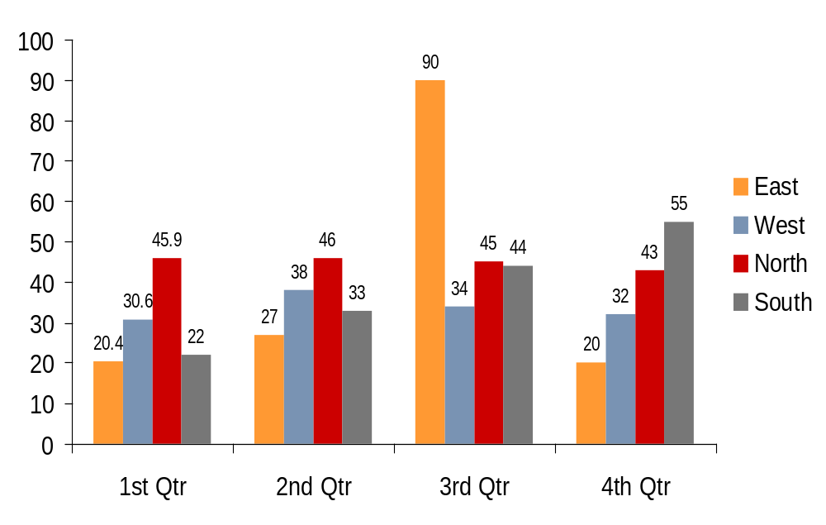
Model Instruction
EDA
  Normality
    QQ PLOT
      Bullet 3
        Bullet 4
Model Evaluation

Slide 7
Model Instruction
Model
  Hypothesis Testing
    Hypothesis
        Null
        Alternative
  PCA
  Machine Learning
    Classification
    KNN
      Bullet 3
        Bullet 4

Slide 8
Value Prediction
Subheading (first level text)
  Bullet 1 (second level text)
    Bullet 2
      Bullet 3
        Bullet 4

Slide 9
Damage Factors Impact
    Vehicle’s milage, Engine power and whether the Car has been damaged or not
    EDA
    Model
    Value Prediction

Slide 10
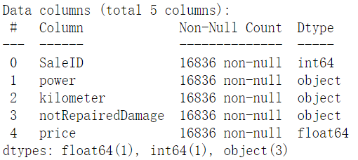
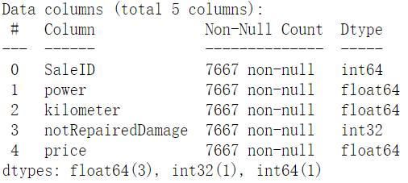
EDA
Before
Data Processing
  Drop NA
  Change Type
  Drop Outerliers
After

Slide 11
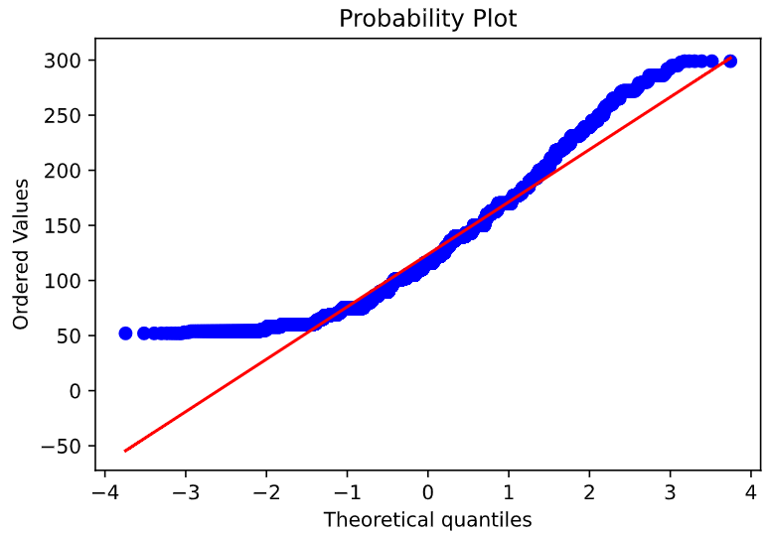
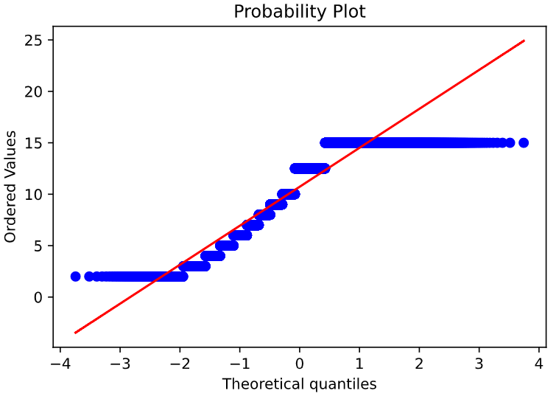
EDA
Power
Model Check
  Noramlity
    QQ Plot
    Histogram
    Boxplot
Kilometer

Slide 12
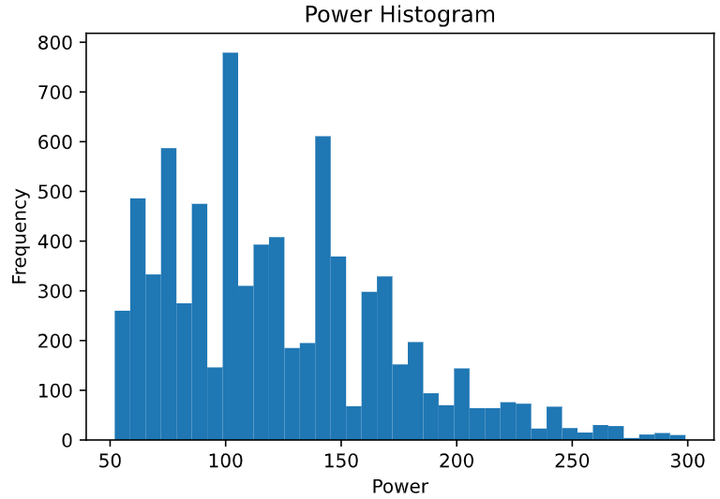
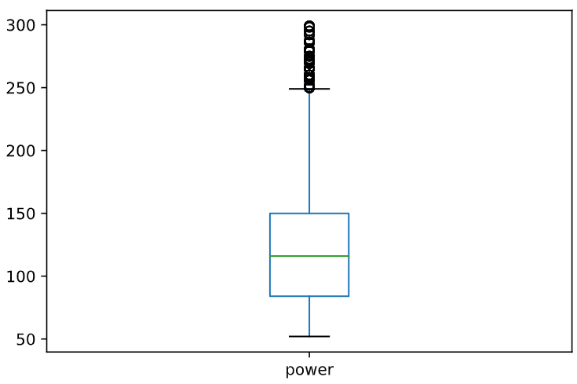
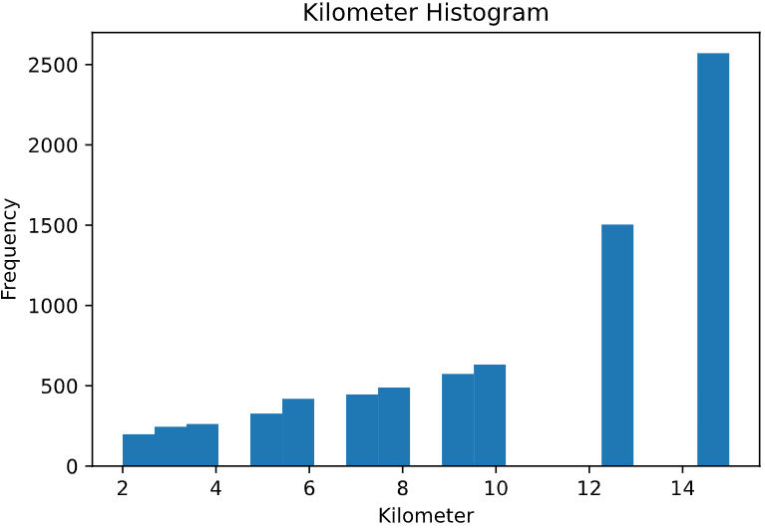
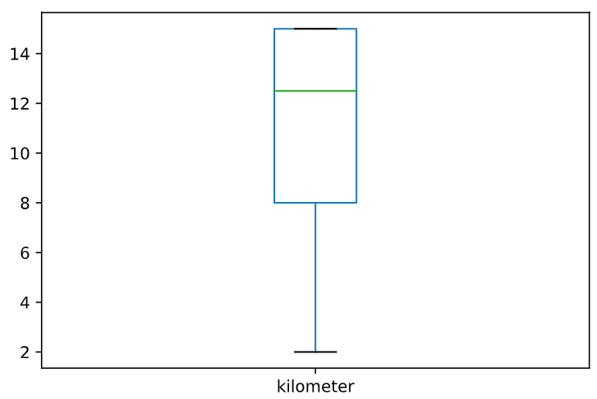
EDA
Histogram
Boxplot

Slide 13
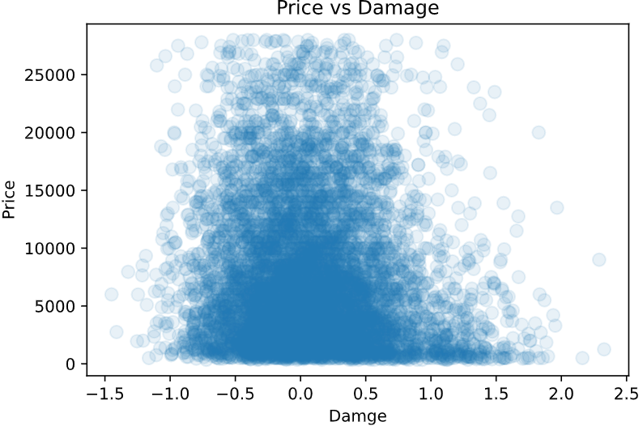
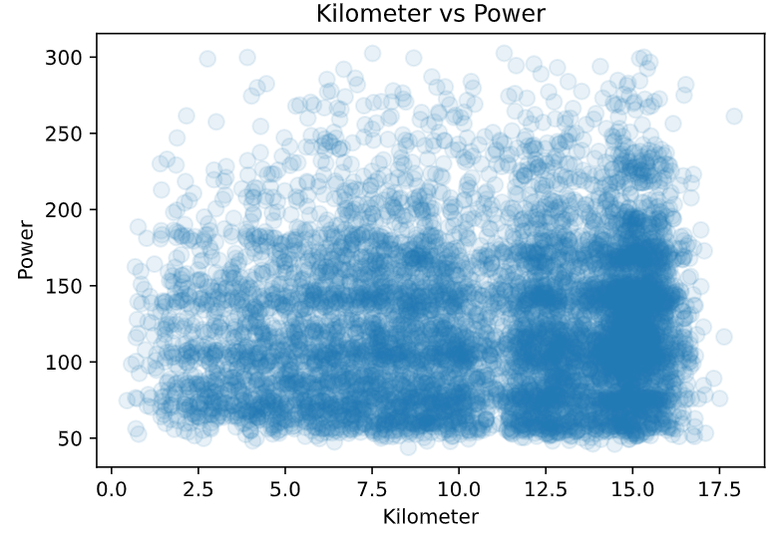
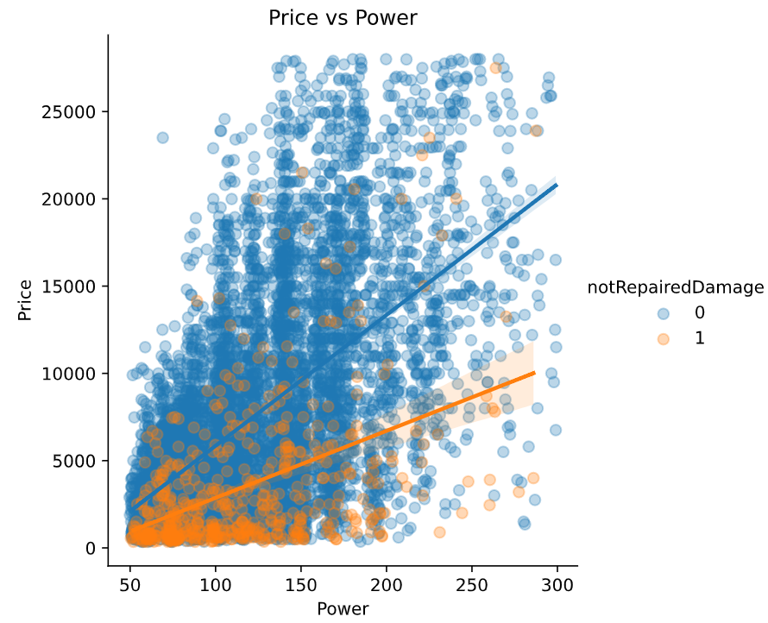
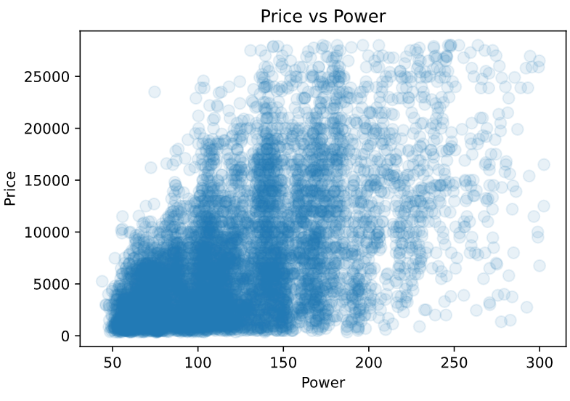
Visualization

Slide 14
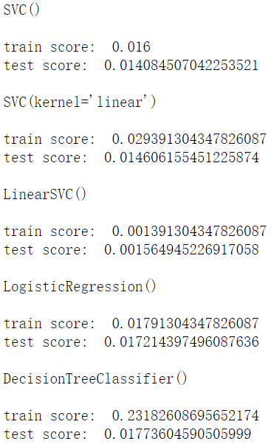
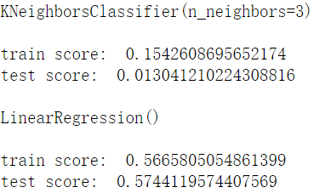
Model Predictions
Model Prediction
  Try seven models
    Train-Test Split
    Cross Validation
  Summary
Linear Regression has the highest accuracy.
Notes:
6053.366341463392

Slide 15
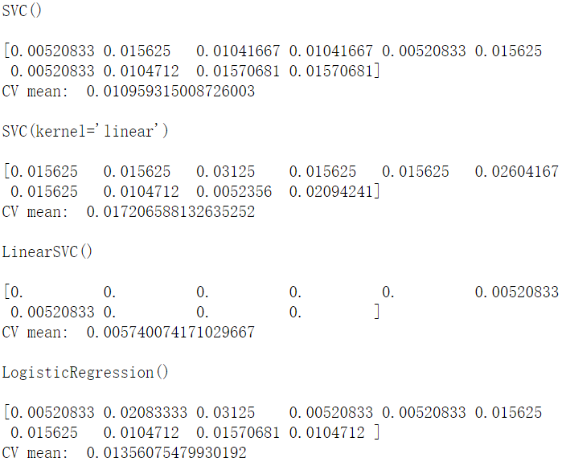
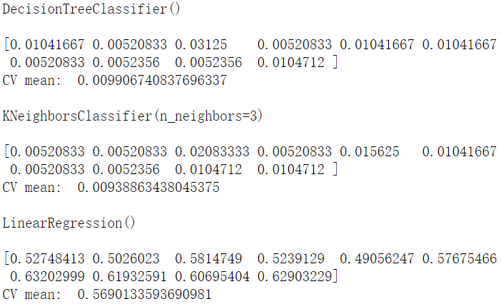
Model Predictions
Model Prediction
  Try seven models
    Train-Test Split
    Cross Validation
Cross Validation gets the same result.
Notes:
6053.366341463392

Slide 16
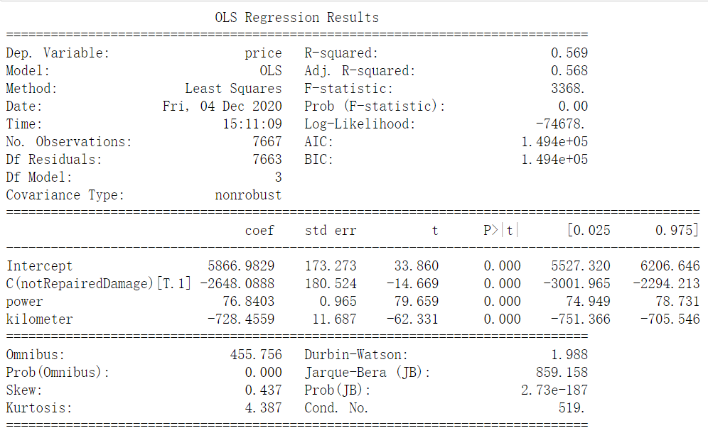
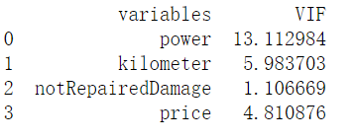
Model Summary
Our predicted price will be
7366.5488457
in this model.
Notes:
6053.366341463392

Slide 17
Model Summary
Our predicted price will be
7366.5488457
in this model.
Notes:
6053.366341463392

Slide 18
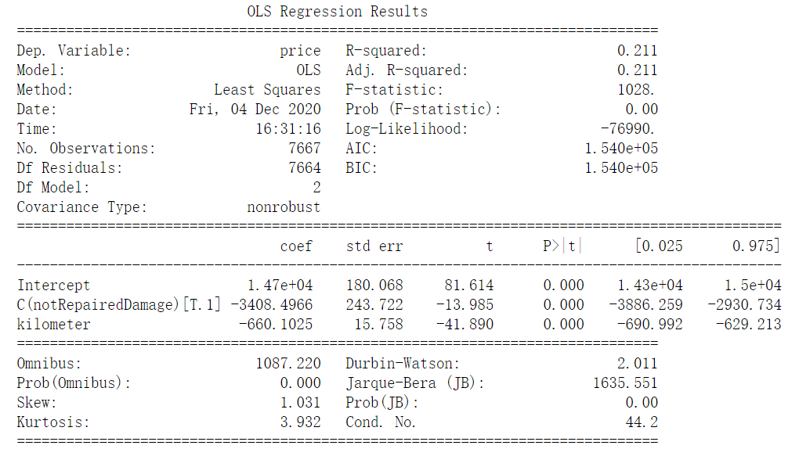
Model Summary
Our predicted price will be
7366.5488457
in this model.

Slide 19
Value Prediction
Subheading (first level text)
  Bullet 1 (second level text)
    Bullet 2
      Bullet 3
        Bullet 4

Slide 20
Suggestions on Buying a Used Vehicle
Recommendations
Cautions

Slide 21
Conclusion
    Conclusion for SMART question 1
    Conclusion for SMART question 2
    Conclusion for SMART question 3

