Slide 1



COMP90041 lab 4

Slide 2
Discussion of Theory
What is a class? What is the relationship between a class and an object?

Slide 3
Discussion of Theory
What is a class? What is the relationship between a class and an object?
A class is a definition of what an object should “look like” (i.e. what data – instance variables – it should hold, and the actions – methods – that can be performed on the objects).
An object is a specific instance of a class.
Classes can be considered as the blueprints which can be used to create individual object with.

Slide 4
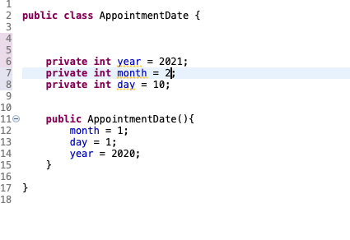
Classes and Methods
A Java program consists of objects from various classes interacting with one another
Every program is a class
Class is a type that you can declare variables of a class type
Object or instance of the class is the value of a class type
Car mycar = new Car();
Human Mike = new Human();
Object has both data and actions (methods).
All objects of the same class might have different data value, but the same data type and methods.
A primitive type value is a single piece of data.
A class type object can have multiple pieces of data and methods.

Slide 5
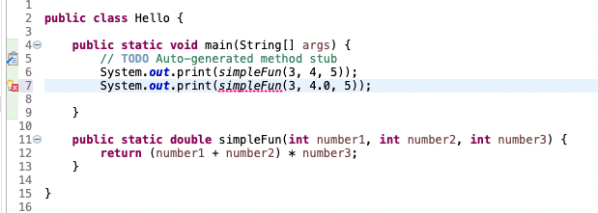
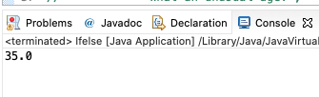
Parameter and argument
A parameter list provides a description of the data required by a method
It indicates the number and types of data pieces needed, the order they must be given and the local name for these pieces as used in the method
Argument is the appropriate values passed to the method (Actual parameters)
The number and order of arguments must exactly match that of the parameter list
If types do not match, Java will try to make an automatic type conversion (but only works from smaller type to bigger one)
call-by-value: value of each argument is passed into the method parameter not name

Slide 6
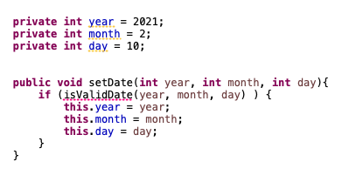
this
this parameter is a hidden parameter
this must be used if local variables have the same name with the instance variables, otherwise all variables will be interpreted as local

Slide 7
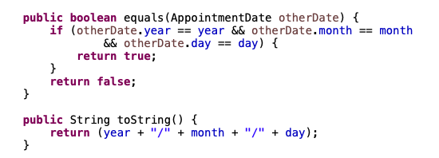
equals and toString
Java expects certain methods such as equals and toString
equals is to compare if the two objects of the class type are the same
toString can be used to display the value of the object

Slide 8
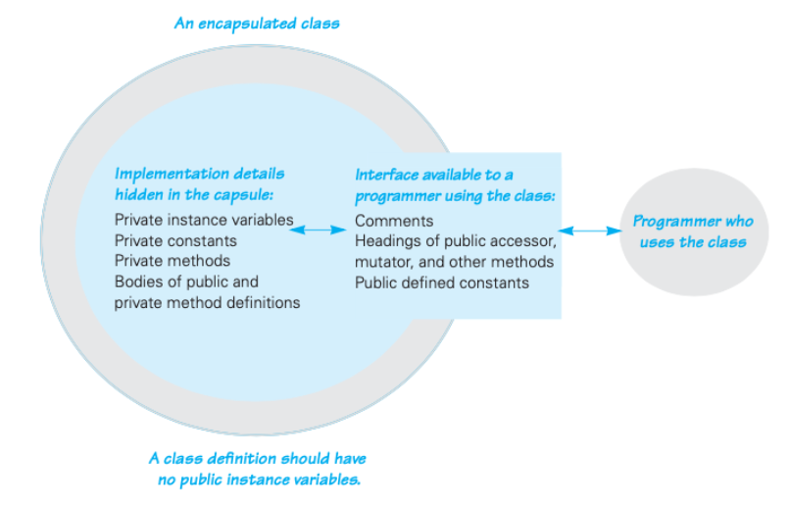
Information hiding and Encapsulation
Information hiding is the practice of separating how to use a class from the details of its implementation, and it is achieved by using modifiers such as private to restrict access to certain parts of an object.
Abstraction is the process of identifying the essential features of an object, while ignoring the details, usually achieved by using interfaces or abstract classes.
Encapsulation means that the data and methods of a class are combined into a single unit (i.e., a class object), which hides the implementation details

Slide 9
Modifiers: public and private
public means that there are no restrictions on where an instance variable or method can be used
private means that an instance variable or method cannot be accessed by name outside of the class
It is considered good programming practice to make all instance variables private
Most methods are public, and thus provide controlled access to the object
Usually, methods are private only if used as helping methods for other methods in the class

Slide 10
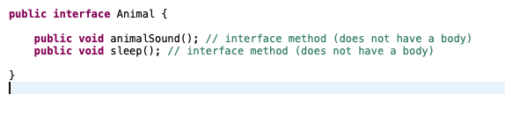
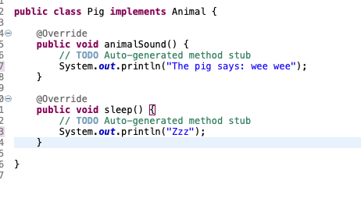
Interface

Slide 11

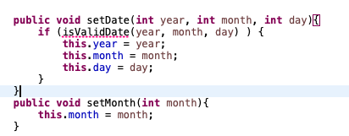
Accessor and Mutator
Accessor methods allow the programmer to obtain the value of an object's instance variables (getter)
Mutator methods allow the programmer to change the value of an object's instance variables in a controlled manner (setter)

Slide 12
Overloading
Overloading is when two or more methods in the same class have the same method name
A signature consists of the name of a method together with its parameter list (not include the returned type)
To be valid, any two definitions of the method name must have different signatures
Java does not permit methods with the same name and different return types in the same class

Slide 13
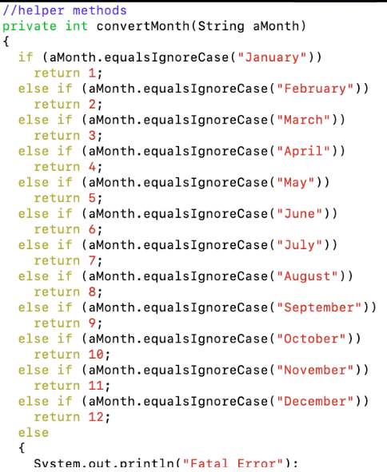
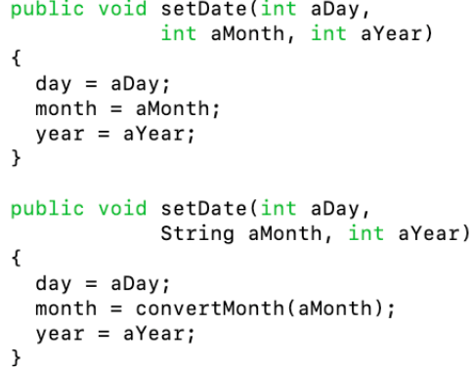
Overloading

Slide 14
Constructor
Constructor is a special kind of method that is designed to initialize the instance variables for an object
A constructor must have the same name as the class
A constructor has no type returned, not even void
Constructors are typically overloaded
A constructor is called when an object of the class is created using new
Date date = new Date(2023, 3, 30);

Slide 15
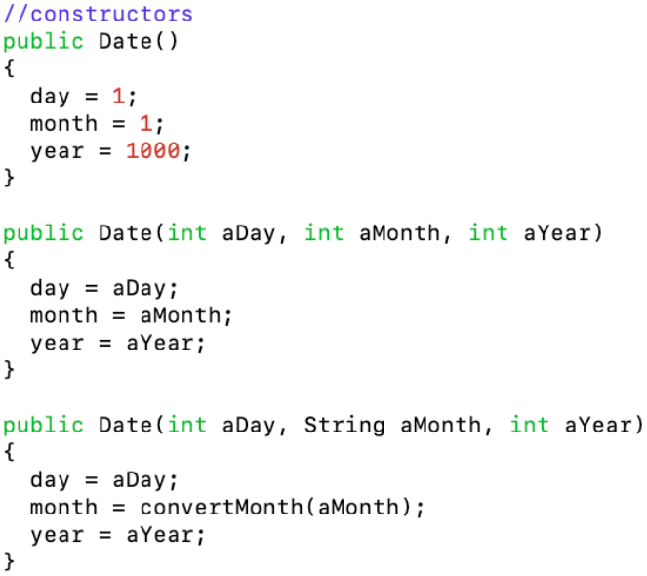
Constructor

