Slide 1



COMP90041 lab 6

Slide 2
Recap
Arrays and arraylists

Slide 3
Theory Questions
What is inheritance in Object Oriented Programming? Why might we want to use it?
What is super()? Why do we need to call it in our constructors of child classes?
What does it mean to override a method?
What is an abstract class and what are abstract methods?

Slide 4
Inheritance
Inheritance is one of the main techniques of object-oriented programming (OOP)
a very general form of a class is first defined and compiled, and then more specialized versions of the class are defined by adding instance variables and methods
The specialized classes are said to inherit the methods and instance variables of the general class
Inheritance is the process by which a new class is created from another class
The new class is called a derived/child/sub class
The original class is called the base/parent/super class
A derived class automatically has all the instance variables and methods that the base class has, and it can have additional methods and/or instance variables as well
public class HourlyEmployee extends Employee
Class Employee defines the instance variables name and hireDate in its class definition
Class HourlyEmployee has additional instance variables wageRate and hours that are specified in its class definition
Inherited Members: The derived class inherits all the public methods, all the instance variables, and all the static variables from the base class

Slide 5
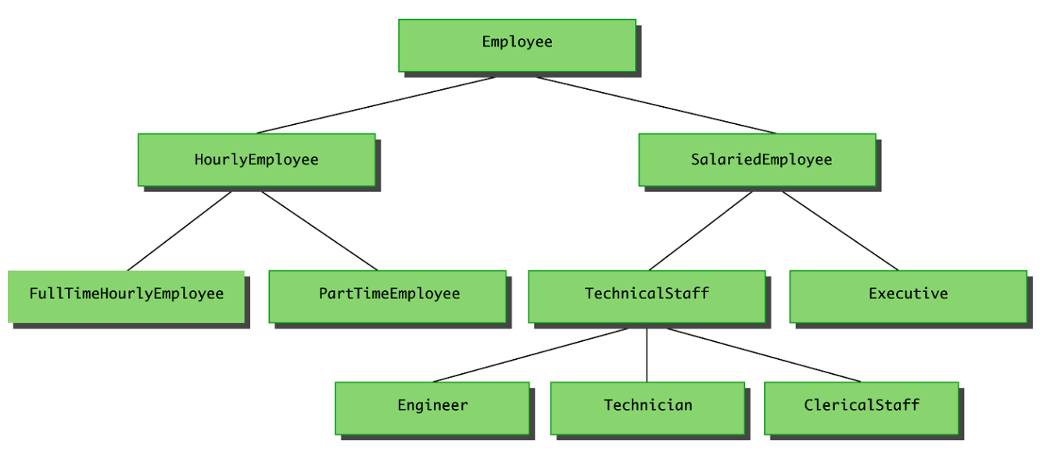
Inheritance

Slide 6
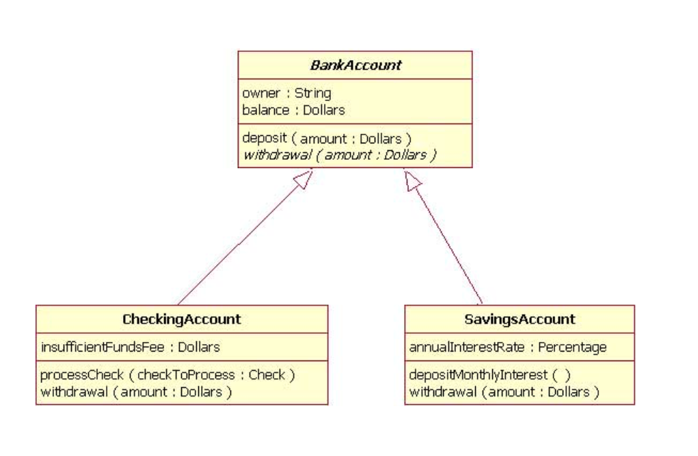
Inheritance

Slide 7
Override
A derived class inherits methods from the base class, it can change or override an inherited method if necessary
the type returned may or may not be changed when overriding a method
if it is a class type, then the returned type may be changed to that of any descendent class of the returned type
public class BaseClass
{...
public Employee getSomeone(int someKey) ...
public class DerivedClass extends BaseClass
{...
public HourlyEmployee getSomeone(int someKey) ...
The access permission of an overridden method can be changed from private in the base class to public (or some other more permissive access) in the derived class
the access permission of an overridden method can not be changed from public in the base class to a more restricted access permission in the derived class
When a method is overridden, the new method definition given in the derived class has the exact same number and types of parameters as in the base class
When a method in a derived class has a different signature from the method in the base class, that is overloading

Slide 8
final
If the modifier final is placed before the definition of a method, then that method may not be redefined in a derived class
It the modifier final is placed before the definition of a class, then that class may not be used as a base class to derive other classes

Slide 9
super
A derived class uses a constructor from the base class to initialize all the data inherited from the base class
A call to the base class constructor can never use the name of the base class, but uses the keyword super instead
public derivedClass(int p1, int p2, double p3) { super(p1, p2); instanceVariable = p3; }
A call to super must always be the first action taken in a constructor definition
An instance variable cannot be used as an argument to super
If a derived class constructor does not include an invocation of super, then the no-argument constructor of the base class will automatically be invoked
Within the definition of a constructor for a class, this can be used as a name for invoking another constructor in the same class
If it is necessary to include a call to both super and this, the call using this must be made first, and then the constructor that is called must call super as its first action
It is only valid to use super to invoke a method from a direct parent
For example, if the Employee class were derived from the class Person, and the HourlyEmployee class were derived form the class Employee, it would not be possible to invoke the toString method of the Person class within a method of the HourlyEmployee class super.super.toString() // ILLEGAL!

Slide 10
this
Sometimes A no-argument constructor uses this to invoke an explicit-value constructor
public ClassName( )
{
this(argument1, argument2);
}
public ClassName(type1 param1, type2 param2)
{ ... }
public HourlyEmployee( )
{ this("No name", new Date(), 0, 0); }
public HourlyEmployee(String theName, Date theDate, double theWageRate, double theHours)

Slide 11
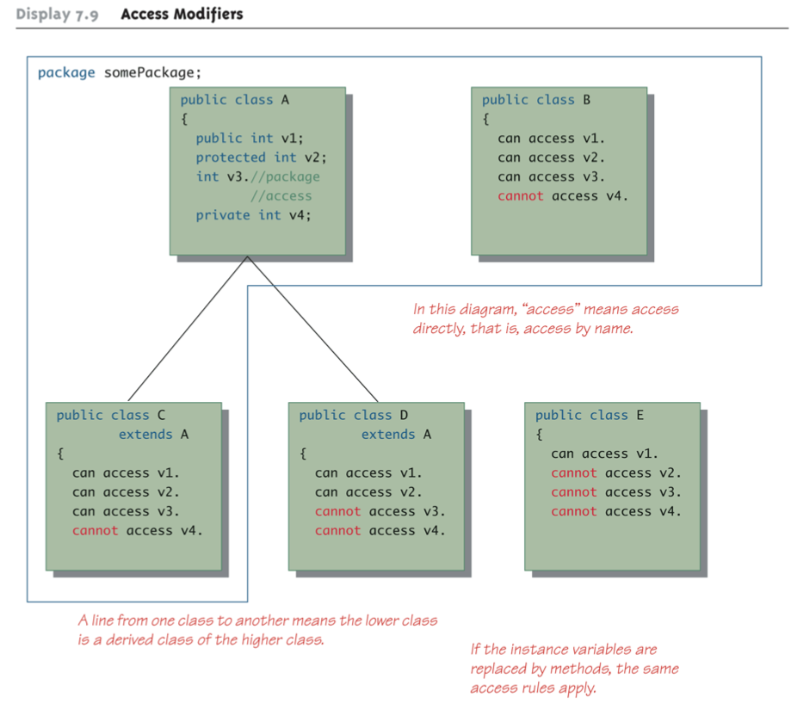
Access mODIFIERS

Slide 12
mODIFIER: pROTECTED
If a method or instance variable is modified by protected (rather than public or private), then it can be accessed by name inside any class derived from it.
An instance variable or method definition that is not preceded with a modifier has package/default access.
Instance variables or methods having package access can be accessed by name inside the definition of any class in the same package

Slide 13
POLYMORPHISM
There are three main programming mechanisms that constitute object-oriented programming (OOP)
Encapsulation Inheritance Polymorphism
Polymorphism is the ability to allow you treat objects of different classes as if they are of the same classes. And it is usually achieved by using inheritance.

Slide 14

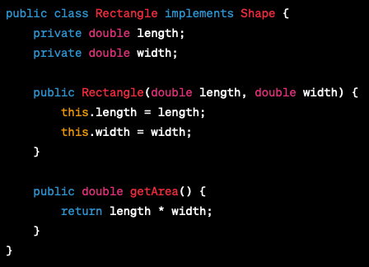
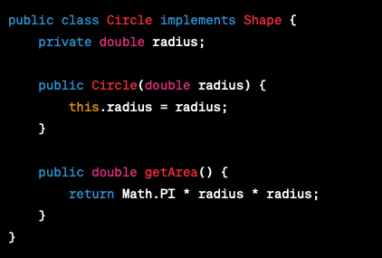
POLYMORPHISM

Slide 15
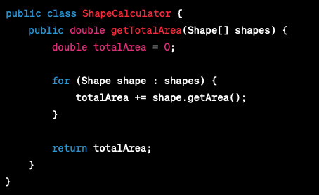
POLYMORPHISM

Slide 16


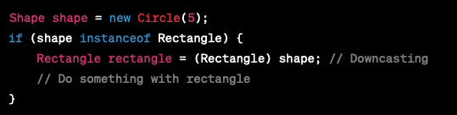
UPCASTIN AND DOWNCASTING
Upcasting is when an object of a derived class is assigned to a variable of a base class (or any ancestor class)
Downcasting is when a type cast is performed from a base class to a derived class (or from any ancestor class to any descendent class)

Slide 17
Abstract Class
In order to postpone the definition of a method, Java allows an abstract method to be declared
An abstract method has a heading, but no method body
The body of the method is defined in the derived classes
The class that contains an abstract method is called an abstract class
An abstract class must have the modifier abstract included in its class heading
public abstract double getPay();
public abstract void doIt(int count);
If a derived class of an abstract class adds to or does not define all of the abstract methods, then it is abstract also, and must add abstract to its modifier
A class that has no abstract methods is called a concrete class

Slide 18
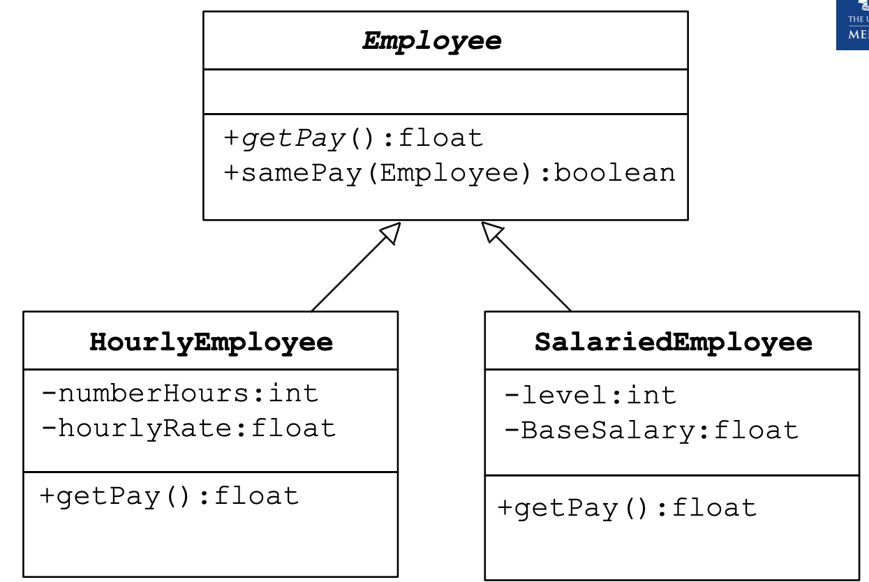
Abstract class

Slide 19
Theory Questions
What is inheritance in Object Oriented Programming? Why might we want to use it?
Inheritance in Object-Oriented Programming allows us to define a class based on another class. A class that inherits from another class gains the instance variables and methods of the other class. This allows for more sophisticated code reuse in our programs beyond simple methods and loops.
A class that inherits from another class is considered to have the same type as that base class. The significance of this is that if we have a collection of items (e.g., an array or ArrayList) that holds a particular base class, we can also hold any objects of any classes that extend from that base class.

Slide 20
Theory Questions
What is super()? Why do we need to call it in our constructors of child classes?
We should call super() from within the constructors of our child classes so that the instance variables within our parent class is properly initialized. super() calls a constructor of the parent class.

Slide 21
Theory Questions
What does it mean to override a method?
Overriding a method means replacing an existing method implementation of a parent class with your own implementation for a particular child class. This is the way in which you can "customize" behaviour for child classes.
Note that we can use the Java annotation @override to indicate to Java that a particular method is meant to override a super method. This allows the Java compiler to help us check whether or not our method is indeed being used to override a method in a parent class.

Slide 22
Theory Questions
What is an abstract class and what are abstract methods?
An abstract class is a class that should never be allowed to be created as an object using the new keyword, as it does not make sense for the class to be instantiated by itself. For example, you may wish to use an abstract class to group common instance variables and implementation of methods, but other methods may still need to be implemented before the class is fully functional.
An abstract method is a method without an implementation. The idea of this is to declare that a particular method must exist, but that the inheriting classes will provide the implementation of the method.
If a class has an abstract method, the class itself should be made abstract as well.

