Slide 1



COMP90041 lab 7

Slide 2
Recap
Inheritance and polymorphism

Slide 3
Theory Questions
What is an Interface? How is it similar to Inheritance? Why might we want to use an Interface instead of Inheritance?
Why do we need to save data to files on the disk? How do we save and load files in Java?
What is an Exception? Why might we want to use an exception rather than simple error handling, such as with an if statement?

Slide 4
Interface
An interface specifies a set of methods that any class that implements the interface must have
An interface serves a function similar to a base class, though it is not a base class
Some languages allow one class to be derived from two or more different base classes, but not Java
Java's way of approximating multiple inheritance is through interfaces
An interface and all of its method headings should be declared public
Abstract classes may implement one or more interfaces Any method headings given in the interface that are not given definitions are made into abstract methods
A concrete class must give definitions for all the method headings given in the abstract class and the interface

Slide 5
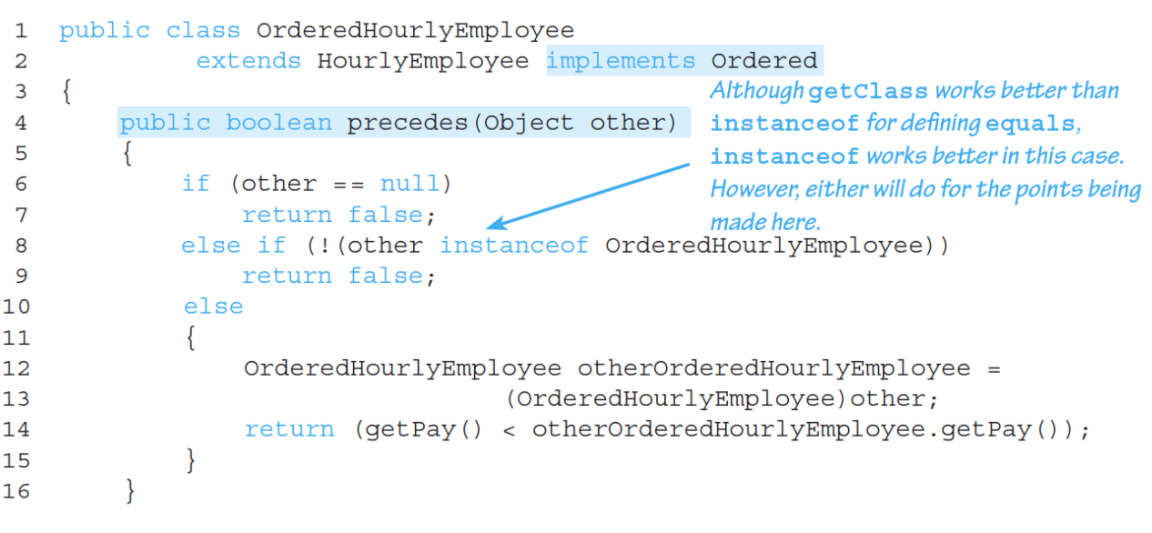
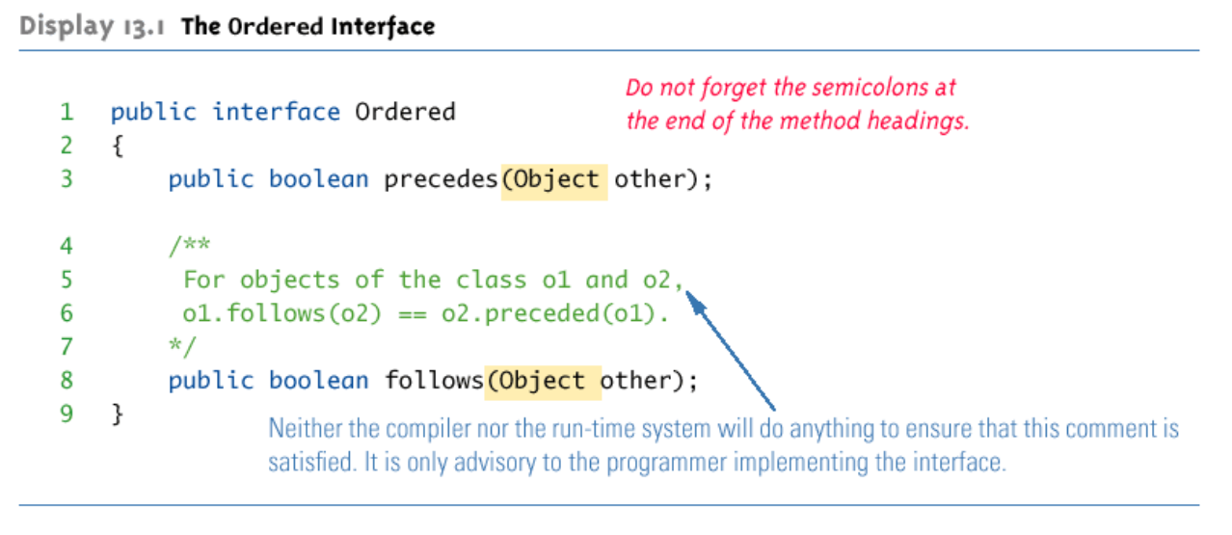
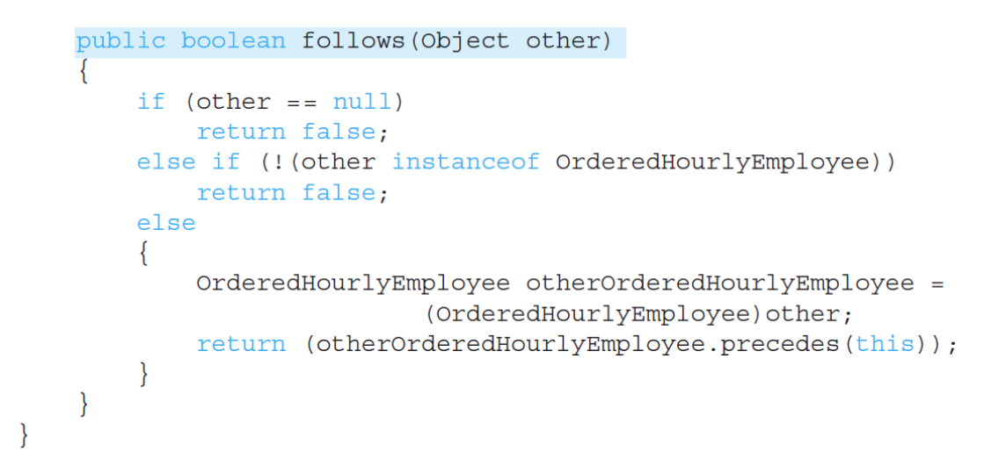
Interface

Slide 6
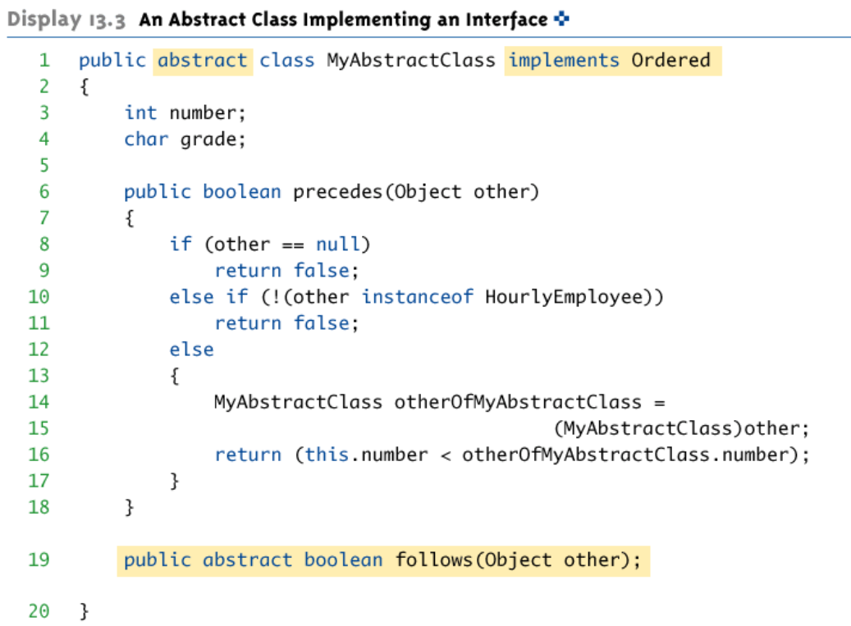
Interface

Slide 7
Interface
Like classes, an interface may be derived from a base interface
The derived interface must include the phrase extends BaseInterfaceName
A concrete class that implements a derived interface must have definitions for any methods in the derived interface as well as any methods in the base interface
An interface can contain defined constants in addition to or instead of method headings
Any variables defined in an interface must be public, static, and final
If a class definition implements two inconsistent interfaces, then that is an error, and the class definition is illegal
One type of inconsistency will occur if the interfaces have constants with the same name, but with different values
Another type of inconsistency will occur if the interfaces contain methods with the same name but different return types

Slide 8
Comparable Interface
The Comparable interface is in the java.lang package, and so is automatically available to any program
It has only the following method heading that must be implemented: public int compareTo(Object other);
The method compareTo must return
A negative number if the calling object "comes before" the parameter other
A zero if the calling object "equals" the parameter other
A positive number if the calling object "comes after" the parameter other
Both the Double and String classes implement the Comparable interface
Interfaces only apply to classes
A primitive type (e.g. double) cannot implement an interface

Slide 9
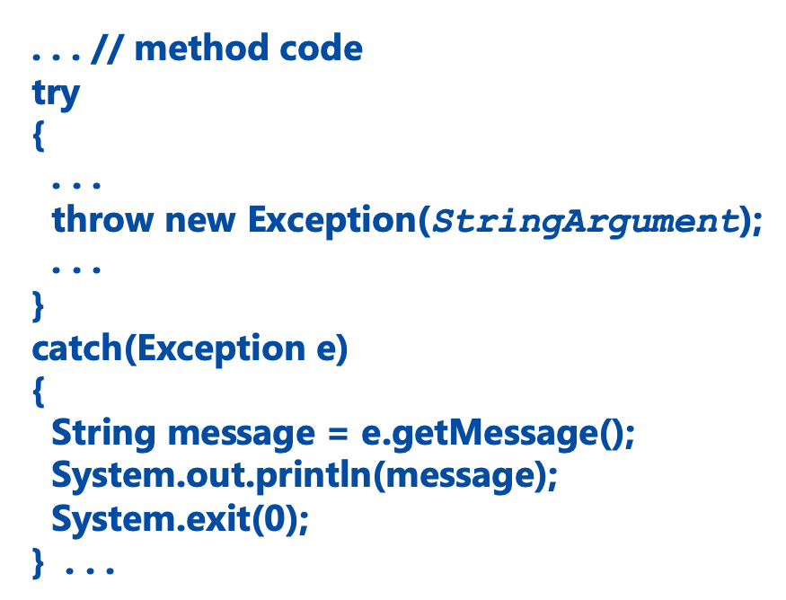
Exception handling
Java provides a mechanism that signals when something unusual happens: throwing an exception
provide code that deals with the exceptional case: handling the exception
A throw statement is similar to a method call: throw new ExceptionClassName(SomeString);
Instead of calling a method, a throw statement calls a catch block

Slide 10
Exception handling
When an exception is thrown, the catch block begins execution
The catch block has only one parameter e is called the catch block parameter
The exception object thrown is plugged in for the catch block parameter
It specifies the type of thrown exception object that the catch block can catch
It provides a name (for the thrown object that is caught) on which it can operate in the catch block
Numerous predefined exception classes are included in the standard packages that come with Java
IOException
NoSuchMethodException
FileNotFoundException
Instead of using a predefined class, exception classes can be programmer-defined
Every exception class to be defined must be a derived class of some already defined exception class

Slide 11
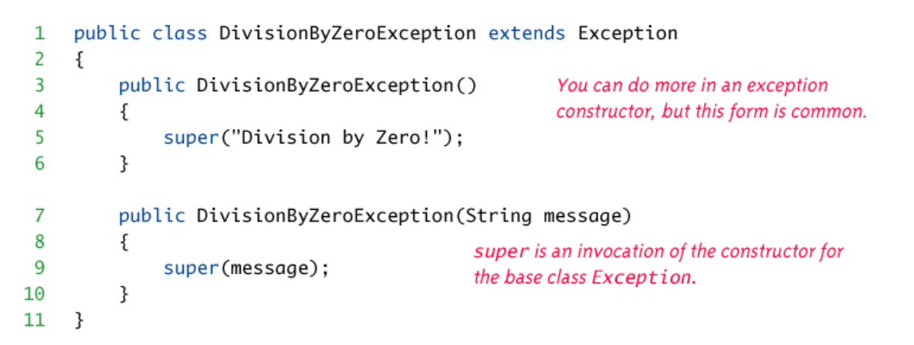
Exception handling

Slide 12
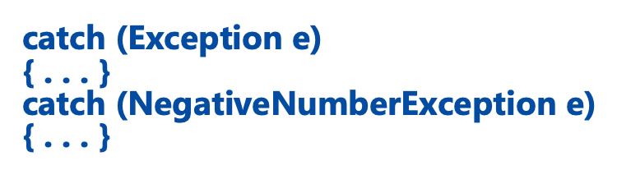
Exception catch
When an exception is thrown in a try block, the catch blocks are examined in order
The first one that matches the type of the exception thrown is the one that is executed

Slide 13
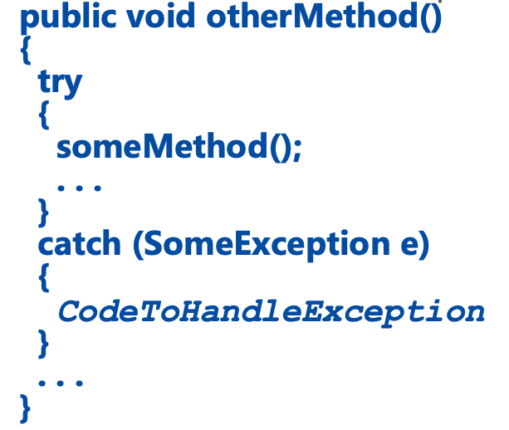
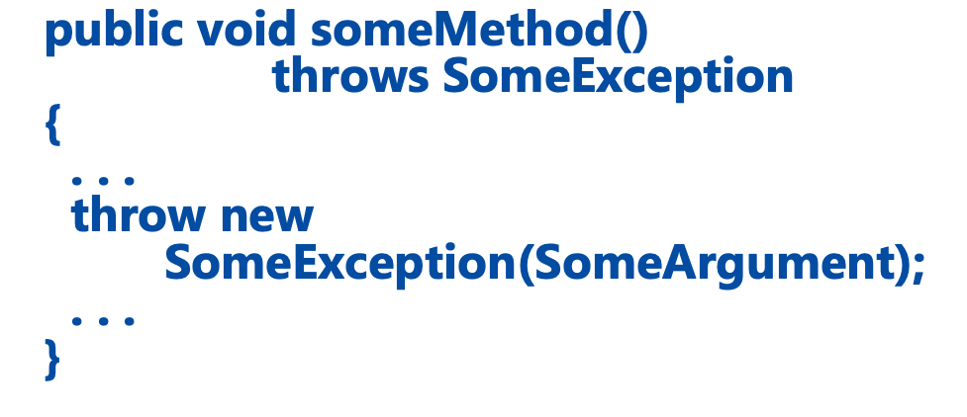
Declaring the exception
Sometimes it makes sense to throw an exception in a method, but not catch it in the same method
If a method can throw an exception but does not catch it, it must provide a warning in the heading
The process of including an exception class in a throws clause is called declaring the exception
If a method throws an exception and does not catch it, then the method invocation ends immediately
If a method can throw more than one type of exception, then separate the exception types by commas
public void aMethod() throws AnException, AnotherException

Slide 14
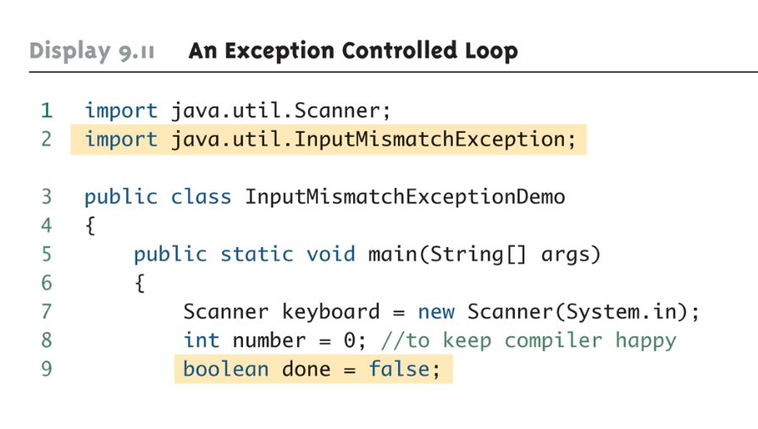
Use exception to control loop

Slide 15
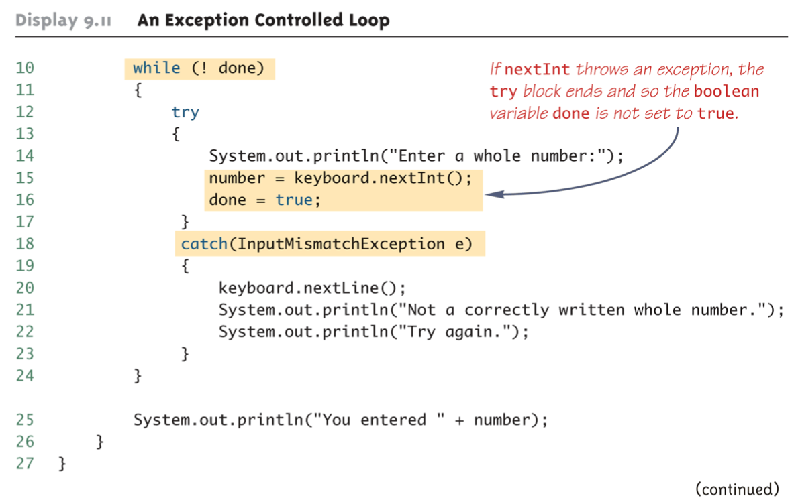
Use exception to control loop

Slide 16
File i/o - File
Files that are designed to be read by human beings, and that can be read or written with an editor are called text files
Files that are designed to be read by programs and that consist of a sequence of binary digits are called binary files
An advantage of text files is that they are usually the same on all computers, so that they can move from one computer to another
An advantage of binary files is that they are more efficient to process than text files

Slide 17
File i/o - stream
A stream is an object that enables the flow of data between a program and some I/O device or file
Input streams can flow from the keyboard or from a file
System.in is an input stream that connects to the keyboard
Output streams can flow to a screen or to a file
System.out is an output stream that connects to the screen

Slide 18
Printwriter
The class PrintWriter is a stream class that can be used to write to a text file
A stream of the class PrintWriter is created and connected to a text file for writing as follows:
PrintWriter outputStreamName;
outputStreamName = new PrintWriter(new FileOutputStream(FileName));
This produces an object of the class PrintWriter that is connected to the file FileName
The process of connecting a stream to a file is called opening the file
If the file already exists, then doing this causes the old contents to be lost
If the file does not exist, then a new, empty file named FileName is created
After doing this, the methods print and println can be used to write to the file
To create a PrintWriter object and connect it to a text file for appending, a second argument, set to true, must be used in the constructor for the FileOutputStream object
outputStreamName = new PrintWriter(new FileOutputStream(FileName, true));
After this statement, the methods print, println and/or printf can be used to write to the file
The new text will be written after the old text in the file

Slide 19
Close/flush a stream
When a program is finished writing to a file, it should always close the stream connected to that file by calling
outputStreamName.close();
This allows the system to release any resources used to connect the stream to the file
If the program does not close the file before the program ends, Java will close it automatically, but it is safest to close it explicitly
Output streams connected to files are usually buffered
Rather than physically writing to the file as soon as possible, the data is saved in a temporary location (buffer)
When enough data accumulates, or when the method flush is invoked, the buffered data is written to the file all at once
This is more efficient, since physical writes to a file can be slow
The method close invokes the method flush, thus insuring that all the data is written to the file
If a program relies on Java to close the file, and the program terminates abnormally, then any output that was buffered may not get written to the file
The sooner a file is closed after writing to it, the less likely it is that there will be a problem

Slide 20
IOEXCEPTION
When performing file I/O there are many situations in which an exception, such as FileNotFoundException, may be thrown
Many of these exception classes are subclasses of the class IOException
These exception classes are all checked exception(compile time exception).
Therefore, they must be caught or declared in a throws clause.
In contrast, the exception classes NoSuchElementException, InputMismatchException, and IllegalStateException are all unchecked exceptions (runtime exception)
Unchecked exceptions are not required to be caught or declared in a throws clause

Slide 21
Scanner
The class Scanner can be used for reading from the keyboard as well as reading from a text file
Simply replace the argument System.in(to the Scanner constructor) with a suitable stream that is connected to the text file
Scanner StreamObject = new Scanner(new FileInputStream(FileName));
Methods of the Scanner class for reading input behave the same whether reading from the keyboard or reading from a text file
For example, the nextInt and nextLine methods
A program that tries to read beyond the end of a file using methods of the Scanner class will cause an exception to be thrown
instead of having to rely on an exception to signal the end of a file, the Scanner class provides methods such as hasNextInt and hasNextLine

Slide 22
Another way to read: BufferedReader
The class BufferedReader is a stream class that can be used to read from a text file
An object of the class Buffered Reader has the methods read and readLine
A stream of the class BufferedReader is created and connected to a text file as follows:
BufferedReader readerObject;
readerObject = new BufferedReader(new FileReader(FileName));
The readLine method is the same method used to read from the keyboard, but in this case it would read from a file
The read method reads a single character, and returns a value (of type int) that corresponds to the character read
Since the read method does not return the character itself, a type cast must be used:
char next = (char)(readerObject.read());
Unlike the Scanner class, the class BufferedReader has no methods to read a number from a text file
A number must be read in as a string, and then converted to a value of the appropriate numeric type using one of the wrapper classes
To read in a single number on a line by itself, first use the method readLine, and then use Integer.parseInt, Double.parseDouble, etc. to convert the string into a number
If there are multiple numbers on a line, StringTokenizer can be used to decompose the string into tokens, and then the tokens can be converted as described above
The method readLine of the class BufferedReader returns null when it tries to read beyond the end of a text file
The method read of the class BufferedReader returns -1 when it tries to read beyond the end of a text file

Slide 23
File path
When a file name is used as an argument to a constructor for opening a file, it is assumed that the file is in the same directory or folder as the one in which the program is run
If it is not in the same directory, the full or relative path name must be given
A path name not only gives the name of the file, but also the directory or folder in which the file exists
A full path name gives a complete path name, starting from the root directory
A relative path name gives the path to the file, starting with the directory in which the program is located

Slide 24
Operate on Binary Files
An ObjectOutputStream object is created and connected to a binary file as follows:
ObjectOutputStream outputStreamName = new ObjectOutputStream(new FileOutputStream(FileName));
After opening the file, ObjectOutputStream methods can be used to write to the file
Methods used to output primitive values include writeInt, writeDouble, writeChar, and writeBoolean
UTF is an encoding scheme used to encode Unicode characters that favors the ASCII character set
The method writeUTF can be used to output values of type String
The stream should always be closed after writing
The class ObjectInputStream is a stream class that can be used to read from a binary file
An ObjectInputStream object is created and connected to a binary file as follows:
ObjectInputStream inStreamName = new ObjectInputStream(new FileInputStream(FileName));
After opening the file, ObjectInputStream methods can be used to read to the file
Methods used to input primitive values include readInt, readDouble, readChar, and readBoolean
The method readUTF is used to input values of type String
If the file contains multiple types, each item type must be read in exactly the same order it was written to the file
The stream should be closed after reading

Slide 25
Operate on Binary Files
All of the ObjectInputStream methods that read from a binary file throw an EOFException when trying to read beyond the end of a file
Objects can also be input and output from a binary file
Use the writeObject method of the class ObjectOutputStream to write an object to a binary file
Use the readObject method of the class ObjectInputStream to read an object from a binary file
It is best to store the data of only one class type in any one file
In addition, the class of the object being read or written must implement the Serializable interface
The streams for sequential access to files are the ones most commonly used for file access in Java
However, some applications require very rapid access to records in very large databases
These applications need to have random access to particular parts of a file
The stream class RandomAccessFile, which is in the java.io package, provides both read and write random access to a file in Java
A random access file consists of a sequence of numbered bytes
Although a random access file is byte oriented, there are methods that allow for reading or writing values of the primitive types as well as string values to/from a random access file

Slide 26
Theory Questions
What is an Interface? How is it similar to Inheritance? Why might we want to use an Interface instead of Inheritance?
An interface can be thought of as a contract. When a class implements an interface, the class is guaranteeing that the methods specified by the interface are implemented. This means that you could call any object that implements the interface with the methods specified by the interface.
An Interface is similar to Inheritance in that classes implementing the Interface will have the methods specified by the interface on them. Note that an interface is similar to an abstract class which only has abstract methods in it, but is not an inheritance relationship.
Since use of an interface does not create an inheritance relationship, it is suitable for use even with classes that are dissimilar. (Inheritance should only be used when conceptually the child classed are more specific versions of a parent class - think of the Vehicle and Plane example. Interfaces are used more flexibly).

Slide 27
Theory Questions
Why do we need to save data to files on the disk? How do we save and load files in Java?
Data (eg variables) saved in memory is volatile, and once the program quits, the memory is lost. Likewise when the computer is shut down. We can persist data onto disk (the hard drive) so that the data is not lost, and reload the data from the file when our program starts again.
Save / Load text files:
Write: PrintWriter, BufferedWriter
Read: Scanner, BufferedReader

Slide 28
Theory Questions
What is an Exception? Why might we want to use an exception rather than simple error handling, such as with an if statement?
An Exception is an object that is used to represent an error. We want to use Exceptions in cases where we are unable to handle the Exception where it arises (because it might be in a method that has general code in it and therefore may not know the context of why the Exception might be thrown). In these cases the Exception can be passed up the call stack (using the throws keyword) to a place where the errors can be handled due to understanding of the context of the error (ie the place in the code where the method was called). If we use a simple if statement then we need to handle the error immediately, but we may not know how we should handle it.
Exceptions are not a replacement for if statement error checks. Both have their places.
Exceptions should not really be thrown and caught in the same method (overcomplicated) - you can use if statements for that. Exceptions are used so you can pass the error around.
Note that you also want to use an if statement to decide if an Exception should be thrown.

