Slide 1



Java first lab

Slide 2
Self Introduction
NAME: zhUOHAN xIE
Bachelor of software engineering at Xiamen University, china
Master of it coursework student, Unimelb
Phd student for natural language generation of unimelb nlp group
Biggest wish now: safe and graduate!

Slide 3
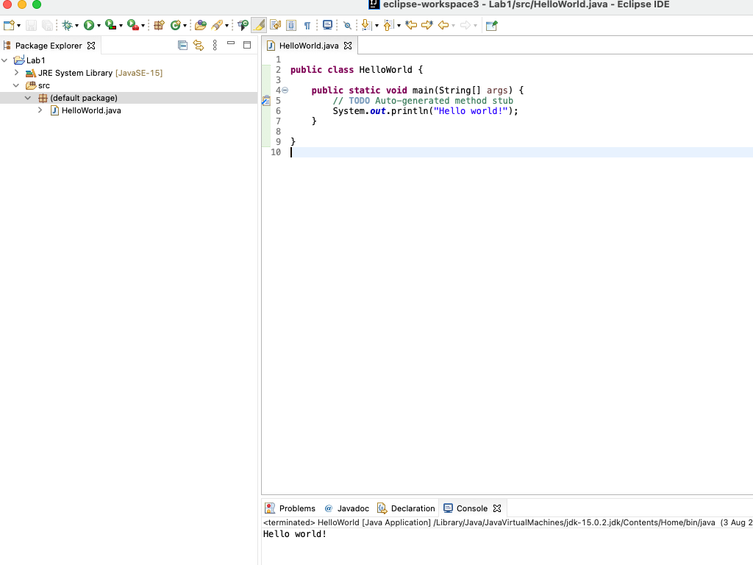
What is a program

Slide 4
Java Variable nAMES
Begin with lower case letter
Follow with lower case, except Capitalise the first letter of each word in your phrase, an approach called camel case
Examples for variable names: height, windowHeight, tallestWindowHeight
Best practice: make them descriptive, but not too long (clear abbreviations are okay)
It is important: DO NOT name it as a, b, c in your assignments, we will deduct mark for it!

Slide 5
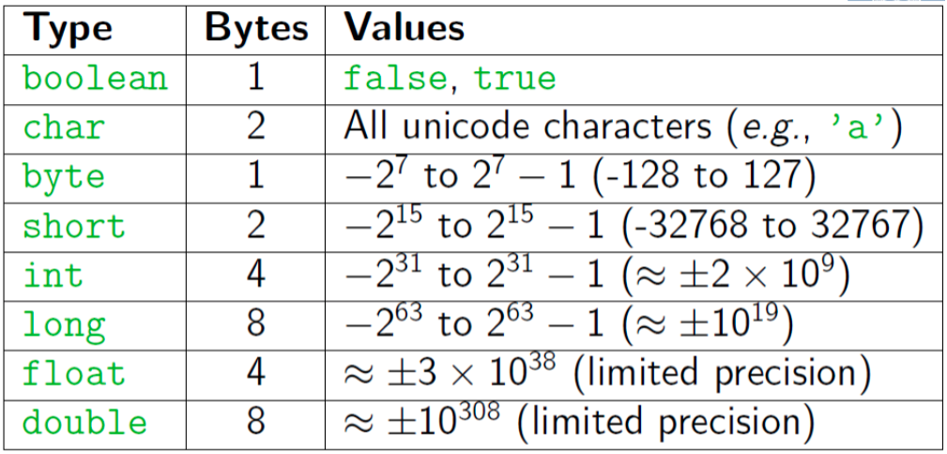
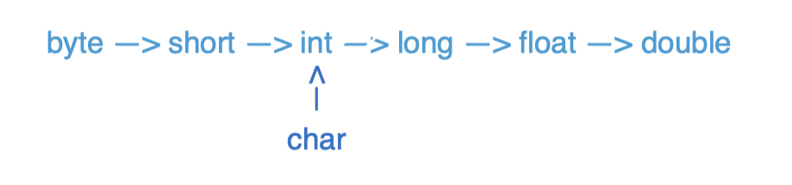
Java DATA Types

Slide 6
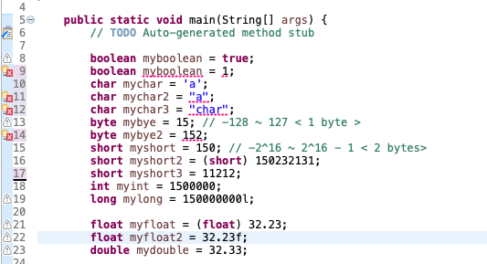
Java dATA Types

Slide 7
Pre/Post Increment/Decrement
Pre-Increment/Decrement
++x/--x: returns the increment/decrement number and x becomes the increment/decrement number
Post-Increment/Decrement
x++/x--: returns the original number and x becomes the increment/decrement number
x == 8
++x == 9
x == 9
x == 4
--x == 3
x == 3
x = 8
x++ + --x = 16
X = 8
x == 4
x-- == 4
x == 3

Slide 8
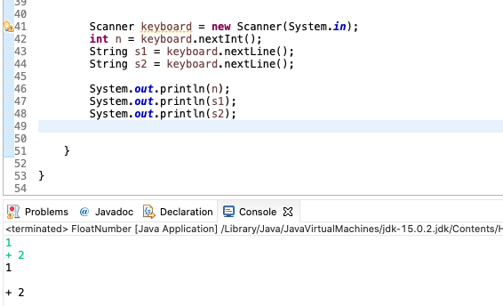
Console I/o(in): Scanner
First to import Scanner package: import java.util.Scanner;
Get from Console: Scanner keyboard = new Scanner(System.in);
Get from File: File text = new File("C:/temp/test.txt");
Scanner scanner = new Scanner(text);
.nextLine() reads the rest of the whole line as string
.next()/ .nextInt() / .nextDouble() reads until whitespace

Slide 9
Console I/o(Out): Scanner
System.out.print: print without a newline at the end.
System.out.print(‘\n’): print a newline
System.out.println: print with a newline at the end.

Slide 10
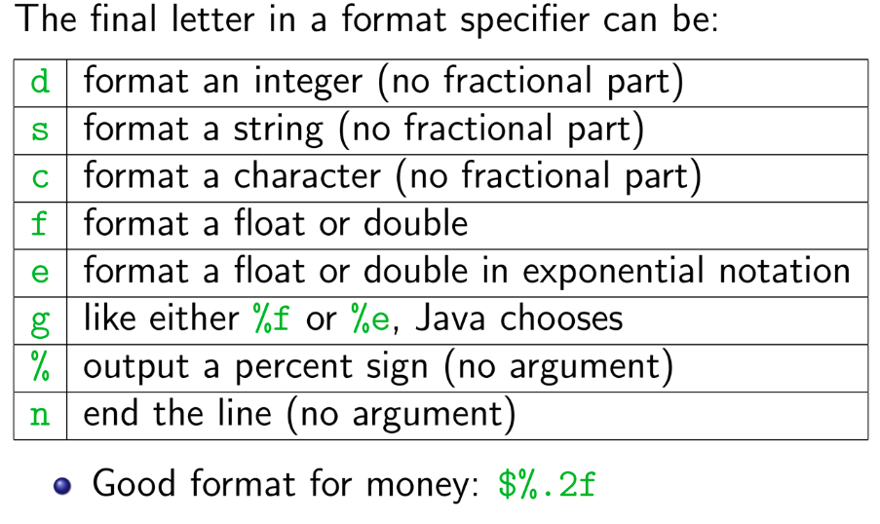
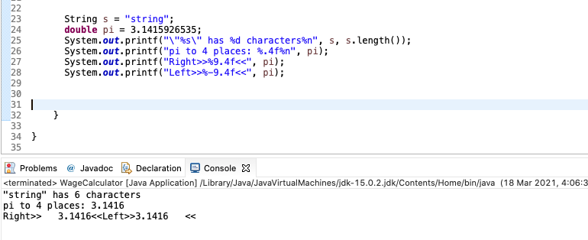
Console I/o(Out): Scanner
printf is like print, but it lets you control how data is formatted
Method from System.out.printf(format-string, args)
Example: System.out.printf(“Avarage: %5.2f”, average)
Format String: %X.Y
X is the minimum number of characters to be printed
Y is the number of digits of the value to print after the decimal point

Slide 11
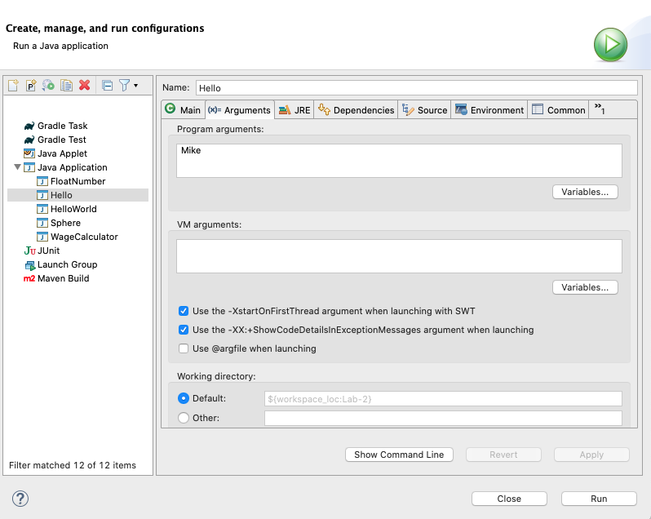
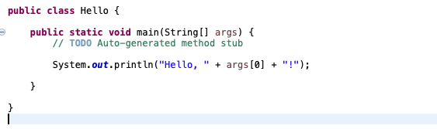
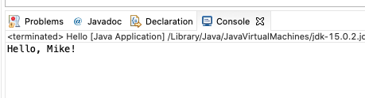
Command Line inputs/arguments
First argument: args[0], second argument: args[1]
Each of these arguments is a string (need to convert to other types for use)

Slide 12
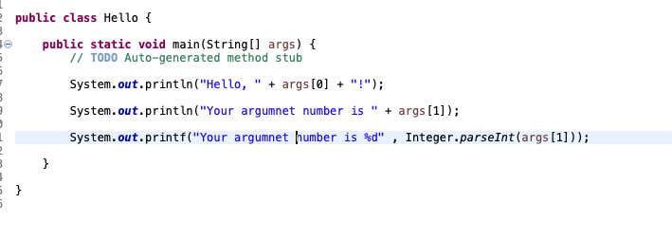
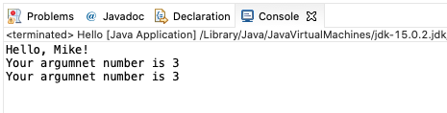
Command Line inputs/arguments
Convert to int
Integer.parseInt(String)

Slide 13
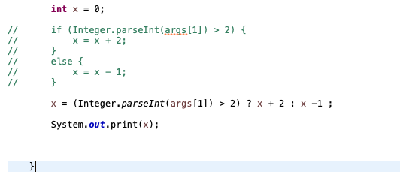

Conditional Operator
Alternative for if-else statement

Slide 14
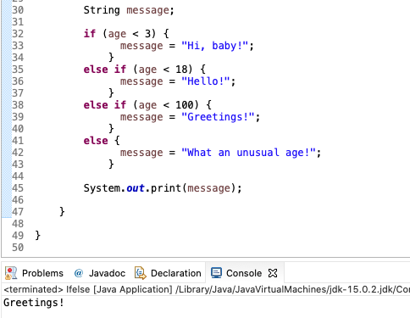
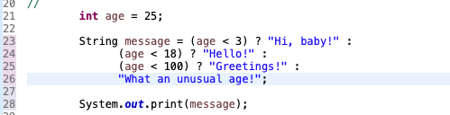
Conditional Operator
If - else if – else statement VS Conditional Operator

