Slide 1
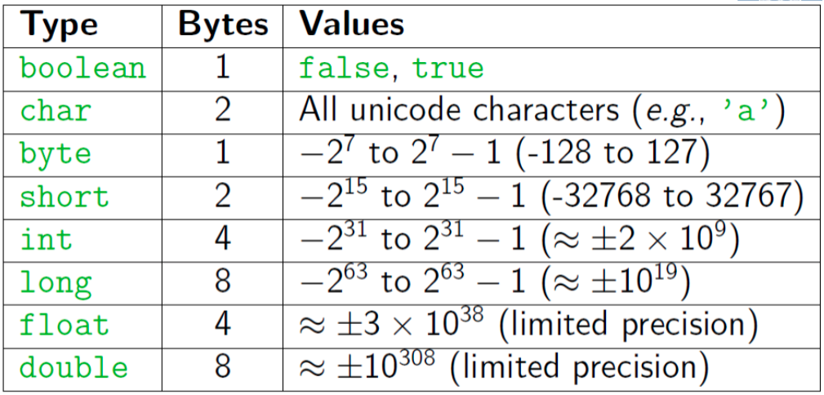
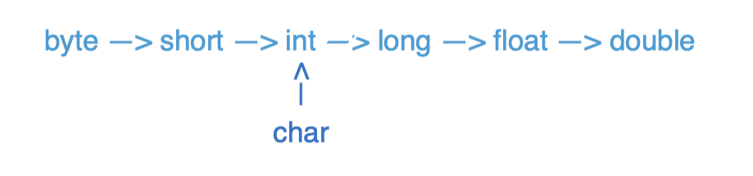
Java Types

Slide 2
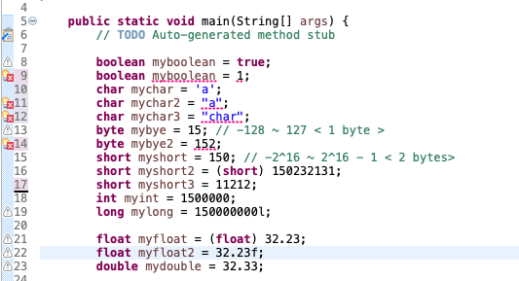
Java Types

Slide 3
Pre/Post Increment/Decrement
Pre-Increment/Decrement
++x/--x: returns the increment/decrement number and x becomes the increment/decrement number
Post-Increment/Decrement
x++/x--: returns the original number and x becomes the increment/decrement number
x == 8
++x == 9
x == 9
x == 4
--x == 3
x == 3
x == 8
x++ == 8
x == 9
x == 4
x-- == 4
x == 3

Slide 4
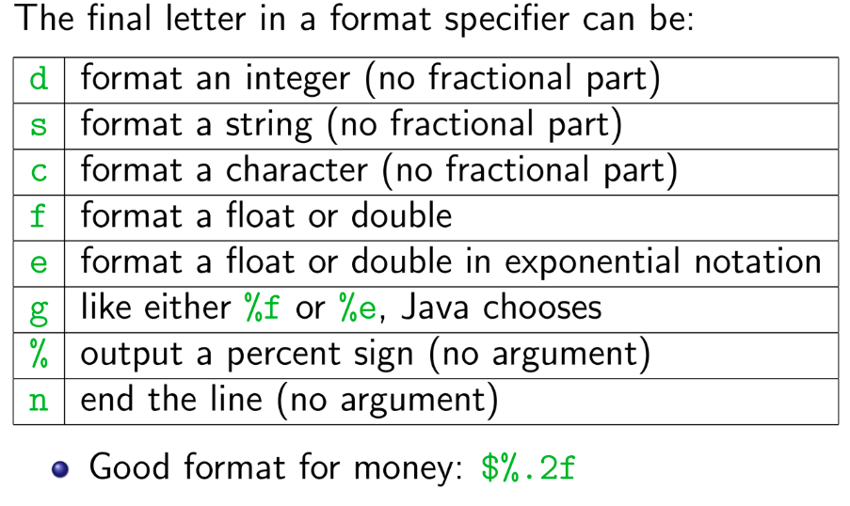
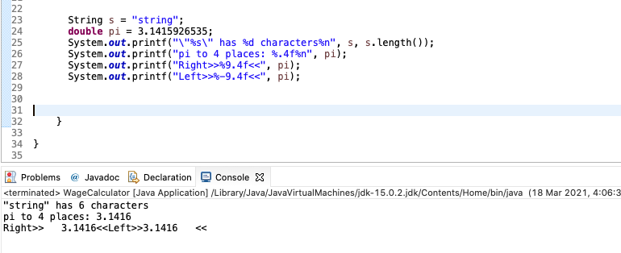
printf
Printf is like print, but it lets you control how data is formatted
Method from System.out.printf(format-string, args)
Example: System.out.printf(“Avarage: %5.2f”, average)
Format String: %X.Y
X is the minimum number of characters to be printed
Y is the number of digits of the value to print after the decimal point

Slide 5
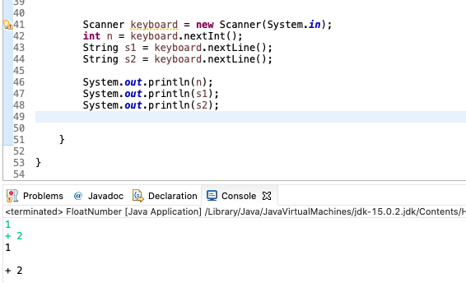
Scanner
Get from Console: Scanner keyboard = new Scanner(System.in);
Get from File: File text = new File("C:/temp/test.txt");
Scanner scanner = new Scanner(text);
.nextLine() reads the rest of the whole line as string
.next()/ .nextInt() / .nextDouble() reads until whitespace

Slide 6
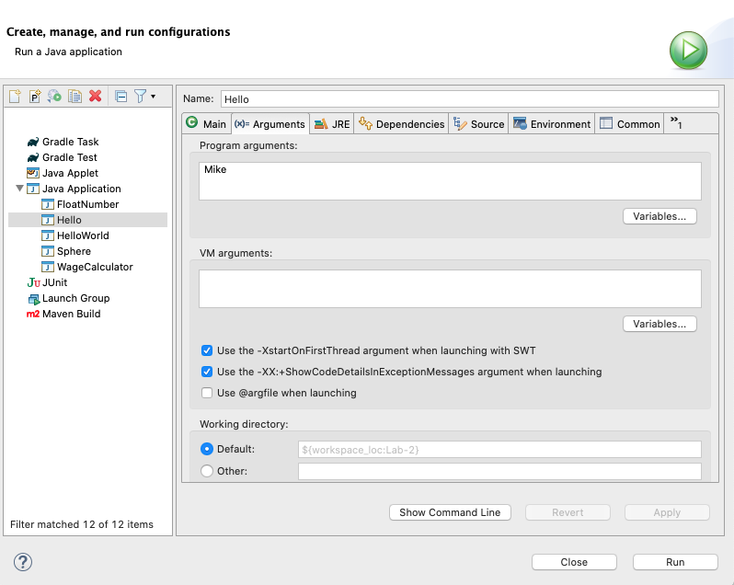
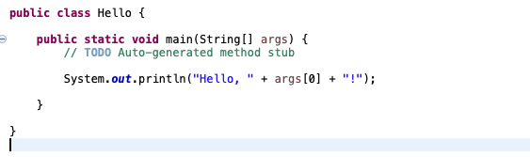
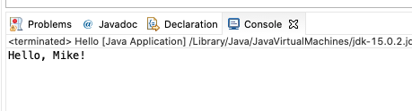
Command Line inputs/arguments
First argument: args[0], second argument: args[1]
Each of these arguments is a string (need to convert to other types for use)

Slide 7
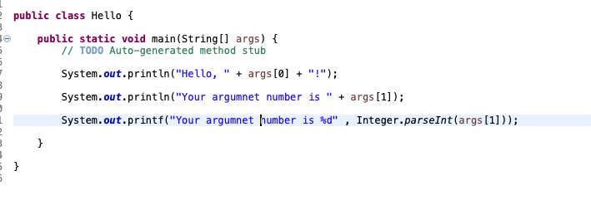
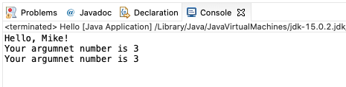
Command Line inputs/arguments
Convert to int
Integer.parseInt(String)

Slide 8
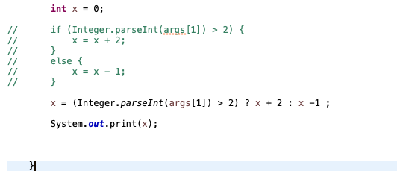

Conditional Operator
Alternative for if-else statement

Slide 9
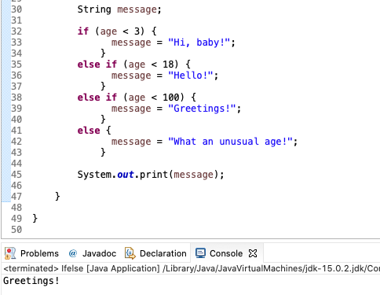
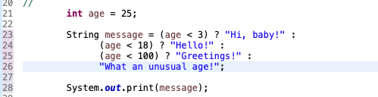
Conditional Operator
If - else if – else statement VS Conditional Operator

Slide 10
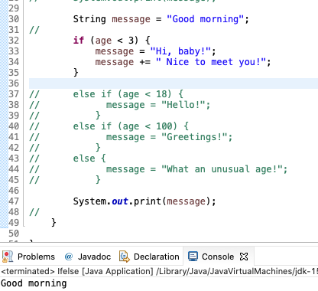
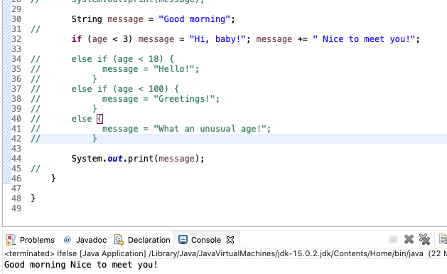
Compound statement
Turns multiple statements into a single statement that can be used in an if.
A good suggestion: Always use braces!
Always use indentation to make your code easy to read

Slide 11
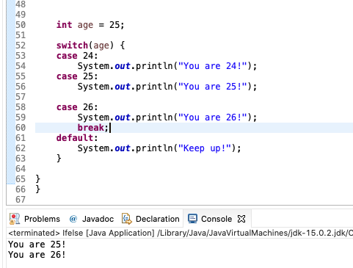
Switch
It begins executing with the next statement and stops when it reaches a break or end of the switch.
Always put break after each statement including default

Slide 12
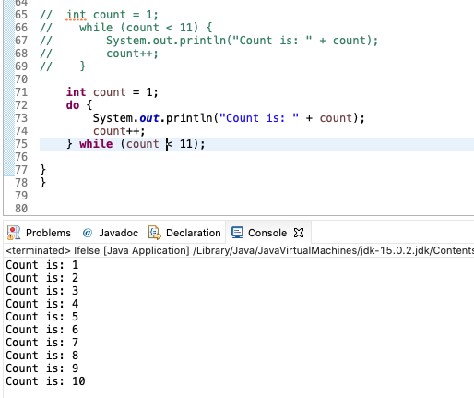
While VS do-while
While
entry control loop
condition is checked before loop execution
never execute loop if condition is false
there is no semicolon at the end of while statement
Do-While
exit control loop
condition is checked at the end of loop
executes false condition at least once since condition is checked later
there is semicolon at the end of while statement.

Slide 13
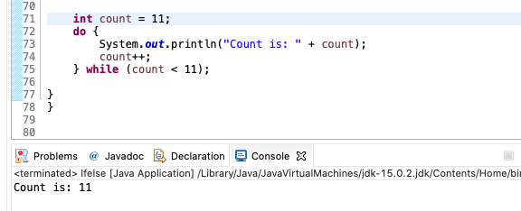
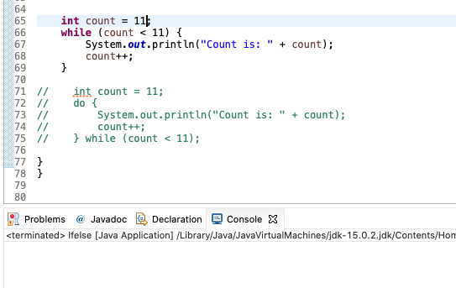
While VS do-while

Slide 14
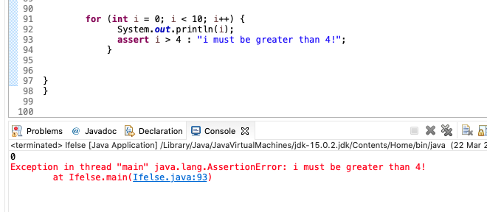
Assert
Check for some must meet condition!
Not common use
Enable Asset in Eclipse

Slide 15
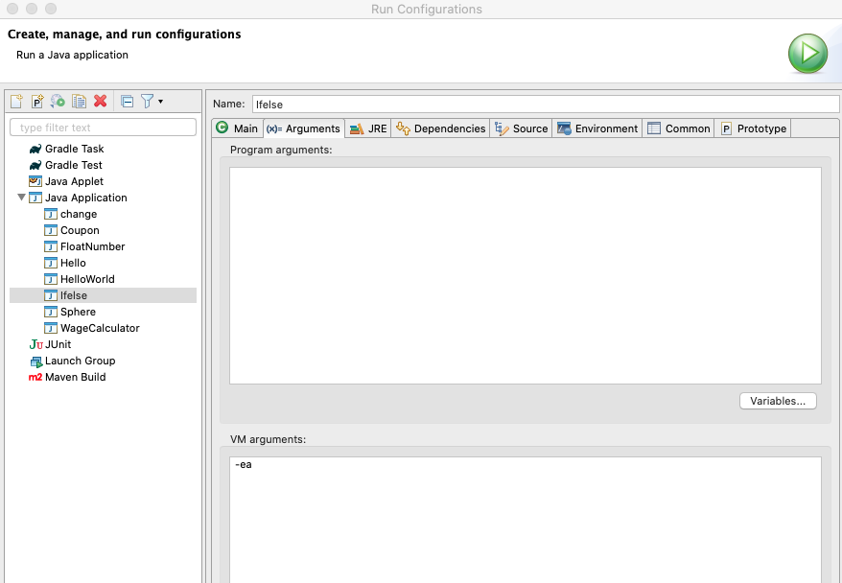

Assert
Check for some must meet condition!
Not common use
Enable Asset in Eclipse or Terminal

Slide 16
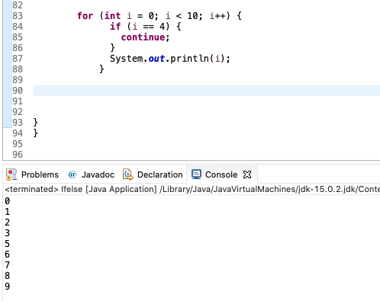
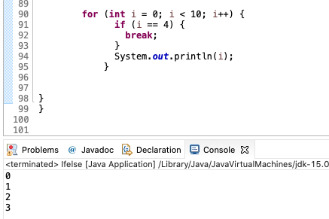
Continue VS Break
Continue passes one iteration; break breaks out of the whole loop

Slide 17
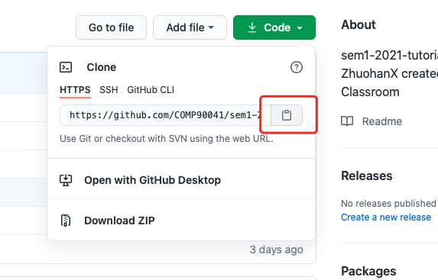
Git Clone a repository
Copy the link!

Slide 18
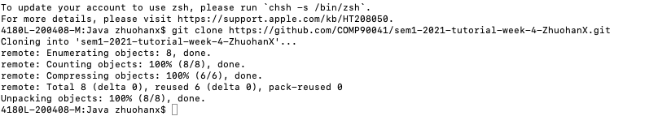
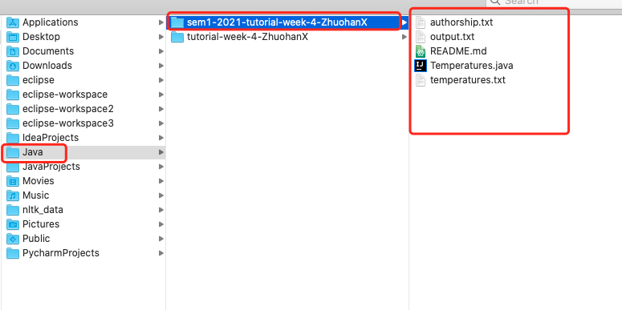
Git Clone a repository
Open a terminal at the suitable location and use git clone (link)

Slide 19
Import from File System and Edit Your Code

Slide 20
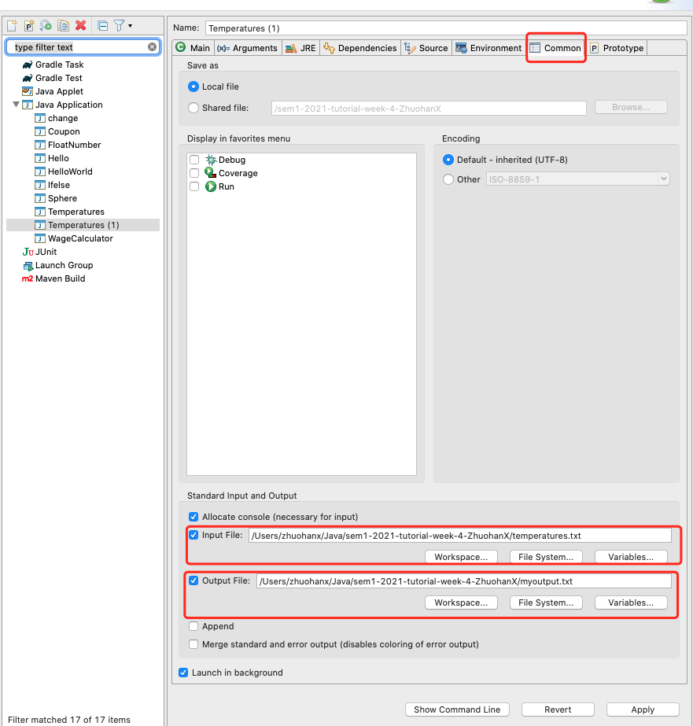
Run code with file input and output
Eclipse: Run configuration > Common > Input File and Output File.
Terminal : Java (Class) < (input file) > (output file)
Command can be separated (use only input or output)

Slide 21
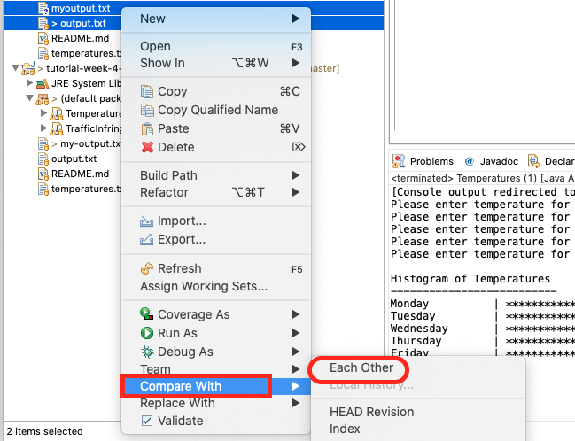
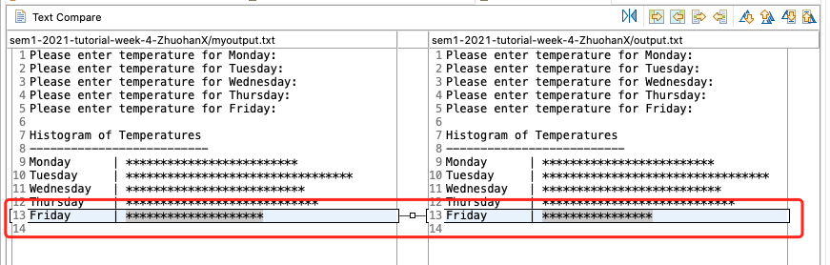
Compare the Differences
Eclipse: Select two files and use compare with each other

Slide 22
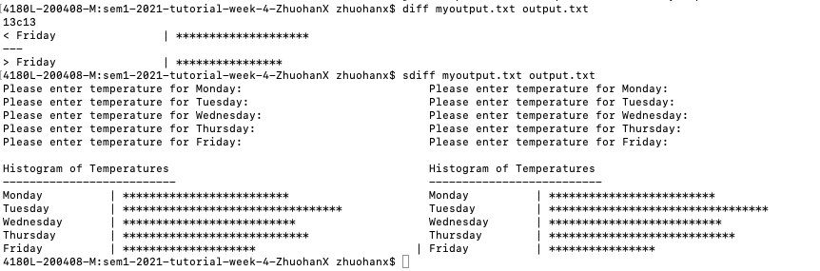
Compare the Differences
Terminal command: sdiff and diff

Slide 23
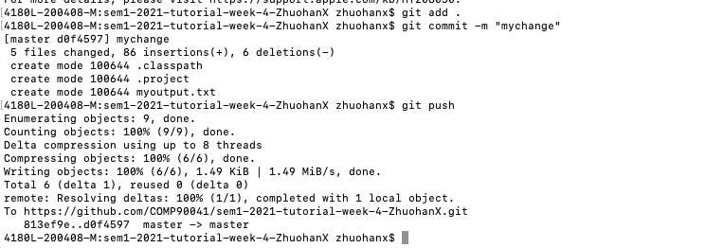
Commit code change and push
Add all your changed code files (. Means all)
Commit with commit message (for yourself to check)
Push to the remote repostitory

Slide 24
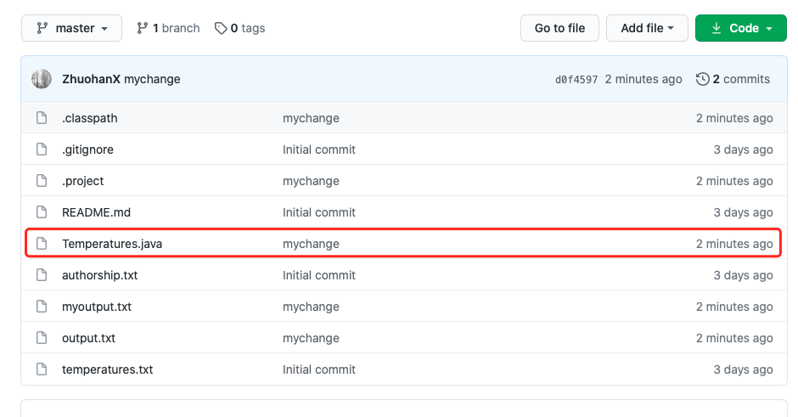
Commit code change and push
Updated file shows message and time!

Slide 25
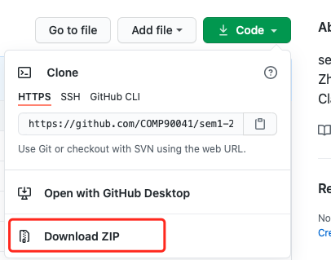
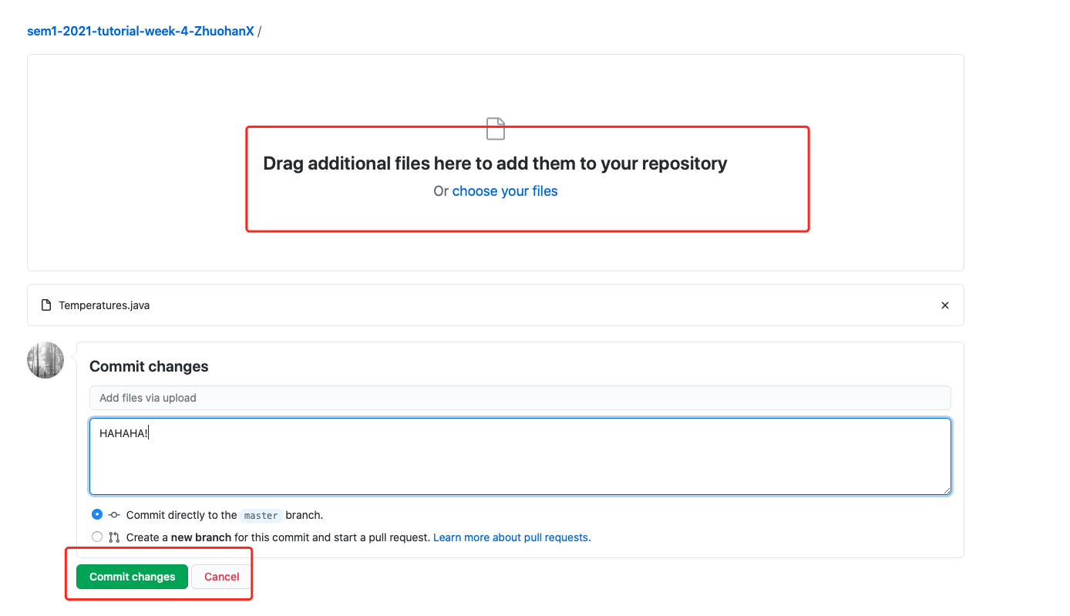
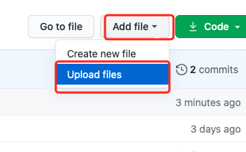
Do everything on Website
Download Code and Edit and drag your files and commit on webpage.

