Slide 1



COMP90041 lab 1

Slide 2
Self Introduction
NAME: zhUOHAN xIE
Email: zhuohan@unimelb.edu.au
Slides: https://github.com/ZhuohanX/COMP90041
Bachelor of software engineering at Xiamen University, china
Master of it coursework student, Unimelb
Phd Candidate for natural language generation from unimelb nlp group

Slide 3
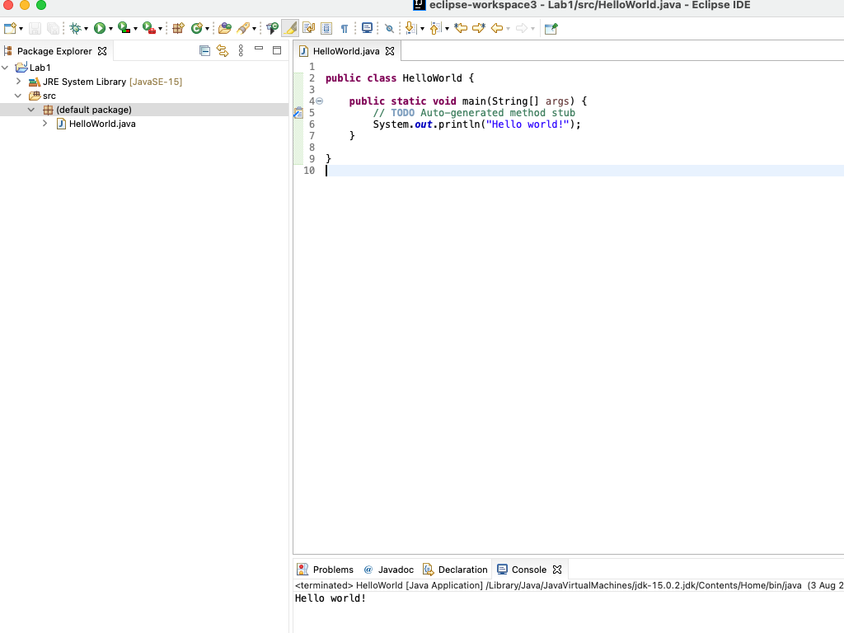
What is a program

Slide 4
Java Variables
Use variables to store your data i=0; while(i<100); i++;
Begin with lower case letter
Follow with lower case, except Capitalise the first letter of each word in your phrase, an approach called camel case
Examples for variable names: height, windowHeight, tallestWindowHeight
Best practice: make them descriptive, but not too long (clear abbreviations are okay)
It is important: DO NOT name it as a, b, c in your assignments, we will deduct mark for it!
It is okay to use i, j, k as indicator to control your loops, etc.
int number = 2;

Slide 5
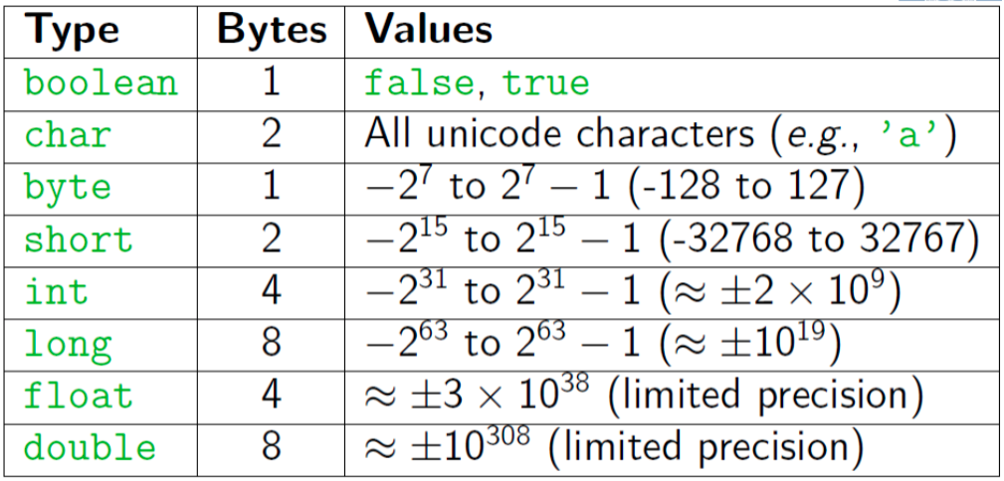
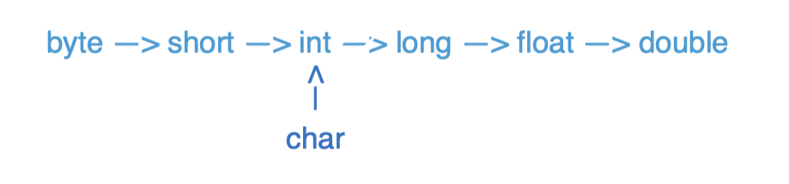
Java DATA Types

Slide 6
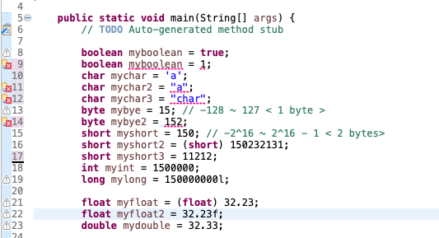
Java dATA Types

Slide 7
Pre/Post Increment/Decrement
Pre-Increment/Decrement
++x/--x: returns the increment/decrement number and x becomes the increment/decrement number
Post-Increment/Decrement
x++/x--: returns the original number and x becomes the increment/decrement number
x == 8
++x == 9
x == 9
x == 4
--x == 3
x == 3
x = 8
x++ =8
x= 9
x == 4
x-- == 4
x == 3

Slide 8
Console I/o(in): Scanner
First to import Scanner package: import java.util.Scanner;
Get from Console: Scanner keyboard = new Scanner(System.in);
Get from File: File text = new File("C:/temp/test.txt");
Scanner scanner = new Scanner(text);
.nextLine() reads the rest of the whole line as string
.next()/ .nextInt() / .nextDouble() reads until whitespace

Slide 9
Console I/o(Out): Scanner
System.out.print: print without a newline at the end.
System.out.print(‘\n’): print a newline
System.out.println: print with a newline at the end.

Slide 10
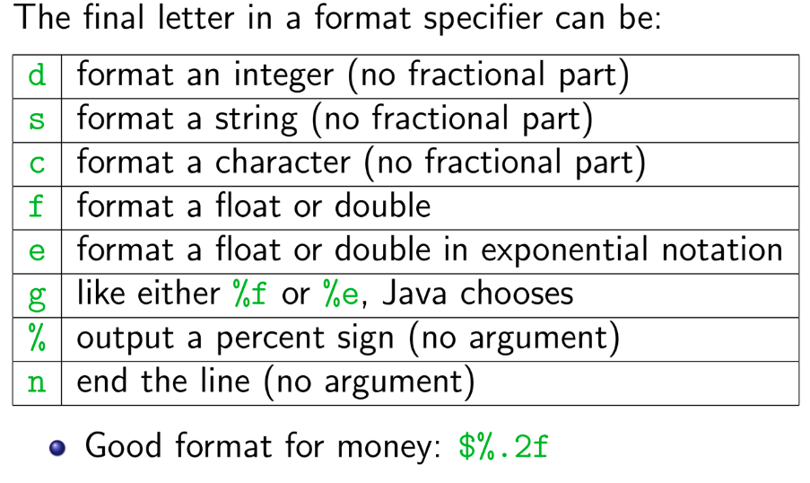
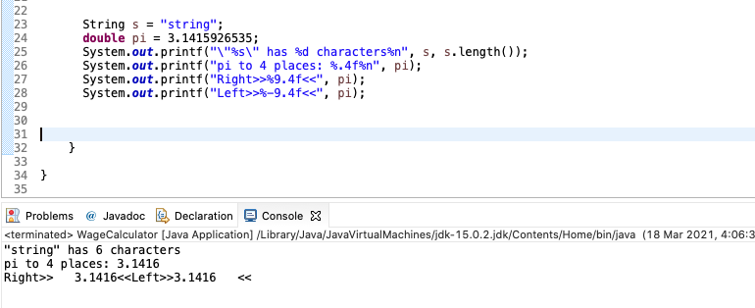
Console I/o(Out): Scanner
printf is like print, but it lets you control how data is formatted
Method from System.out.printf(format-string, args)
Example: System.out.printf(“Avarage: %5.2f”, average)
Format String: %X.Y
X is the minimum number of characters to be printed
Y is the number of digits of the value to print after the decimal point

Slide 11
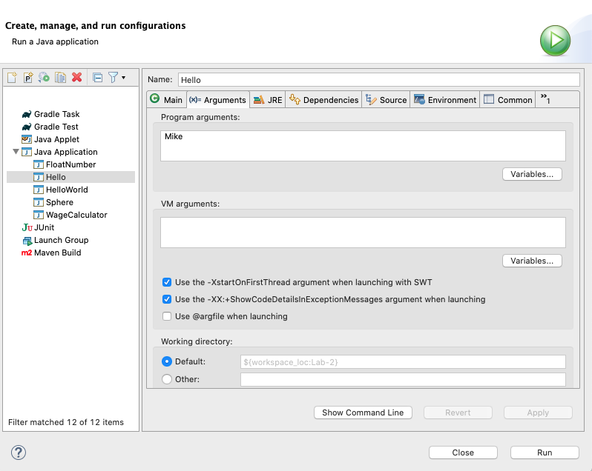
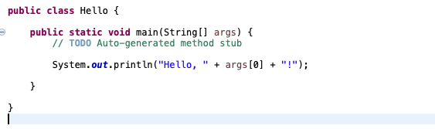
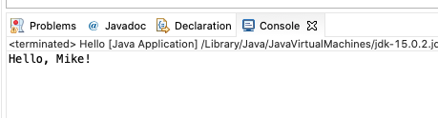
Command Line inputs/arguments
First argument: args[0], second argument: args[1]
Each of these arguments is a string (need to convert to other types for use)

Slide 12
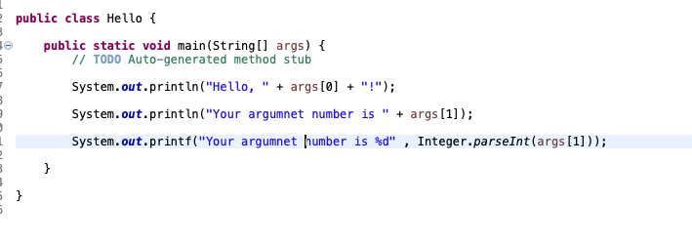
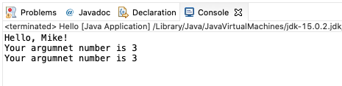
Command Line inputs/arguments
Convert to int
Integer.parseInt(String)

Slide 13
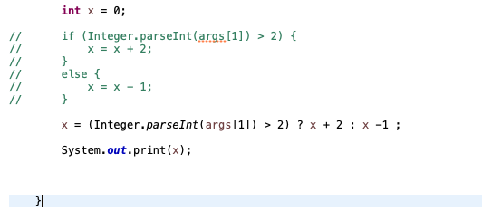

Conditional Operator
Alternative for if-else statement

Slide 14
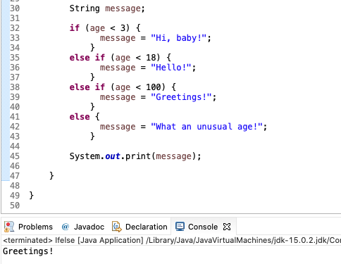
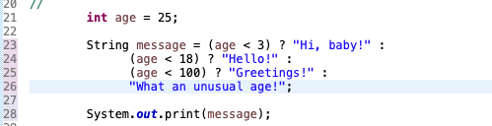
Conditional Operator
If - else if – else statement VS Conditional Operator

