Slide 1



Java Fourth lab

Slide 2
Recap
Class and methods
Modifiers: public and private
Accessor and mutator
Overloading (in constructor)

Slide 3
static methods and variables
A static method can be used without a calling object, need to use the keyword static
public static returnedType MethodName(parameters…)
A static method is invoked using the classname.methodname()
A static method has no this inside the method, so it cannot refer to an instance variable of the class or invoke a non-static method of the class, but it can invoke another static method
A static variable is a variable that belongs to the class as a whole, not just to one object.
Only one copy of a static variable per class, unlike instance variable where each object has its own copy
All objects of the class can read and change a static variable
Static method can access a static variable
Math class has a lot methods you can call using Math.methodnames()

Slide 4
Wrapper classes for primitive types
Wrapper classes provide a class type corresponding to each of the primitive types and makes it possible to have class types that behave somewhat like primitive types.
Boxing: go from a primitive type to an object of its wrapper class
Unboxing: go from an object of wrapper class to the corresponding value of a primitive type
Boxing: Integer integerObject = new Integer(2);
Unboxing: int i = integerObject.intValue();

Slide 5
Variables and Memory
Second memory is used to hold files for “permanent” storage
Main memory (primary memory) is used by the computer when running a program
Values in a program are kept in main memory
Main memory consists of a long list of numbered locations called bytes
Address: the number that identifies a byte
Values of most data types require more than one byte of storage and the
Address of the first byte of this memory location is used as the address for the data
When the variable is a primitive type, the value of the variable is stored in the memory location, each primitive type always require the same amount of memory to store its values
When the variable is a class type, only the memory address (or reference) where the object is located is stored in the memory location

Slide 6
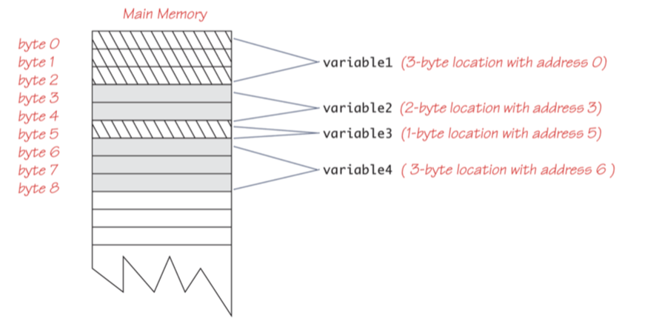

Slide 7
Class Assignment and Parameters
Two reference variables can contain the same reference, assignment sets the reference to the same object
variable1 = variable2;
A method cannot change the value of a variable of a primitive type that is an argument to the method
In contrast, a method can change the values of the instance variables of a class type that is an argument to the method.
== operator checks that two class type variables have the same memory address
equals checks two class type variables have the same data values (often write by yourself)
null is a ”placeholder” for a reference that does not name any memory location, it is like a memory address, use == or != not equals

Slide 8
Immutable and mutable Class
A class that contains no methods (other than constructors) that change any of the data in an object of the class is called an immutable class (String class is an immutable class)
The mutable objects support the setters and getters both. Comparatively, the immutable objects support only setters, not getters.
Objects of such classes are called immutable objects
A class that contains public mutator methods or other public methods that can change the data in its objects is called a mutable class
Objects of which are mutable objects

Slide 9
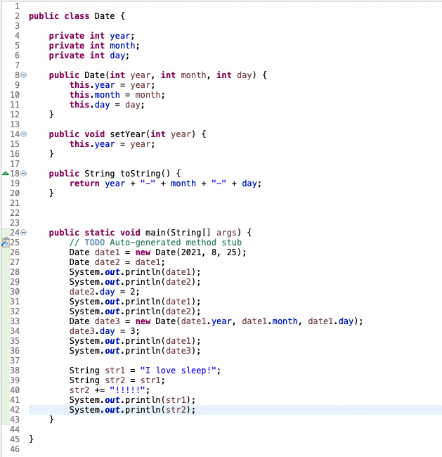
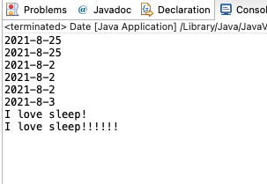
Immutable and mutable Class

Slide 10
Deep and Shallow Copy
A copy constructor is a constructor with a single argument of the same type as the class
A deep copy of an object is a copy that with one exception has no references in common with the original. Exception: References to immutable objects
Any copy that is not a deep copy is called a shallow copy
Privacy leak: Shallow Copy without create a new instance variable for mutable class or return a mutable object can cause privacy leak. The values can be changed by others

