Slide 1



Java fifth lab

Slide 2
Recap
Class and methods
Deep copy and shallow copy

Slide 3
Arrays
An array that behaves like this collection of variables, all of type double, can be created using one statement as follows:
double[] score = new double[5];
Use index score[0], score[1], score[2], score[3], score[4] to get the number 1, 2, 3, 4, 5 of the element.
An array is declared and created in almost the same way that objects are declared and created
BaseType[] ArrayName = new BaseType[size];
Usually use a for loop to go through an array.
Array is an object and has an instance variable: length.
score.length is 5.
Index is from 0 to length-1, other indexs would cause an out-of-bounds error.
Initialize with declare: int[] age = {2, 12, 1} (age.length is 3)
Or initialize with a for loop
If not initialized, they will automatically be initialized to the default value for their base type

Slide 4
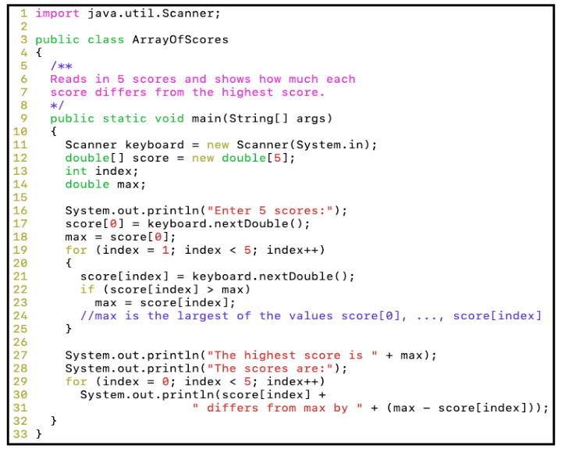
Arrays

Slide 5
Arrays and Reference
Arrays are objects
A variable of an array type holds the address of where the array object is stored in memory
Since an array is a reference type, the behavior of arrays with respect to assignment (=), equality testing (==), and parameter passing are the same as that described for classes
the assignment operator (=) copies this memory address
the equality operator (==) tests two arrays share the same address, not values.
Need to write methods to check length and each values to check if they are equal.
The heading for the main method of a program has a parameter for an array of String
You can return an array in the method.
Date[] holidayList = new Date[20];
Each of these indexed variables are automatically initialized to null
for (int i=0; i<holidayList.length; i++) { holidayList[i] = new Date(); }
Both array indexed variables and entire arrays can be used as arguments to methods

Slide 6
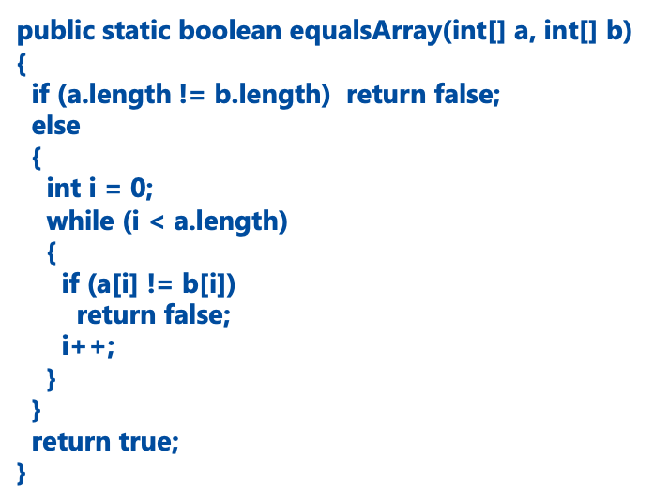
Arrays and Reference

Slide 7
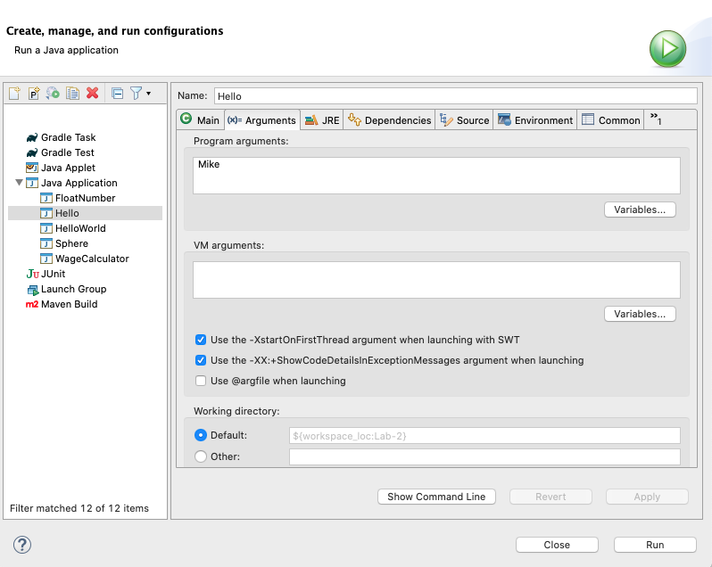
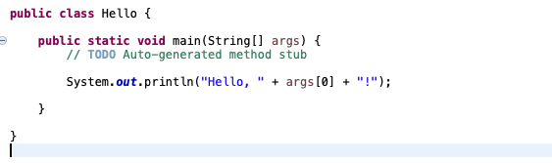
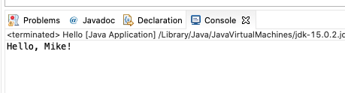
Command Line inputs/arguments
First argument: args[0], second argument: args[1]
Each of these arguments is a string (need to convert to other types for use)

Slide 8
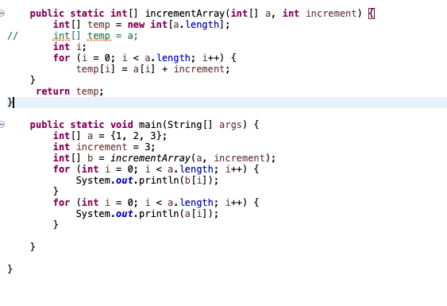
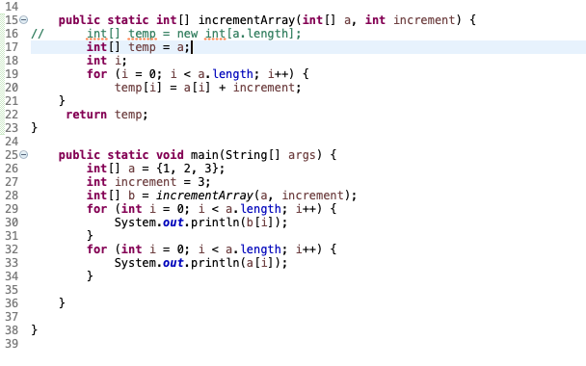
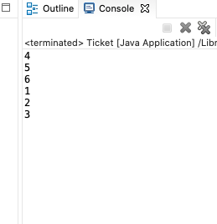
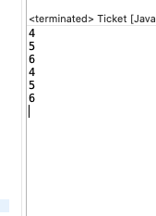
Arrays and Reference

Slide 9
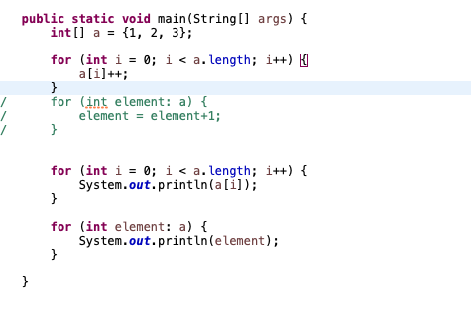
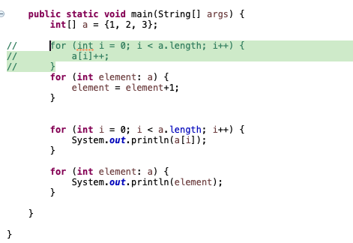
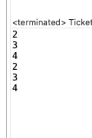
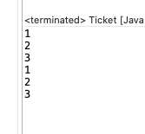
for-each loop to go through array

Slide 10
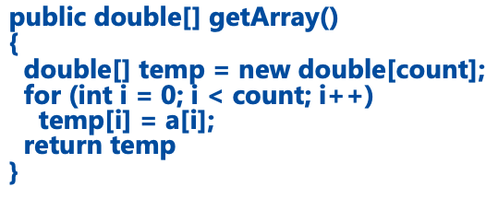
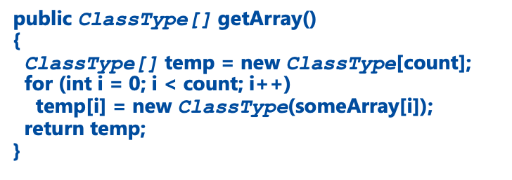
Avoid privacy leak for array
Array is a mutable object, don’t give an array directly, but create a new one and copy all values.

Slide 11
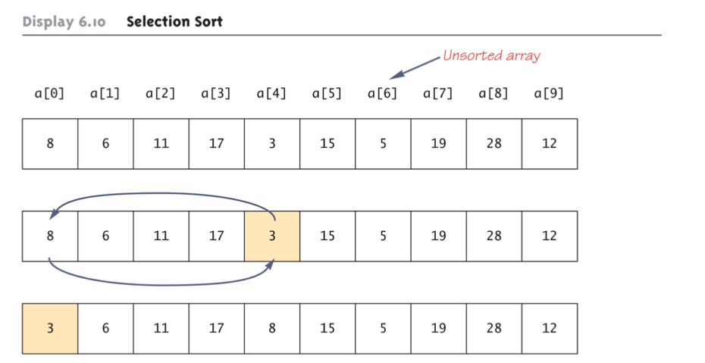
Selection Sort in Array

Slide 12
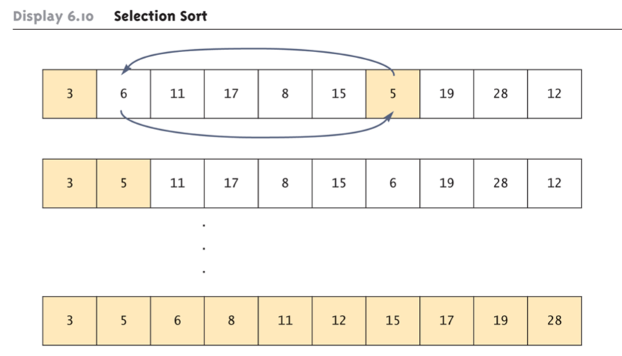
Selection Sort in Array

Slide 13
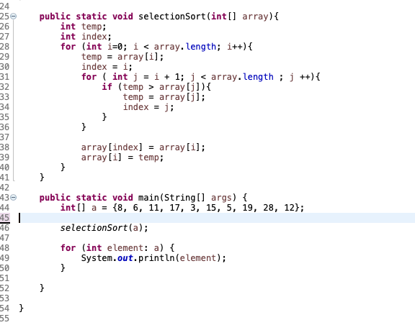
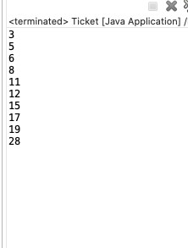
Selection Sort in Array

Slide 14
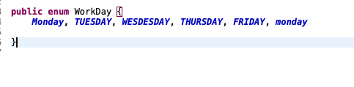
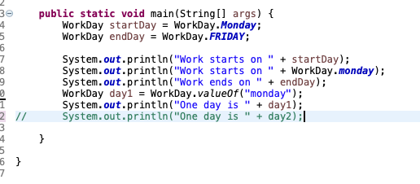
Enumerated Type
Work likes String but one variable can only be set to within the fixed items. Perfectly fit with switch

Slide 15
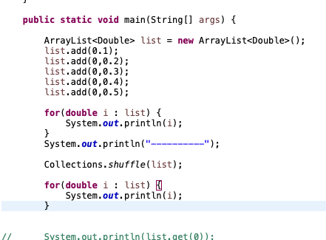
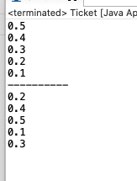
ArrayList
An object that can works like array, but change length and less effeciently.
The class ArrayList is implemented using an array as a private instance variable – When this hidden array is full, a new larger hidden array is created and the data is transferred to this new array
An ArrayList is less efficient than an array It does not have the convenient square bracket notation The base type of an ArrayList must be a class type or interface type (or other reference type): it cannot be a primitive type
ArrayList come with many powerful methods you can use.

Slide 16
Multidimendional Arrays
Multidimensional arrays are declared and created in the same ways as one-dimensional arrays.
double[][]table = new double[100][10];
int[][][] figure = new int[10][20][30];
Person[][] = new Person[10][100];
Two-dimensional array is array of arrays
char[][] page = new char[30][100];
page.length is equal to 30
page[0].length is equal to 100
Ragged array: an array that has a
different number of elements per row

Slide 17
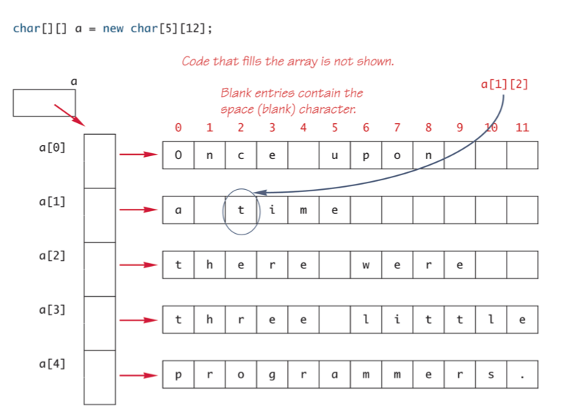
Multidimendional Arrays

Slide 18
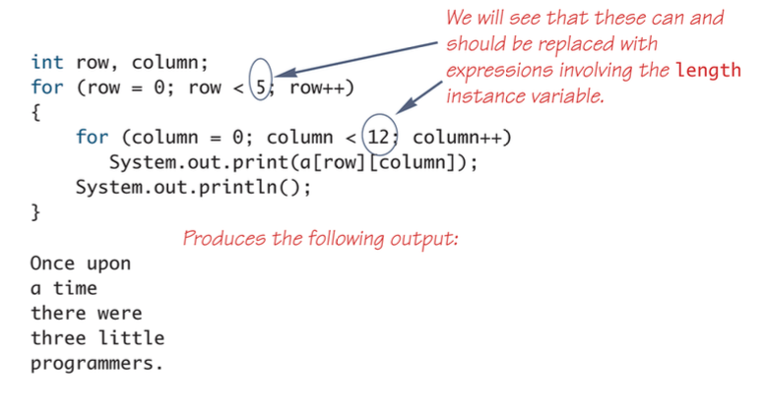
Multidimendional Arrays

Slide 19
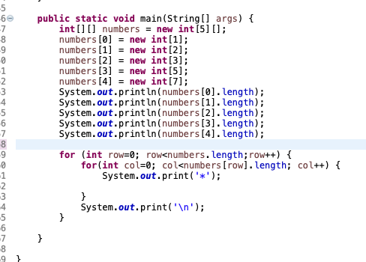
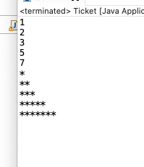
Multidimendional Arrays

