Slide 1



COMP90041 lab 2

Slide 2
Recap
How have you been going with programming / the subject / University Life ?
Are you able to run java outside the Ed platform?
Any question about Java variable name or types?
Any question about Terminal input and output?

Slide 3
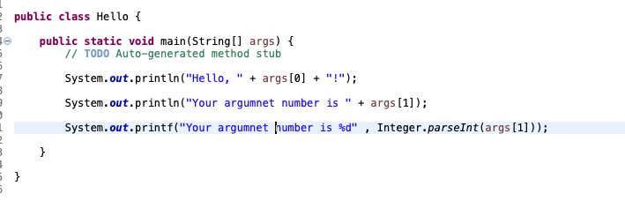
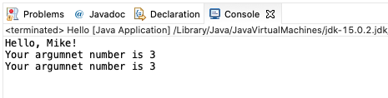
Command Line inputs/arguments
Convert to int
Integer.parseInt(String)

Slide 4
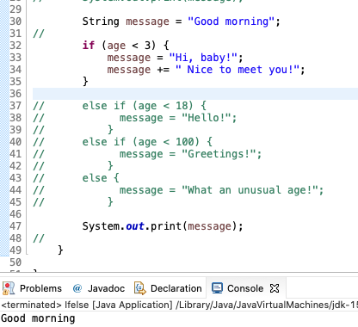
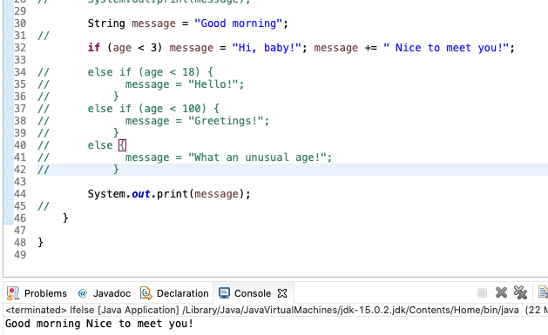
Compound statement
Turns multiple statements into a single statement that can be used in an if.
A good suggestion: Always use braces!
Always use indentation to make your code easy to read

Slide 5
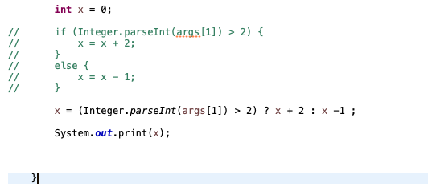

If-else and Conditional Operator
Alternative for if-else statement

Slide 6
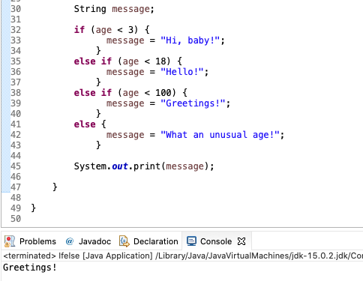
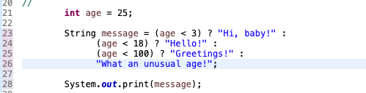
Conditional Operator
If - else if – else statement VS Conditional Operator

Slide 7
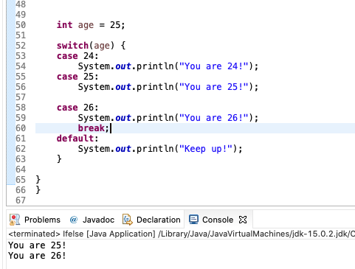
Switch
It begins executing with the next statement and stops when it reaches a break or end of the switch.
Always put break after each statement including default
Why use switch when if-else is so powerful??? Simple to read and modify and faster when we have more case.
Recommend to use when you have multiple atomic conditions!

Slide 8
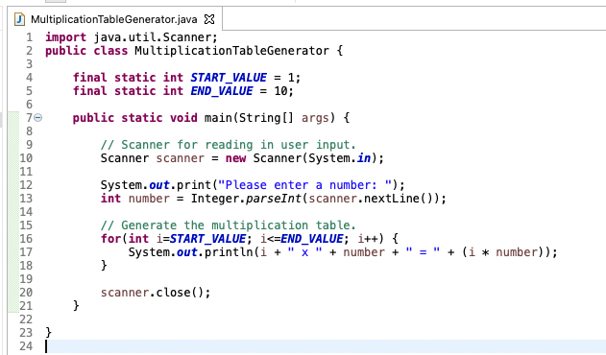
For loop
It begins executing with the next statement and stops when it reaches a break or end of the switch.
Always put break after each statement including default

Slide 9
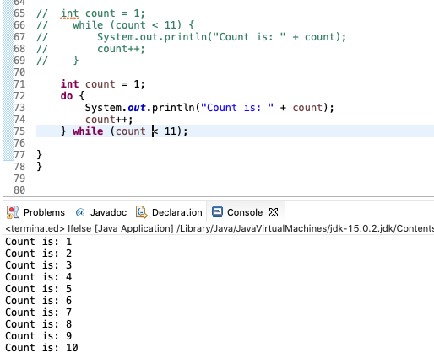
While VS do-while
While
entry control loop
condition is checked before loop execution
never execute loop if condition is false
there is no semicolon at the end of while statement
Do-While
exit control loop
condition is checked at the end of loop
executes false condition at least once since condition is checked later
there is semicolon at the end of while statement.

Slide 10
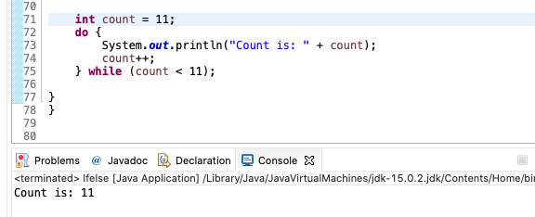
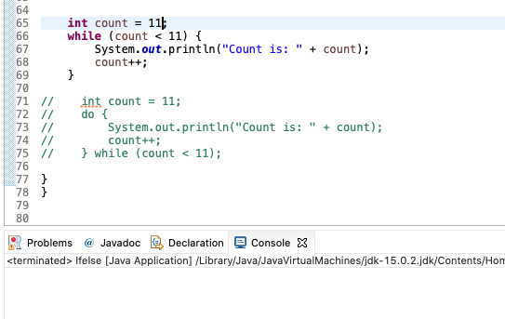
While VS do-while

Slide 11
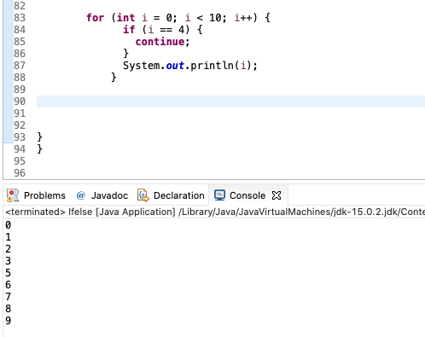
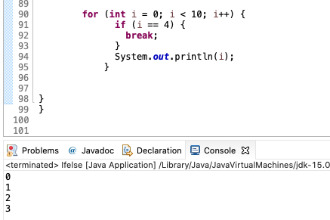
Continue VS Break
Continue passes one iteration; break breaks out of the whole loop

Slide 12
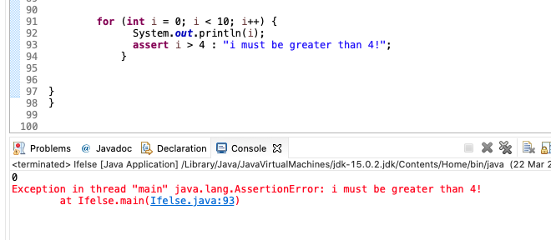
Assert
Check for some must meet condition!
Not common use
Enable Asset in Eclipse

Slide 13
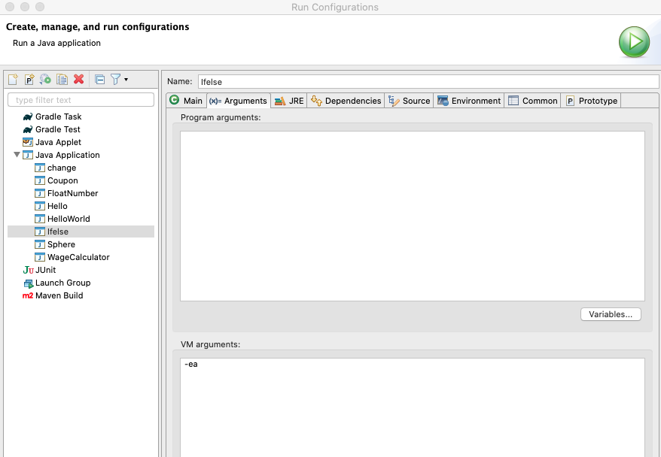

Assert
Check for some must meet condition! (Not common use)
Enable Asset in Eclipse or Terminal
java -enableassertions / -ea

