Slide 1



COMP90041 lab 3

Slide 2
Recap
Conditions : if-else if-else and switch
Loops: for and while
Break and continue

Slide 3
Discussion of Theory
What is duplicate code? Why do we want to avoid it? How can we factor it out?

Slide 4
Discussion of Theory
What is duplicate code? Why do we want to avoid it? How can we factor it out?
Duplicate code is code that is very similar, which was likely created by copying and pasting existing code, and modifying small parts of it.
While using duplicate code can sometimes be a convenient and "quick" way of solving a problem, it creates maintenance issues in your code.
Namely, if your code needs to be updated because it has a bug, or a feature needs to be added, then you need to change the code in every copy of the code.
Instead, we should generalize such code using loops and methods.

Slide 5
Discussion of Theory
What are loops, and how do they help us simplify our code in programming?

Slide 6
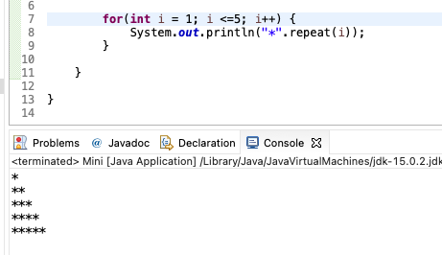
Discussion of Theory
What are loops, and how do they help us simplify our code in programming?
For repetitive actions, we use loops to avoid repeating the code

Slide 7
Discussion of Theory
How do you choose for loop or while loop?

Slide 8
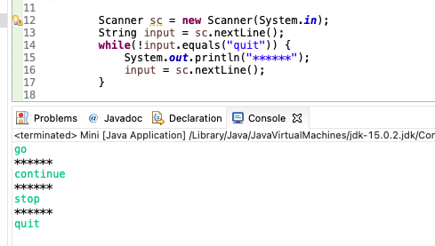
Discussion of Theory
Choose for loop or while loop

Slide 9
Discussion of Theory
What is a method? How does it help us simplify our code?
A method can be thought of as a function (ie a mathematical function) that takes in inputs, performs some actions, and may produce some output.
Method consists of a heading and a method body
Methods are invoked using the name of the calling object (non-static methods) or class name (static methods)
Static methods: Classname.methodname(); or Math.pow();
Non-static methods: objectname.methodname() or str1.equals(str2)
Method can compute and return a type value or just perform an action and no return (void method)
A program in Java is a class that contains a main method (a void method)
public static void main(String[] args)

Slide 10
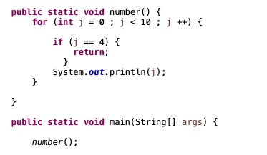
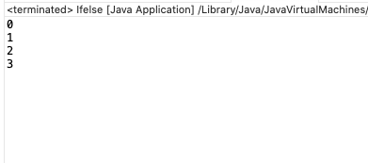
return
The body of a method that returns a value must contain one or more return statements
A return statement specifies the value returned and ends the method invocation: return Expressions;
A void method need not contain a return statement but can use return to end the code.

Slide 11
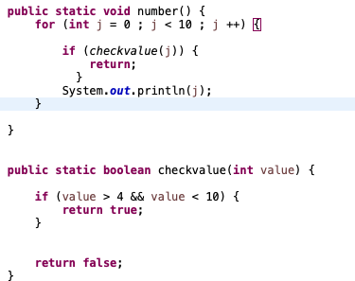
Use returned value
A invocation of a method that returns a value can be used anyplace that a value of the RetrunedType can be used.
An invocation of a method that returns a value of type boolean returns either true or false, usually used in if-else statement or while loops.

