Slide 1
Digital Integrated Circuits Designing Combinational Logic Circuits Fuyuzhuo

Slide 2
Combinational vs. Sequential Logic
Combinational
Sequential
Output =
(
)
Output =
(
)
f
In, Previous In
f
In

Slide 3
agenda
Static CMOS design
Ratioed logic design-Pseudo NMOS
Pass transistor design
Dynamic logic

Slide 4

agenda
Static CMOS design
Ratioed logic design___Pseudo NMOS
Pass transistor design
Dynamic logic
What is the difference between inverter and logic?

Slide 5
Static CMOS logic
CMOS static characteristic
CMOS propagate delay
Large fan-in technology
Logic effort
CMOS power analysis

Slide 6
Static CMOS Circuit
Gate output is connected to either V_{DD} or V_{SS} via a low-resistive path*
Contrast to the dynamic circuit class, which relies on temporary storage of signal values on the capacitance of high impedance circuit nodes
* except during the switching transients

Slide 7
Standard Cell Layout Methodology
Routing
channel
V_{DD}
signals
GND
What logic function is this?
Notes:
Route VDD and GND horizontally
Route singals in poly perpendicular to VDD and GND (vertically) – poly can serve as input to both nfets and pfets
Order inputs (consistent Euler path) to optimize the horizontal connectivity of diff strips
want unbroken row of devices with abutting source/drain connections – so there is only one strip of diffusion in both wells
3) Place diffs in horizontal strips
4) Interconnect appropriately
Interconnect between cells are done in “routing channels”
Contacts and wells not shown.
What does this implement?? (NAND feeding an Inverter – so an AND)

Slide 8
OAI21 Logic Graph
X
PUN
A
j
C
B
C
X
i
V_{DD}
X = !(C • (A + B))
C
i
B
j
A
A
B
PDN
A
GND
B
C
Notes:
Systematic approach to derive order of input signal wires so gate can be laid out to minimize area
Note PUN and PDN are duals (parallel <-> series)
Vertices are nodes (signals) of circuit, VDD, X, GND and edges are transitions

Slide 9
Two Stick Layouts of !(C • (A + B))
interrupt
A
C
B
A
B
C
V_{DD}
V_{DD}
X
X
GND
GND
uninterrupted diffusion strip
Notes:
Line of diffusion layout – abutting source-drain connections
Note crossover of left layout eliminated by A B C ordering – talk about area needed for via (and speed impact due to via resistance)

Slide 10
Consistent Euler Path
An uninterrupted diffusion strip is possible only if there exists a Euler path in the logic graph
X
C
X
i
V_{DD}
B
j
A
GND
Euler path: a path through all nodes in the graph such that each edge is visited once and only once
For a single poly strip for every input signal, the Euler paths in the PUN and PDN must be consistent (the same)

Slide 11
Consistent Euler Path
An uninterrupted diffusion strip is possible only if there exists a Euler path in the logic graph
X
C
X
i
V_{DD}
B
j
A
GND
Euler path: a path through all nodes in the graph such that each edge is visited once and only once
A
B
C
For a single poly strip for every input signal, the Euler paths in the PUN and PDN must be consistent (the same)
Notes:
A path through all nodes in the graph such that each edge is visited once and only once.
The sequence of signals on the path is the signal ordering for the inputs.
PUN and PDN Euler paths are (must be) consistent (same sequence)
If you can define a Euler path then you can generate a layout with no diffusion breaks
A B C
C A B
B C A → no PDN -> show how with ppt pen drawing
B A C
A C B -> no PDN
C B A

Slide 12
OAI22 Logic Graph
X
PUN
A
C
B
D
D
C
X
V_{DD}
X = !((A+B)•(C+D))
C
D
B
A
A
B
PDN
A
GND
B
C
D
Notes:
Consistent Euler paths
ABDC
BDCA
DCAB
CABD
BACD
ACDB
CDBA
DBAC
and NOT DACB, BCAD, etc.

Slide 13
OAI22 Layout
A
B
D
C
V_{DD}
X
GND
Some functions have no consistent Euler path like
x = !(a + bc + de) (but x = !(bc + a + de) does!)
Notes:
Can you draw the Euler diagrams for both and show the consistent Euler path(s) for the second?

Slide 14
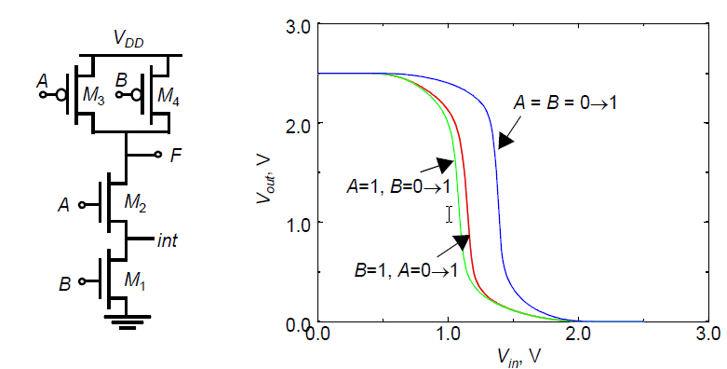
VTC is Data-Dependent
The threshold voltage of M₂ is higher than M₁ due to the body effect (γ)
V_{Tn1} = V_{Tn0}
V_{Tn2} = V_{Tn0} + γ(√(|2φ_{F}| + V_{int}) - √|2φ_{F}|)
since V_{SB} of M₂ is not zero (when V_{B} = 0) due to the presence of Cint
Notes:
VTC characteristics are dependent upon the data input patterns applied to the gate (so the noise margins are also data dependent!)
Threshold voltage of M2 will be higher than transistor M1 due to body effect
Case 1 – both transistors in the PUN are on simultaneously for A=B=0, representing a strong pull-up. In the other two cases only one of the pull-up devices is on. So the VTC is shifted left as a result of the weaker PUN for the second and third cases.
Case 2 – see Case 3, small difference can be attributed to the body effect of M2 and the drive voltage
Case 3 – M2 as resistor in series with M1, so only small effect on VTC; since pulldown is strong and pullup weaker than case 1, VTC shifted to the left
(also have to discharge both CL (on the output) and Cint (possibly) thru M1 so will also be slower!)

Slide 15
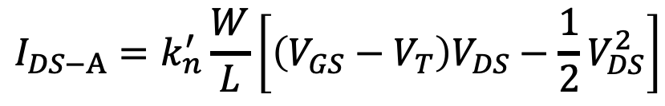
VTC is Data-Dependent
$$I_{DS−A}=k_{n}^{′}\frac{W}{L}\left[\left(V_{GS}−V_{T}\right)V_{DS}−\frac{1}{2}V_{DS}^{2}\right]$$
Notes:
VTC characteristics are dependent upon the data input patterns applied to the gate (so the noise margins are also data dependent!)
Threshold voltage of M2 will be higher than transistor M1 due to body effect
Case 1 – both transistors in the PUN are on simultaneously for A=B=0, representing a strong pull-up. In the other two cases only one of the pull-up devices is on. So the VTC is shifted left as a result of the weaker PUN for the second and third cases.
Case 2 – see Case 3, small difference can be attributed to the body effect of M2 and the drive voltage
Case 3 – M2 as resistor in series with M1, so only small effect on VTC; since pulldown is strong and pullup weaker than case 1, VTC shifted to the left
(also have to discharge both CL (on the output) and Cint (possibly) thru M1 so will also be slower!)

Slide 16
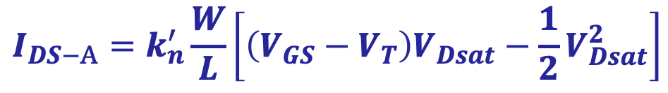
VTC is Data-Dependent
$$I_{DS−A}=k_{n}^{′}\frac{W}{L}\left[\left(V_{GS}−V_{T}\right)V_{Dsat}−\frac{1}{2}V_{Dsat}^{2}\right]$$
Notes:
VTC characteristics are dependent upon the data input patterns applied to the gate (so the noise margins are also data dependent!)
Threshold voltage of M2 will be higher than transistor M1 due to body effect
Case 1 – both transistors in the PUN are on simultaneously for A=B=0, representing a strong pull-up. In the other two cases only one of the pull-up devices is on. So the VTC is shifted left as a result of the weaker PUN for the second and third cases.
Case 2 – see Case 3, small difference can be attributed to the body effect of M2 and the drive voltage
Case 3 – M2 as resistor in series with M1, so only small effect on VTC; since pulldown is strong and pullup weaker than case 1, VTC shifted to the left
(also have to discharge both CL (on the output) and Cint (possibly) thru M1 so will also be slower!)

Slide 17
CMOS Properties
Full rail-to-rail swing high noise margins
not dependent upon device sizes ratioless
Always a path to Vdd or Gnd low output impedance
zero steady-state input current high input resistance
No direct path steady state no static power
Propagation delay function of load capacitance and resistance of transistors

Slide 18
Static CMOS logic
CMOS static characteristic
CMOS propagate delay
Large fan-in technology
Logic effort
CMOS power analysis

Slide 19
Delay Definitions
t_{pdr}: rising propagation delay
From input to rising output crossing V_{DD}/2
t_{pdf}: falling propagation delay
From input to falling output crossing V_{DD}/2
t_{pd}: average propagation delay(max-time)
t_{pd} = (t_{pdr} + t_{pdf})/2
t_{r}: rise time
From output crossing 0.1 V_{DD} to 0.9 V_{DD}
t_{f}: fall time
From output crossing 0.9 V_{DD} to 0.1 V_{DD}

Slide 20
Delay Definitions
t_{cdr}: rising contamination delay
Minimum time from input to rising output crossing V_{DD}/2
t_{cdf}: falling contamination delay
Minimum time from input to falling output crossing V_{DD}/2
t_{cd}: average contamination delay(min-time)
Minimum time from input crossing 50% to the output crossing 50%
t_{pd} = (t_{cdr} + t_{cdf})/2

Slide 21
Simulated Inverter Delay
Solving differential equations by hand is too hard
SPICE simulator solves the equations numerically
Uses more accurate I-V models too!
But simulations take time to write

Slide 22
Why we need estimation?
We have timing analyzer at different levels
The architectural/micro-architectual level
Logic level
Circuit level
Layout level
GIGO(Garbage In Garbage Out)!
Simulation could only tell how fast…, it could not tell how to modify the circuit

Slide 23
Delay Estimation
We would like to be able to easily estimate delay
Not as accurate as simulation
But easier to ask “What if?”
The step response usually looks like a 1st order RC response with a decaying exponential.
Use RC delay models to estimate delay
C = total capacitance on output node
Use effective resistance R
So that t_{pd} = RC
Characterize transistors by finding their effective R
Depends on average current as gate switches

Slide 24
Input Pattern Effects on Delay
Delay is dependent on the pattern of inputs
Low to high transition
both inputs go low
delay is 0.69 R_{p}/2 C_{L}
one input goes low
delay is 0.69 R_{p} C_{L}
High to low transition
both inputs go high
delay is 0.69 2R_{n} C_{L}
R_{p}
R_{p}
A
B
R_{n}
C_{L}
B
R_{n}
C_{int}
A

Slide 25
Transistor Sizing
R_{p}
R_{p}
R_{p}
2
A
B
2
4
4
B
R_{n}
R_{p}
C_{int}
C_{L}
Minimum timing
A
2
2
B
R_{n}
R_{n}
R_{n}
C_{L}
C_{int}
1
A
A
B
1
Balance between Pullup and Pulldown Network
Notes:
Assumes Rp = Rn

Slide 26
Sizing has different options
B
8
6
A
4
3
C
8
6
D
4
6
OUT = D + A • (B + C)
A
2
D
1
B
2
C
2
Notes:
For class lecture.
Red sizing assuming Rp = Rn
Follow short path first; note PMOS for C and B 4 rather than 3 – average in pull-up chain of three – (4+4+2)/3 = 3
Also note structure of pull-up and pull-down to minimize diffusion cap at output (e.g., single PMOS drain connected to output)
Green for symmetric response and for performance (where Rn = 3 Rp)
Sizing rules of thumb
PMOS = 3 * NMOS
1 in series = 1
2 in series = 2
3 in series = 3
etc.

Slide 27
Elmore Delay
ON transistors look like resistors
Pullup or pulldown network modeled as RC ladder
Elmore delay of RC ladder

Slide 28
RC Delay Models
Use equivalent circuits for MOS transistors
Ideal switch + capacitance and ON resistance
Unit nMOS has resistance R, capacitance C
Unit pMOS has resistance 2R, capacitance C
Capacitance proportional to width
Resistance inversely proportional to width

Slide 29
Example: 3-input NAND
Sketch a 3-input NAND with transistor widths chosen to achieve effective rise and fall resistances equal to a unit inverter (R)

Slide 30
Example: 3-input NAND
Sketch a 3-input NAND with transistor widths chosen to achieve effective rise and fall resistances equal to a unit inverter (R)

Slide 31
Example: 3-input NAND
Sketch a 3-input NAND with transistor widths chosen to achieve effective rise and fall resistances equal to a unit inverter (R)

Slide 32
3-input NAND Caps
Annotate the 3-input NAND gate with gate and diffusion capacitance.

Slide 33
3-input NAND Caps
Annotate the 3-input NAND gate with gate and diffusion capacitance.

Slide 34
Example: 2-input NAND
Estimate worst-case rising and falling delay of 2-input NAND driving h identical gates.

Slide 35
Example: 2-input NAND
Estimate rising and falling propagation delays of a 2-input NAND driving h identical gates.

Slide 36
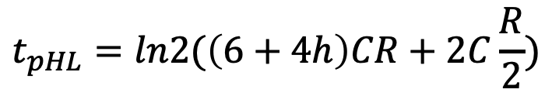

Example: 2-input NAND
Estimate rising and falling propagation delays of a 2-input NAND driving h identical gates.
✓
✓
$$t_{pHL}=ln2(\left(6+4h\right)CR+2C\frac{R}{2})$$
$$t_{pLH}=ln2(\left(6+4h\right)CR+2CR)$$

Slide 37
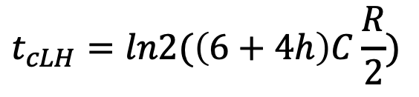

Contamination Delay
Best-case (contamination) delay can be substantially less than propagation delay.
Ex: If both inputs fall simultaneously
✓
✓
✓
✓
$$t_{cLH}=ln2(\left(6+4h\right)C\frac{R}{2})$$
$$t_{cHL}=ln2(\left(6+4h\right)CR)$$

Slide 38
Practice:
1. Sketch a 4-input NAND gate with transistor widths chosen to achieve effective rise and fall resistance equal to a unit inverter.
Compute the t_{LH} and t_{HL} propagation delays(in terms of R and C) of the NAND gate driving h identical NAND gates using the ELMORE delay model
A:
t_{pLH}=ln2[4C*R+4C*R+4C*R+ (12C+6Ch) R*]=RCln2[24+6h]
t_{pHL}=ln2[4C*R/4+2R/4*4C+3R/4*4C+4R/4*(12C+6Ch)]=RCln2[1+2+3+(12+6h)]=ln2(18+6h)

Slide 39
Layout Comparison
Which layout is better?

Slide 40
Diffusion Capacitance
assumed contacted diffusion on every s / d.
Good layout minimizes diffusion area
Ex: NAND3 layout shares one diffusion contact
Reduces output capacitance by 2C
Merged uncontacted diffusion might help too

Slide 41
Fan-In Considerations
A
B
C
D
A
C_{L}
B
C₃
Distributed RC model
(Elmore delay)
t_{pHL} = 0.69 R_{eqn}(C₁+2C₂+3C₃+4C_{L})
C
C₂
D
C₁
Propagation delay deteriorates rapidly as a function of fan-in quadratically in the worst case
Notes:
While output capacitance makes full swing transition (from VDD to 0), internal nodes only transition from VDD-VTn to GND
C1, C2, C3 on the order of 0.85 fF for W/L of 0.5/0.25 NMOS and 0.375/0.25 PMOS
CL of 3.2 fF with no output load (all diffusion capacitance – intrinsic capacitance of the gate itself).
To give a 80.3 psec tpHL (simulated as 86 psec)

Slide 42
Worst case of t_{pLH}
A
B
C
D
A=1
C_{L}
B=1
C₃
C=1
C₂
D=1→0
C₁
𝛕 =2R/2*(2NC+C_{ext})+2R/2*NC*N=2NRC+RC_{ext} +N²RC
Notes:
While output capacitance makes full swing transition (from VDD to 0), internal nodes only transition from VDD-VTn to GND
C1, C2, C3 on the order of 0.85 fF for W/L of 0.5/0.25 NMOS and 0.375/0.25 PMOS
CL of 3.2 fF with no output load (all diffusion capacitance – intrinsic capacitance of the gate itself).
To give a 80.3 psec tpHL (simulated as 86 psec)

Slide 43
t_{p} as a function of fan-In and fan-out
Fan-in: quadratic due to increasing resistance and capacitance
Fan-out: each additional fan-out gate adds two gate capacitances to C_{L}
t_{p} = a₁F_{I} + a₂F_{I}² + a₃F_{O}
Notes:
a1 term is for parallel chain, a2 term is for serial chain, a3 is fan-out

Slide 44
Delay Dependence on Input Patterns
Shared cap. discharging
Input Data Pattern | Delay (psec)
A=B=0→1 | 69(max)
A=1, B=0→1 | 62
A= 0→1, B=1 | 50
A=B=1→0 | 35(min)
A=1, B=1→0 | 76
A= 1→0, B=1 | 57
A=B=1→0
A=1 →0, B=1
Voltage [V]
A=1, B=1→0
NMOS = 0.5μm/0.25 μm
PMOS = 0.75μm/0.25 μm
C_{L} = 100 fF
time [ps]
Shared cap. charging
Notes:
A=b=0->1与a=1,b=0->1的不同在于后者只要B一变化就开始放电，而前者需要等到A导通了才能放电
Gate sizing should result in approximately equal worst case rise and fall times.
Reason for difference in the last two delays is due to internal node capacitance of the pulldown stack. When A transitions, the pullup only has to charge CL; when A=1 and B transitions pullup have to charge up both CL and Cint.
For high to low transitions (first three cases) delay depends on state of internal node. Worst case happens when internal node is charged up to VDD – VTn.
Conclusions: Estimates of delay can be fairly complex – have to consider internal node capacitances and the data patterns.

Slide 45
Static CMOS logic
CMOS static characteristic
CMOS propagate delay
Large fan-in technology
Logic effort
CMOS power analysis

Slide 46
How to choose design techniques for large fan-in
Larger parasitic capacitor, larger load to the preceding gate
Load is dominated by fan-out, the design technique makes sense
Solution
Progressive transistor sizing
Transistor ordering
Alternative logic structures
Isolating fan-in from fan-out using buffer insertion

Slide 47
Transistor ordering
critical path
critical path
charged
0→1
charged
In₃
1
C_{L}
In₁
M3
C_{L}
M3
1
In₂
1
discharged
In₂
M2
C₂
charged
M2
C₂
1
discharged
In₁
charged
In₃
M1
C₁
M1
C₁
0→1
delay determined by time to discharge C_{L}, C₁ and C₂
delay determined by time to discharge C_{L}
Notes:
For lecture.
Critical input is latest arriving signal
Place latest arriving signal (critical path) closest to the output

Slide 48
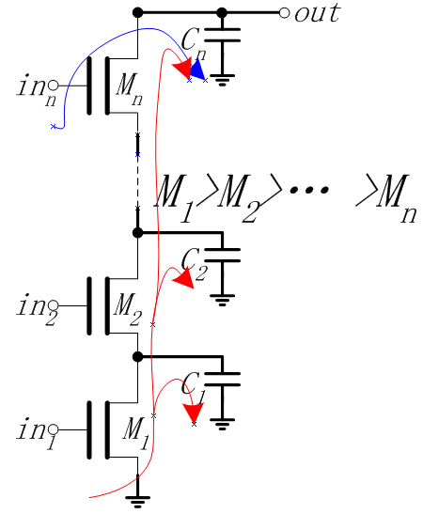
Progressive sizing
Distributed RC line
M₁ > M₂ > M₃ > … > M_{N}
the closest to the output is the smallest
Can reduce delay by more than 20%; decreasing gains as technology shrinks
Notes:
M1 have to carry the discharge current from M2, M3, … MN and CL so make it the largest
MN only has to discharge the current from MN (no internal capacitances)

Slide 49
Alternative logic structures
F = ABCDEFGH
Notes:
Reduced fan-in -> deeper logic depth
Reduction in fan-in offsets, by far, the extra delay incurred by the NOR gate (second configuration).
Only simulation will tell which of the last two configurations is faster, lower power

Slide 50
Isolating fan-in from fan-out using buffer insertion
Large fan-in
Large fan-out
isolating
C_{L}
C_{L}
Notes:
Reduce CL on large fan-in gates, especially for large CL, and size the inverters progressively to handle the CL more effectively

