Slide 1

System Identification of Damped Harmonic Oscillators via Physics-Informed HNNs
Muyuan Zhuo
2026 Winter - EE495

Slide 2
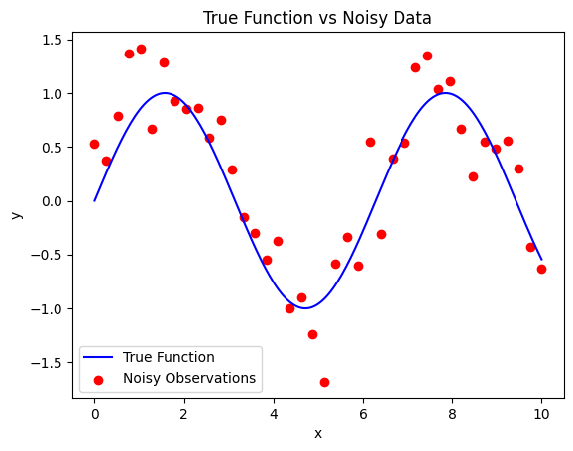
The Problem: Learning from Imperfect Data
Pain points:
Sparse Data,
Noisy Measurements,
Overfitting
……

Slide 3
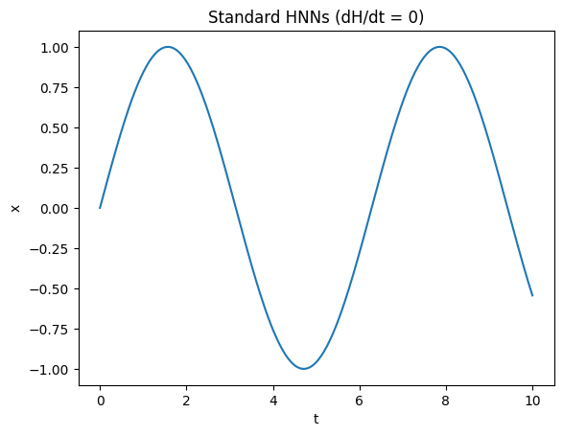
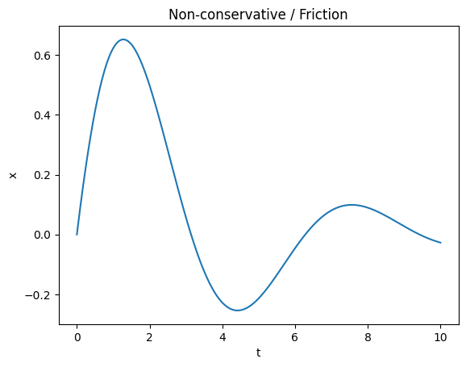
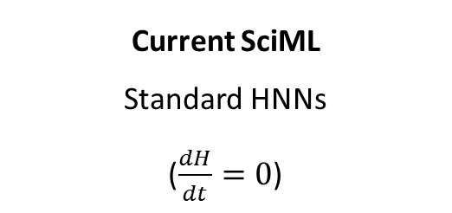
Current Approaches & The Gap
Current SciML
Standard HNNs
($\frac{dH}{dt}=0$)
Reality
Non-conservative / Friction

Slide 4
Our Proposal
Modify HNN for dissipative forces.
Robustly reconstruct trajectories.
Identify hidden damping parameters.

Slide 5
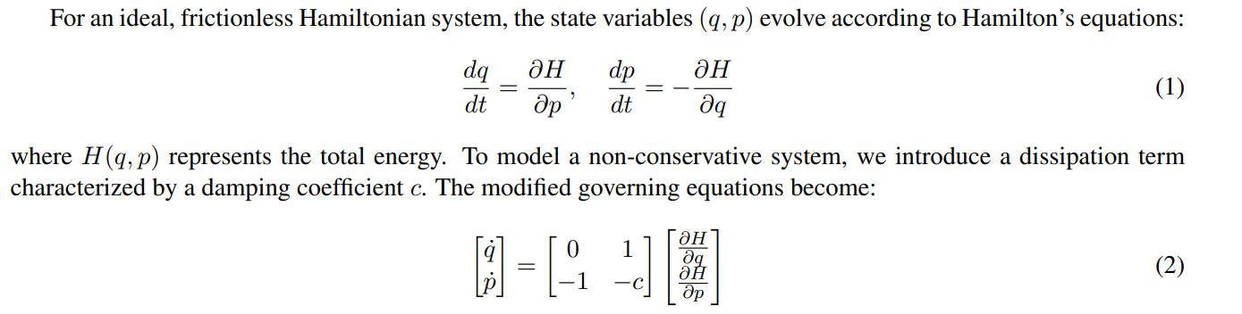
Methodology: The Physics Prior
Learnable Dissipation Term

Slide 6
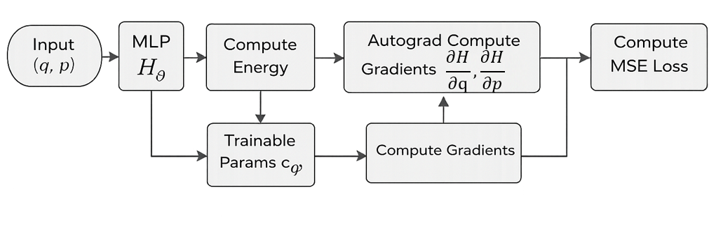
Methodology: Network Architecture

Slide 7
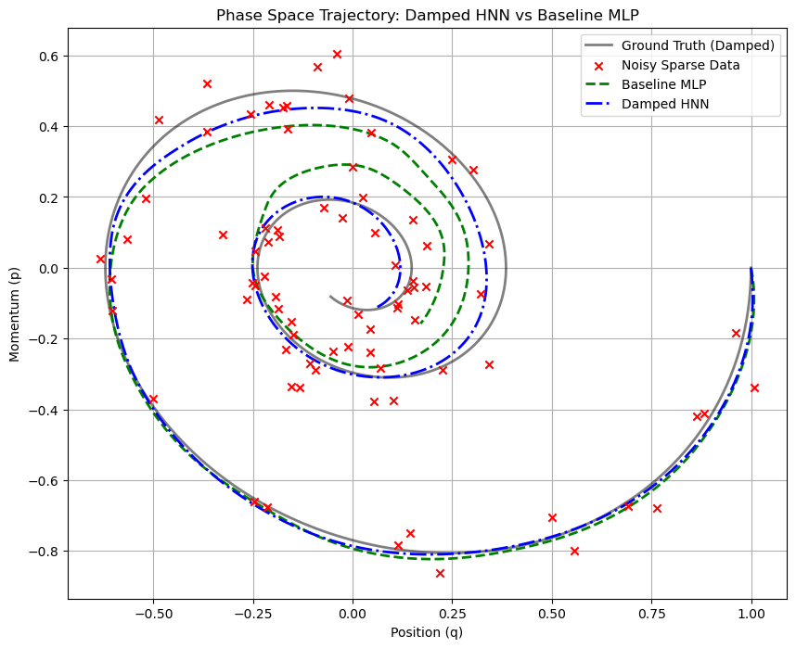
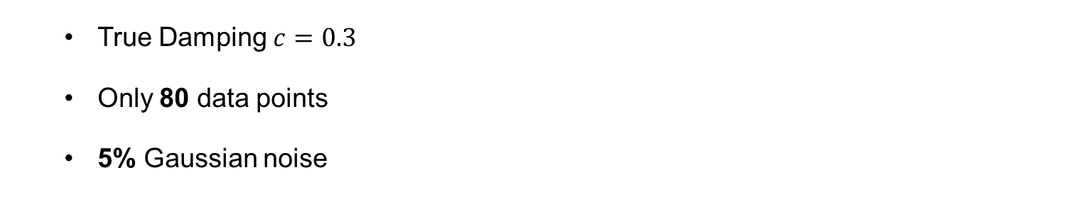
Experimental Setup & Results
True Damping $c=0.3$
Only 80 data points
5% Gaussian noise

Slide 8
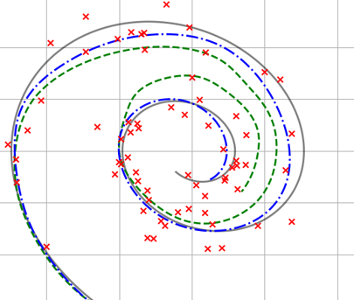
Discussion: The Overfitting Paradox
Baseline MLP has lower training loss, but fails to generalize. Purely data-driven fits noise; Physics acts as a regularizer.

Slide 9
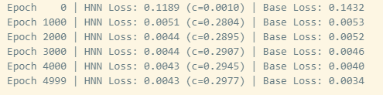
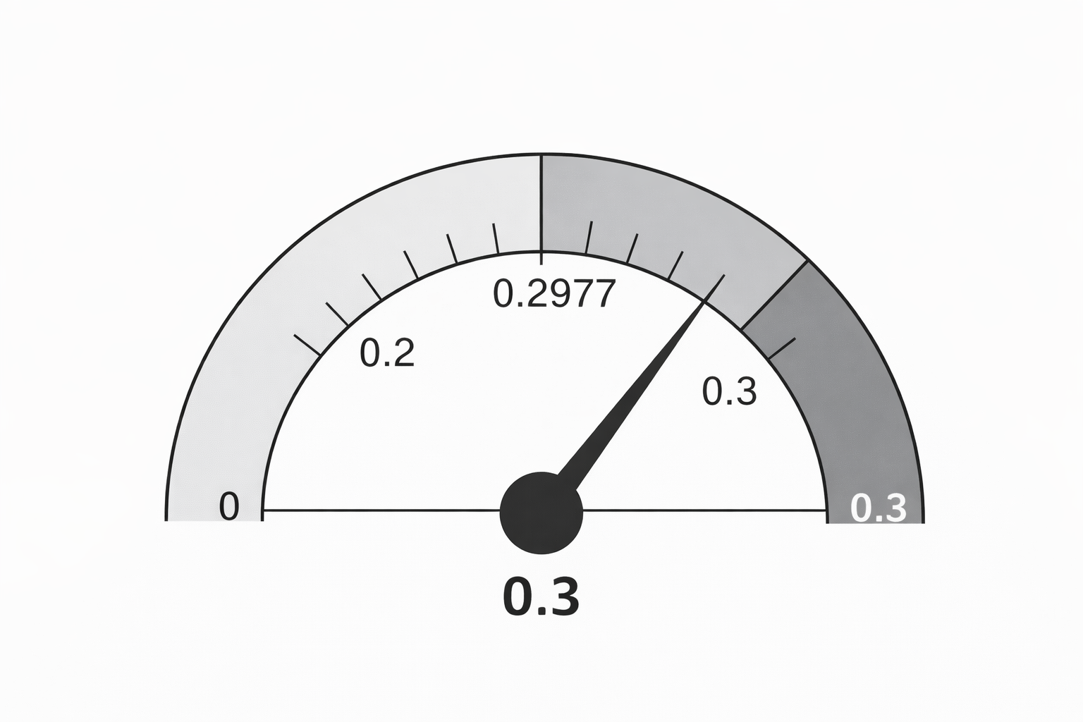
Results: Parameter Extraction

Slide 10
Conclusion & Future Work
Success in non-conservative environments.
Accurate extraction of hidden physical parameters.
Future: Port-Hamiltonian / Chaotic dissipative systems.

