Slide 1
PRESENTATION FLOW
Introduction
Purpose
Video demonstration
GitHub commands via the terminal and comparison with the desktop app
Conclusion

Slide 2
Tools to Host and Manage Static Sites: GitHub and GitHub pages
Group 14:
Karlos Abellanosa, Zhuoqun Li, Danish Akbar, & Mok

Slide 3
Purpose
Why we chose to present about GitHub / GitHub pages: previous experience in using Github / Github pages
What is GitHub? It is a type of version Control and is important for collaboration
What about GitHub pages? A static site designed to host your website directly from a GitHub repository and uses a theme

Slide 4
Video presentation

Slide 5
EXAMPLES
Basic GitHub commands via the terminal

Slide 6
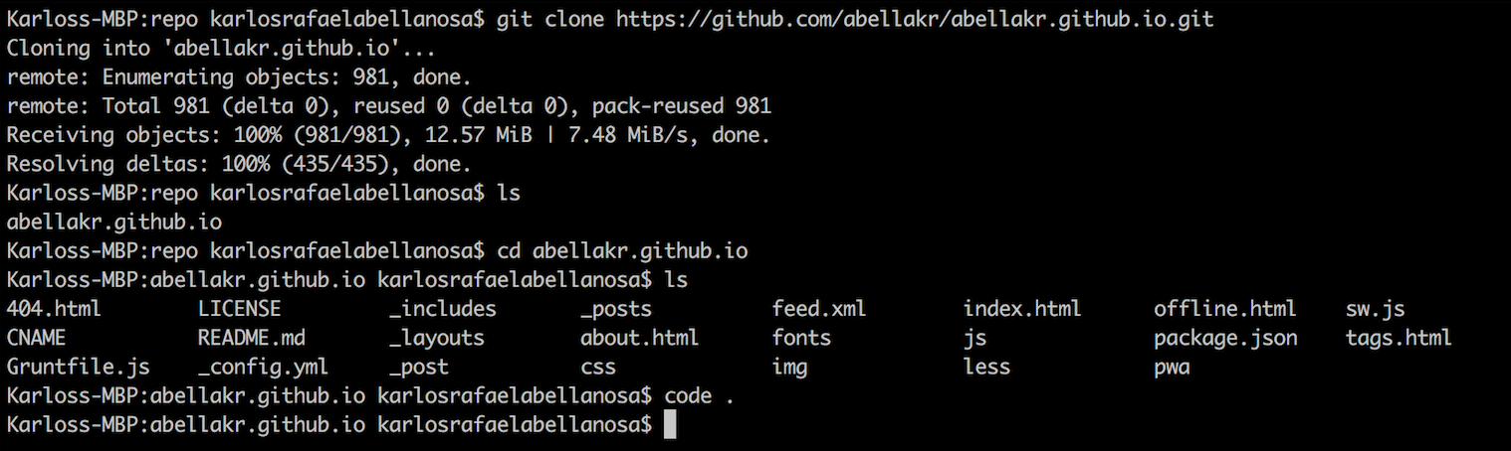
Example 1: CLONING A REPO VIA TERMINAL

Slide 7
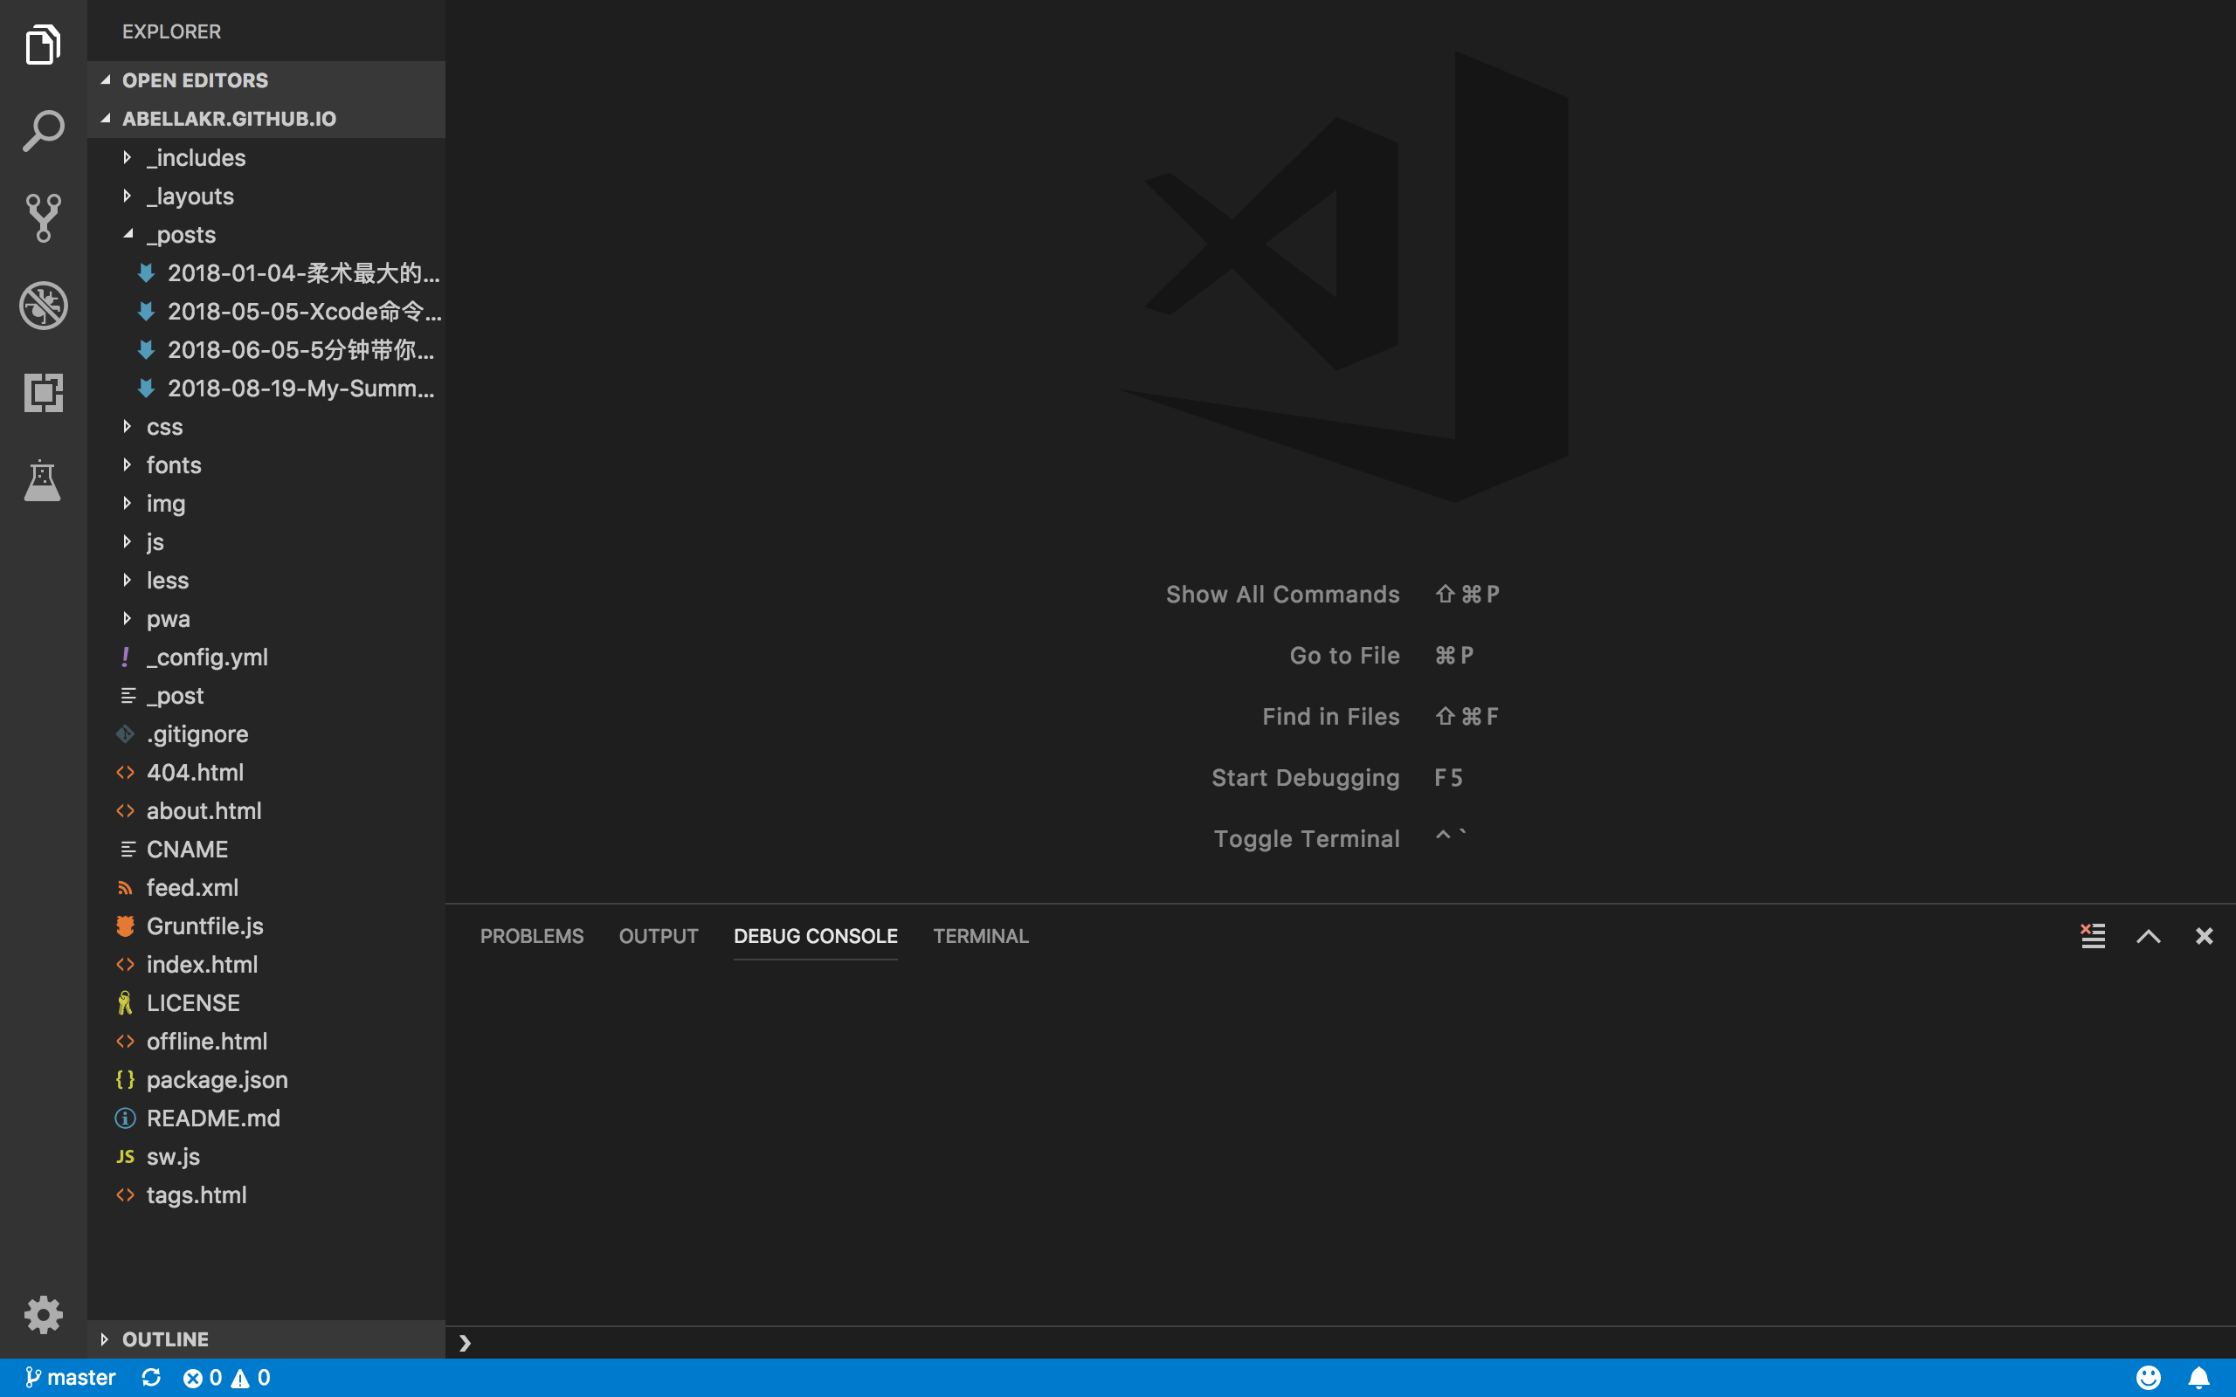
Quick tip:
Use ’code .’ to open your current working directory in visual studio code

Slide 8
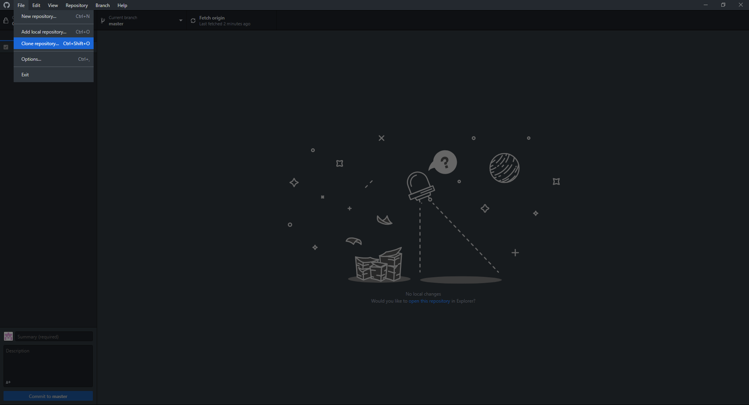
Example 1: CLONING A REPO via desktop app

Slide 9
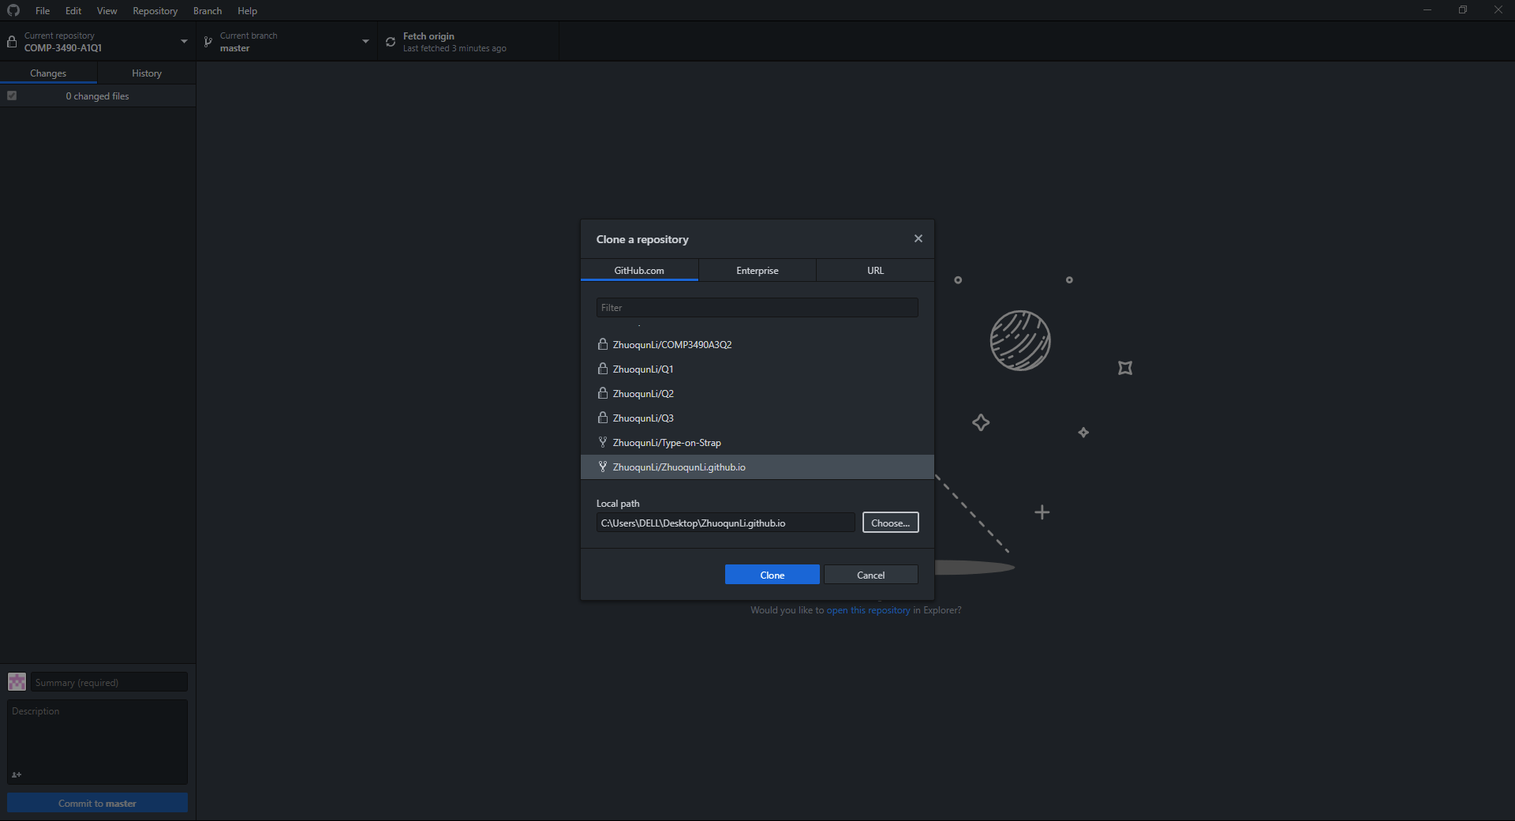
Example 1: CLONING A REPO via desktop app

Slide 10
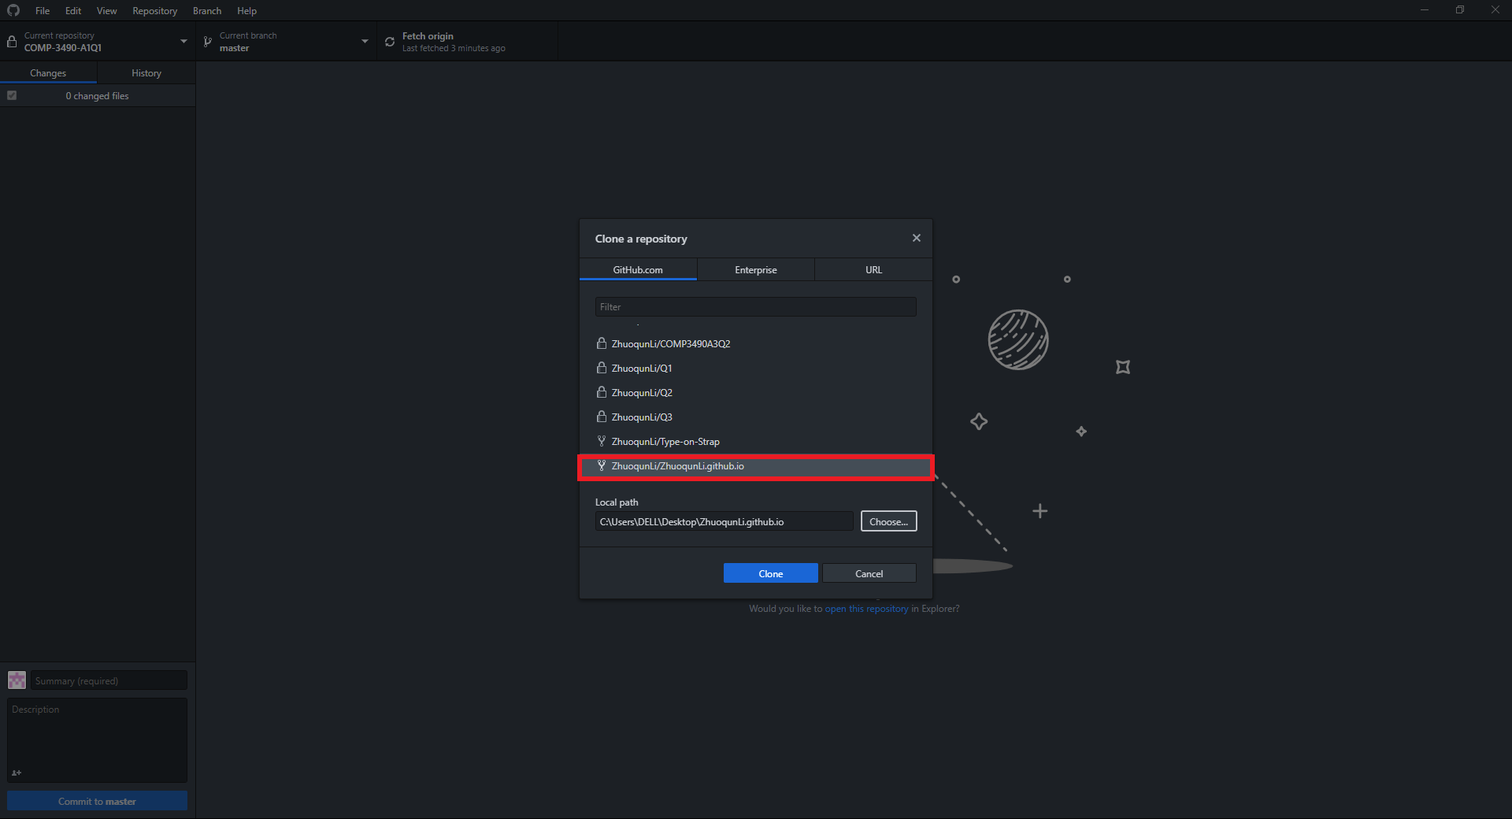
Example 1: CLONING A REPO via desktop app

Slide 11
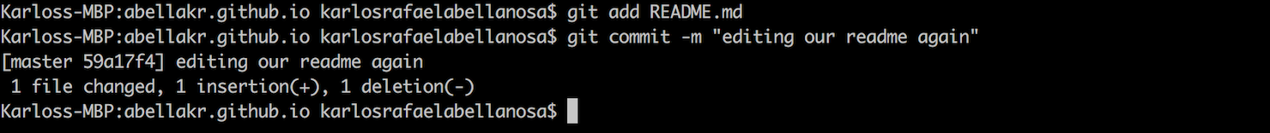
EXAMPLE 2: ADDS AND COMMITS VIA TERMINAL

Slide 12
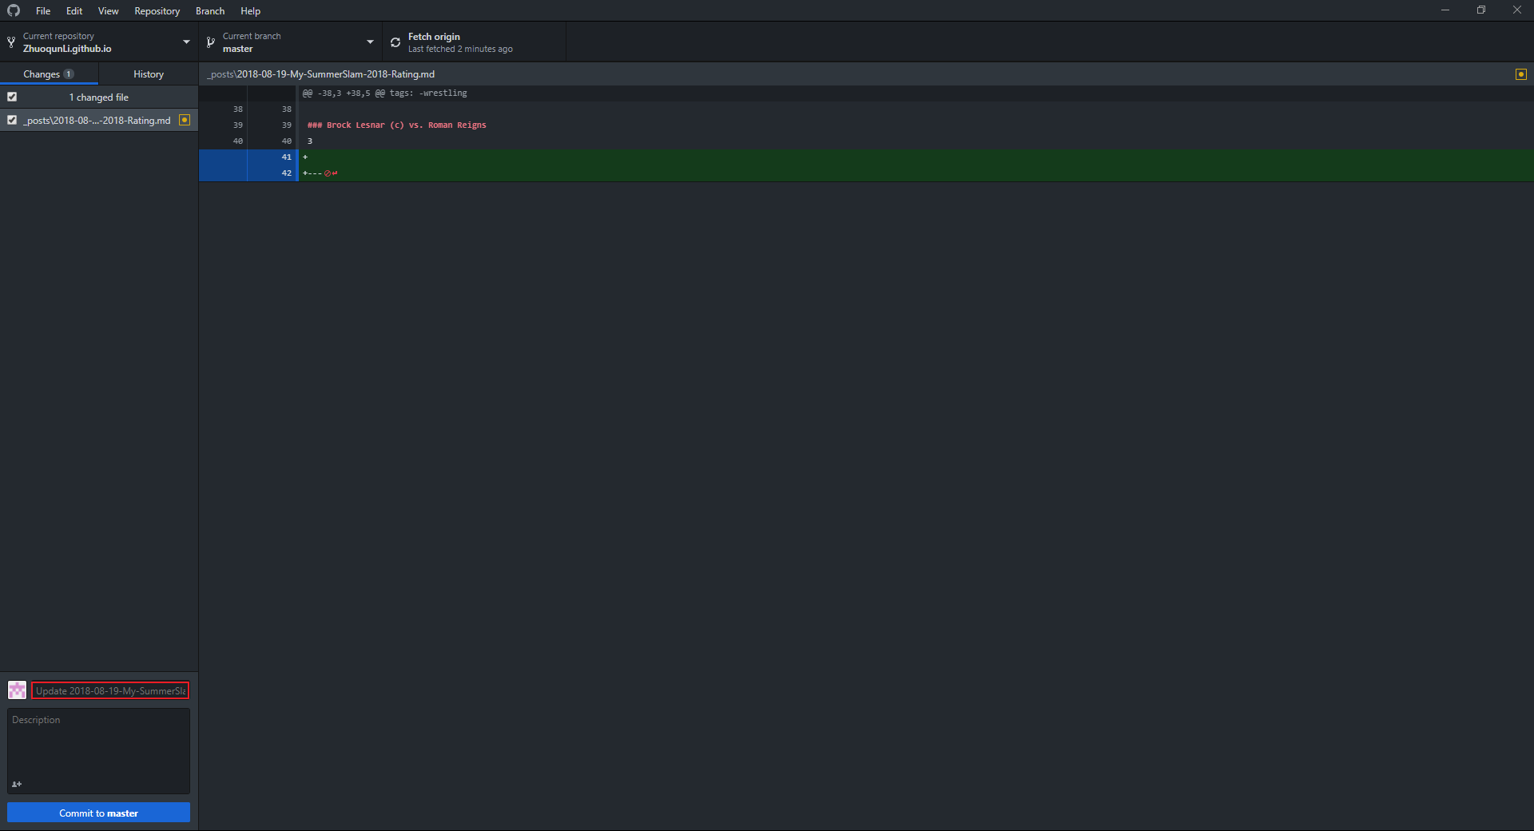
EXAMPLE 2: ADDS AND COMMITS VIA desktop APP

Slide 13
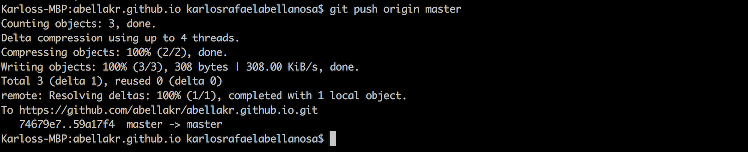
EXAMPLE 3: PUSHING via terminal

Slide 14
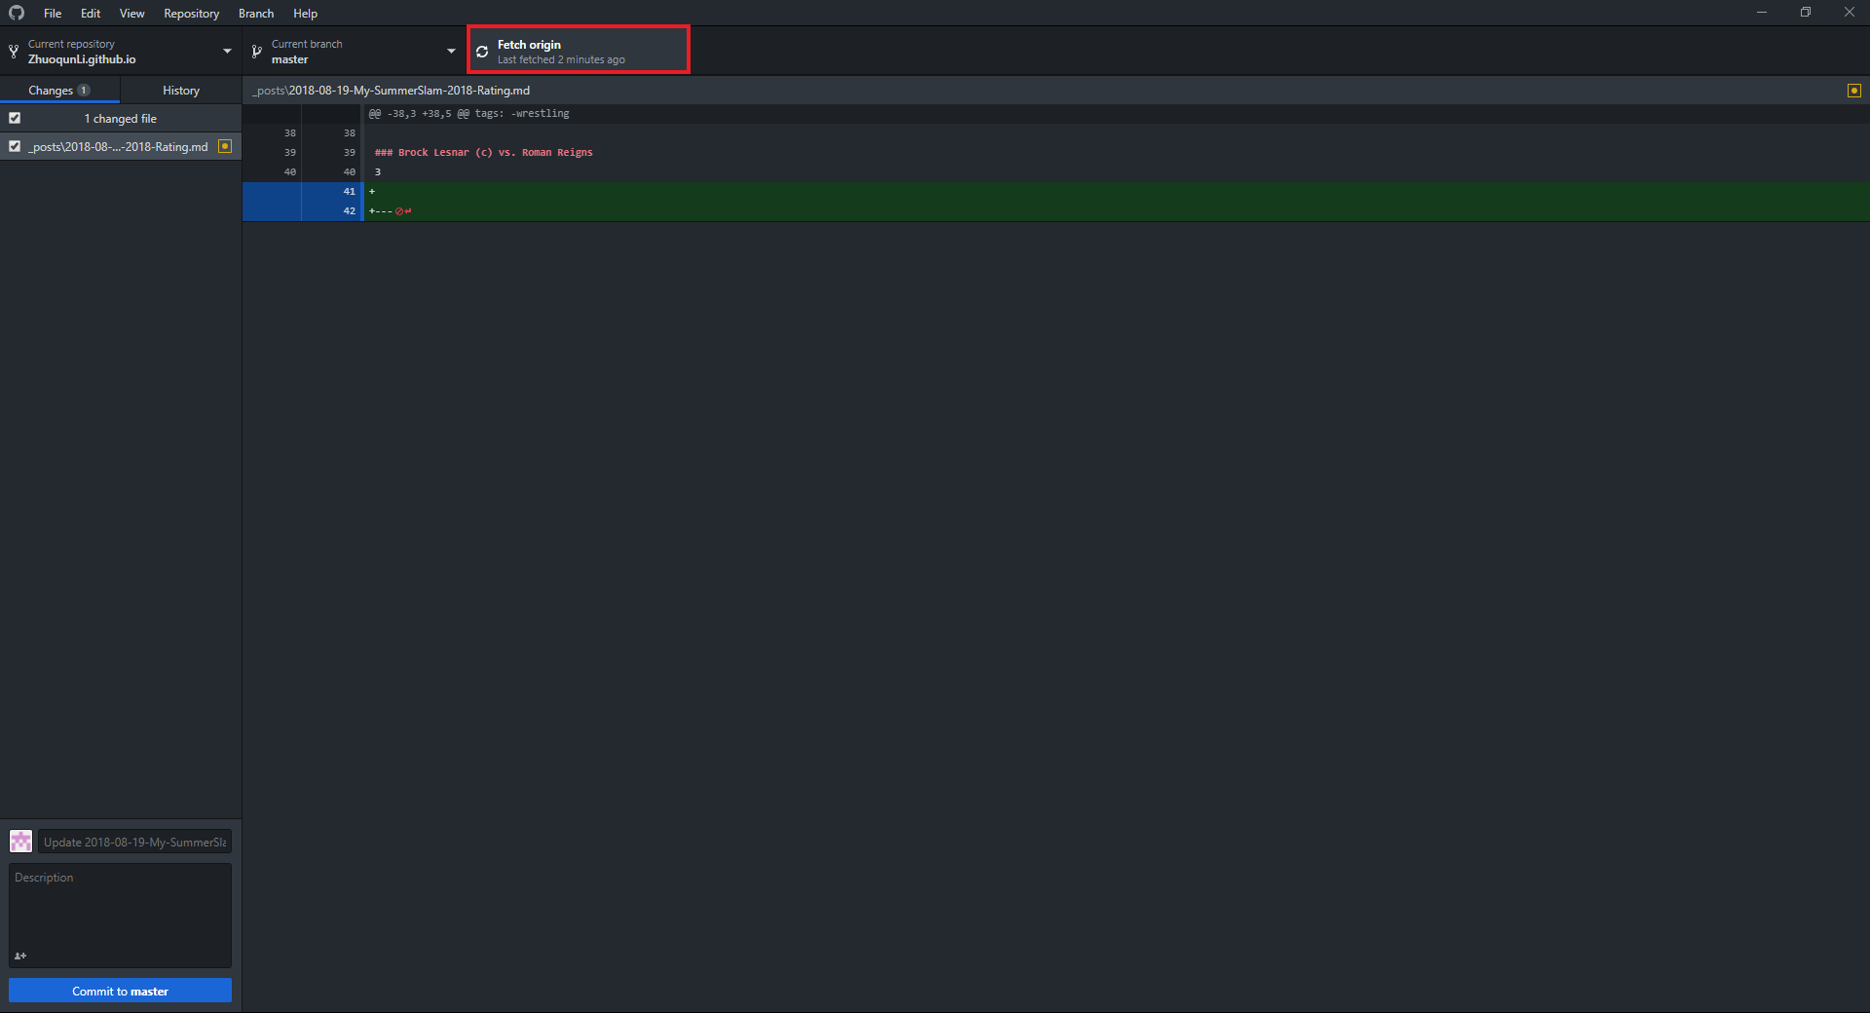
EXAMPLE 3: PUSHING via Desktop app

Slide 15
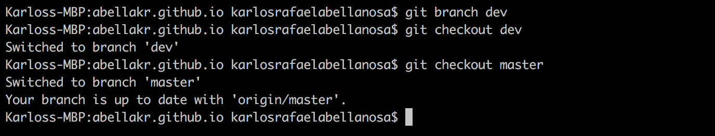
EXAMPLE 4: BRANCHING AND CHECKOUT via terminal

Slide 16
Quick tip:
git checkout –b [new_branch_name] to create a branch and instantly checkout to it

Slide 17
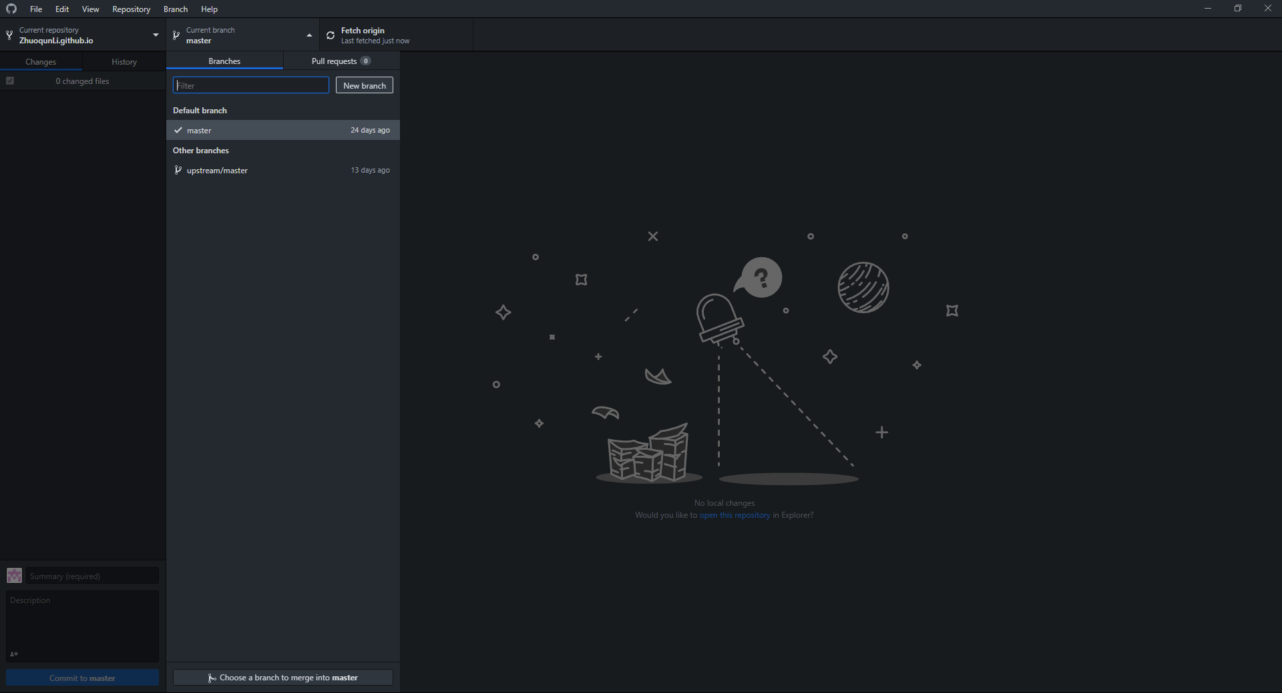
EXAMPLE 4: BRANCHING AND CHECKOUT via desktop app

Slide 18
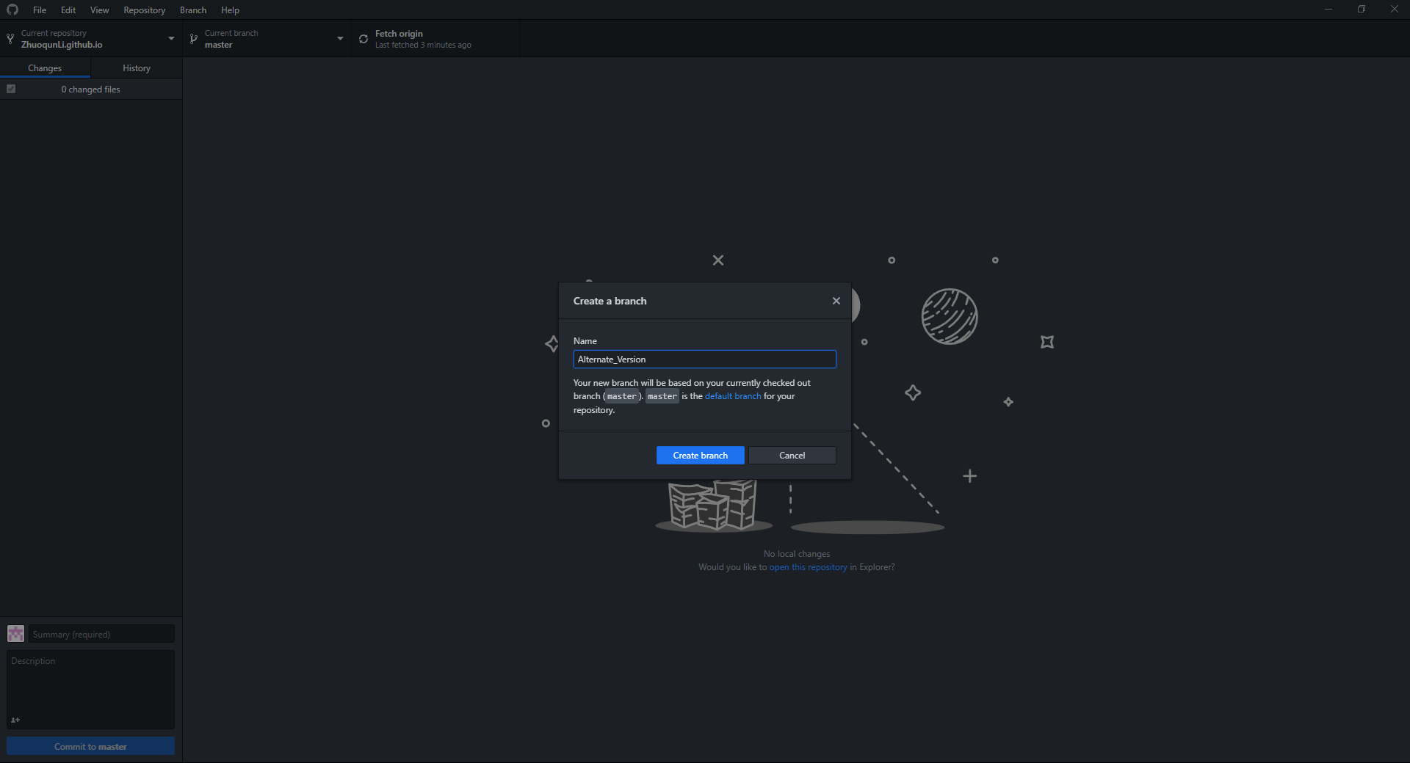
EXAMPLE 4: BRANCHING AND CHECKOUT via desktop app

Slide 19
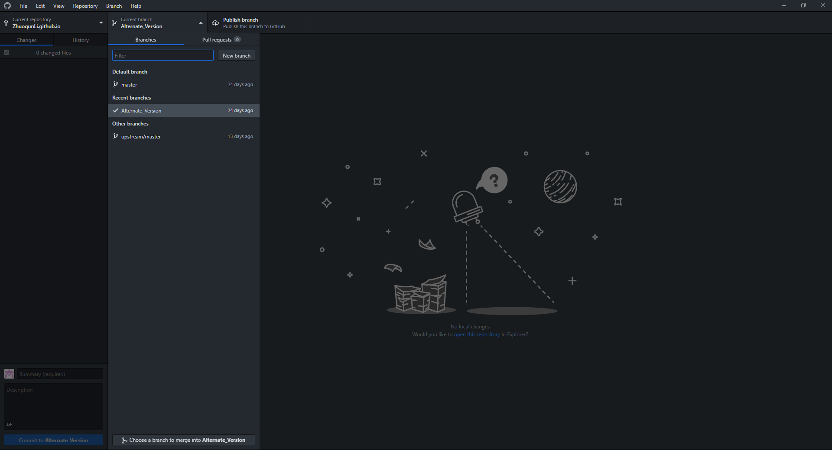
EXAMPLE 4: BRANCHING AND CHECKOUT via desktop app

Slide 20
CONCLUSION
GitHub and GitHub pages make collaborations easier
Important to learn especially in software engineering

Slide 21
Questions?

