Slide 1

Airline Reservation System
By Zhuowen Nie

Slide 2


UML
DatabaseTable
UI
Nunit

Slide 3
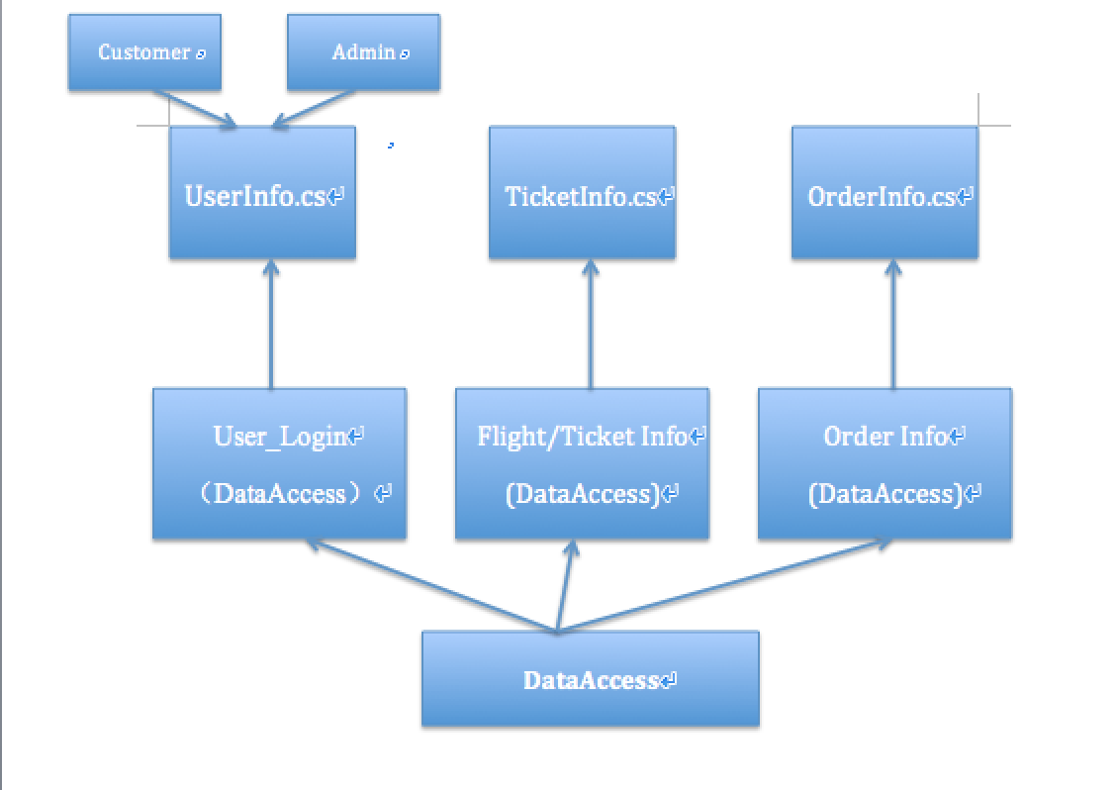
UML

Slide 4
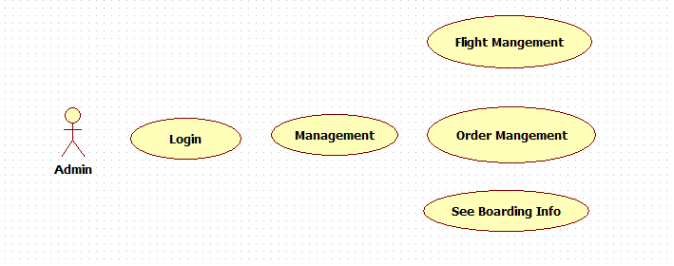
UML

Slide 5
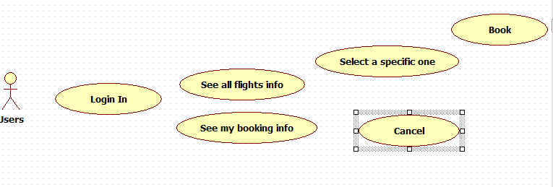
UML

Slide 6

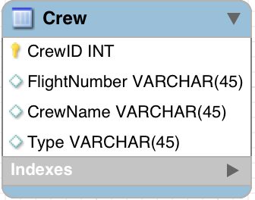
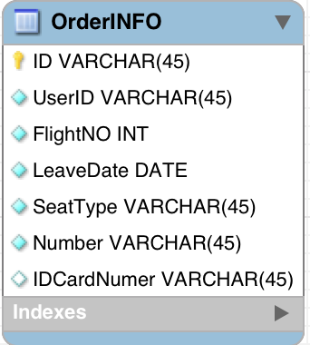
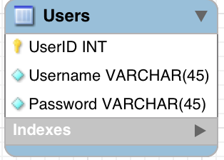
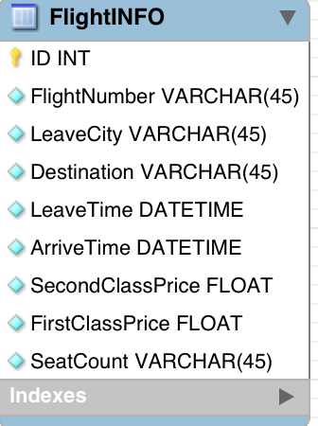
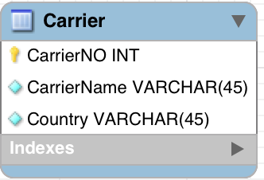
MS SQL Server (ADO.NET)
Tables

Slide 7

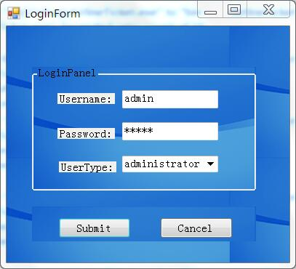
UI (Admin)
There are two types about users: Admin and Customer.
Input username and corresponding password to submit.
All usernames and passwords are store in database.

Slide 8
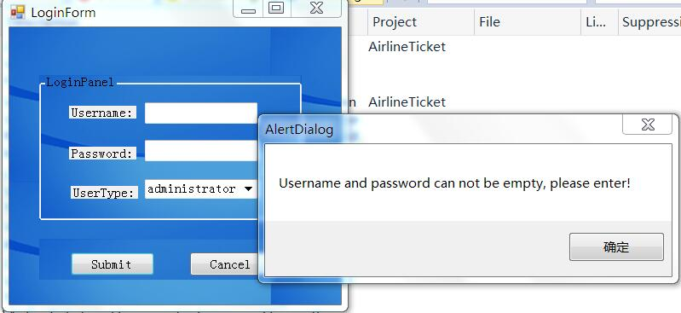
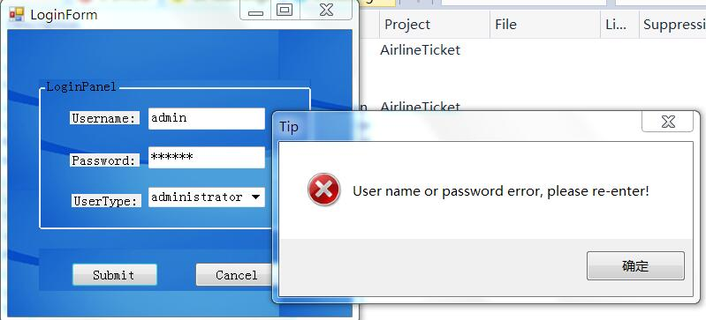
UI (Admin)
When input errors or null, it will throw exceptions.

Slide 9
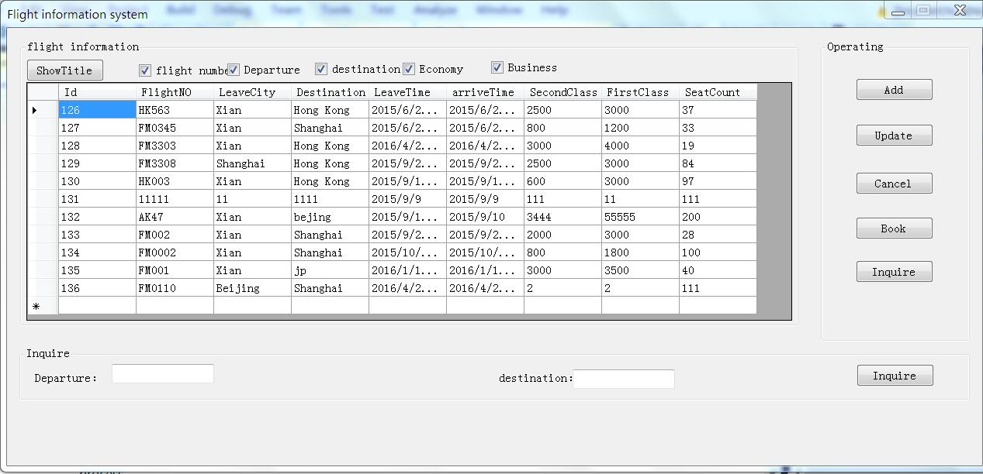
Admin Login Successfully(Add,Update,Cancel,Search)

Slide 10
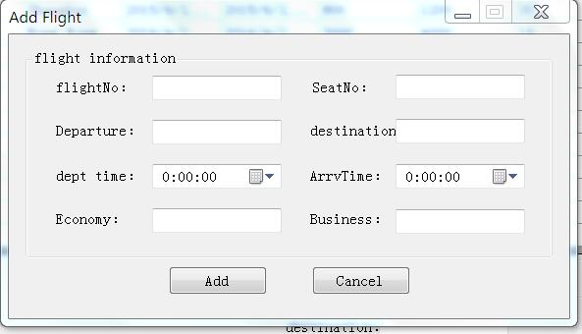
Click Add Function
Admin need to input FlightNO, SeatCount, Departure,Destination and so on. When click add the data will store in database.

Slide 11
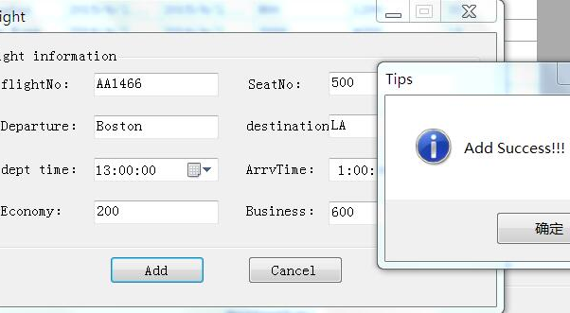
Add Successfully

Slide 12
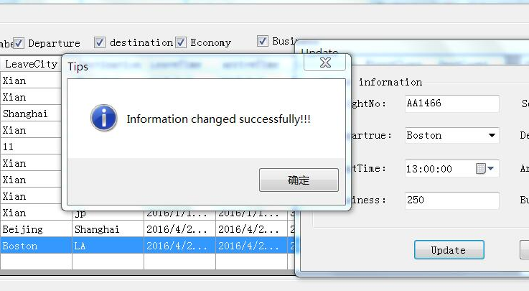
Update Successfully!

Slide 13
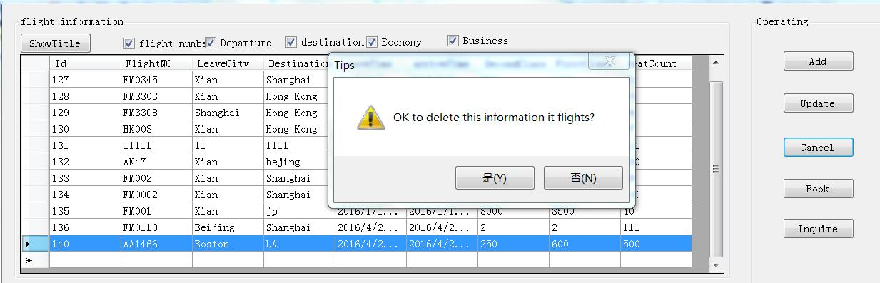
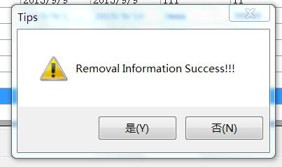
Cancel
When Remove successfully, the data will delete from database.

Slide 14
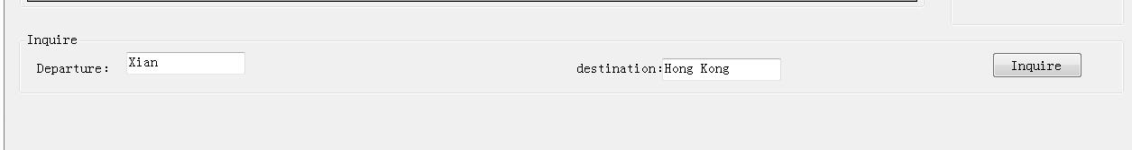
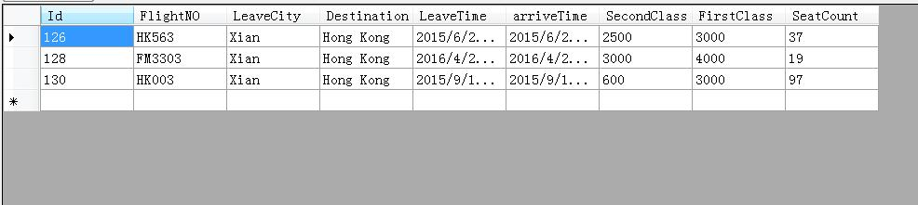
Search

Slide 15
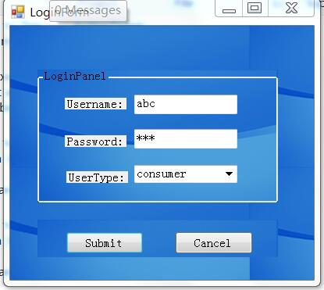
UI (Customer)
Username:abc
Password:abc
UserType:Costomer

Slide 16
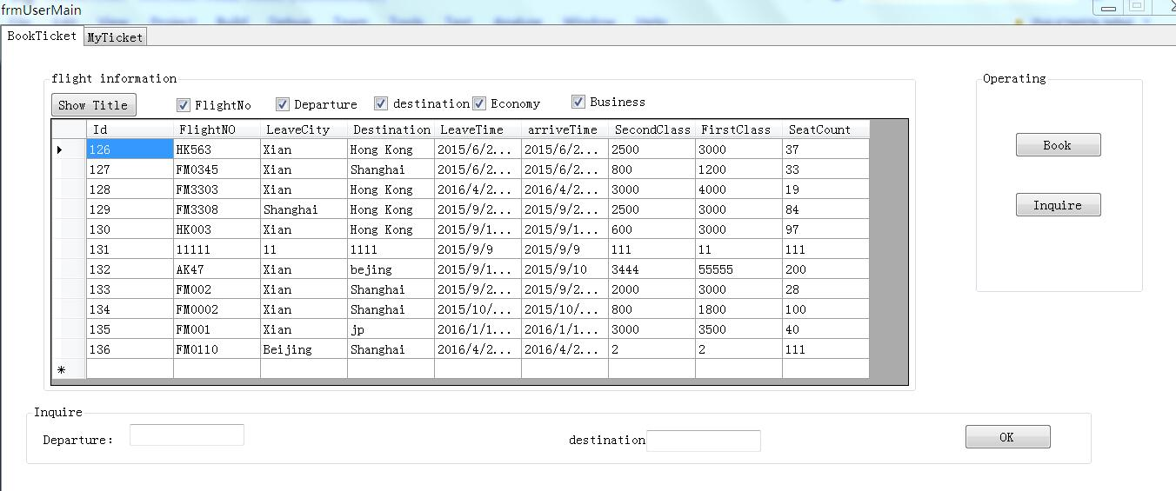
Customer(Book, Search)
Customer see all Flight information and choose one to book. Then he will see book situation in MyTicket

Slide 17
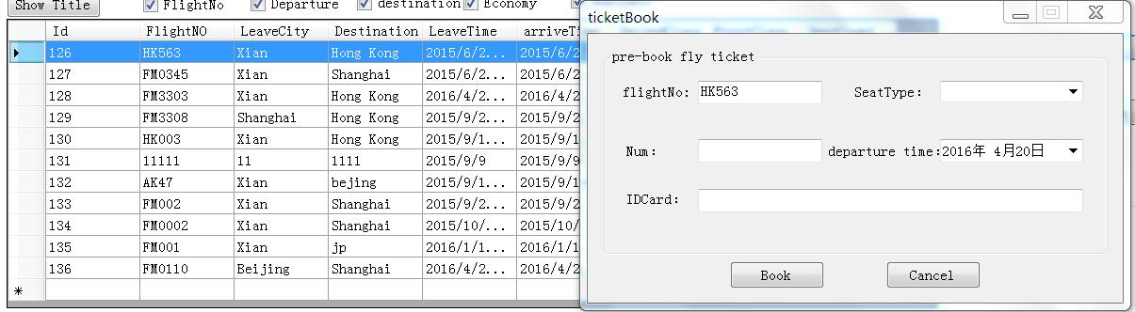
Book
Users choose one row to book. Click the book button, the the ticketbook window will show on the screen. Uses need to input seat type including business or economy, how many tickets want to buy, Departure Time and ID number

Slide 18
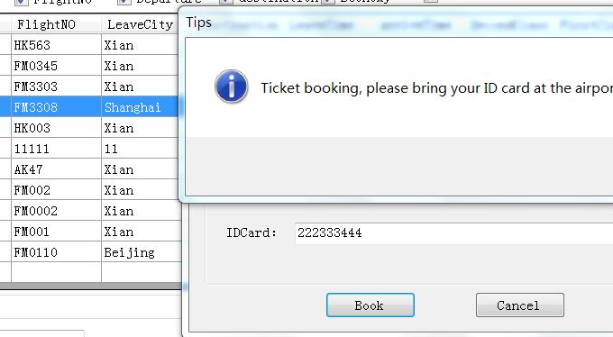
Book Successfully
The book information will show MyBook and order INFO that the admin manage.

Slide 19
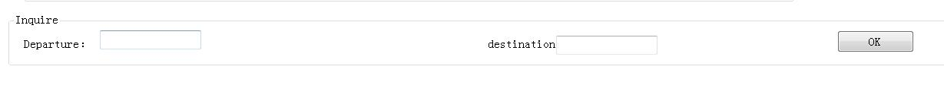
Search
Users also has search function like admin.

Slide 20
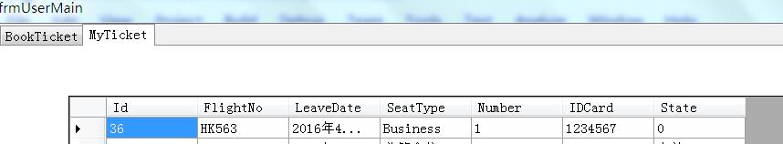
My Ticket
In MyTicket, Users can see all the ticket he has booked. The ’0 ’means has already boarded. ‘1’ means this ticket haven’t used yet.

Slide 21
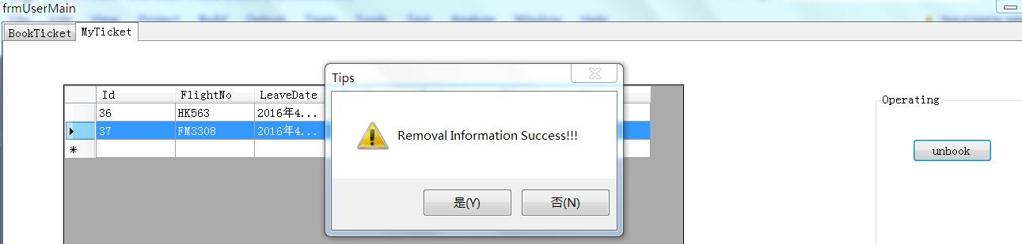
Unbook(Cancel)
Users also can cancel the flight he has booked.

Slide 22
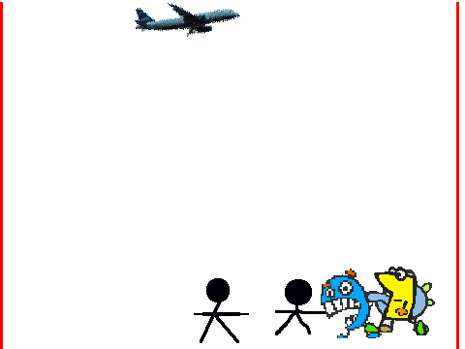
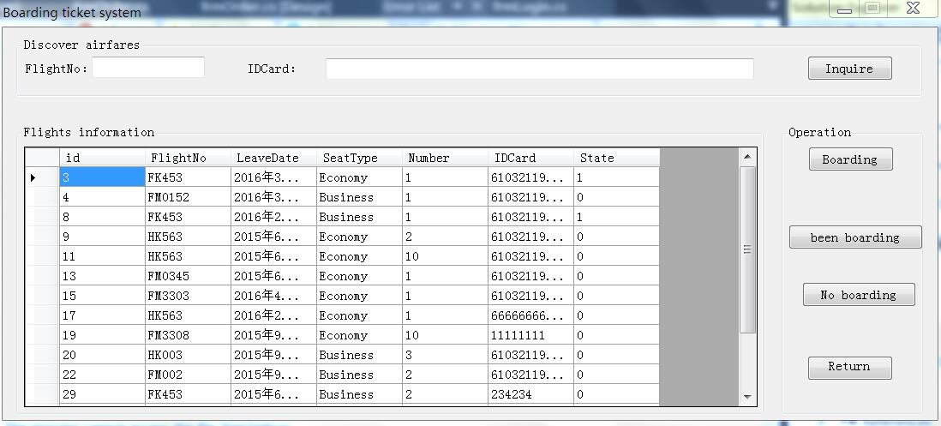
Admin manager Boarding INFO
Admin see all the order information that users have booked until now. (‘1’ means not boarding, ‘0’ means already boarded)

Slide 23
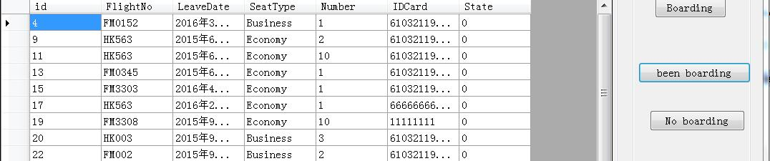
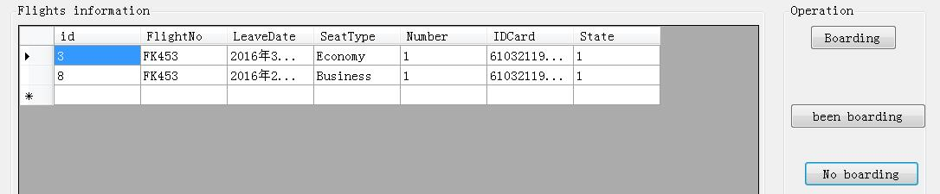
Click BeenBoarding Button, It will show all have been boarded Customer INFO
Click NoBoarding Button, It will show all have not been boarded Customer INFO,and then click Boarding Button, the state will covert ‘1’ to ‘0’, that means this customer has boarded.

Slide 24
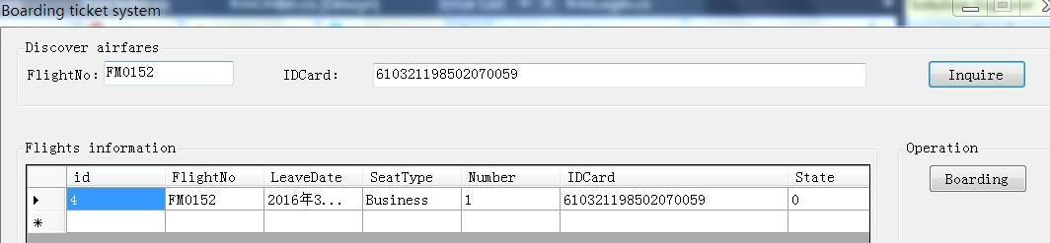
Admin can also input flightno and customer ID number to search boarding status of a specific user.

Slide 25
Nunit Test(Idea)
1.First, Check the login page, there is not allowed to have empty input .

Slide 26
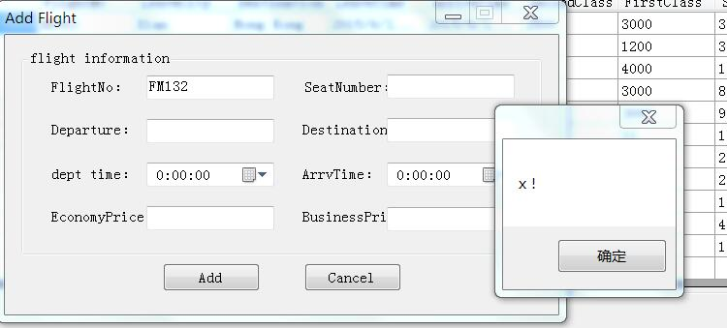
There are so many blanks that require numbers only. If you input a word or null, there will be shown errors.

Slide 27
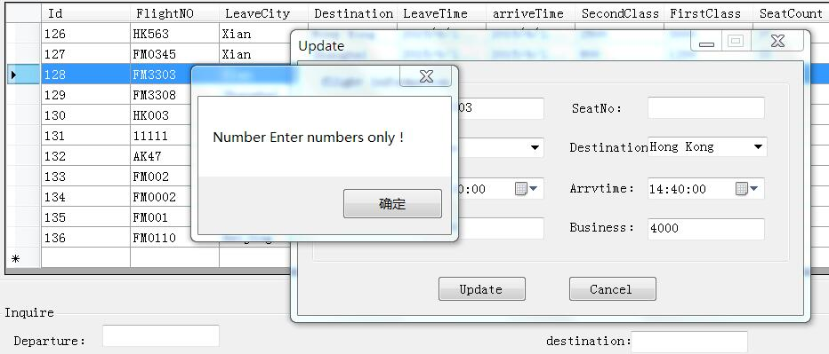
Update

Slide 28
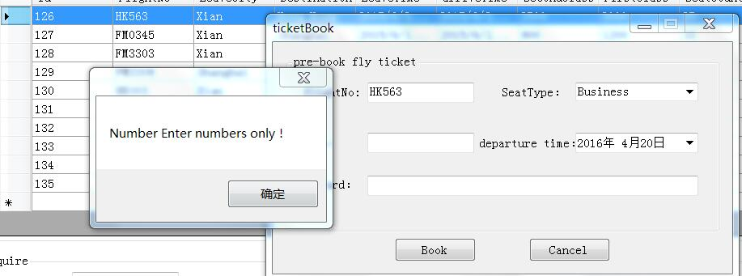
Book ticket

Slide 29
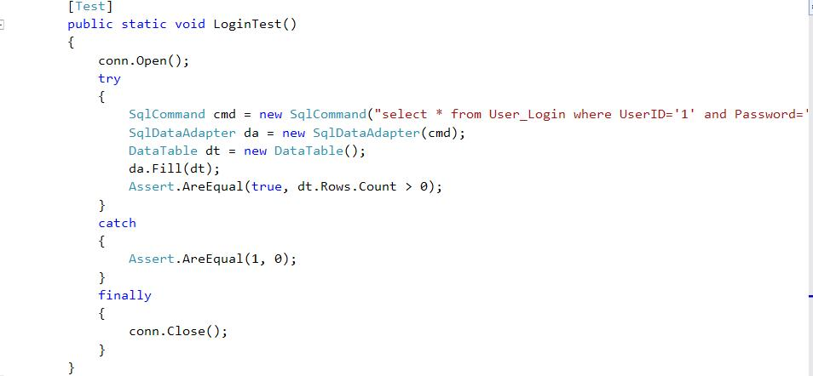

Slide 30
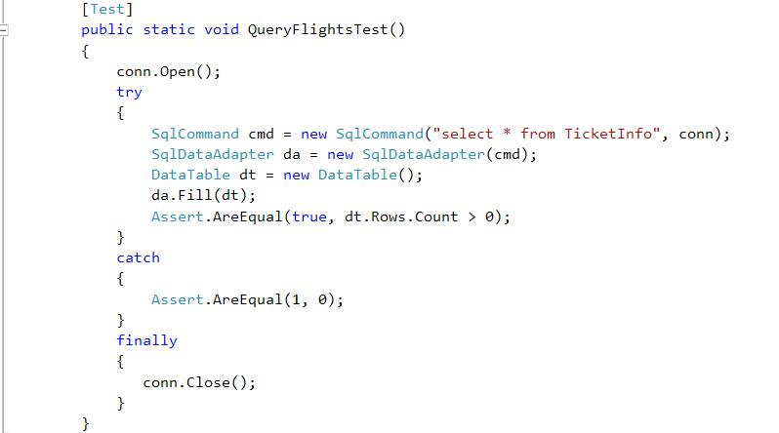

Slide 31
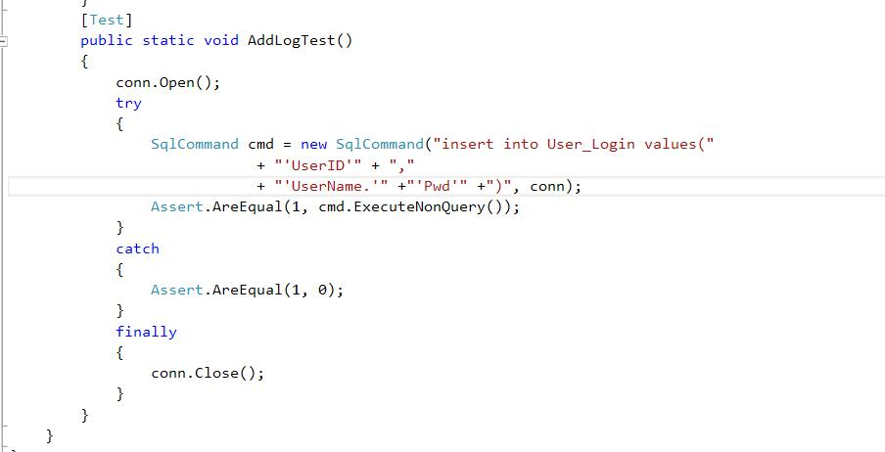

Slide 32
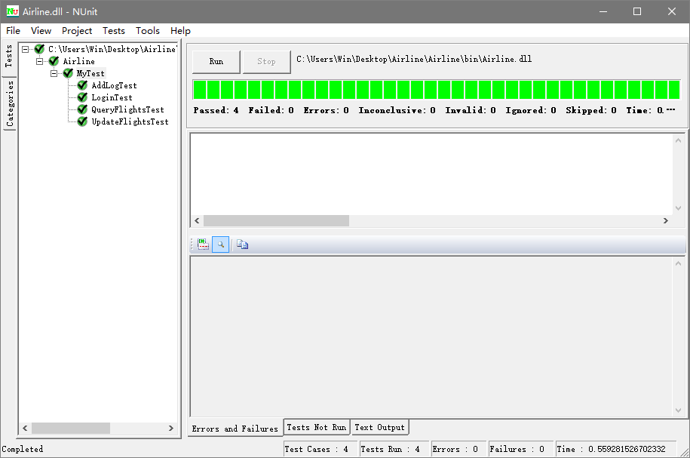
I created four test cases, and all pass.

Slide 33
Thank you !
By Zhuowen Nie

