Slide 1
Chevron New Energies Interactive Learning Hub
Bezerra, Lara
Wang, Zhuoyi
Wong, Ethan
Colorado School of Mines
02/25/2024

Slide 2



Members of Developing Team
Lara Bezerra
Zhuoyi Wang
Ethan Wong
Senior in Applied Mathematic And Satistics with Computational Emphasis
Junior in Computer Science with Robotics and Intelligence Systems Emphasis, Engineering Physics Minor
Junior for a Bachelor of Science in General Computer Science

Slide 3
— Chevron
Goal: Develop a tool that educates about the importance, benefits, and mechanisms of new energy technologies to young adults.

Slide 4
Our Solution
A website with multiple features, where you can learn more about each of the new technologies Chevron New Energies is currently interested in.
It also contains a chatbot implementing GPT4 trained on a dataset created specifically for this website. And finally, a memory game testing all the knowledge acquired from the features.

Slide 5



Coding Languages Used
JavaScript
Python
HTML5
React package to build the website and user interface
Original build of memory game present in website
Connect chatbot’s OPENAI API to answer questions on page

Slide 6
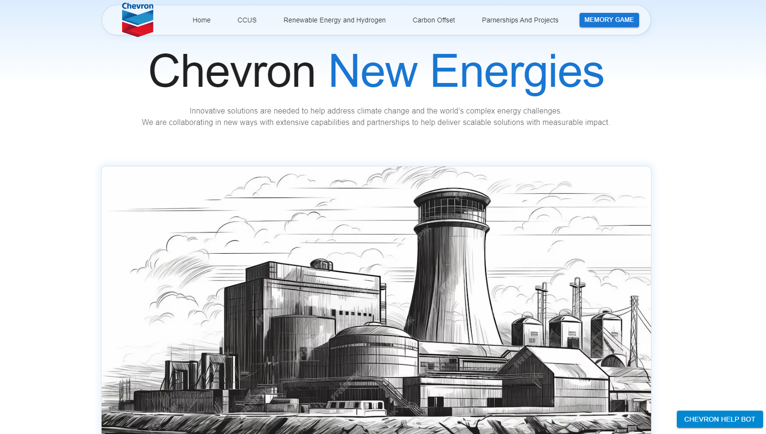
Application Layout
Features
Memory Game
Each of the new technologies more in depth
Try out your newfound knowledge on Chevron New Technologies
Main Content
Chat Bot
Differs from page to page in the website
Ask questions about the project and Chevron’s current goals

Slide 7
Cost of Implementation
Development Costs:
Manpower: The majority of the cost comes from the development team's effort. Considering the learning curve for React and integrating it with a backend, the man-hours can be substantial.
Tools and Services: Include costs for any development tools or services used, even if they have free tiers, as scaling up may incur costs.
Learning Resources: Any courses or materials purchased to learn React or other technologies.
Testing: Time and resources spent on testing, which might include the use of testing platforms.
Operational Costs:
OpenAI API: Usage costs depend on the number of API calls made. For heavy usage, consider OpenAI's pricing tiers to estimate expenses.
Maintenance: Regular updates of React, Flask, and other dependent libraries to keep the application secure and efficient.

Slide 8
CCUS+Global Partners
Hydrogen Delivery
Carbon Offsets
Renewable Energies

Slide 9
Challenges and Impediments
Technical Challenges:
Integration Complexity: Difficulty in ensuring seamless communication between the React frontend and Flask backend.
Learning Overhead: Time spent upskilling on React, which has a rich ecosystem with a steep learning curve.
API Limitations: Constraints imposed by the OpenAI API, such as rate limits or response formats.
Project Management Challenges:
Time Management: Balancing the development timeline with the learning process for new technologies.
Scope Creep: The tendency to extend the scope of the project as more features and functionalities are considered.

Slide 10
Key Learnings
Web Dev
Existing Solutions
Communication
Website development takes time and translation between languages, as well as accordance in collaborators
The details of things like CCUS were unknown to all of us
In a team of developers, communicating needs and helping each other is essential

Slide 11
Future Improvements
Deployment and Hosting
Feature Development
Community and Engagement
User Feedback: Establishing a system for collecting user feedback and incorporating it into future iterations.
Gamification: Enhancing the memory game with more features, levels, and possibly a leaderboard to encourage competition.
Hosting Service: Selecting a hosting provider (like Google Cloud, AWS, Heroku) that suits our needs and budget.
Domain Purchase: Acquiring a custom domain name for the web application.
Scaling Up: Planning for increased traffic and usage, potentially leading to higher hosting costs.
User Accounts: Implementing authentication for personalized experiences and saving progress in educational content.
Content Expansion: Adding more interactive elements and diversified content to cover a broader range of topics.
Performance Optimization: Continuous profiling and optimization to ensure the application runs smoothly as it scales.

Slide 12
Citations
https://www.chevron.com/what-we-do/energy/new-energies
https://www.iea.org/energy-system/carbon-capture-utilisation-and-storage
https://www.chevron.com/-/media/chevron/operations/documents/CCUS-Fact-Sheet-April-2023.pdf
https://carboncredits.com/the-ultimate-guide-to-understanding-carbon-credits/
https://www.offsetguide.org/understanding-carbon-offsets/what-is-a-carbon-offset/
https://afdc.energy.gov/fuels/hydrogen_basics.html
https://www.pnnl.gov/explainer-articles/renewable-fuels#:~:text=Renewable%20fuels%20are%20fuels%20produced,on%20how%20it%20is%20produced.
https://ethanolrfa.org/
https://afdc.energy.gov/data
https://www.wikipedia.org/
https://chat.openai.com/
https://openai.com/blog/openai-api

