Slide 1

Quantifying immediate cost savings and long-term structural value through self-performing freight
Pilot outcomes, modeling insights, and roadmap for site-level rollout

Slide 2


~8k invoices and 10 key sites form the modeling base—covering 95% of priority products invoice value and $2M in spend
Source
Description
Criteria for developing sample size
1
Historical freight data
Sample size from historical freight data from January 2024 - YTD
Total unique invoices
188 087
From the records 188 087 invoices were observed with project value of up to $618m and not all invoices have freight costs
2
XGS freight rates
XGS freight rates for 10 sites (SPN,SPJ,SPW,SPT,DIT)
Total invoices with project freight
52 316
Total freight costs is $16,23m
3
IFS commodity matrix
IFS commodity matrix with focus on 1VNL(70), 1CPT(100) and 1CBL(10)
Total invoices with at least one priority commodity
18 511
1CBL,1VNL,1CNS and 1CPT are highest value products
4
Diverzify conversion rates
Diverzify conversion rates for 1CBL,1CPT and 1VNL commodities
Total invoices where priority commodities account for >70% of invoices spend and correct conversions
17 976
Priority commodities dominate the total invoice value averaging 95%
5
Diverzify manufacturers
Diverzify manufacturers providing key commodities
All key manufacturers represented in the sample invoices
~10 000
Only manufacturers in Georgia are considered
6
Diverzify sites
Diverzify sites
Top 10 sites with freight costs
8 100
10 sites account for USD2M of freight spend
Source: AIA analysis, Diverzify IFS accounts, Diverzify supplier database, Diverzify IFS commodities,

Slide 3
The freight model focused on commodities that offer predictable and scalable optimization
15 commodities account for ~92% of spend (mUSD)
1CNS supplier spend concentrated on DTC (mUSD)
15 sites account for 80% of 1CNS spend (mUSD)
1CNS has no consistent origin-destination (OD) pairs as it is often imported with highly variable routes and ports of entry
GM is a heterogenous bucket which varies by project scope and supplier mix
RBL is low density and light, meaning its freight cost contribution is negligible relative to volume
39% of 1CNS freight spend is concentrated on a single supplier: Dal Tile Corporation
This concentration creates a strategic opportunity for direct supplier negotiation or route optimization
Limited variability in supplier base reduces the complexity of non-model interventions (e.g. fixed rates or contracted lanes)
Just 15 sites account for the bulk of 1CNS freight spend, indicating strong site-level concentration
Enables targeted efforts like site-level supplier agreements, consolidation, or bundling strategies
Offers non-model-based freight savings potential through operational or contractual levers
Source: AIA analysis, Diverzify IFS accounts, Diverzify supplier database, Diverzify IFS commodities

Slide 4
Thank you

Slide 5
17 sites account for ~75-80% of freight spend the recommended implementation rate tables are outlined in following pages
Freight savings per site (000 USD)
10 sites, 8,138 invoices, and 3 priority commodities. Invoices with priority products >70% of invoice value (Jan 2024 –Feb 2025)
Source: AIA analysis, Diverzify IFS historical data Jan 2024 - Feb 2025, XGS freight rates 2025

Slide 6
Outline
SPCP
SPW
SPT
SPHU
SPTM
PVF
SPJ
SPN
CCS
SPB
SPL
DIT
SPLV
CCSG
SPCB

Slide 7
SPW Performance Profile & Commodity Quote Rates
AIA Analysis, Diverzify IFS historical data Jan 2024 - Feb 2025, XGS Freight rates 2025

Slide 8
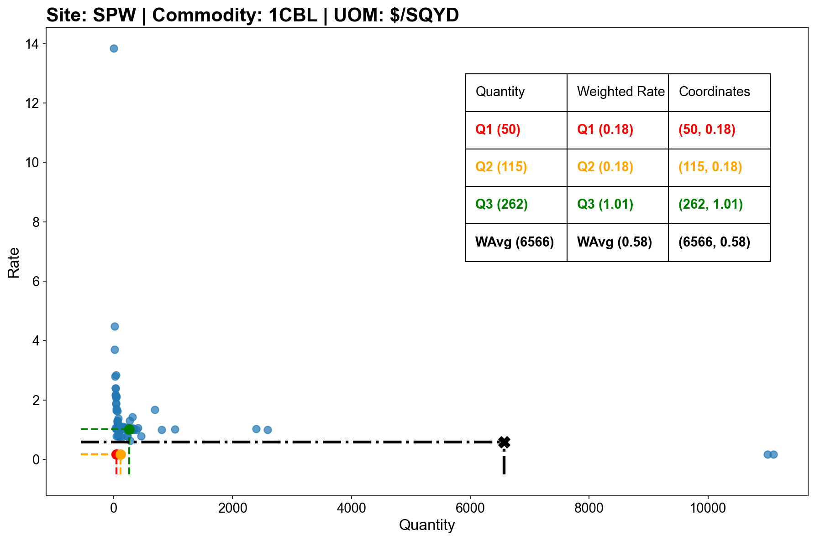
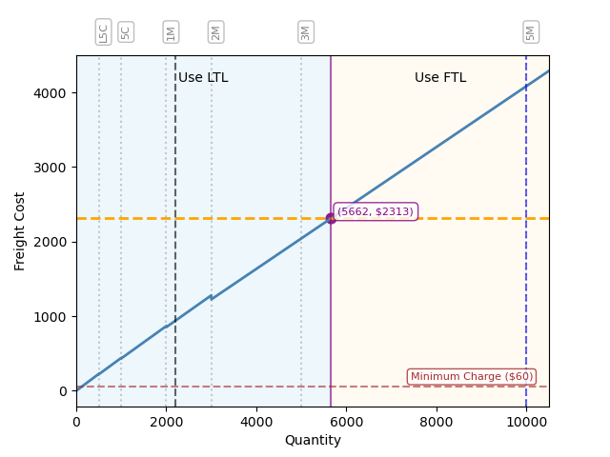
Carpet Roll historical rates and FTL decision “sweet spot”
Carpet Roll (1CBL)
Carpet Tile (1CPT)
Vinyl Tile (1VNL)
Activate FTL
Minimum charge
LTL
FTL
Threshold
Capacity
($/SQYD)
($)
(SQYD)
(SQYD)
Notes
To convert VNL shipments from Pounds (LBS) per Square Foot (SQFT) to SQFT conversion factor: 1.28 LBS/SQFT
Georgia sites only, analysis of historical freight rates

Slide 9
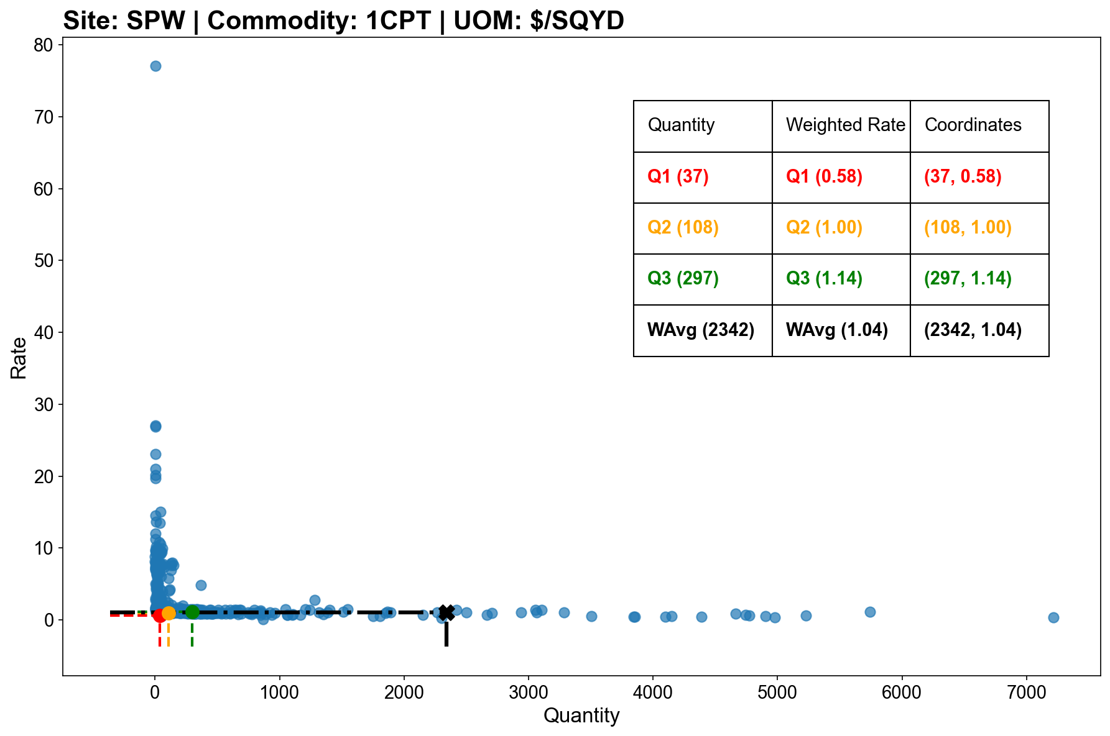
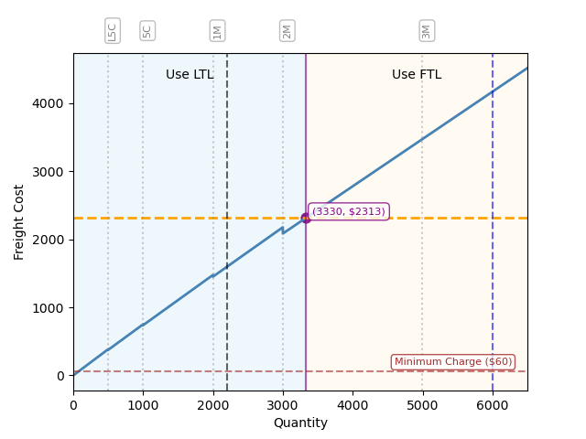
Carpet Tiles historical rates and FTL decision “sweet spot”
Carpet Roll (1CBL)
Carpet Tile (1CPT)
Vinyl Tile (1VNL)
Activate FTL
Minimum charge
LTL
FTL
Threshold
Capacity
($/SQYD)
($)
(SQYD)
(SQYD)
Notes
To convert VNL shipments from Pounds (LBS) per Square Foot (SQFT) to SQFT conversion factor: 1.28 LBS/SQFT
Georgia sites only, analysis of historical freight rates

Slide 10
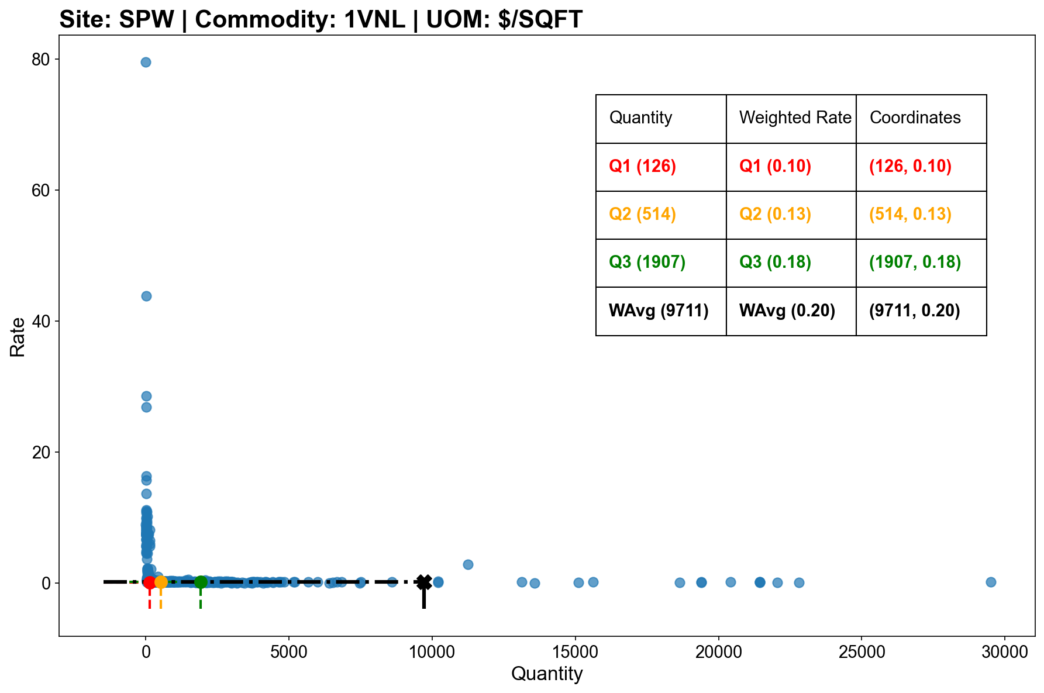
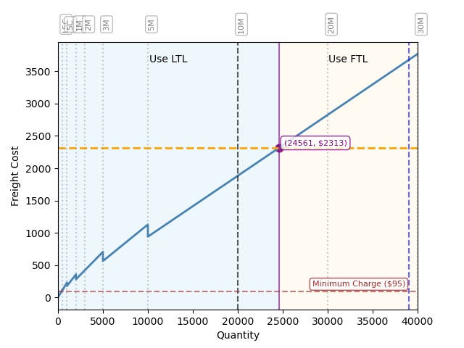
Vinyl historical rates and FTL decision “sweet spot”
Carpet Roll (1CBL)
Carpet Tile (1CPT)
Vinyl Tile (1VNL)
Activate FTL
Minimum charge
LTL
FTL
Threshold
Capacity
($/SQFT)
($)
(SQFT)
(SQFT)
Notes
To convert VNL shipments from Pounds (LBS) per Square Foot (SQFT) to SQFT conversion factor: 1.28 LBS/SQFT
Georgia sites only, analysis of historical freight rates

Slide 11
Outline
SPCP
SPW
SPT
SPHU
SPTM
PVF
SPJ
SPN
CCS
SPB
SPL
DIT
SPLV
CCSG
SPCB

Slide 12
SPT Performance Profile & Commodity Quote Rates
AIA Analysis, Diverzify IFS historical data Jan 2024 - Feb 2025, XGS Freight rates 2025

Slide 13
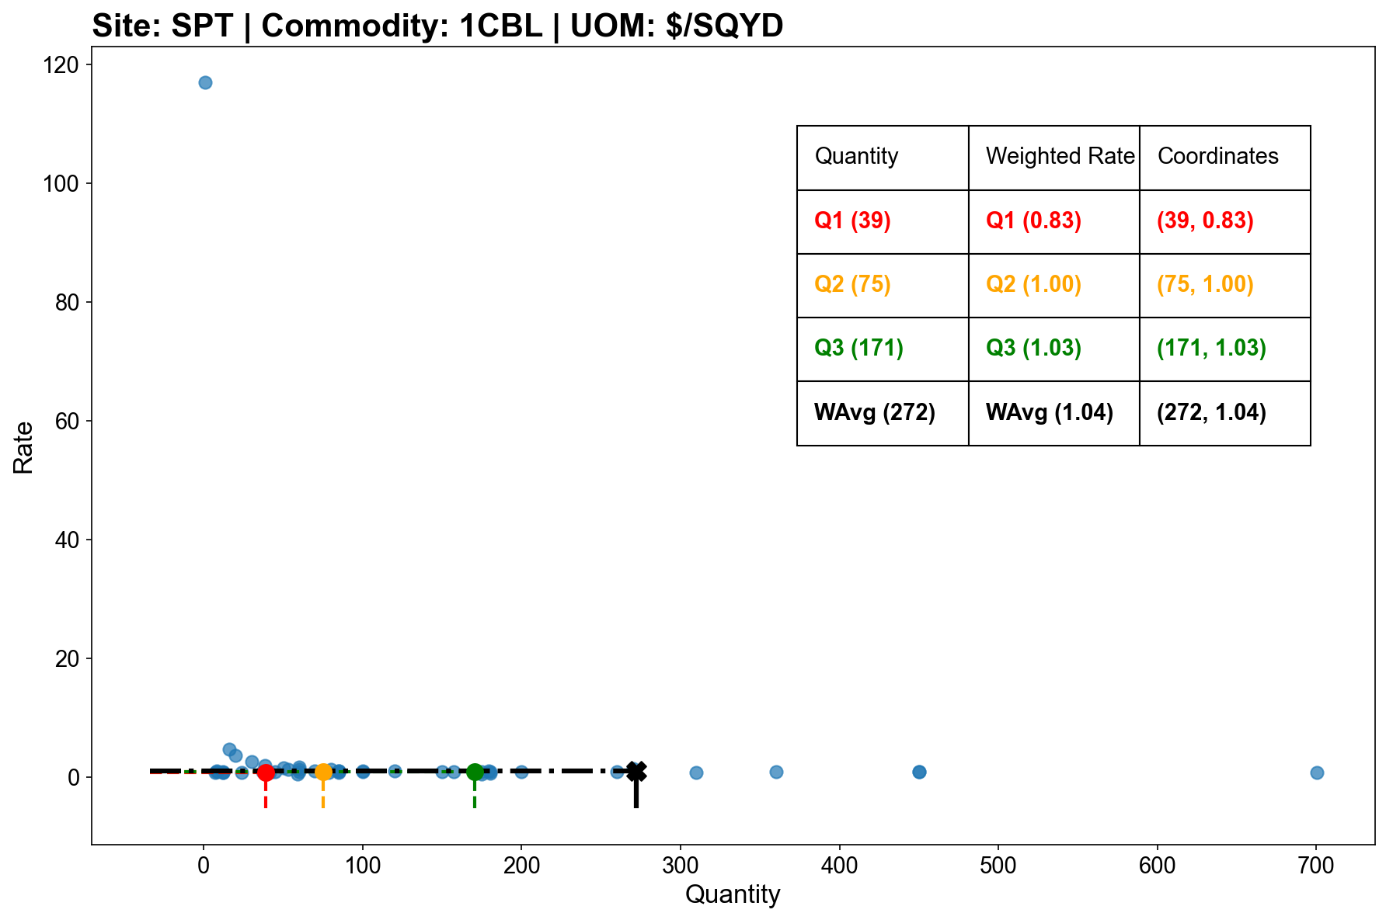

Carpet Roll historical rates and FTL decision “sweet spot”
Carpet Roll (1CBL)
Carpet Tile (1CPT)
Vinyl Tile (1VNL)
Activate FTL
Minimum charge
LTL
FTL
Threshold
Capacity
($/SQYD)
($)
(SQYD)
(SQYD)
Notes
To convert VNL shipments from Pounds (LBS) per Square Foot (SQFT) to SQFT conversion factor: 1.28 LBS/SQFT
Georgia sites only, analysis of historical freight rates

Slide 14
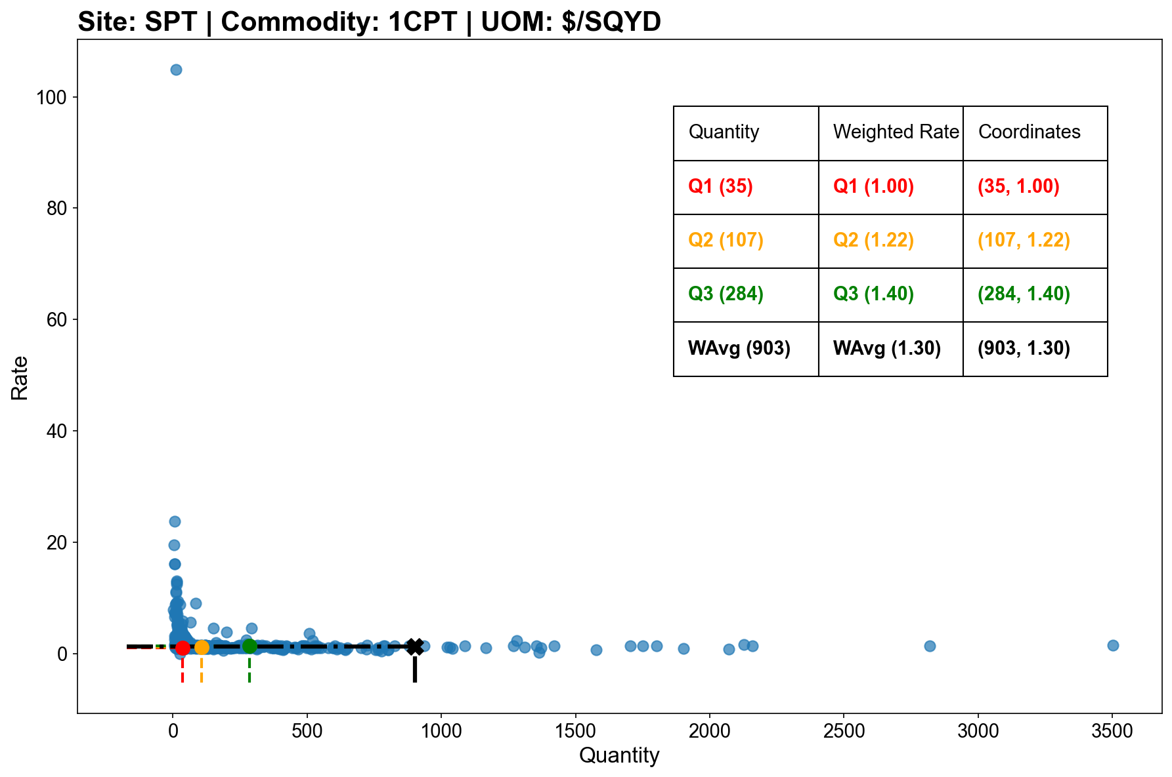
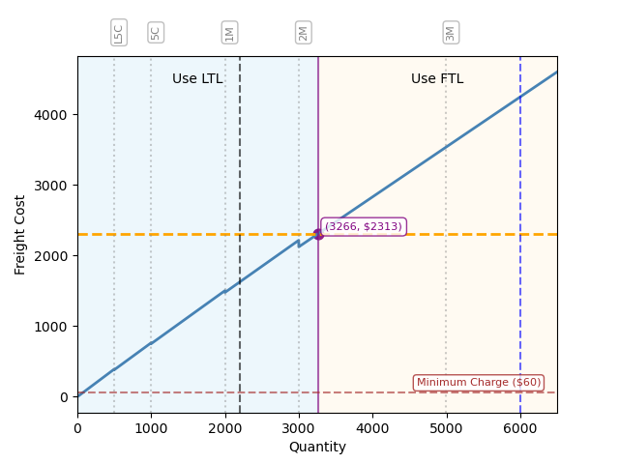
Carpet Tiles historical rates and FTL decision “sweet spot”
Carpet Roll (1CBL)
Carpet Tile (1CPT)
Vinyl Tile (1VNL)
Activate FTL
Minimum charge
LTL
FTL
Threshold
Capacity
($/SQYD)
($)
(SQYD)
(SQYD)
Notes
To convert VNL shipments from Pounds (LBS) per Square Foot (SQFT) to SQFT conversion factor: 1.28 LBS/SQFT
Georgia sites only, analysis of historical freight rates

Slide 15
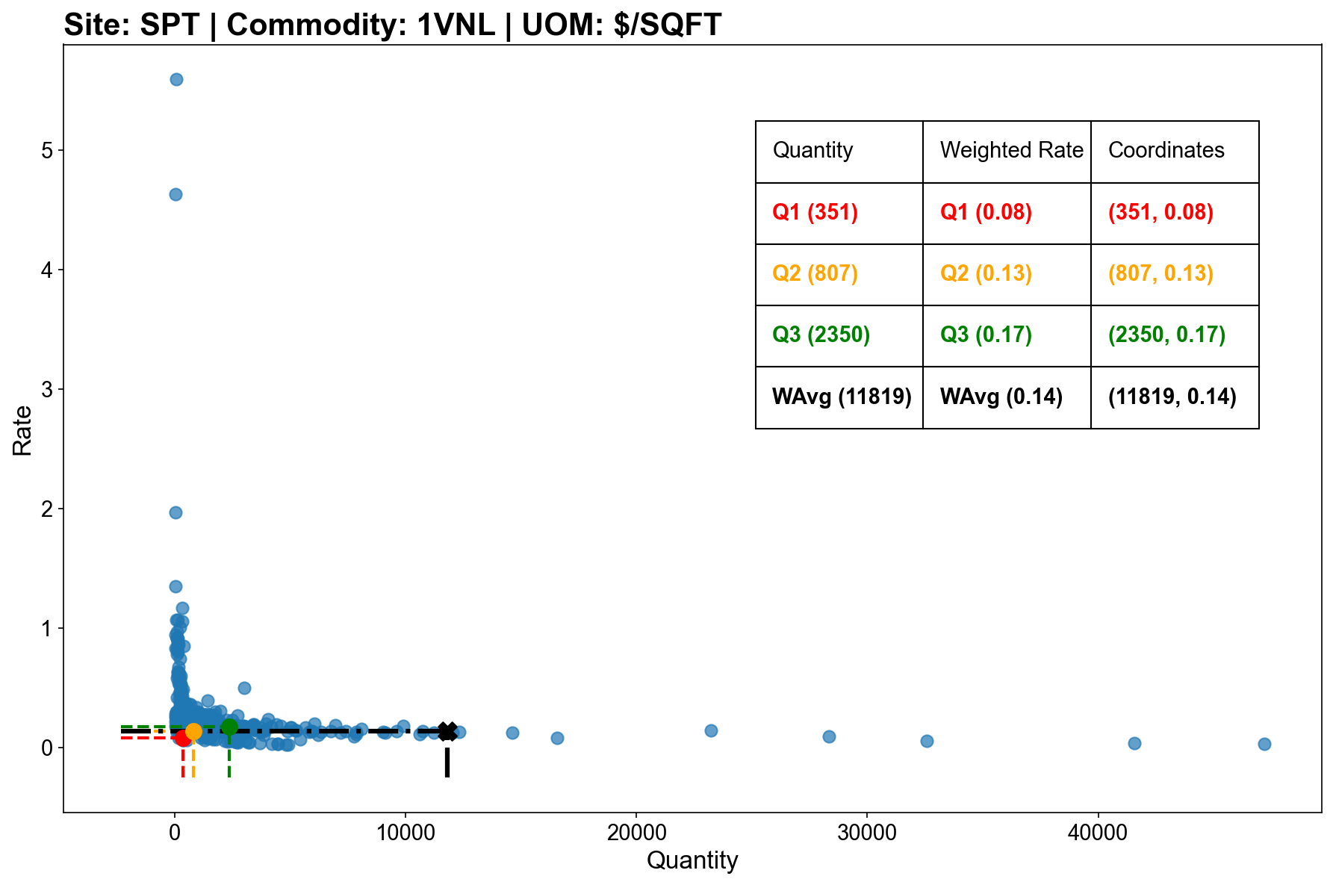

Vinyl historical rates and FTL decision “sweet spot”
Carpet Roll (1CBL)
Carpet Tile (1CPT)
Vinyl Tile (1VNL)
Activate FTL
Minimum charge
LTL
FTL
Threshold
Capacity
($/SQFT)
($)
(SQFT)
(SQFT)
Notes
To convert VNL shipments from Pounds (LBS) per Square Foot (SQFT) to SQFT conversion factor: 1.28 LBS/SQFT
Georgia sites only, analysis of historical freight rates

Slide 16
Outline
SPCP
SPW
SPT
SPHU
SPTM
PVF
SPJ
SPN
CCS
SPB
SPL
DIT
SPLV
CCSG
SPCB

Slide 17
For example: SPJ Performance Profile & Commodity Quote Rates
AIA Analysis, Diverzify IFS historical data Jan 2024 - Feb 2025, XGS Freight rates 2025

Slide 18
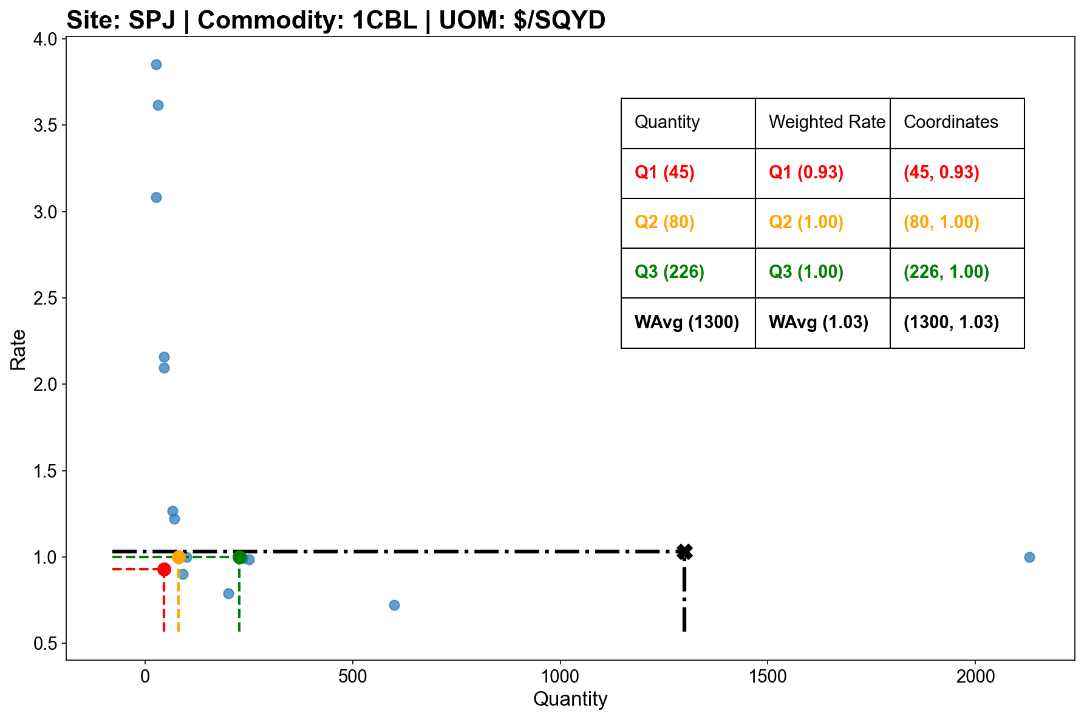
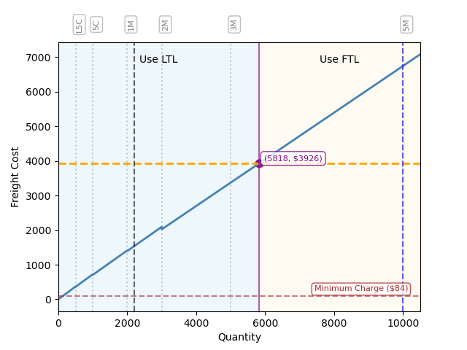
Carpet Roll historical rates and FTL decision “sweet spot”
Carpet Roll (1CBL)
Carpet Tile (1CPT)
Vinyl Tile (1VNL)
Activate FTL
Minimum charge
LTL
FTL
Threshold
Capacity
($/SQYD)
($)
(SQYD)
(SQYD)
Notes
To convert VNL shipments from Pounds (LBS) per Square Foot (SQFT) to SQFT conversion factor: 1.28 LBS/SQFT
Georgia sites only, analysis of historical freight rates

Slide 19
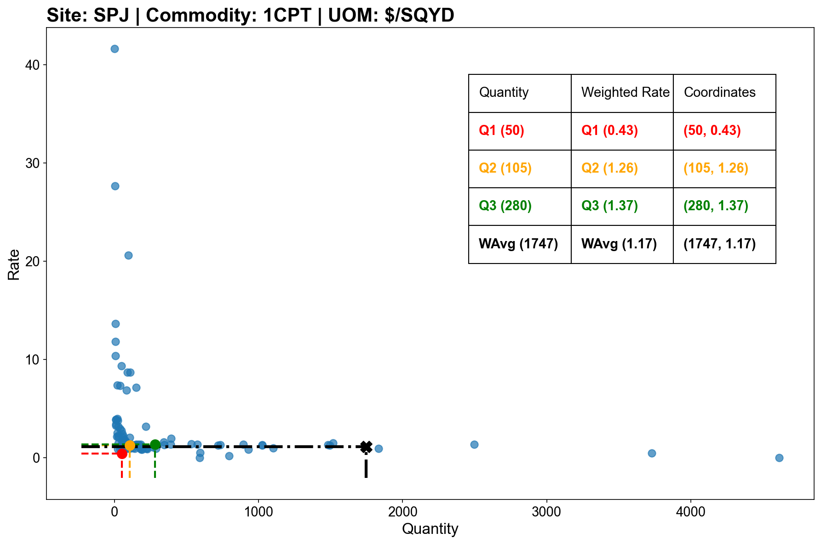

Carpet Tiles historical rates and FTL decision “sweet spot”
Carpet Roll (1CBL)
Carpet Tile (1CPT)
Vinyl Tile (1VNL)
Activate FTL
Minimum charge
LTL
FTL
Threshold
Capacity
($/SQYD)
($)
(SQYD)
(SQYD)
Notes
To convert VNL shipments from Pounds (LBS) per Square Foot (SQFT) to SQFT conversion factor: 1.28 LBS/SQFT
Georgia sites only, analysis of historical freight rates

Slide 20
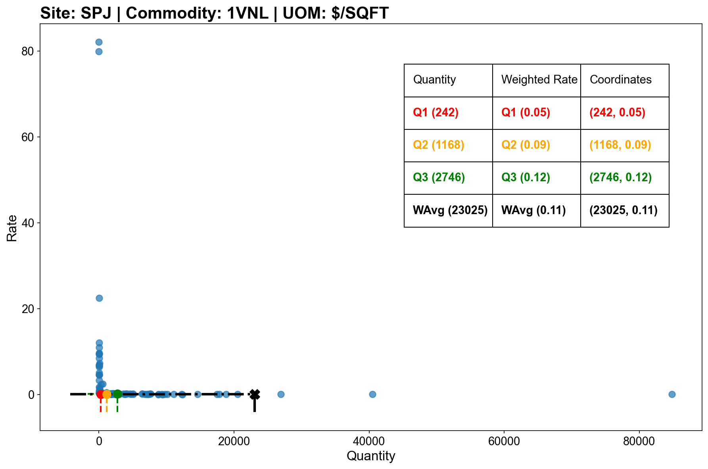
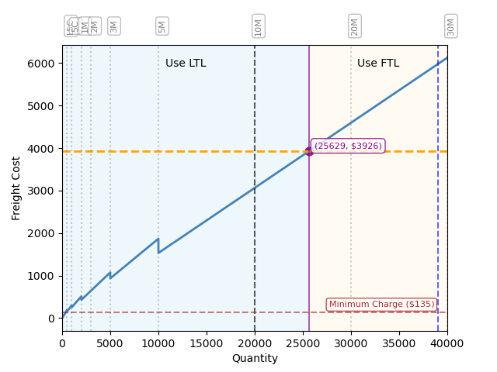
Vinyl historical rates and FTL decision “sweet spot”
Carpet Roll (1CBL)
Carpet Tile (1CPT)
Vinyl Tile (1VNL)
Activate FTL
Minimum charge
LTL
FTL
Threshold
Capacity
($/SQFT)
($)
(SQFT)
(SQFT)
Notes
To convert VNL shipments from Pounds (LBS) per Square Foot (SQFT) to SQFT conversion factor: 1.28 LBS/SQFT
Georgia sites only, analysis of historical freight rates

Slide 21
Outline
SPCP
SPW
SPT
SPHU
SPTM
PVF
SPJ
SPN
CCS
SPB
SPL
DIT
SPLV
CCSG
SPCB

Slide 22
SPN Performance Profile & Commodity Quote Rates
AIA Analysis, Diverzify IFS historical data Jan 2024 - Feb 2025, XGS Freight rates 2025

Slide 23
For example: SPTM Performance Profile & Commodity Quote Rates
xx
xx
xx
AIA Analysis, Diverzify IFS historical data Jan 2024 - Feb 2025, XGS Freight rates 2025

Slide 24
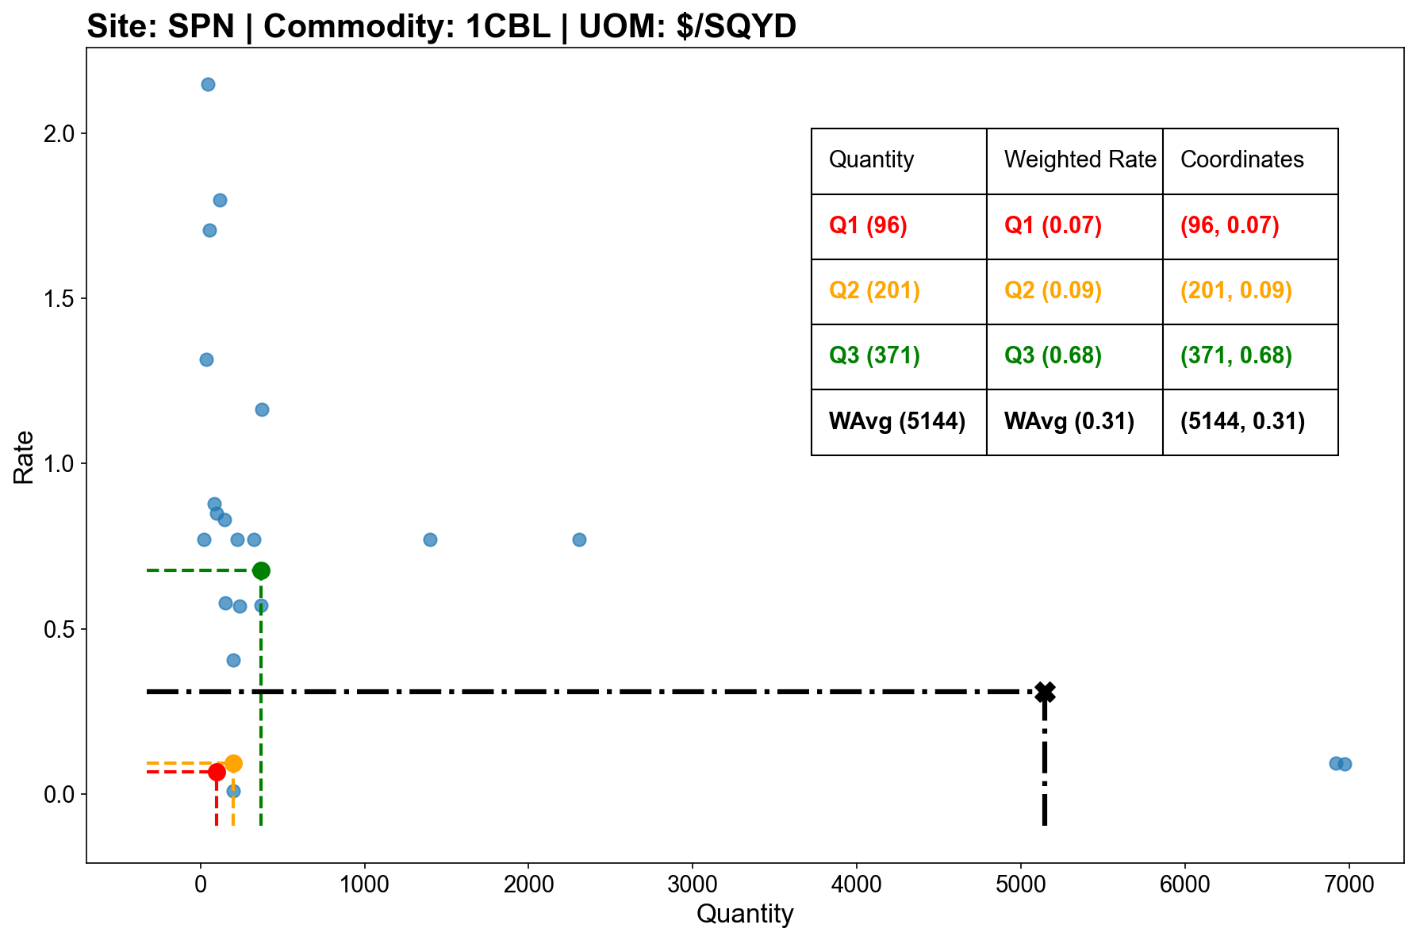
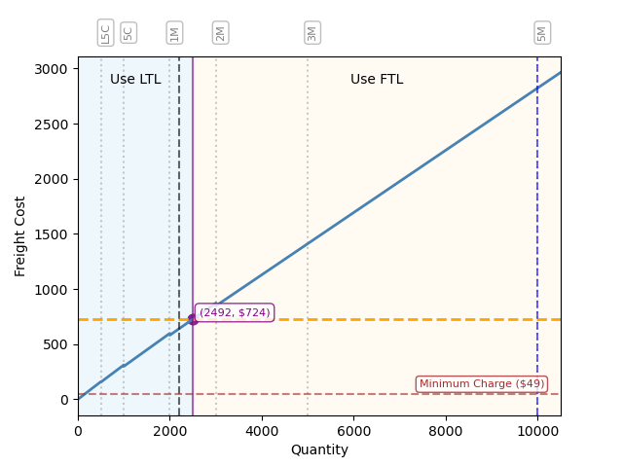
Carpet Roll historical rates and FTL decision “sweet spot”
Carpet Roll (1CBL)
Carpet Tile (1CPT)
Vinyl Tile (1VNL)
Activate FTL
Minimum charge
LTL
FTL
Threshold
Capacity
($/SQYD)
($)
(SQYD)
(SQYD)
Notes
To convert VNL shipments from Pounds (LBS) per Square Foot (SQFT) to SQFT conversion factor: 1.28 LBS/SQFT
Georgia sites only, analysis of historical freight rates

Slide 25
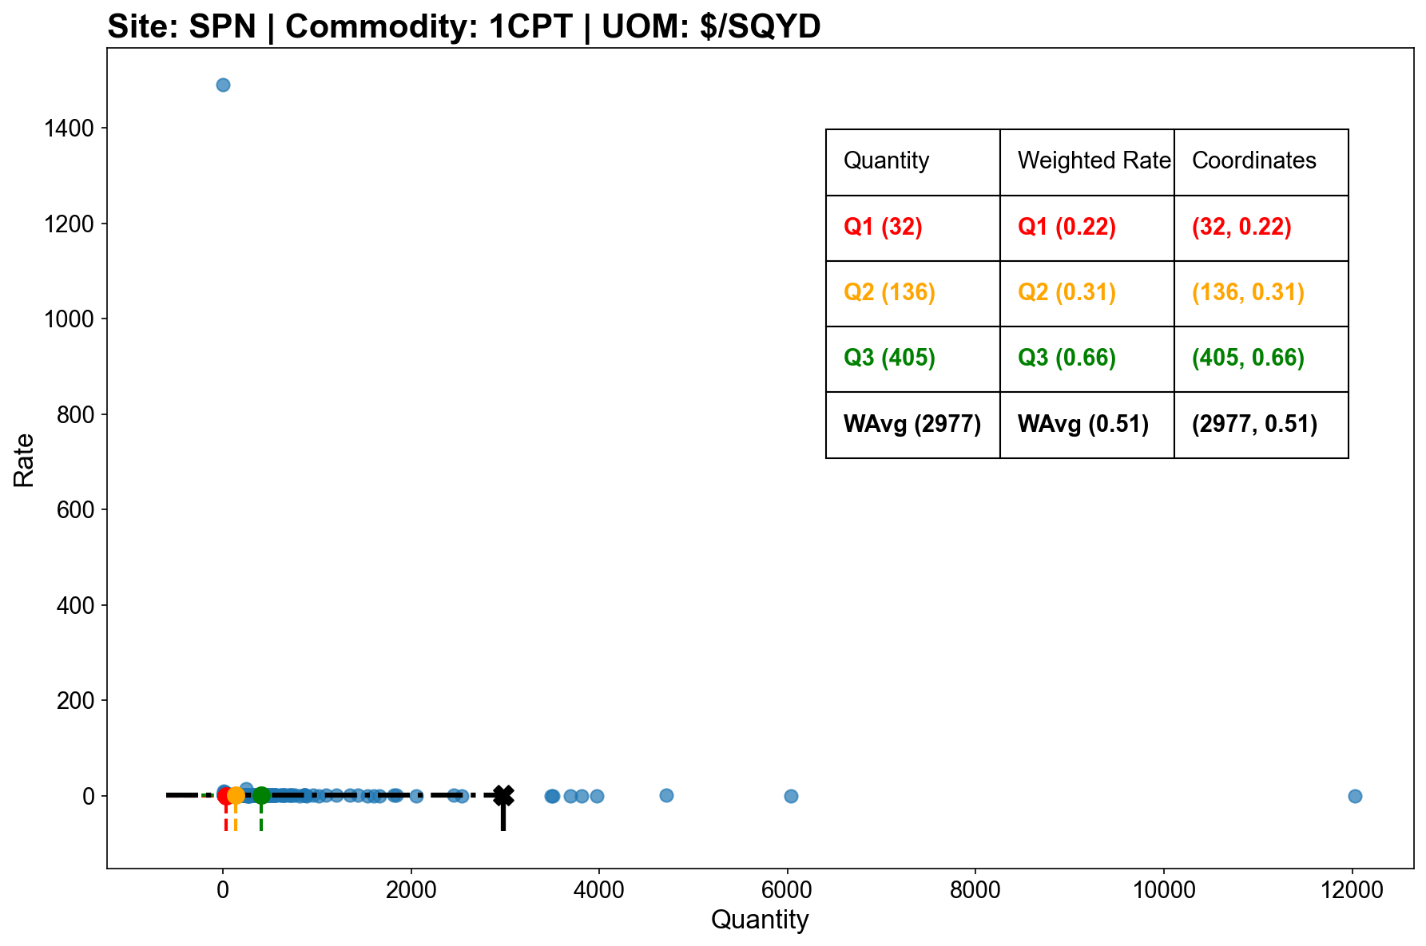
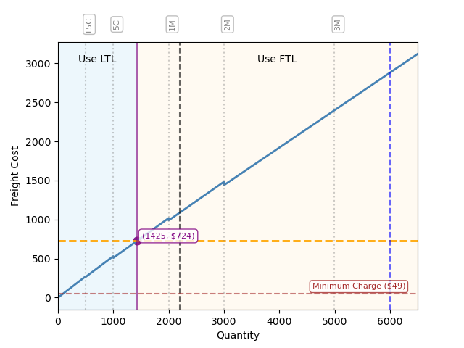
Carpet Tiles historical rates and FTL decision “sweet spot”
Carpet Roll (1CBL)
Carpet Tile (1CPT)
Vinyl Tile (1VNL)
Activate FTL
Minimum charge
LTL
FTL
Threshold
Capacity
($/SQYD)
($)
(SQYD)
(SQYD)
Notes
To convert VNL shipments from Pounds (LBS) per Square Foot (SQFT) to SQFT conversion factor: 1.28 LBS/SQFT
Georgia sites only, analysis of historical freight rates

Slide 26
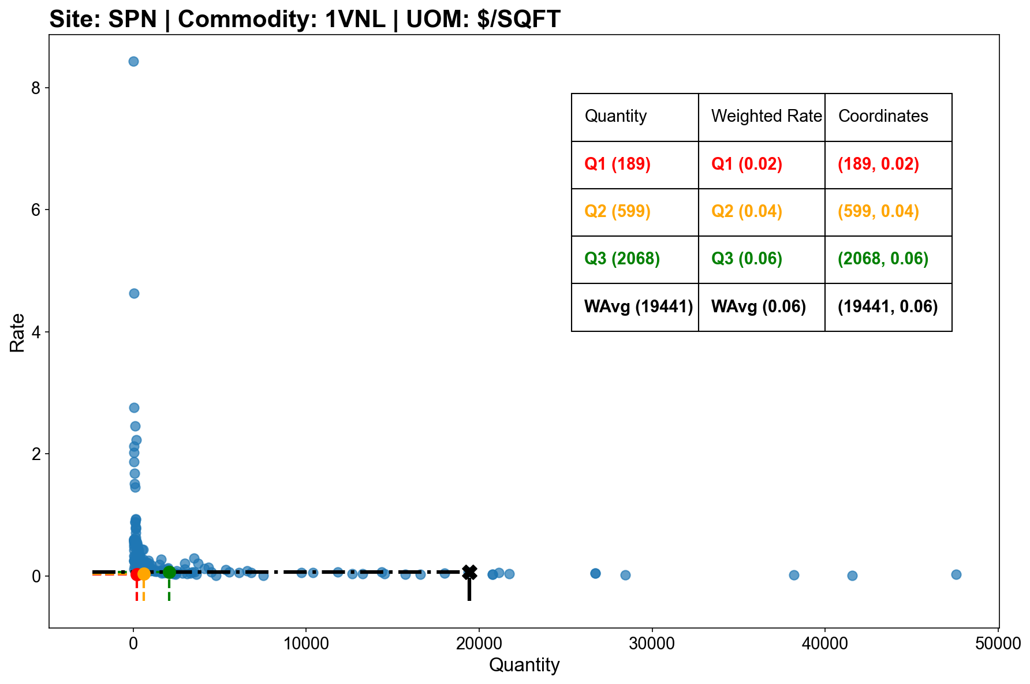
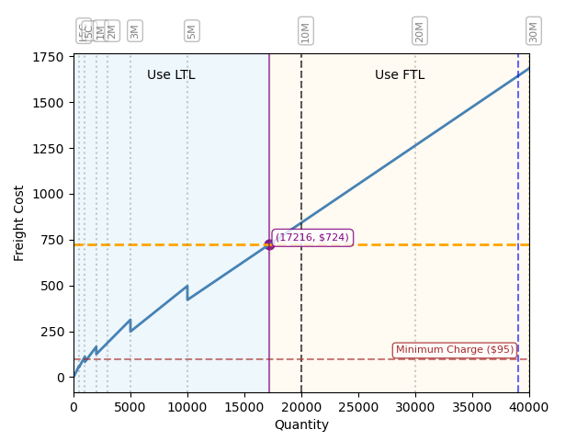
Vinyl historical rates and FTL decision “sweet spot”
Carpet Roll (1CBL)
Carpet Tile (1CPT)
Vinyl Tile (1VNL)
Activate FTL
Minimum charge
LTL
FTL
Threshold
Capacity
($/SQFT)
($)
(SQFT)
(SQFT)
Notes
To convert VNL shipments from Pounds (LBS) per Square Foot (SQFT) to SQFT conversion factor: 1.28 LBS/SQFT
Georgia sites only, analysis of historical freight rates

