Slide 1
WebGL Path Tracer
Xinyue Zhu

Slide 2
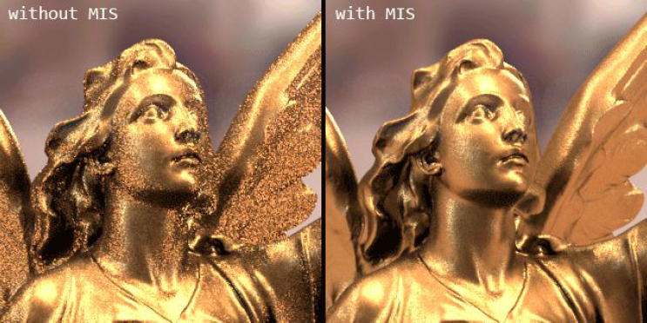
Project Overview
eg. http://madebyevan.com/webgl-path-tracing/
glsl: https://www.shadertoy.com/view/MtfGR4
base code: deferred shader from homework6
using WebGL

Slide 3

Monte Carlo Path Tracer
MIS is a variance reduction technique that exploits the fact that Monte Carlo Path Estimator converge more quickly if the samples taken from p(x) to the f(x).
* concentrate on the part where the value of the intergrand is relatively high.

Slide 4

MIS
1) Direct Light sampling: only samples the part that intersect with light
2) BRDF sampling: sample ray directions that have higher contribution to the reflect color(it is not calculate randomly it’s generate according to the brdf)

Slide 5
Effects
perfect specular
lambert
refract
microfacet brdf: beckmann distribution/blinn-phong
Notes:
which describe a surface is composed of many micro-facets and each micro-facet will only reflect light in a single direction according to their normal

Slide 6
Mailstone
11/23: write the MIS code on the shadertoy
11/30: build the whole WebGL path tracer.
12/07: add control features and other material terms (add other micro-facet brdfs, using different Distribution term and Geometry term ) , do the performance analysis.

