Slide 1
Web

Slide 2
World Wide Web
an information system where documents and other web resources are identified by Uniform Resource Locators (URLs, such as https://example.com/), which may be interlinked by hypertext, and are accessible over the Internet.
The resources of the Web are transferred via the Hypertext Transfer Protocol (HTTP) and may be accessed by users by a software application called a web browser and are published by a software application called a web server.

Slide 3
The same-origin policy
An origin is made up of the following three parts: the protocol, host, and port number.
In short, the same-origin policy enforces that documents that interact with each other have the same origin.

Slide 4
Cross-origin Resource Sharing
CORS defines a way in which a browser and server can interact to determine whether it is safe to allow the cross-origin request.
The CORS standard manages cross-origin requests by adding new HTTP headers to the standard list of headers.

Slide 5
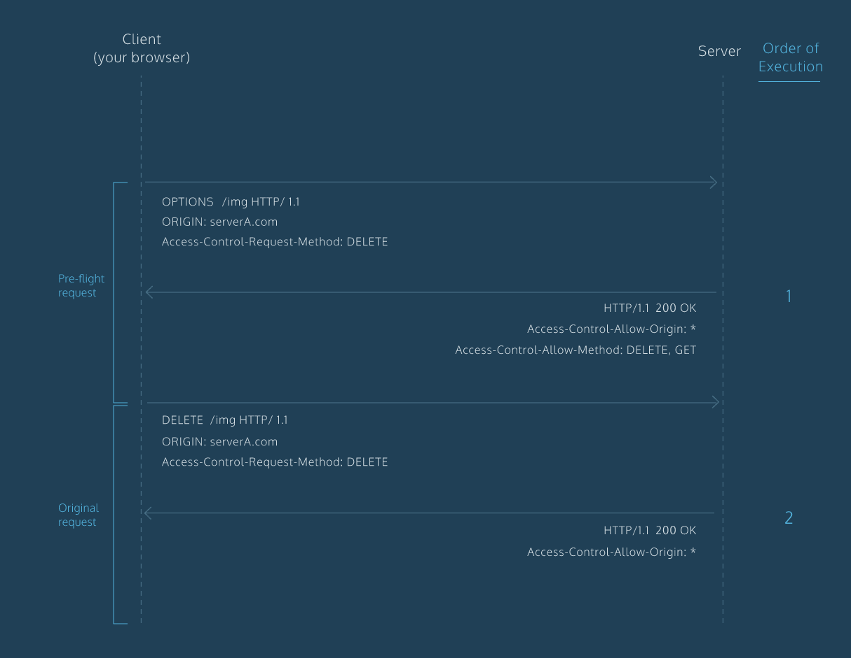
HOW CORS

