Slide 1

Mastering Concurrency in Python
A structured study of Python's concurrency models — exploring how tasks are executed, coordinated, and optimized for real-world performance.
STUDY NOTES
09/04/2026
Author
Caleb Hattingh
Published
O'Reilly Media · 2nd Edition, 2020
Source Code
github.com-Mastering-Concurrency-in-Python

Slide 2
Chapter 01

Slide 3
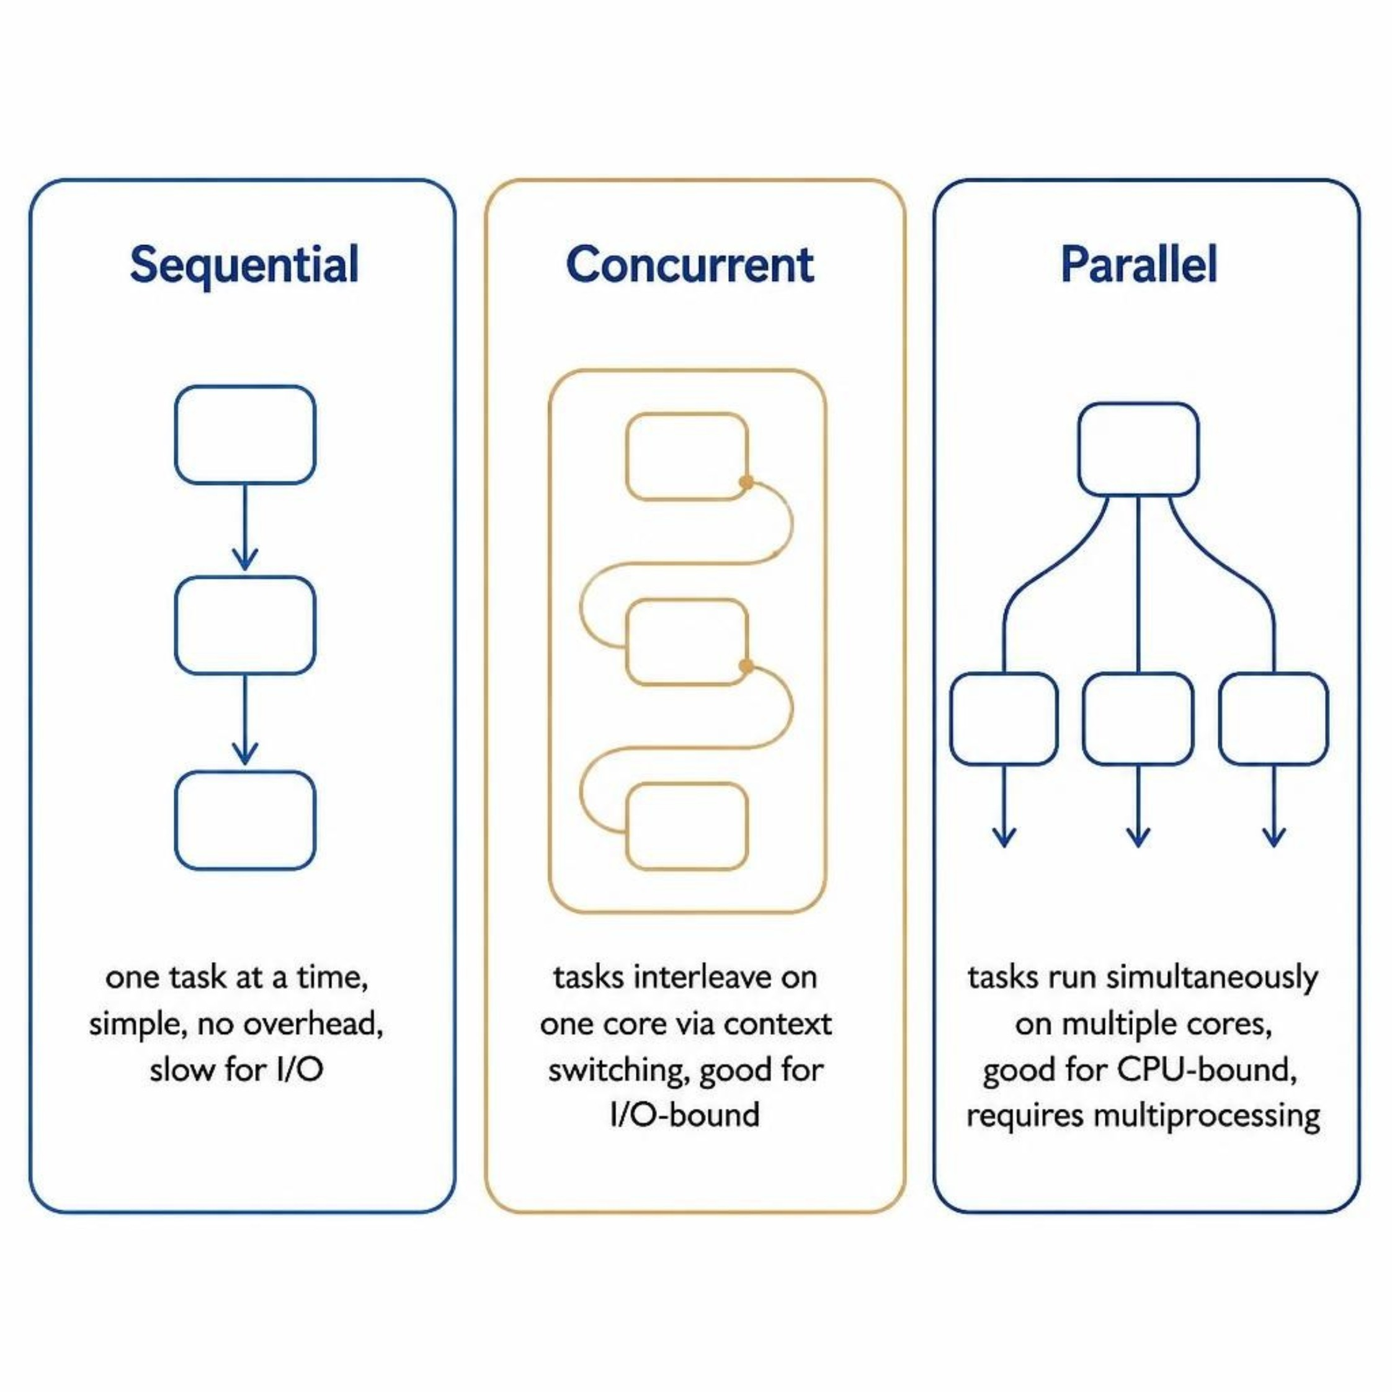
Concurrent vs. Sequential vs. Parallel
Three distinct models for executing tasks — each with different trade-offs in performance, complexity, and resource usage.
Sequential
Tasks run one after another. Simplest model, but idle during I/O waits.
Concurrent
指系统具备处理多个任务的能力。它强调的是“交替执行”。在单核 CPU 上，通过极短的时间片切换（上下文切换），让多个任务看起来像在同时进行，但实际上同一瞬间只有一个任务在跑。
Parallel
指系统具备同时执行多个任务的能力。它强调的是“同时进行”。必须在多核 CPU 或多处理器环境下，同一瞬间有多个任务真正在各自的核上运行。

Slide 4
Question
What is the idea behind concurrency, and why is it useful?
是指系统具有处理多个问题的能力，在同一个core上面 交替执行任务使其效率最大化
What are the differences between concurrent programming and sequential programming and parallel programming?
Sequential programming 是程序按照特定顺序执行。而Parallel programming 和 concurrent progamming是指系统拥有同时执行多个程序的能力。
而parallel program和concurrent progam的区别是 parallel能使用多个core去同时执行多个任务
而concurrent program只能在单一core上面 交替执行任务
Can every program be made concurrent or parallel?
Some tasks are naturally reply on other results. This type of programming inherently sequentially.
What are embarrassingly parallel tasks?
Tasks can be split into independently sub-tasks, which have no/zero communication between them, like image processing;
3d video rendering;

Slide 5
Question
What are inherently sequential tasks?
Each step is reply on the previous step’s result.
What does I/O bound mean?
程序的性能瓶颈在于等待数据从外部设备（磁盘/网卡）传入或传出，而非 CPU 内部计算.典型的解决方案：异步非阻塞 + 批量操作 +
缓存（Redis/内存）
How is concurrent processing currently being used in the real world?
Heavily calculation area, like AI, 3D rendering; web rendering.

Slide 6
Chapter 02

Slide 7
Concurrent vs. Sequential vs. Parallel
Three distinct models for executing tasks — each with different trade-offs in performance, complexity, and resource usage.
Sequential
Tasks run one after another. Simplest model, but idle during I/O waits.
Concurrent
指系统具备处理多个任务的能力。它强调的是“交替执行”。在单核 CPU 上，通过极短的时间片切换（上下文切换），让多个任务看起来像在同时进行，但实际上同一瞬间只有一个任务在跑。
Parallel
指系统具备同时执行多个任务的能力。它强调的是“同时进行”。必须在多核 CPU 或多处理器环境下，同一瞬间有多个任务真正在各自的核上运行。

