Slide 1
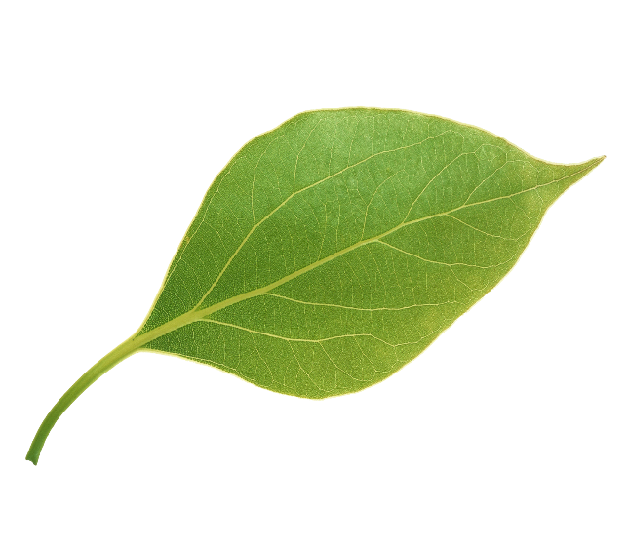
4*4*2048
Reshape
Flatten (100352)
Dense 256
Dense 1
Activation
7*7 Conv, 64
3*3 Conv, 64
3*3 Conv, 64
3*3 Conv, 64
3*3 Conv, 64
7*7 Conv, 128
7*7 Conv, 128
3*3 Conv, 512
3*3 Conv, 512
3*3 Conv, 64
3*3 Conv, 64
152 Layers
3*3 Conv, 512
Input Image
4*4*2048
Dropout

